Slide 1
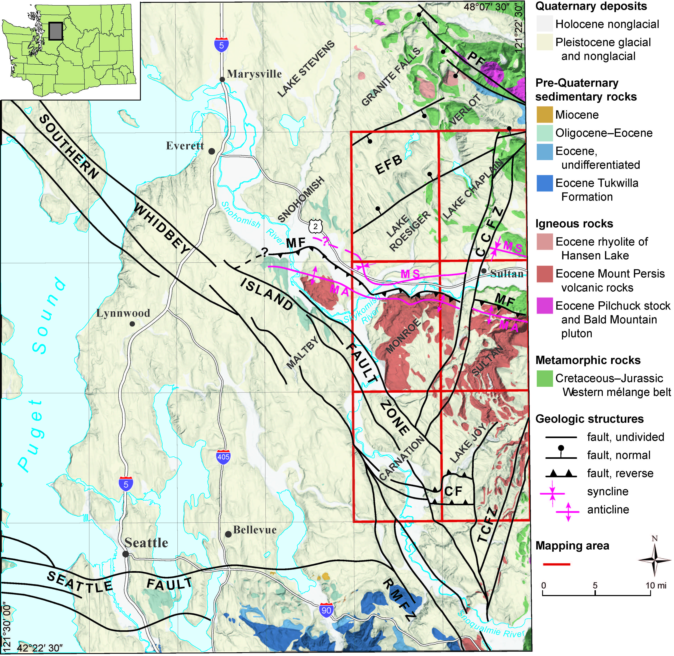
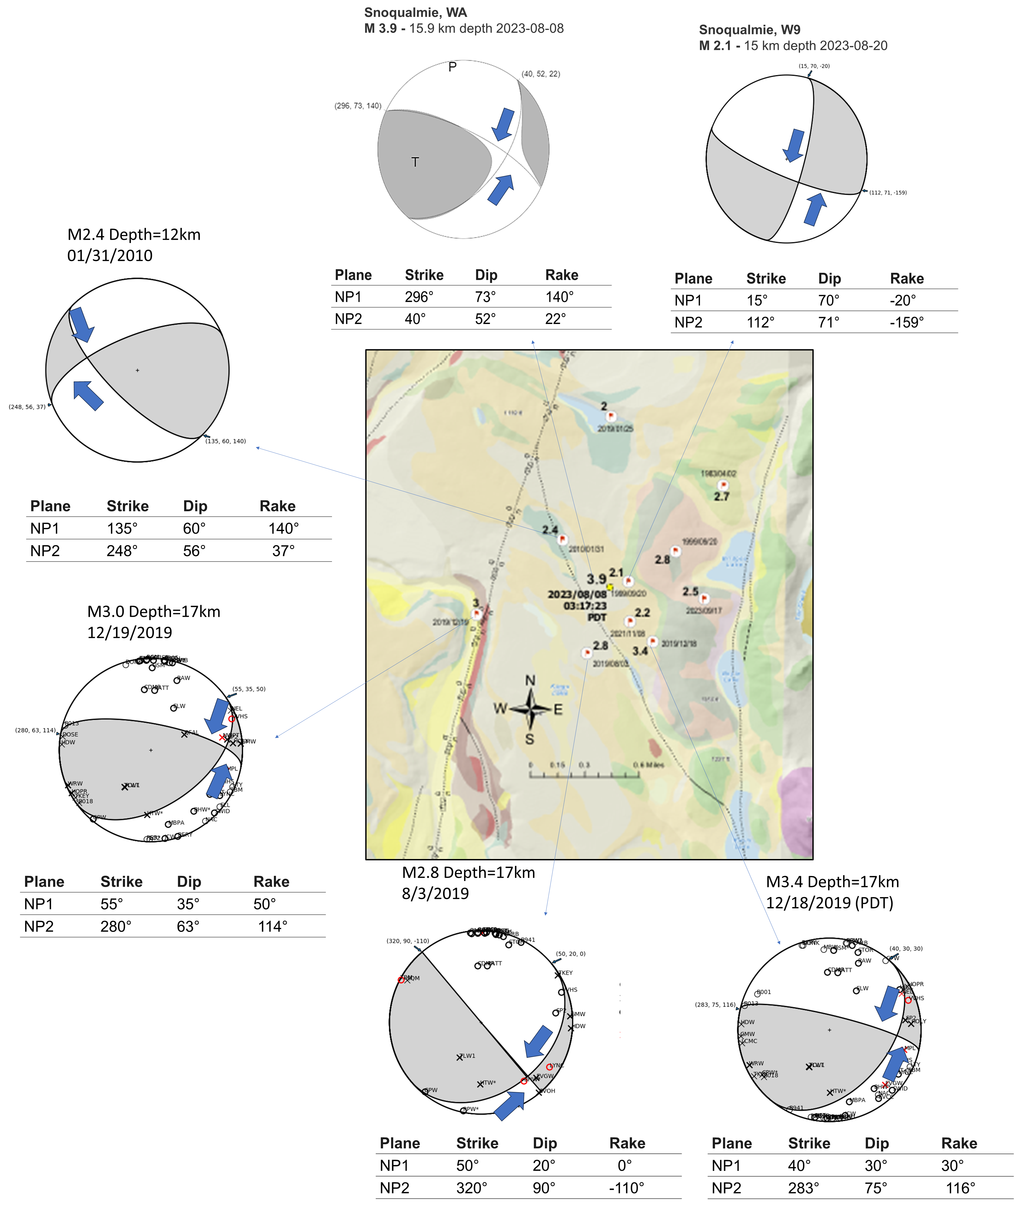
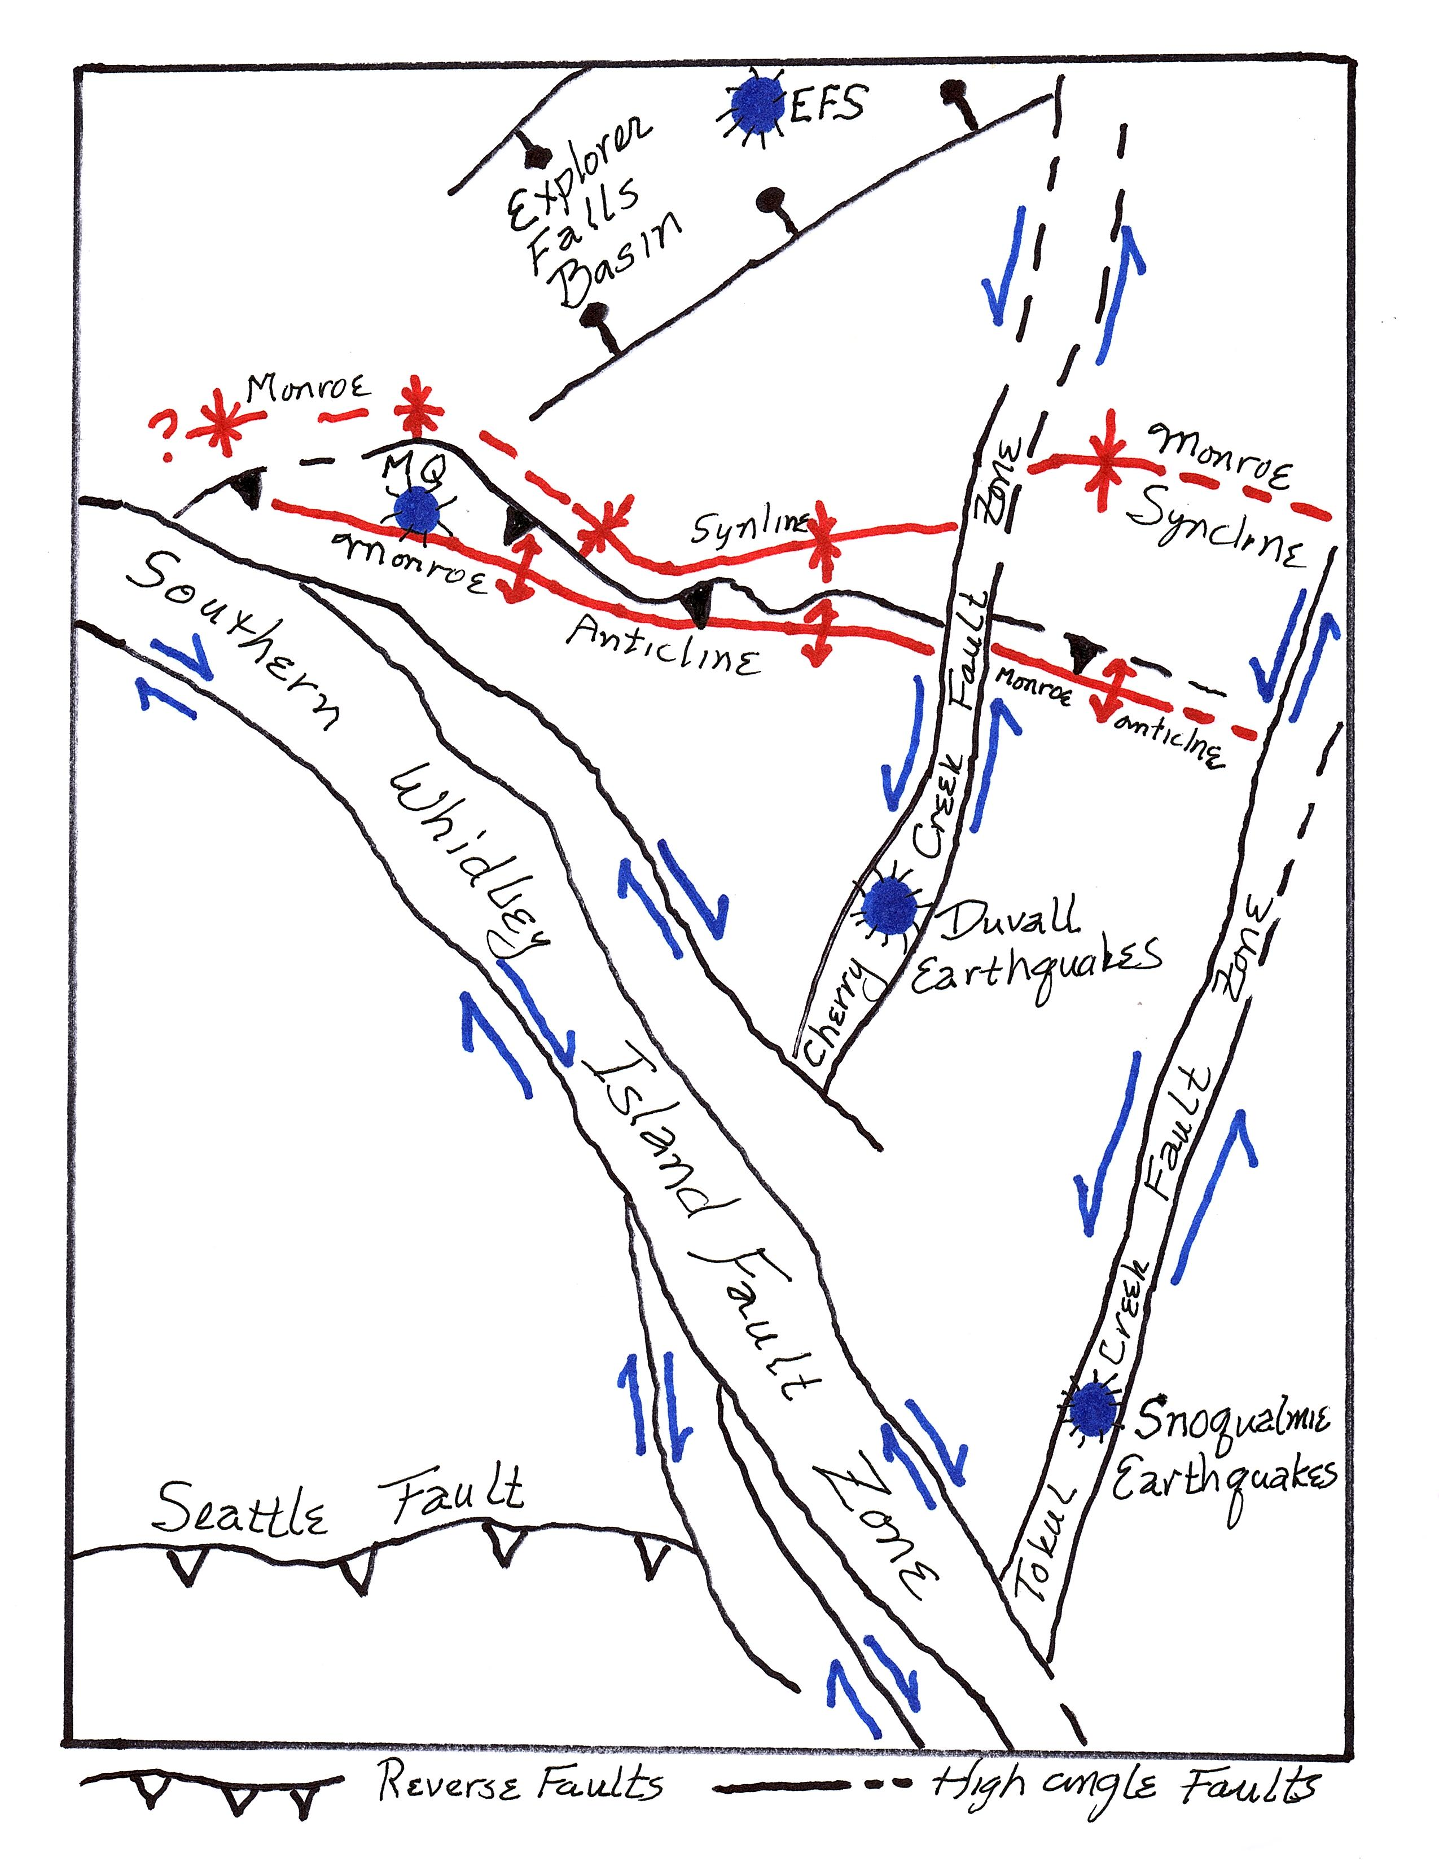
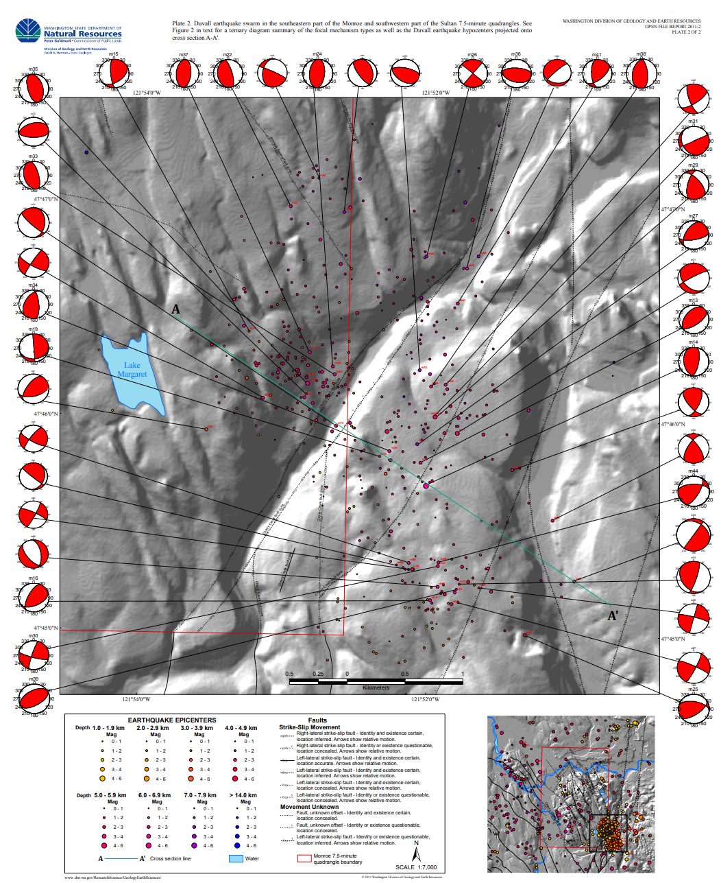
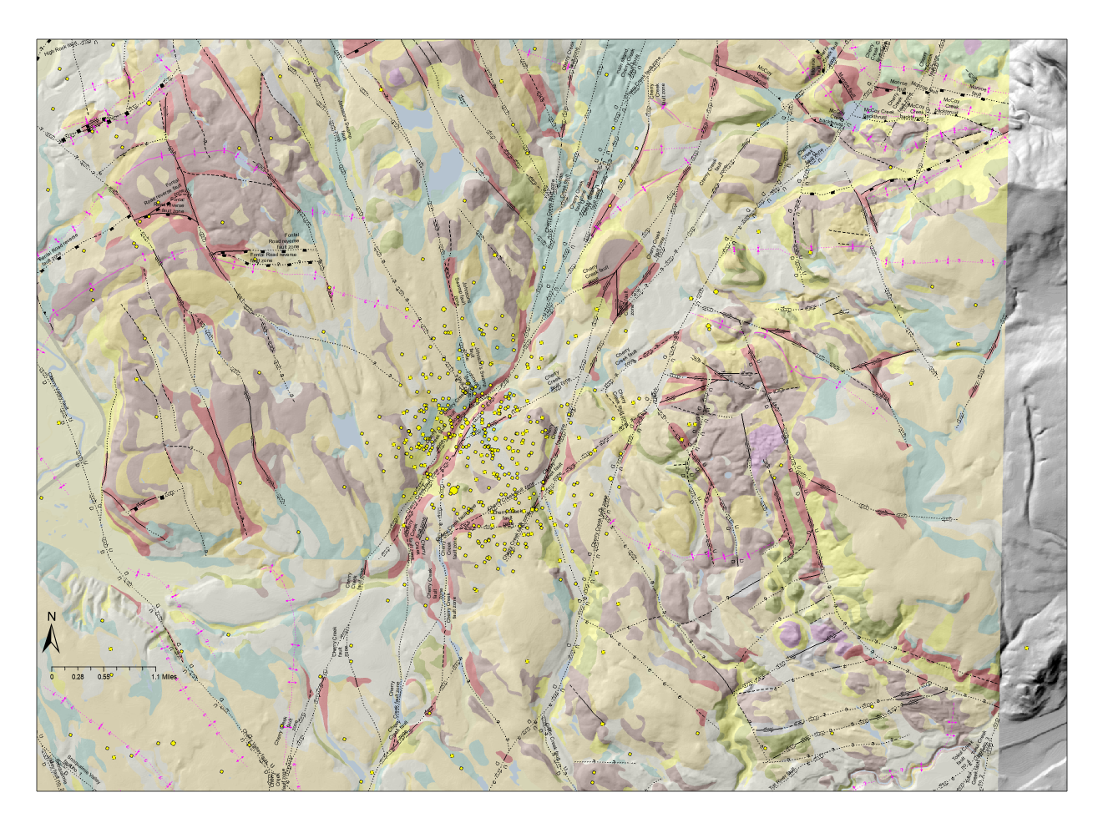
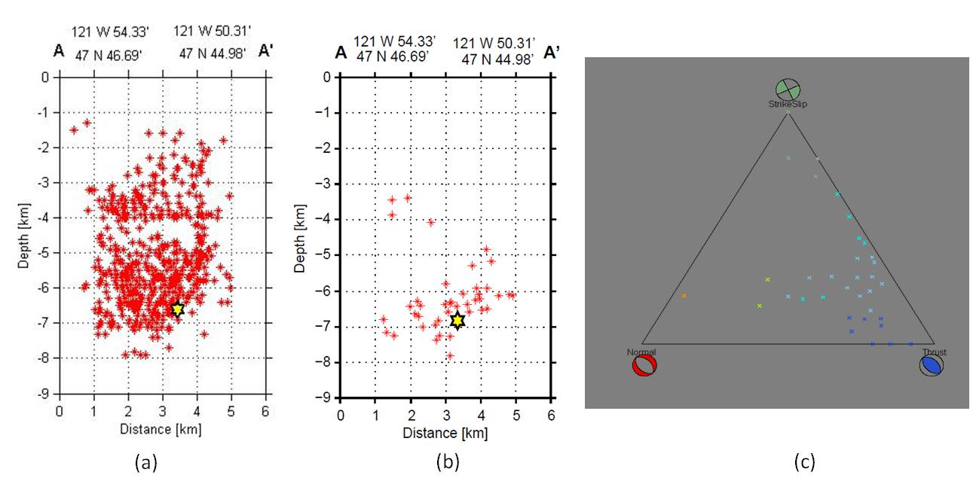
FAULT AND MAIN QUAKE LOCATIONS
TOKUL CREEK FAULT ZONE AND THE SNOQAULMIE EARTHQUAKES
The Tokul Creek Fault Zone (TCFZ) was initially mapped by Tabor and others (1993) and Dragovich and others (2009a). This long and straight fault forms a strong northeast-trending lineament that extends for ~25 miles and like the CCFZ has a few NE-trending strands. The southern portion of the TCFZ likely merges with the SWIF (Figures 1-4). A series of earthquakes (M=3.8 max) likely occurred on the TCF general fault zone (8/8/2023). The TCFZ focal mechanisms associated with the Snoqualmie earthquake swarm mostly indicate strike-slip to oblique slip fault offset. This offset is consistent with the TCFZ being a left-lateral conjugate to the SWIF. Note the geometric, kinematic, and structural similarities between the TCFZ and the CCFZ. Focal mechanisms indicate oblique slip with “up” on the east consistent with the TCFZ accommodating uplift of the Cascades. We find the correlation of the TCFZ with the Snoqualmie earthquake swarm location and focal mechanisms as compelling and assign a moderately strong correlation between the SQ and the TCFZ structures.
MQ
EQ
DQ
Figure 5D. Geologic map showing the two strands of the northeast-trending Tokul Creek fault zone. The shown earthquakes occur within the TCFZ represented by the two main NE-trending faults. Pre-Tertiary basement rocks occur direct east of the TCFZ suggestive of a component of uplift directly east of the faults as noted above. The earthquakes show left-lateral, strike slip to oblique slip offset on a northeast trending fault zone. A 2.4 M earthquake spatially associated with a northwest trending fault has a right-lateral strike-slip focal mechanism consistent with (1) offset on a TCFZ transfer fault; and (2) the simple conjugate model shown on Figure 2. As noted above the TCFZ and the CCFZ (Figure 3 and 4) have many similarities and together form an important NE trending, left-lateral displacement zone in the Cascade foot hills.
SQ
FIGURE 3. Regional simplified geologic map showing simplified geologic units and faults. See Figure 3 for the fault zone and fold names and the location of the Explorer Falls Basin. The yellow dots are the central locations of the earthquake swarms we discuss. SQ, the Snoqualmie earthquake; DQ, the Duvall earthquake; MQ, the Monroe earthquake; EQ, Explorer Falls basin earthquakes. Also see Figure 4 for general earthquake locations.
CHERRY CREEK FAULT ZONE (CCFZ) AND THE DUVALL EARTHQUAKE
OVERVIEW--The CCFZ was mapped by Dragovich and others (2012, 2013, 2014a,b). This long and straight fault forms a strong northeast-trending lineament that extends for about 25 miles. The TCFZ and the CCFZ have several structural similarities. Like the TCF, the southern portion of the TCF likely merges with the SWIF. Also like the CCFZ, The TCF focal mechanisms mostly indicate left-lateral strike-slip offset (consistent with this fault zone being conjugate to the SWIF as shown on Figures 1-4). We find the correlation of the CCFZ structure with the kinematics and location of the Duvall earthquake swarm as compelling. As a result, we assign a moderately strong correlation between the DQ and the CCFZ structures.
FIGURE 4. Regional simplified geologic map showing simplified geologic units and faults. Also see Figure 2 for the fault zone and fold names and the location of the Explorer Falls Basin. The blue dots are the central locations of the earthquake swarms. MQ, the Monroe earthquake; EFS, Explorer Falls basin earthquake swarm. Note the apparent conjugate relationship of the of the Tokul Creek and Cherry Creek faults with the Southern Whidbey Island fault zone (SWIF).
Figure 5C. The May 2, 1996 Duvall earthquake epicenters (max. M_{L}=5.3 or Md=5.4) originated at a shallow depth (~2-8 km) along the CCFZ (Dragovich and others, 2010a,b, 2011). Figure above shows the Duvall earthquake swarm hypocenters and focal mechanisms in detail. The majority of the microearthquakes, including aftershocks of Duvall earthquake, occurred in a depth range of 2-8 km (relocated events)(Figure 5B). We interpret the focal mechanism data to indicate that these earthquakes occurred along several faults within a left-lateral strike-slip fault zone flower structure. In this scenario, fault displacements and strain are partitioned between both (1) left-lateral, high-angle, northeast trending strike-slip to oblique faults (RED BOXES figure above), and (2) lower angle northeast-trending reverse faults or thrusts in the CCFZ. We suspect the thrusts and reverse faults are anastomosing structures that link the high-angle faults. This is supported by the focal mechanism data, which shows that most displacements have either have a left-lateral northeast- trending solution or a northeast-trending thrust solution. It is also supported by the field mapping and outcrop structures which show that the CCFZ is dominated by northeast-trending fault splays with strike-slip kinematics. (Dragovich and others, 2010a,b).
Figure 5B. Duvall earthquake swarm information. All the micro and moderate earthquakes in the swarm; Figure 2b only Duvall earthquakes with focal mechanisms. See Figure 5C for epicenter locations of the focal mechanisms within the CCFZ. Cross-sections are plotted using the ZMAP tool (Wyss and others, 2001). Ternary diagram showing the variation in focal mechanisms for the Duvall earthquake. The dominance of thrust and strike-slip focal mechanism on this ternary diagram suggests partitioning of displacements between thrust and strike-slip faults within a positive flower structure (Dragovich and others, 2011B Monroe data supplement).
Figure 5A. The Duvall quake swarm (DQ) and 24K Geologic Mapping. The NE-trending main strands of the CCFZ are associated with the DQ and aftershocks. The red polygons are tectonized bedrock including thick gouge zones associated with the fault strands.

