Slide 1
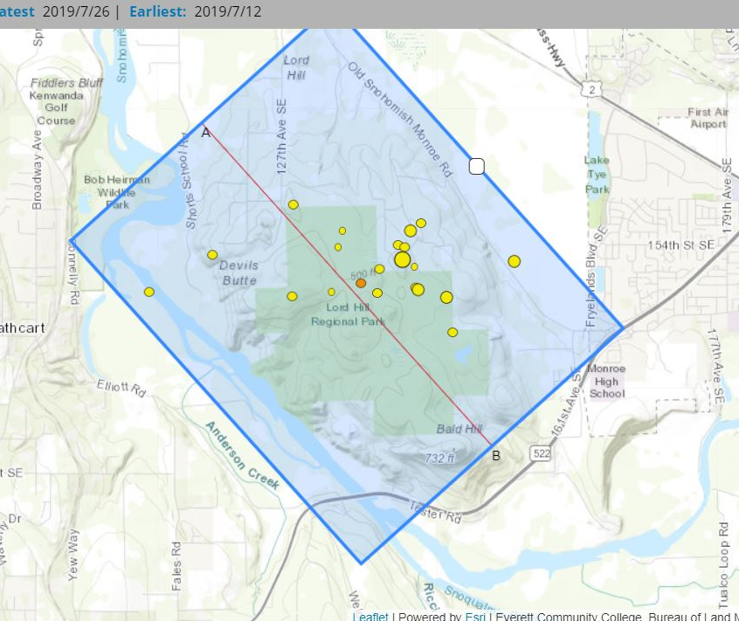
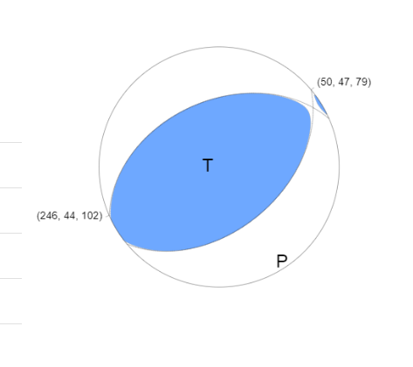
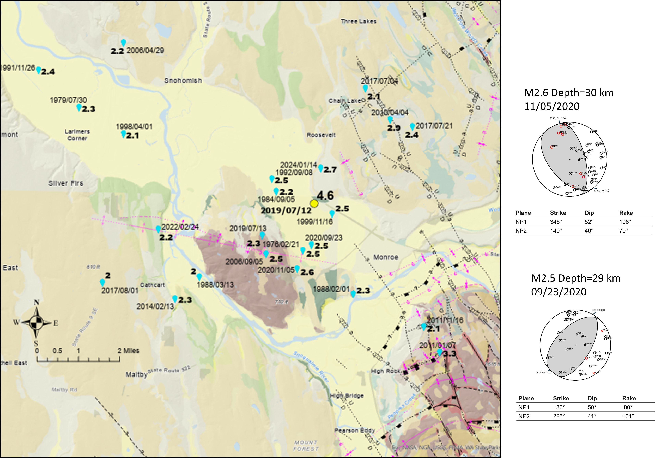
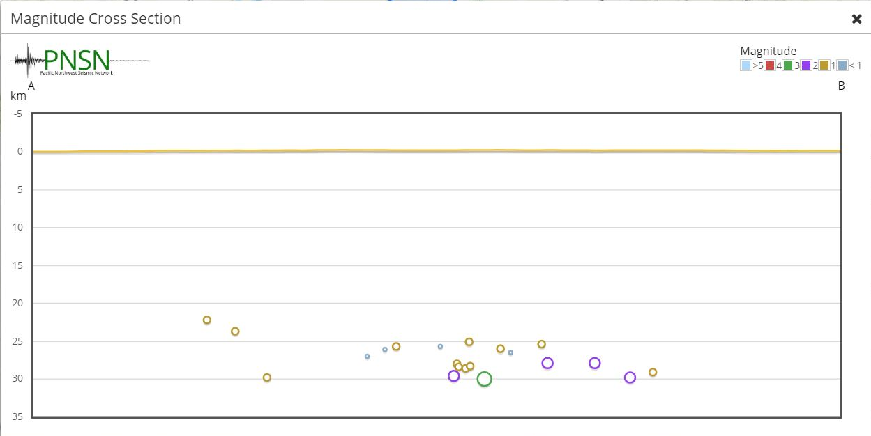
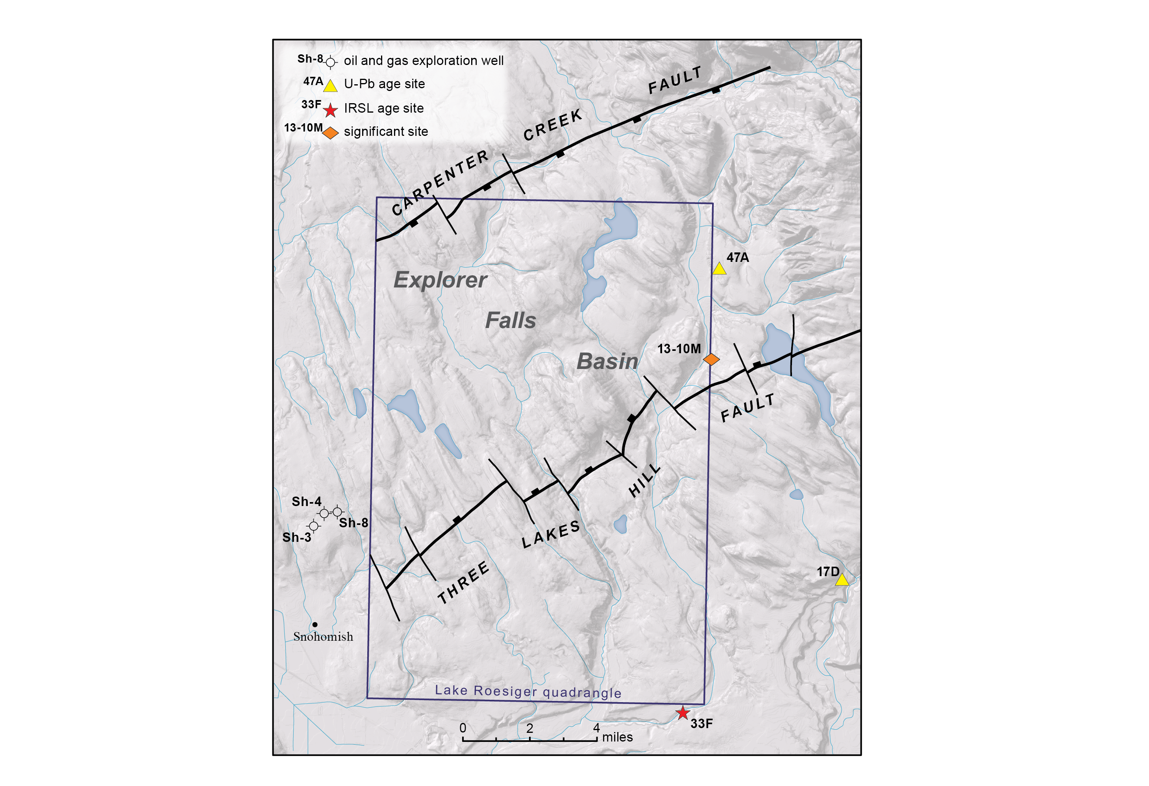
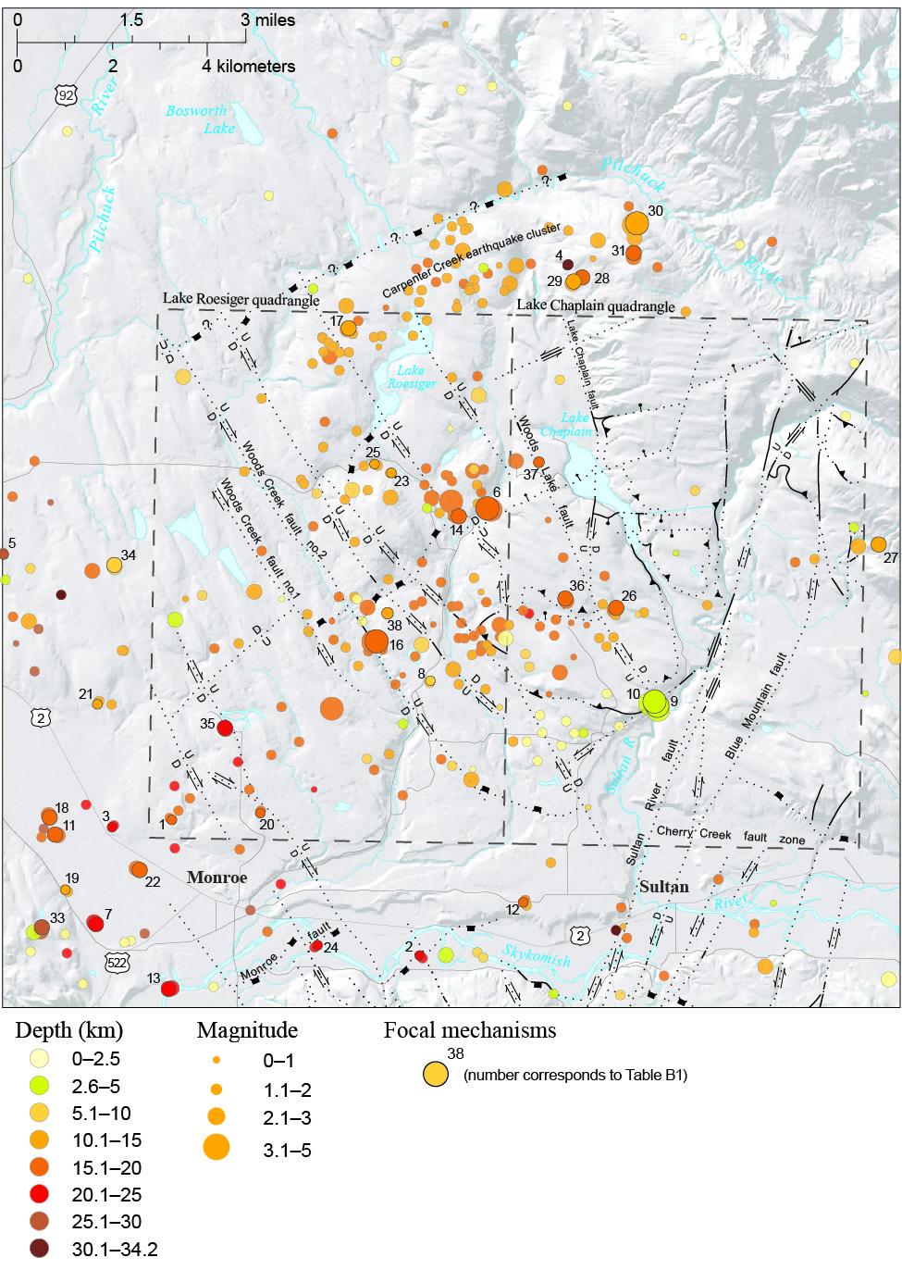
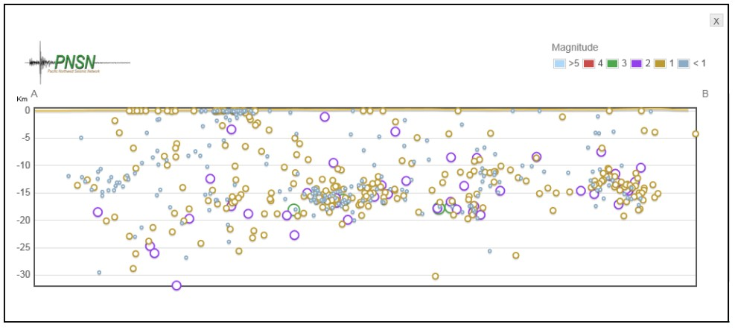
MONROE FAULT (MF) AND THE MONROE EARTHQUAKE SWARM
MONROE FAULT, ANTICLINE, AND SYNCLINE--Dragovich and others (abstract) forwarded that the Monroe anticline overlies the Monroe Fault (MF) as an upper plate flexural slip fold. This structure folds SP Olympia beds as young as ~22 ka according to multiple radiocarbon and OSL/IRSL ages. North of the MF, the Monroe synclinal basin is cored by ancient Skykomish provenance (SP) Olympia beds over a long axial area and locally preserves a ~300-m thick composite sequence of folded SP alluvium spanning several nonglacial episodes. Buried Tertiary strata in the syncline suggest growth folding since the Eocene or Oligocene. The MF system is similar to the Seattle fault system. They are both east-west trending, north-verging structures responding to regional north-south compression with southerly hanging wall uplifts bounded by major basins to the north. The correlative NW-trending southern Whidbey Island fault zone (SWIF) is dominantly strike-slip fault zone. Although work remains, the MF intersects the SWIF-RMFZ at an inflection in this composite structure and could be an eastward partition of the SWIF accommodating only north-south contraction in the Cascade foothills east of the SWIF oblique structure. The MF is offset by strands of the southern Whidbey Island fault zone (SWIF) near directly west of Lords Hill (Figure 1, 3, and 4). Preliminary findings suggest the MF system is accommodating north-south contraction in the Cascade foothills east of the SWIF-RMFZ. MONROE EARTHQUAKE--The MF is an east-striking set of reverse faults mapped from the Sultan area to the west through Monroe where the MF joins the SWIF near Lords Hill. A series of (M=4.6 max) quakes occurred on 12 July 2019 near the MF and south of Snohomish River west of Monroe. The reverse focal mechanism for the mainshock and many of the aftershocks (Figure 7B) on an east-west trending fault is consistent with the kinematics of the MF mapped in detail at the surface to the east. It is noteworthy that the Monroe earthquake swarm occurs in the Monroe anticline fold axis area (Lords Hill area) perhaps suggestive of a causal relationship the MF, shortening, and active north-south compression (Figure 7C). However, because the MF location in the Lords Hill area is tenuous and the earthquakes are relatively deep -- and do not shallow to the north as expected for offset on a reverse fault -- the correlation of the MF with as the 2019 earthquakes is made with only moderate confidence and requires further study.
Figure 7B. Main shock thrust/reverse focal mechanism.
Figure 7D. Geologic map of the Lords Hill area showing the Monroe Quakes. Most of the focal mechanism are thrust/reverse fault mechanisms. Note the Monroe anticline on Lords Hill associated with the earthquake swarm area.
Figure 7C. Cross section showing the 22-30 km depths of the Monroe earthquakes. (Looking northeast). The overall depth of the swarm makes correlation of the earthquakes with the Monroe fault problematic. However, it is noteworthy that the swarm occurs in the Monroe anticline axial area and generally south of our project of the MF (Figures 3 and 4).
EARTHQUAKES IN THE EXPLORER FALLS BASIN (EFB)
The EFB is a fault-bound graben that preserves Eocene-Oligocene sedimentary rocks and a thick succession of Pleistocene nonglacial basin strata (Dragovich and others, 2014a). The EFB was initially mapped in the northwestern part of Lake Chaplain quadrangle and Lake Roesiger quadrangle where it merges stratigraphically with the Everett basin (Figures 1,3, and 4). Both basins are defined by Tertiary and, locally, Quaternary stratigraphic sections that thickened due to tectonism.
Figure 6C (Right) earthquake epicenters in and around the Lake Roesiger and Lake Chaplain 7.5-minute quadrangles (dashed boxes). Faults are simplified from the mapping of Dragovich and others (2011a, 2013, 2014a). Figure 6B cross section below, seismic activity is concentrated in the EFB with earthquakes distributed across the middle to upper crust. Looking SW
Figure 6A. Faults bounding the Explorer Falls basin (EFB) of Dragovich and others (2015). The EFB is a likely Tertiary to Pleistocene inverted basin with the bounding original extensional faults interpreted to be rejuvenated as compressional reverse faults
EFB CONCLUSION—More work remains, but we suspect that some of these earthquakes are related to active deformation and shortening of the EFB. Inversion of the EFB occurs due to rejuvenation of the basin-bounding Carpenter Creek and Three Lake Hill faults as reverse faults. Basin inversion leads to intra-basinal deformation, including folding, tilting, and local uplift. The Carpenter Creek fault (Figure 6A) generally aligns with a linear band of seismicity south of the fault, which contains many reverse fault focal mechanisms, consistent with modern reverse movement the EFB faults including the bounding faults. Most compelling is the observation that the band of seismicity is spatially associated with a probable inverted Quaternary basin that is unique to the general area suggesting a causal relationship.
REFERENCES
Anderson, M. L.; Blakely, R. J.; Wells, R. E.; Dragovich, J. D., 2024, Deep structure of Siletzia in the Puget Lowland: Imaging an obducted plateau and accretionary thrust belt with potential fields: Tectonics, v. 43, no. 2.
Dragovich, J. D., Littke, H. A., Anderson, M. L., Hartog, Renate, Wessel, G. R., DuFrane, S. A., Walsh, T. J., MacDonald, J. H., Jr., Mangano, J. F., Cakir, Recep, 2009a, Geologic map of the Snoqualmie 7.5-minute quadrangle, King County, Washington: Washington Division of Geology and Earth Resources Geologic Map GM-75, 2 sheets, scale 1:24,000. [http://www.dnr.wa.gov/publications/ger_gm75_geol_map_snoqualmie_24k.zip].
Dragovich, J. D., Littke, H. A., MacDonald, J. H., Jr., DuFrane, S. A., Anderson, M. L., Wessel, G. R., Hartog, Renate, 2009b, Geochemistry, geochronology, and sand point count data for the Snoqualmie 7.5-minute quadrangle, King County, Washington: Washington Division of Geology and Earth Resources Open File Report 2009-4. [http://www.dnr.wa.gov/publications/ger_ofr2009-4_snoqualmie_suppl.zip].
Dragovich, J. D., Walsh, T. J., Anderson, M. L., Hartog, Renate, DuFrane, S. A., Vervoot, Jeff, Williams, S. A., Cakir, Recep, Stanton, K. D., Wolff, F. E., Norman, D. K., Czajkowski, J. L., 2009c, Geologic map of the North Bend 7.5-minute quadrangle, King County, Washington, with a discussion of major faults, folds, and basins in the map area: Washington Division of Geology and Earth Resources Geologic Map GM-73, 1 sheet, scale 1:24,000. [http://www.dnr.wa. gov/publications/ger_gm73_geol_map_northbend_24k.zip].
Dragovich, J. D., Anderson, M. L., MacDonald, J. H., Jr., Mahan, S. A, DuFrane, S. A., Littke, H. A., Wessel, G. R., Saltonstall, J. H., Koger, C. J., Cakir, Recep, 2010a, Supplement to the geologic map of the Carnation 7.5-minute quadrangle, King County, Washington—Geochronologic, geochemical, point count, geophysical, earthquake, fault, and neotectonic data: Washington Division of Geology and Earth Resources Open File Report 2010-2, 42 p., 8 digital appendices. [http://www.dnr.wa.gov/publications/ger_ofr2010-2_carnation_supplement.zip].
Dragovich, J. D., Littke, H. A., Anderson, M. L., Wessel, G. R., Koger, C. J., Saltonstall, J. H., MacDonald, J. H., Jr., Mahan, S. A., DuFrane, S. A., 2010b, Geologic map of the Carnation 7.5-minute quadrangle, King County, Washington: Washington Division of Geology and Earth Resources Open File Report 2010-1, 1 sheet, scale 1:24,000, with 21 p. text. [ http://www.dnr.wa.gov/publications/ger_ofr2010-1_geol_map_carnation_24k.zip].
Dragovich, J. D., Anderson, M. L., Mahan, S. A., Koger, C. J., Saltonstall, J. H., MacDonald, J. H., Jr., Wessel, G. R., Stoker, B. A., Bethel, J. P., Labadie, J. E., Cakir, Recep, Bowman, J. D., DuFrane, S. A., 2011a, Geologic map of the Monroe 7.5-minute quadrangle, King and Snohomish Counties, Washington: Washington Division of Geology and Earth Resources Open File Report 2011-1, 1 sheet, scale 1:24,000, with 24 p. text. [http://www.dnr.wa.gov/publications/ger_ofr2011-1_geol_map_ monroe_24k.zip].
Dragovich, J. D., Mahan, S. A., Anderson, M. L., MacDonald, J. H., Jr., Wessel, G. R., DuFrane, S. A., Cakir, Recep, Bowman, J. D., Littke, H. A., 2011b, Analytical data from the Monroe 7.5-minute quadrangle, King and Snohomish Counties, Washington—Supplement to Open File Report 2011-1: Washington Division of Geology and Earth Resources Open File Report 2011-2, 58 p., 2 plates, 2 Microsoft Excel files. [http://www.dnr.wa.gov/publications/ger_ofr2011-2_monroe_supplement.zip].
Dragovich, J. D., Anderson, M. L., Mahan, S. A., MacDonald, J. H., Jr., McCabe, C. P., Cakir, Recep, Stoker, B. A., Villeneuve, N. M., Smith, D. T., Bethel, J. P., 2012, Geologic map of the Lake Joy 7.5- minute quadrangle, King County, Washington: Washington Division of Geology and Earth Resources Map Series 2012-01, 2 sheets, scale 1:24,000, with 79 p. text and 1 Excel file. [http://www.dnr.wa.gov/publications/ger_ms2012-01_geol_map_lake_joy_24k.zip].
Dragovich, J. D., Littke, H. A., Mahan, S. A., Anderson, M. L., MacDonald, J. H., Jr., Cakir, R., Stoker, B. A., Koger, C., Bethel, J. P., Dufrane, S. A., Smith, D. T., Villeneuve, N. M., 2013, Geologic map of the Sultan 7.5- minute quadrangle, King and Snohomish Counties, Washington: Washington Division of Geology and Earth Resources Map Series 2013- 01,1 sheet, scale 1:24,000, with 52 p. text. [http://www.dnr.wa.gov/publications/ger_ms2013-01_geol_map_sultan_24k.zip].
Dragovich, J. D., Frattali, C. L., H. A., Anderson, M. L., Mahan, S. A., MacDonald, J. H., Jr., Stoker, B. A., Smith, D. T., Koger, C. J., Cakir, R., Dufrane, S. A., Sauer, K. B., 2014a, Geologic map of the Lake Chaplain 7.5- minute quadrangle, Snohomish County, Washington: Washington Division of Geology and Earth Resources Map Series 2014-01, 1 sheet, scale 1:24,000, with 51 p. text. [http://www.dnr.wa.gov/publications/ger_ms2014-01_geol_map_lake_chaplain_24k.zip].
Dragovich, J. D., Mahan, S. A., Anderson, M., Macdonald, J. H., Jr., Frattali, C., Littke, H. A., Stoker, H. A., Koger, C. J., Smith, D. T., Dufrane, S. A., 2014b, The Monroe fault, anticline, and synclinal basin—A potentially active fault and fold system in the Skykomish River Valley, Snohomish County, Washington: Geological Society of America Abstracts with Programs 46 (6), p. 779.
Dragovich, J. D., Mahan, S. A., Anderson, M. L., MacDonald, J. H., Jr, Schilter, J. F., Frattali, C. L., Koger, C. J., Smith, D. T., Stoker, B. A., DuFrane, Andrew, Eddy, M. P., Cakir, Recep, Sauer, K. B., 2015, Geologic map of the Lake Roesiger 7.5-minute quadrangle, Snohomish County, Washington: Washington Division of Geology and Earth Resources Map Series 2015-01, 1 sheet, scale 1:24,000, 47 p. text [http://www.dnr.wa.gov/publications/ger_ms2015-01_geol_map_lake_roesiger_24k.zip]
Tabor, R. W., Frizzell, V. A., Jr., Booth, D. B., Waitt, R. B., Whetten, J. T., and Zartman, R. E., 1993, Geologic map of the Skykomish River 30- by 60-minute quadrangle, Washington: U.S. Geological Survey Miscellaneous Investigations Series Map I-1963, 1 sheet, scale 1:100,000, with 42 p. text. [http://geopubs.wr.usgs.gov/i-map/i1963/

