Slide 1



New material of the Hedgehog Amphechinus (Erinaceidae, Eulipotyphla) from the Oligocene of the Pacific Northwest, USA
Nicholas A. Famoso
Beth R. Carroll
Jennifer L. Cavin
Angela S.P. Lin

Slide 2
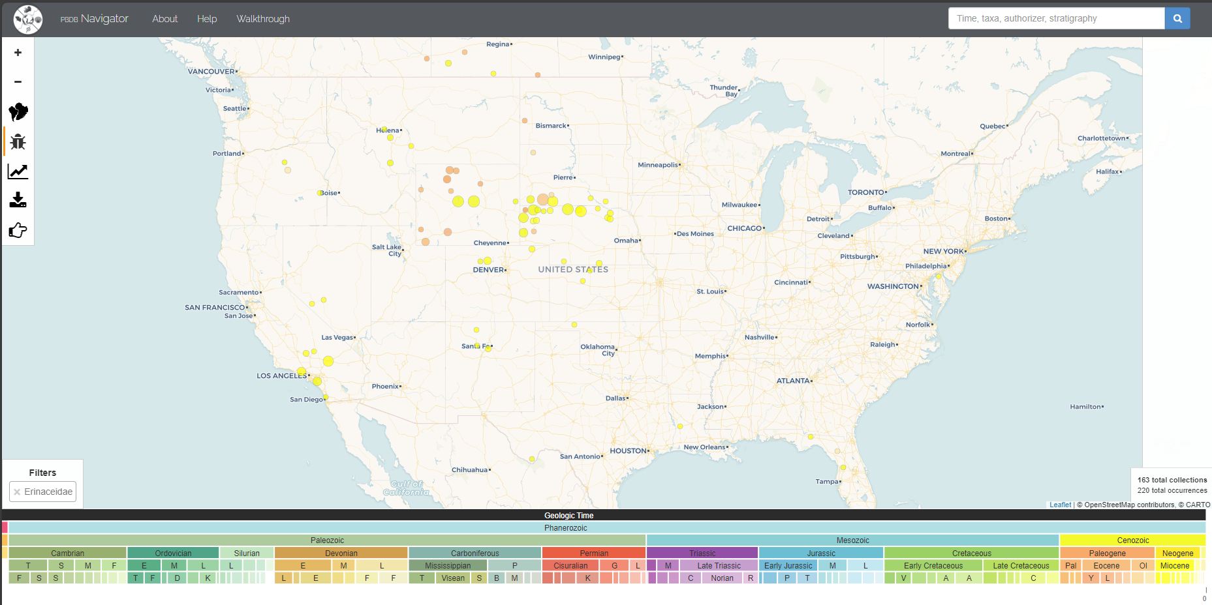
Distribution of Erinaceidae

Slide 3
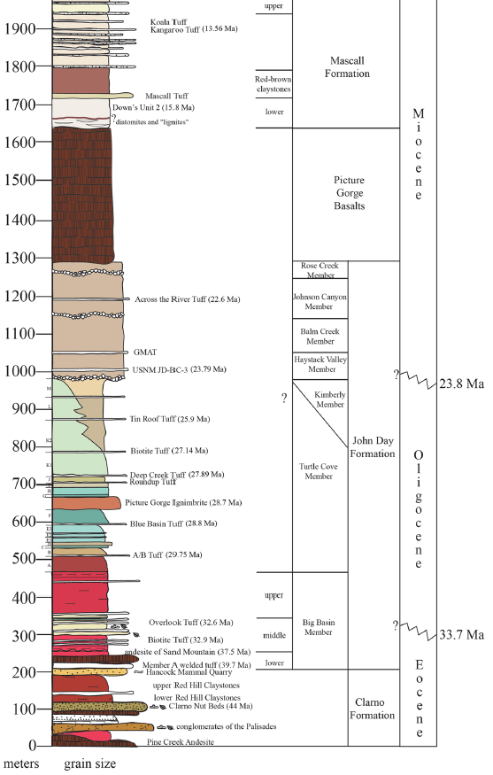
Known PNW Fossils
John Day Formation (Arikareean)
  Turtle Cove Member (Sheep Rock Unit)
    K1 – Ocajila sp.
    K2 – Ocajila sp.
  Kimberly Member (Lonerock)
    cf. Amphechinus sp. (isolated tooth)
Crooked River Mascall Formation (Barstovian)
  Cave Basin
    Lanthanotherium sawini
    Lanthanotherium dehmi
Butte Creek Volcanic Sandstone (Barstovian)
  Red Basin
    Lanthanotherium sp.

Slide 4
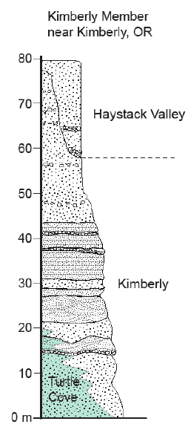
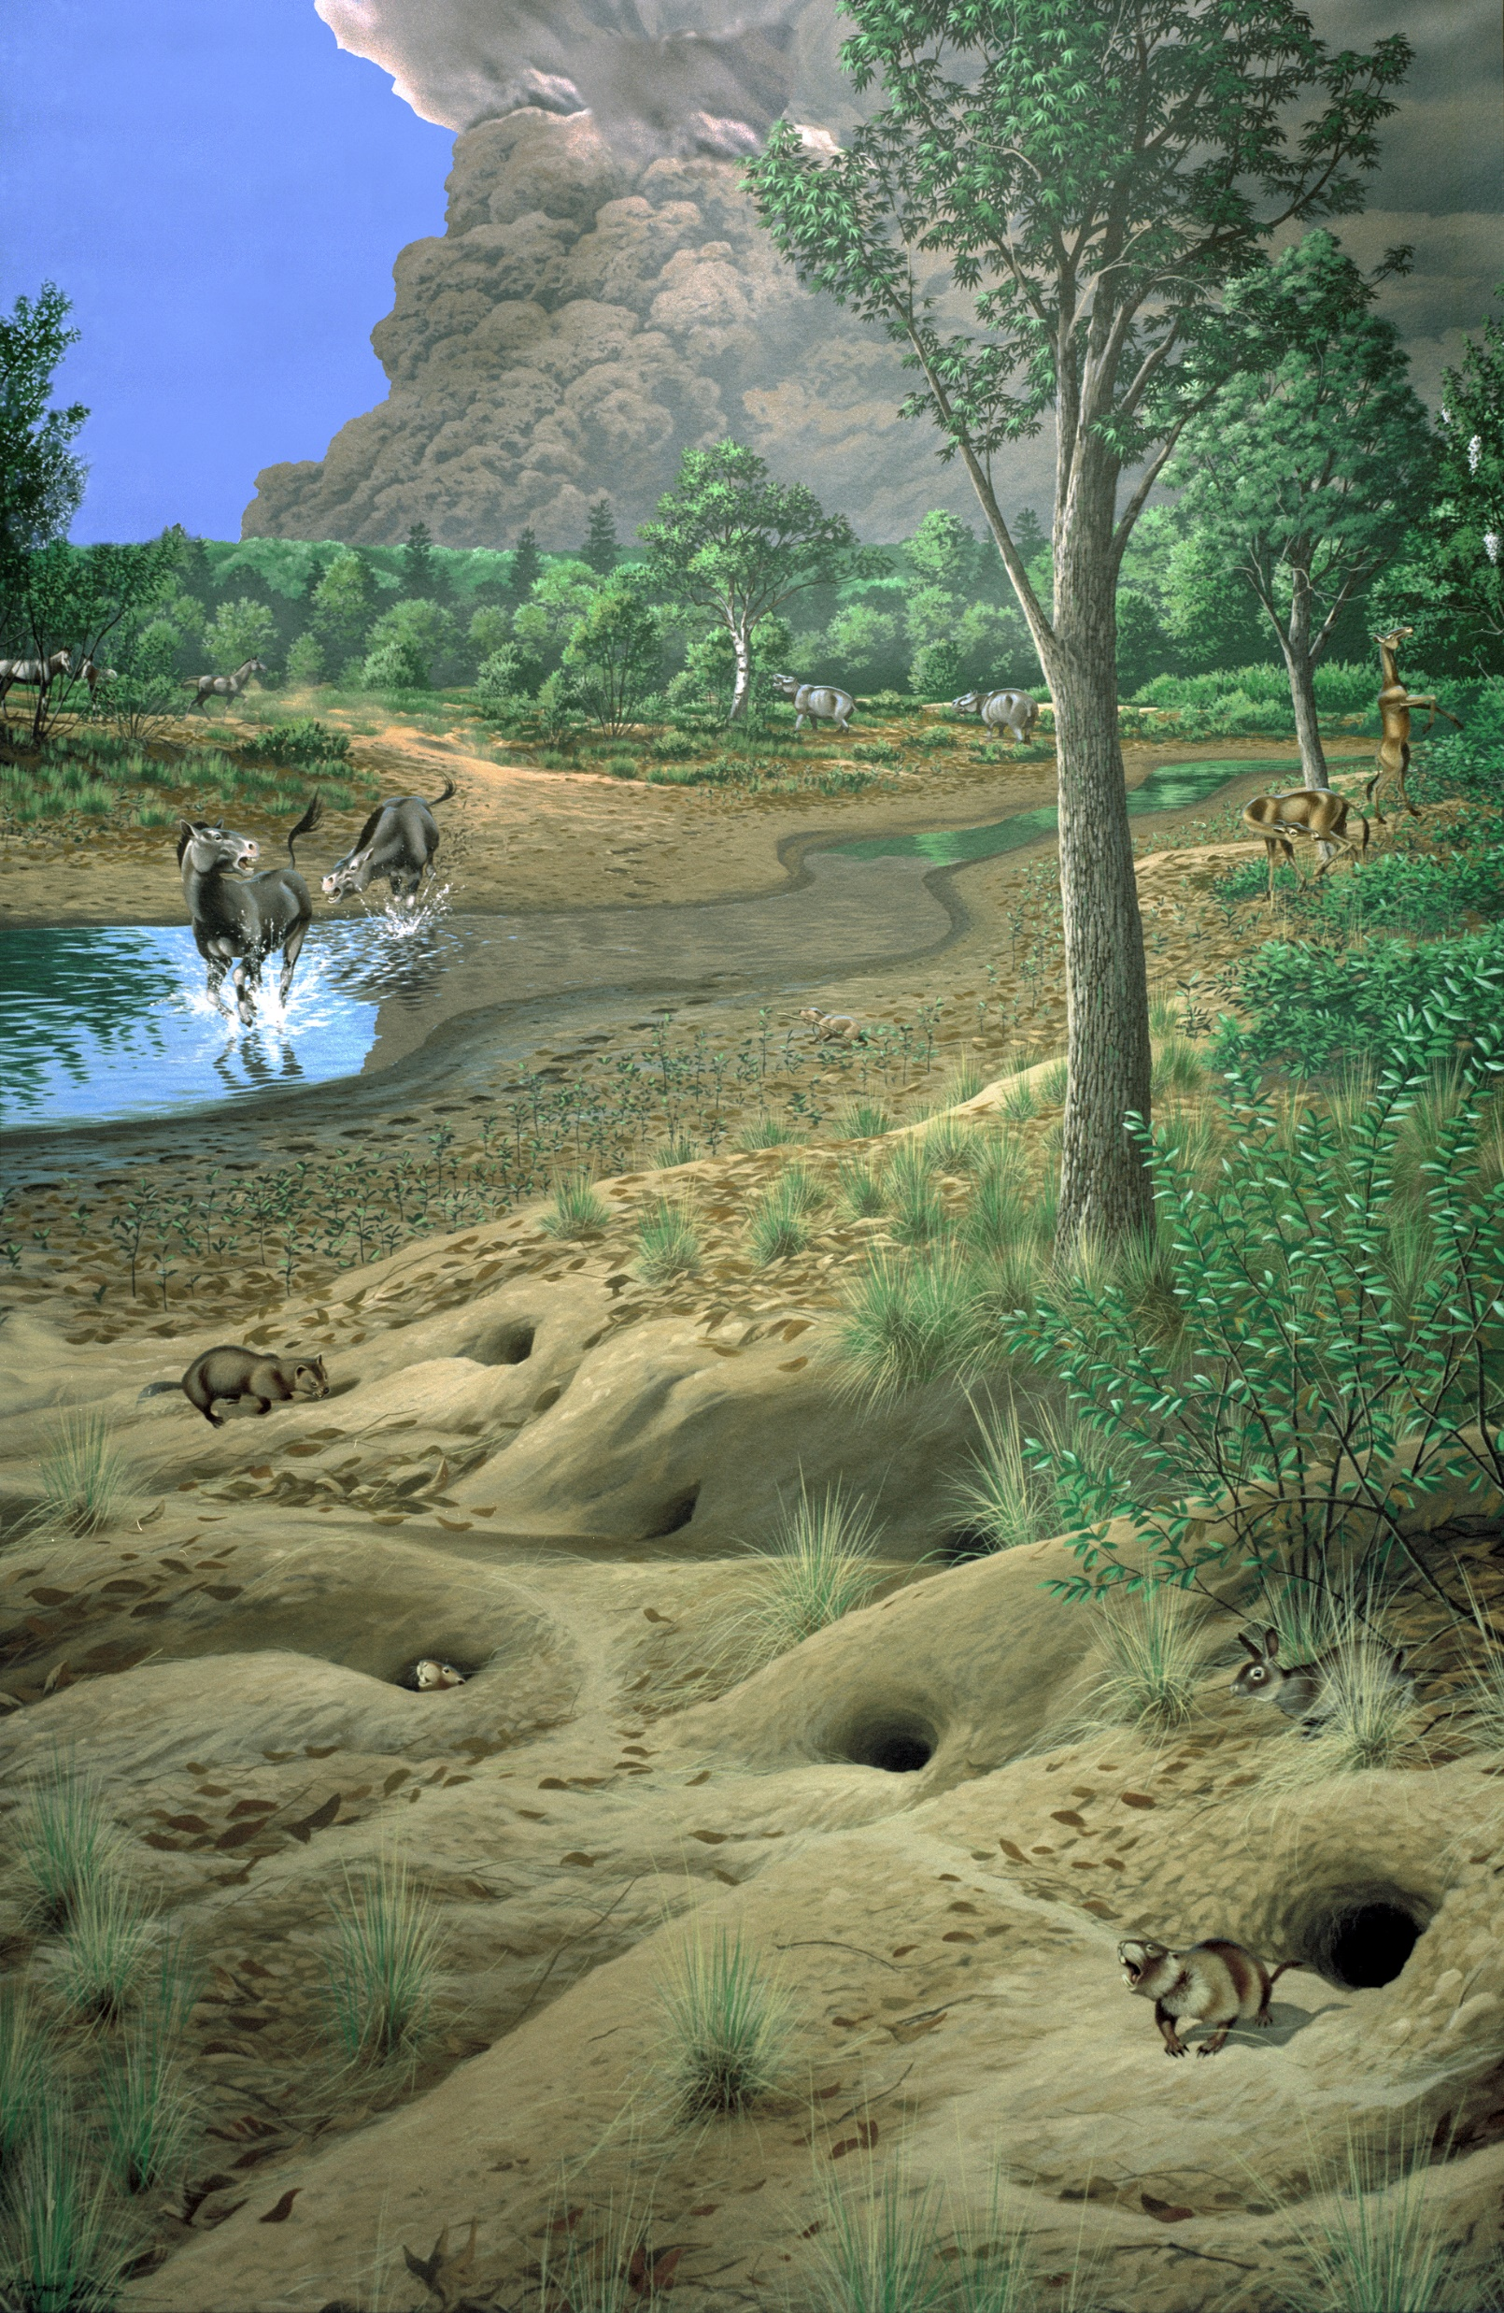



Locality
JDNM-296, Rudio Creek 4
Grant County, Oregon
John Day Formation
  Kimberly Member
Gray siltstone with concretions
Age estimate
  26.601 +0.024/-0.095 to 25.527 + 0.687/-0.694 Ma

Slide 5
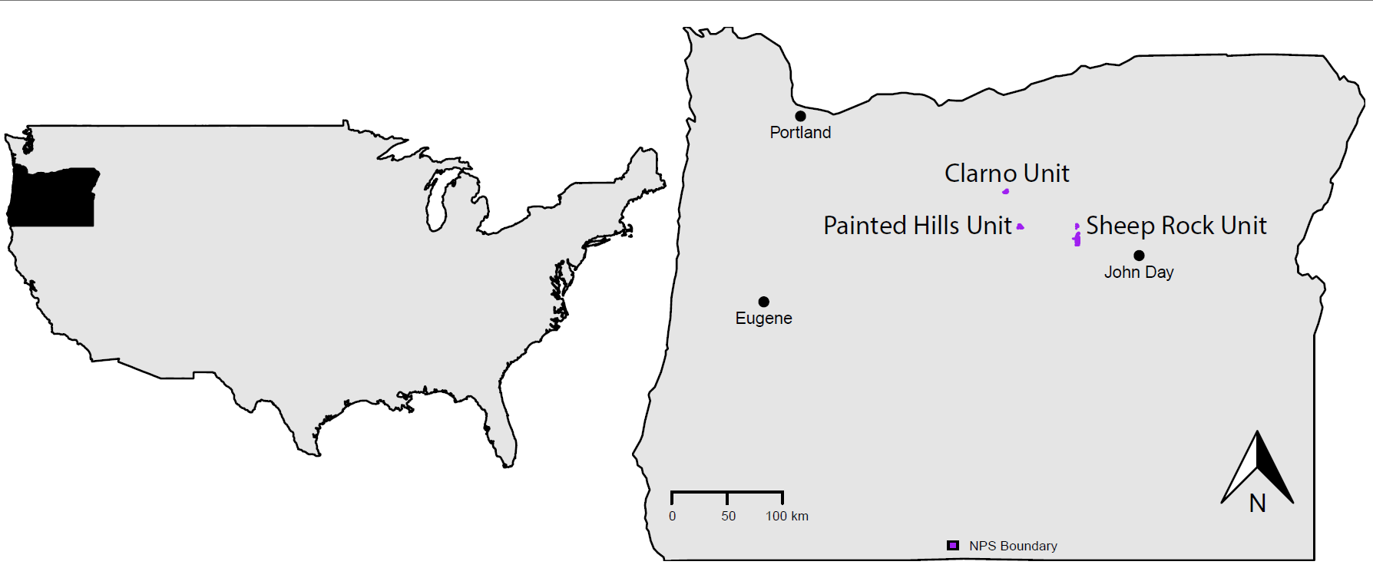
Locality

Slide 6
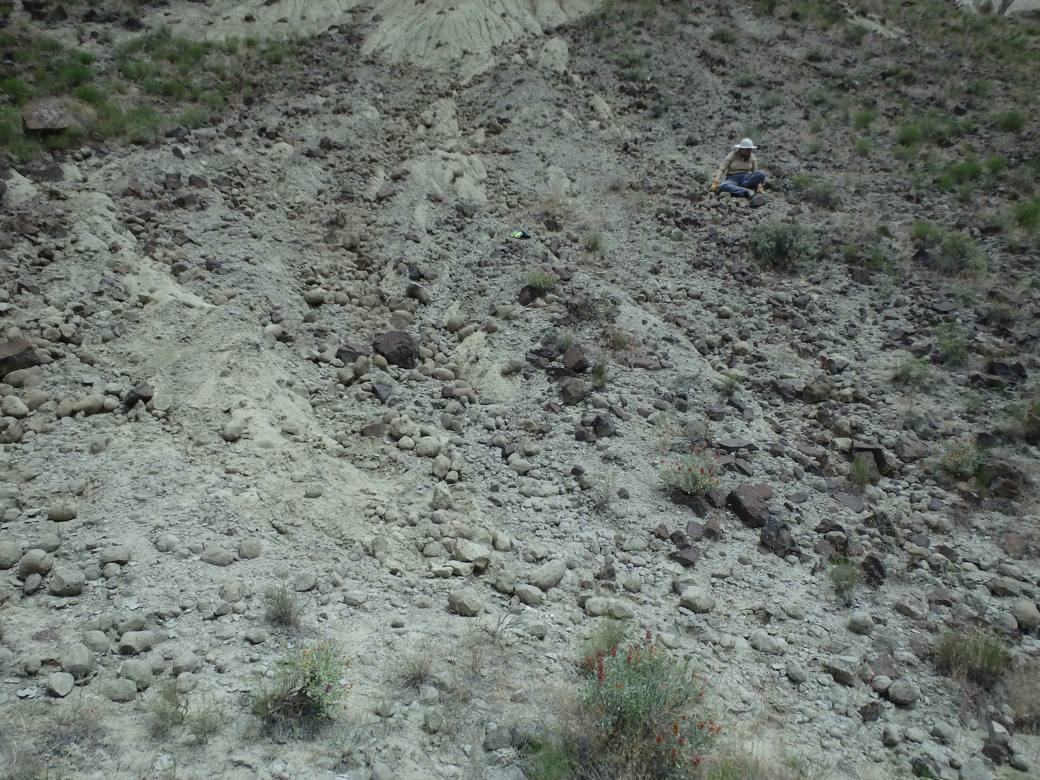
Fieldwork
BLM Permit
  OR-50953
Surface Collected
  June 27, 2019
BLM19NAF-006

Slide 7
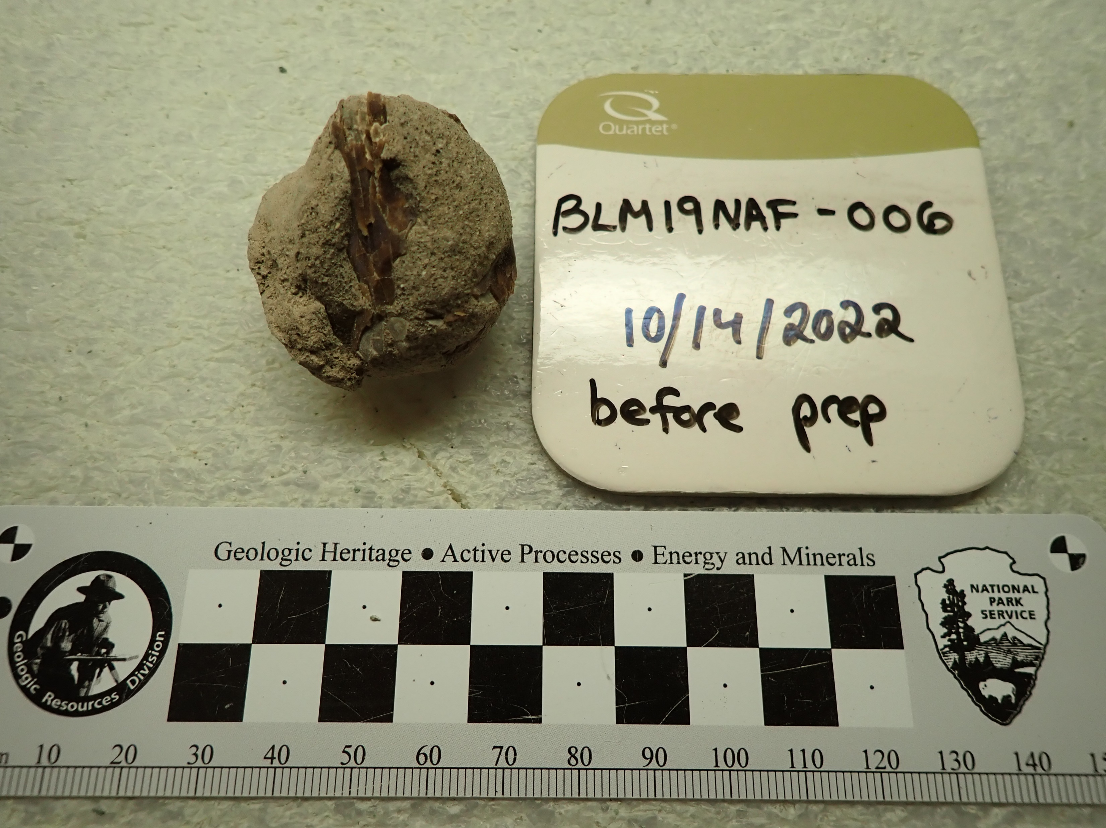
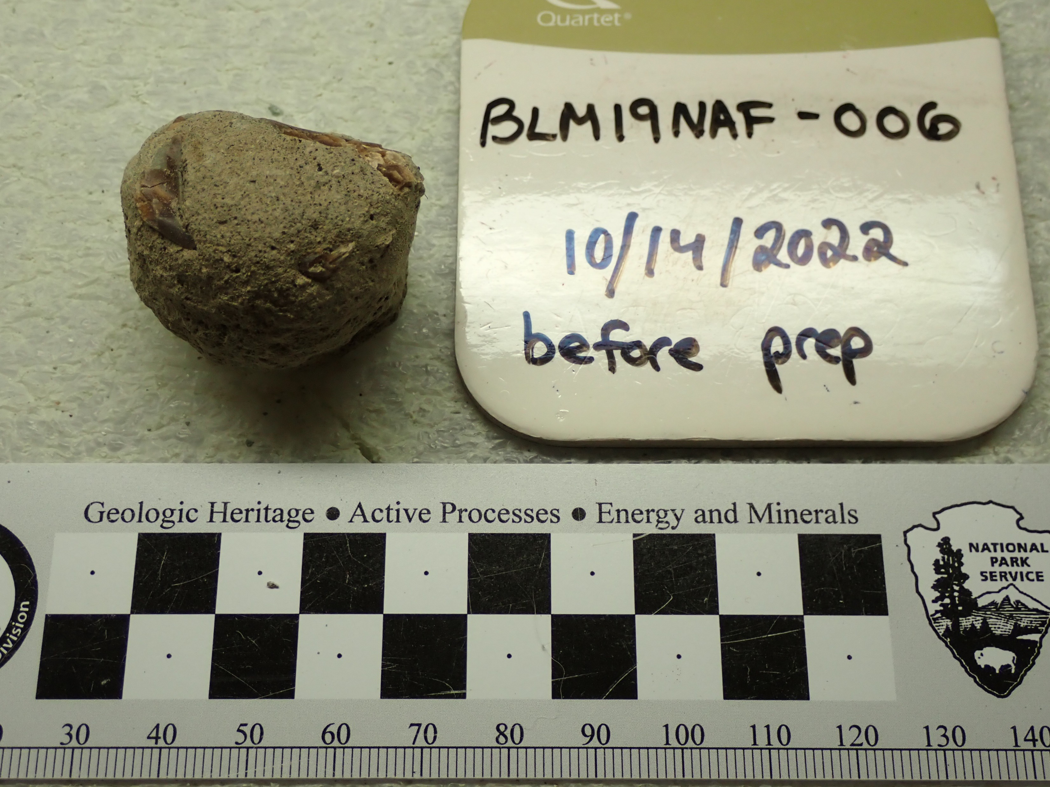
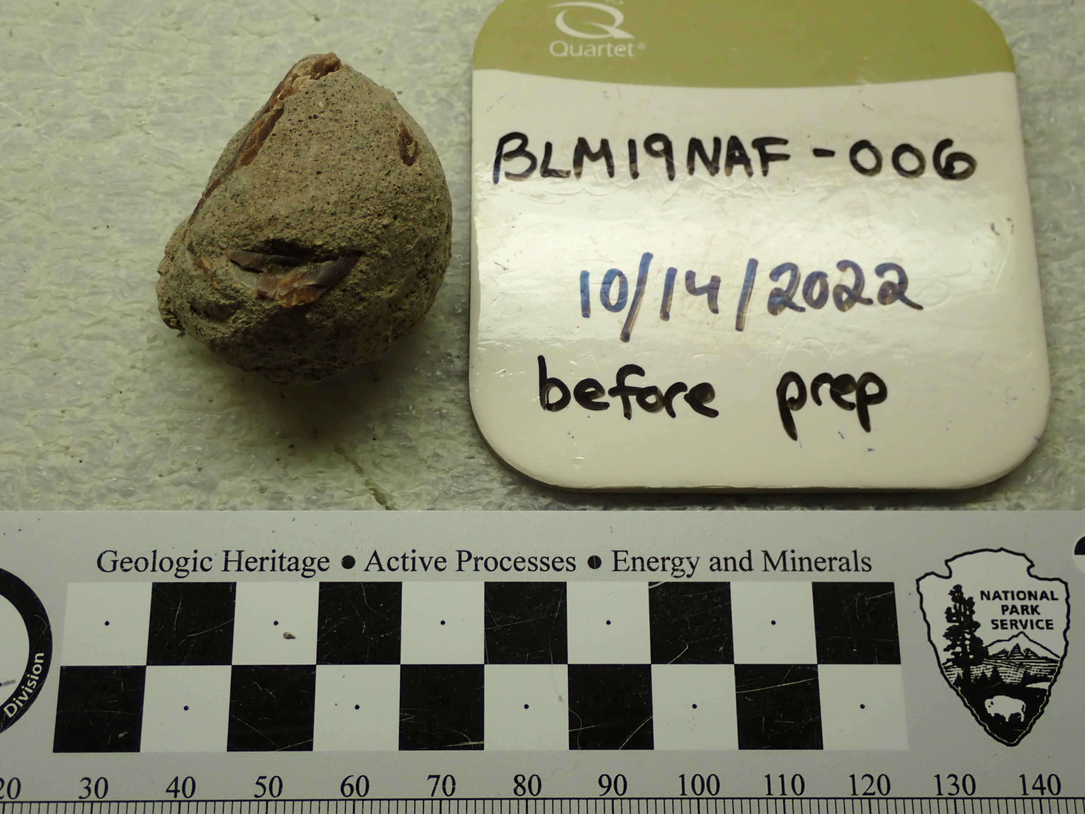
Mechanical Preparation

Slide 8
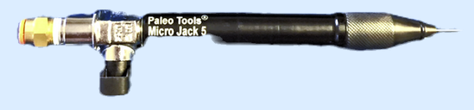
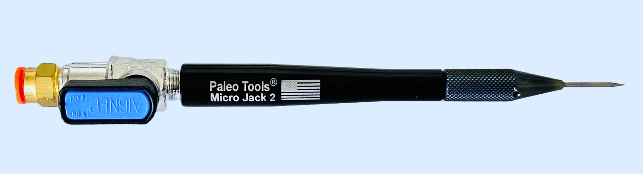
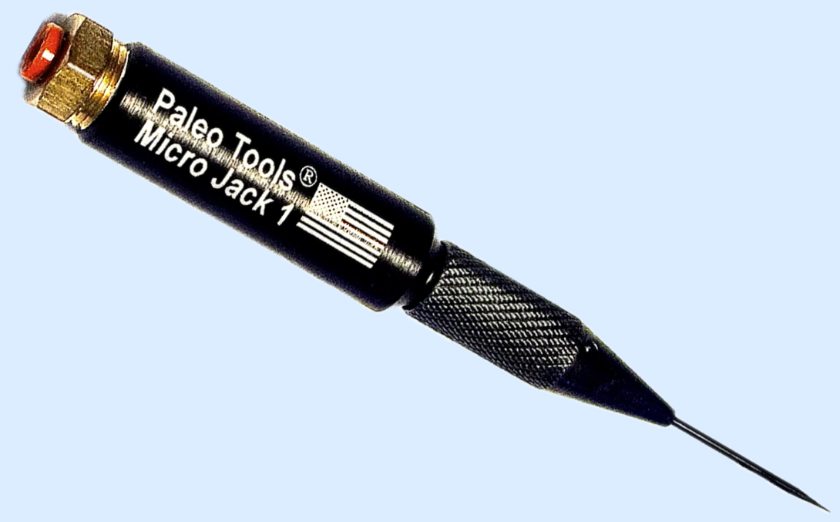
Mechanical Preparation
Pinvice
Microjack 1, 2, 5
B-15 Consolident (PVA)
~15 hrs of prep
  October 14, 2022 to December 9, 2022

Slide 9
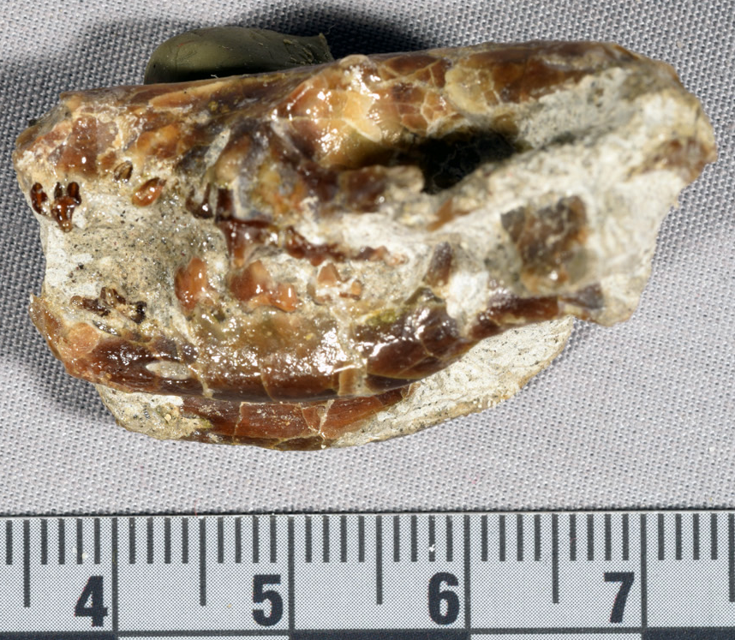
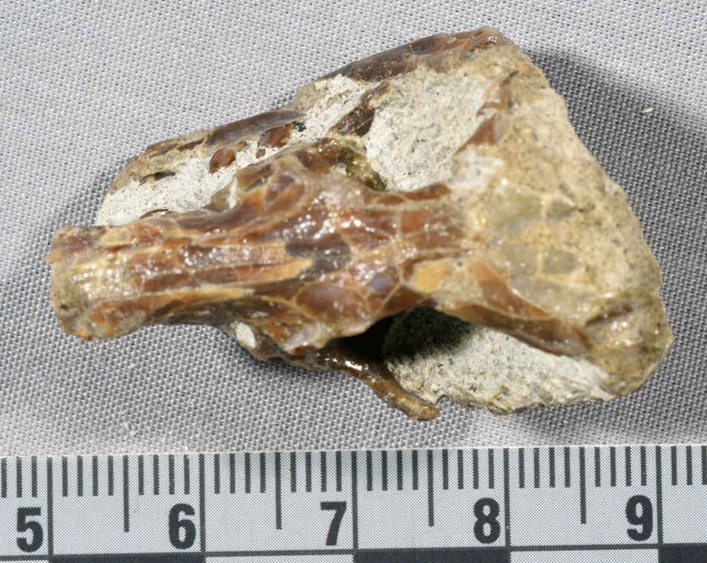
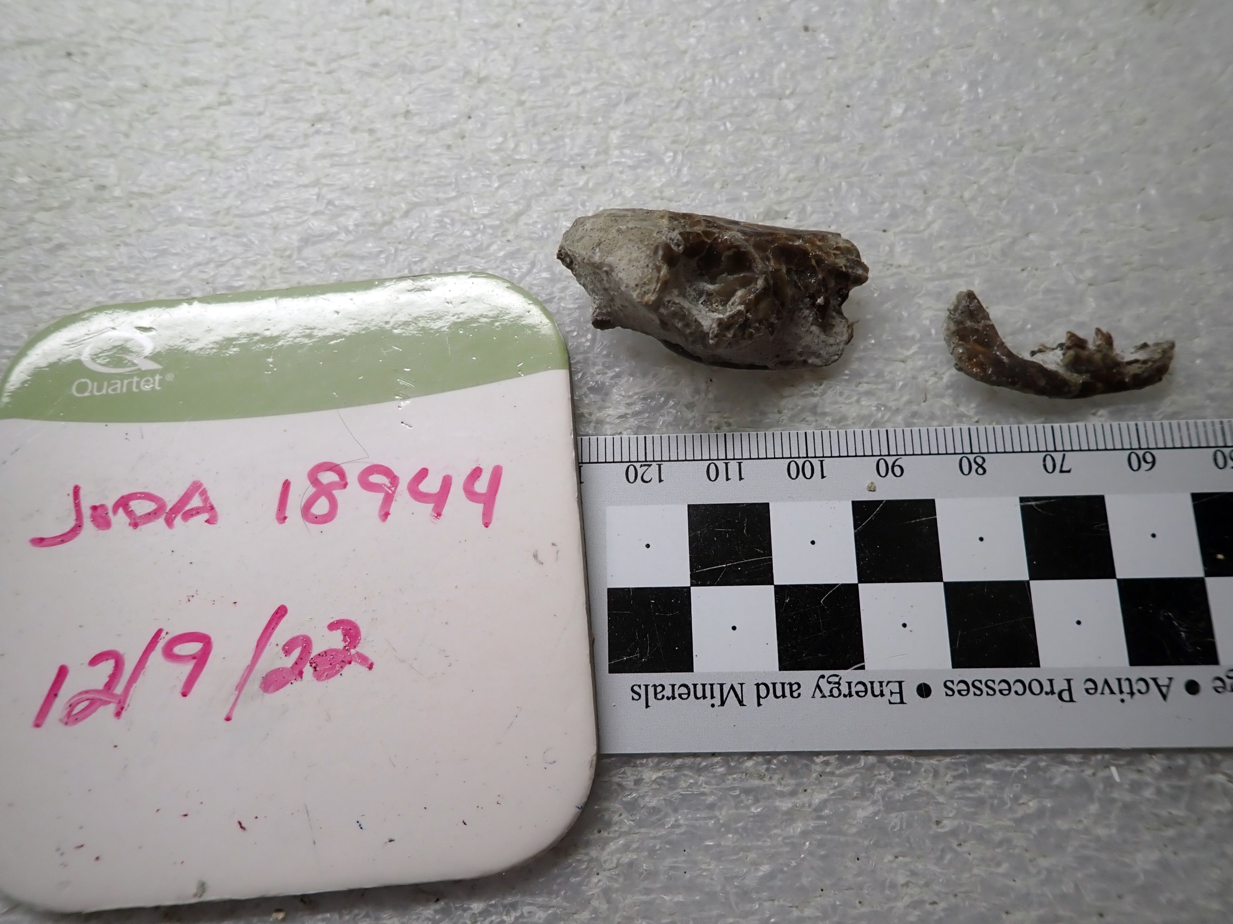
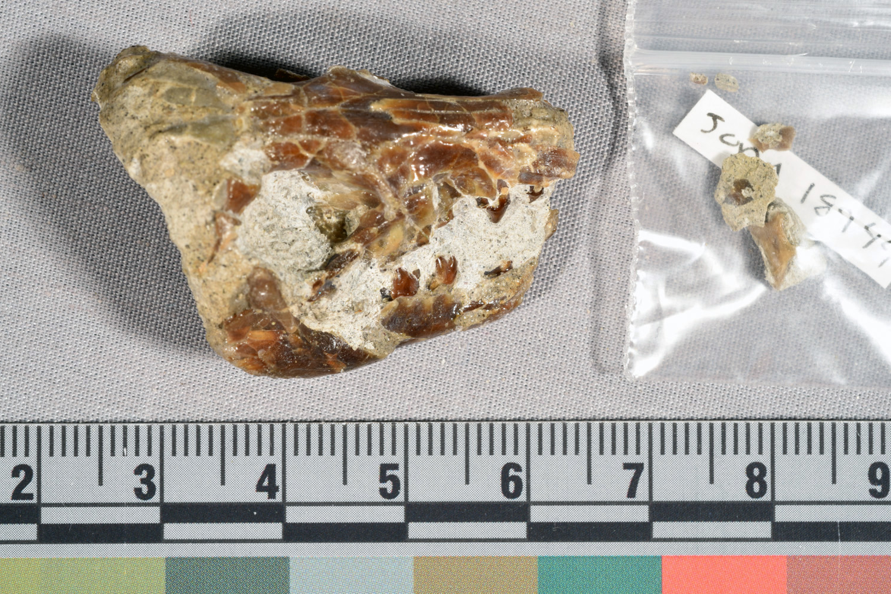
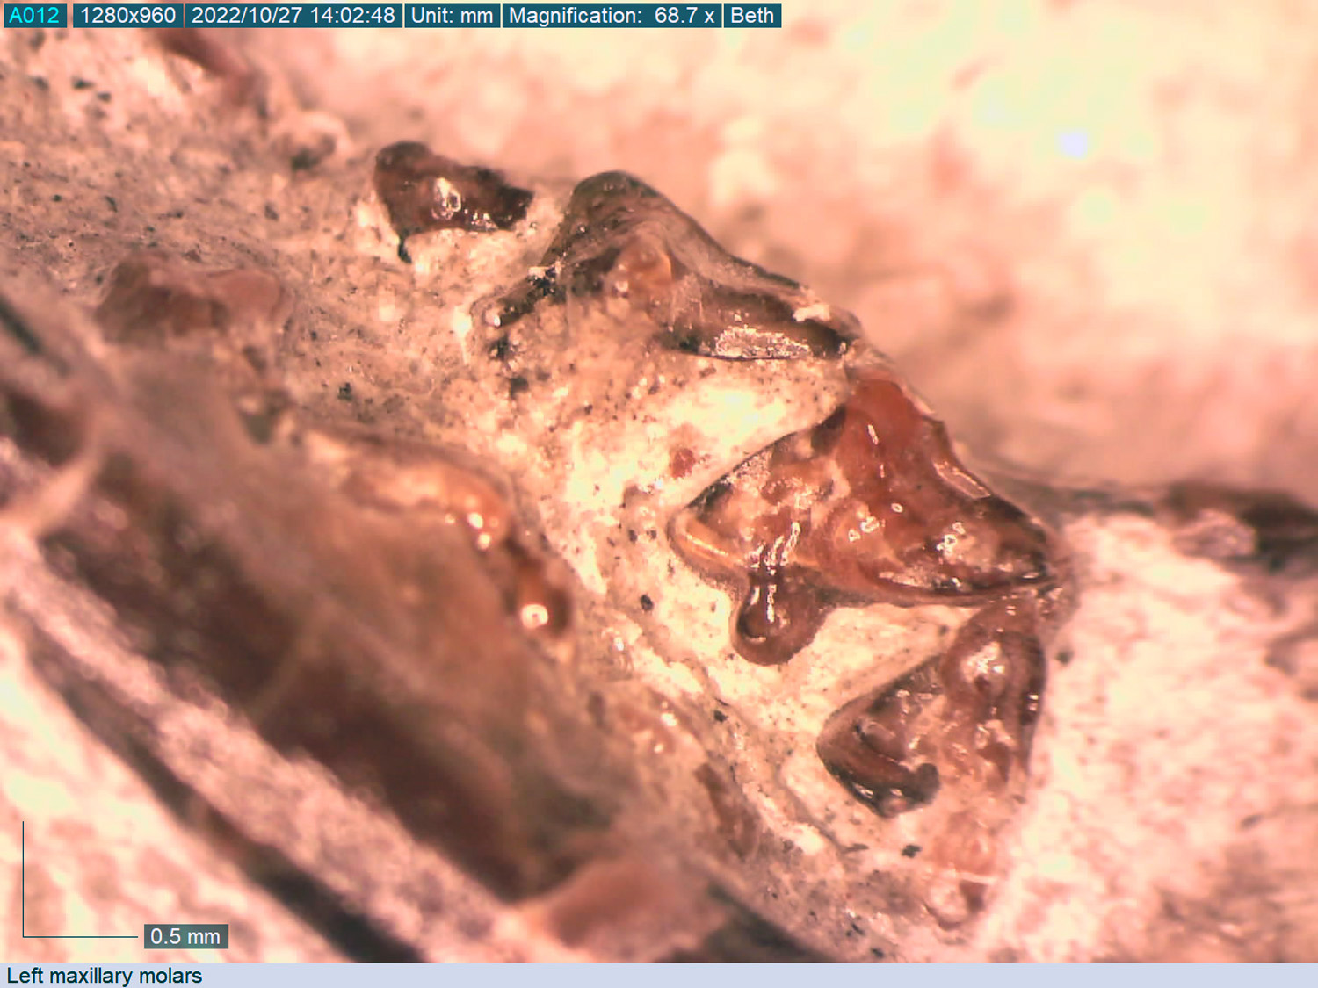
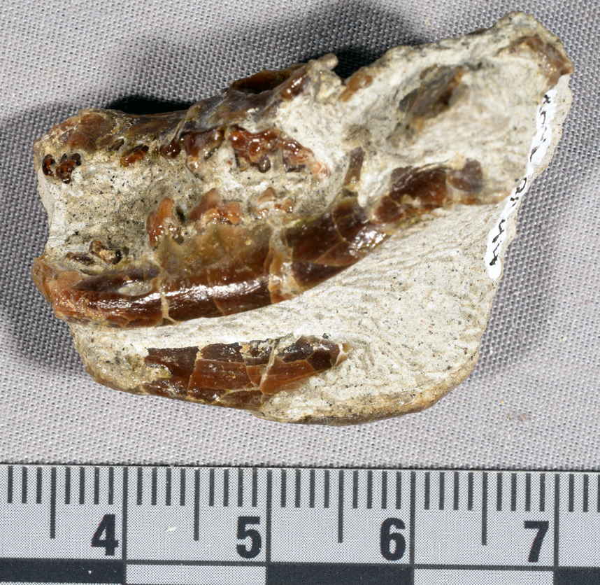
JODA 18944

Slide 10
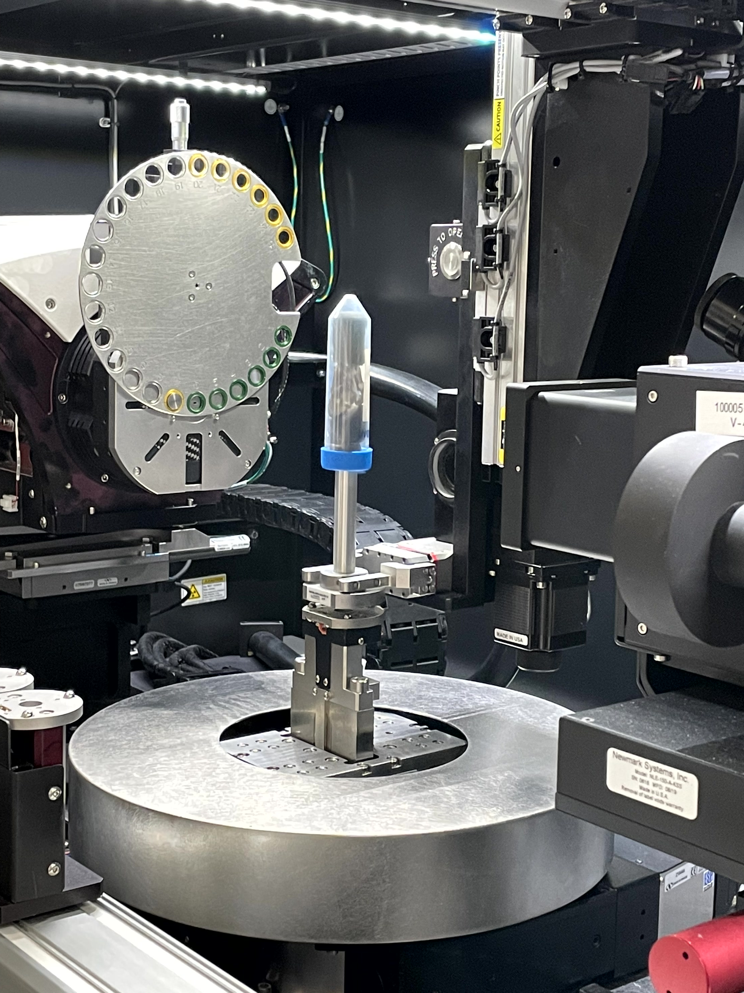
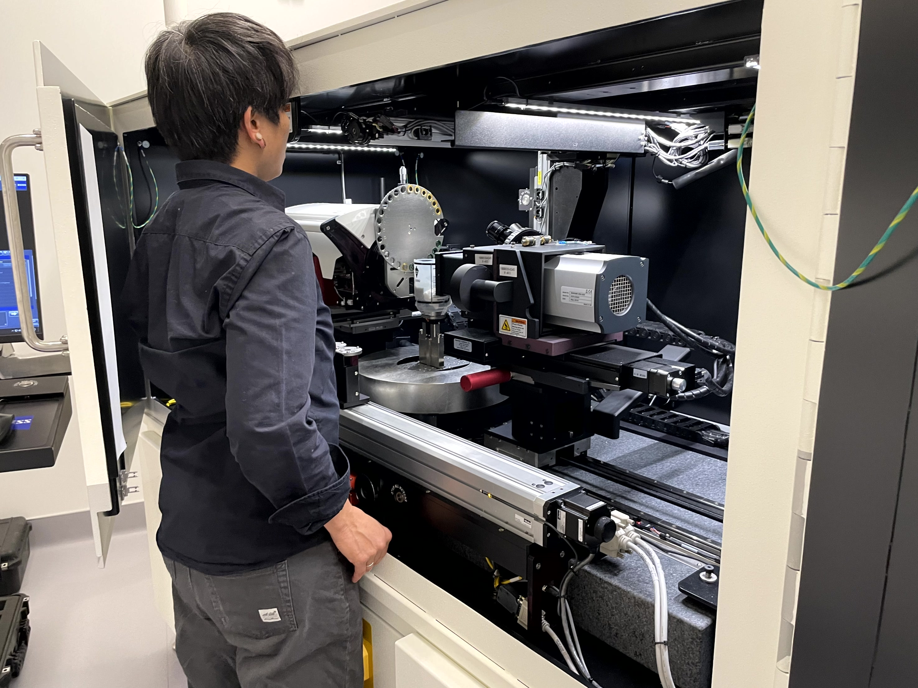
micro-CT scan
Zeiss Xradia 620 Versa
voxel size (um) | energy (kV) | power (W) | objective | filter | binning | scan time
33.861 | 120 | 17.5 | 0.4X | HE1 | 2 | 4:26

Slide 11
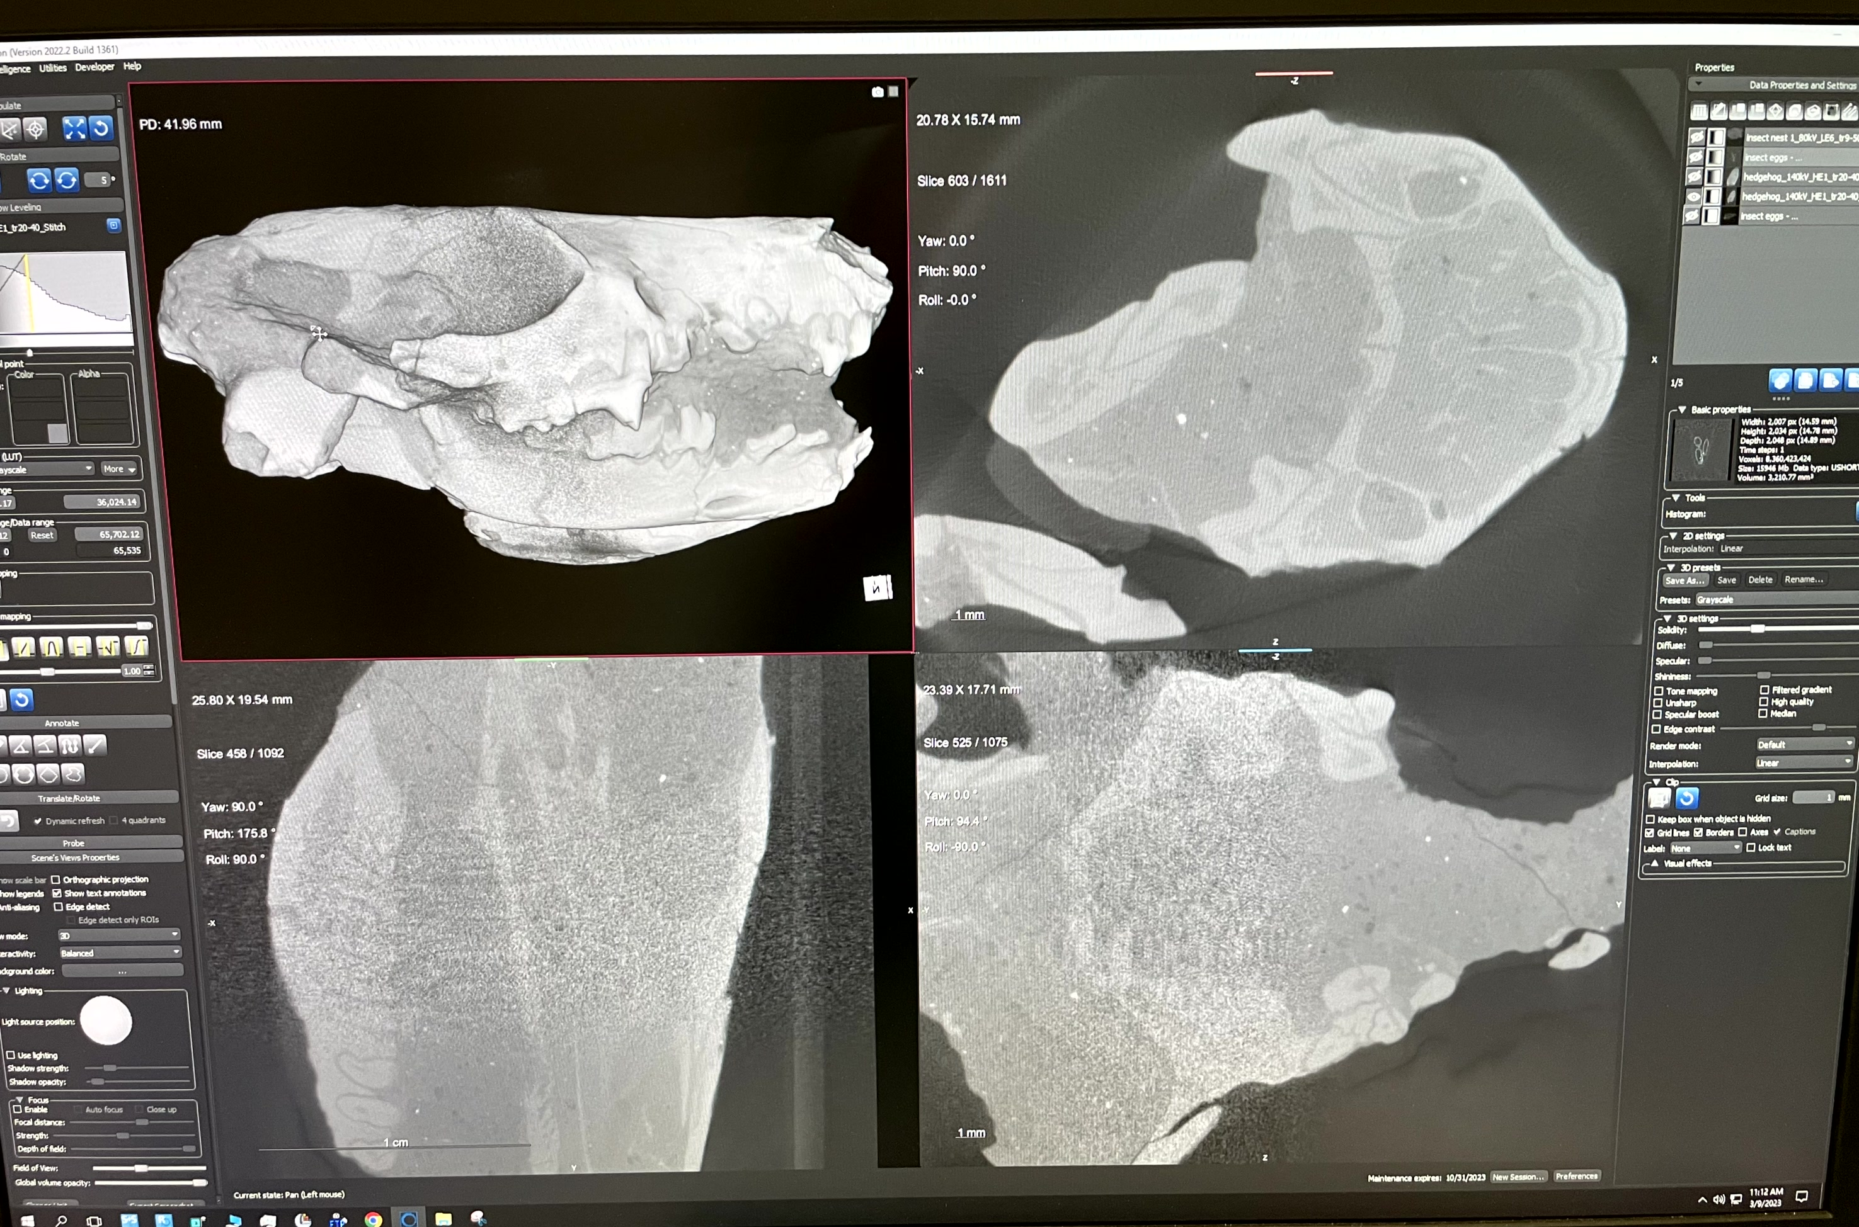
micro-CT scan

Slide 12

3D Model
DICOM Files
3D Slicer
.stl file for model

Slide 13
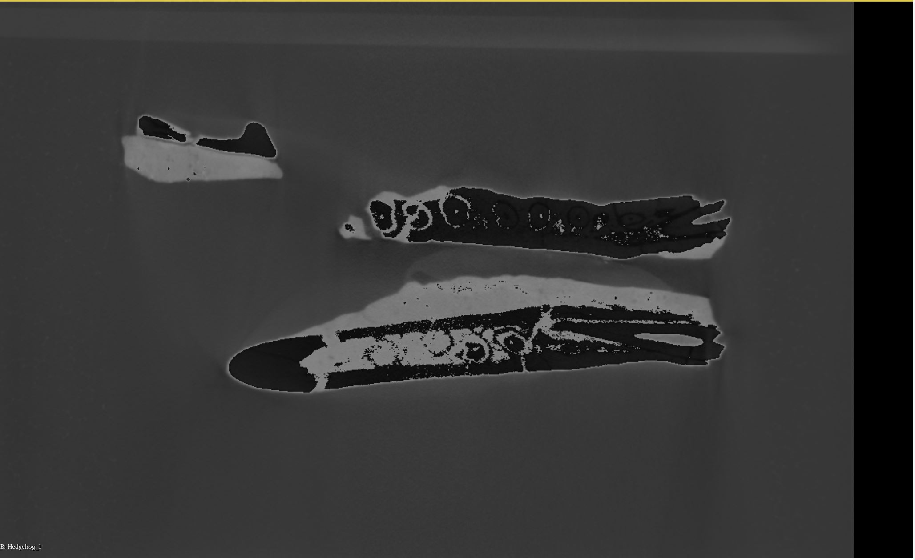
First Lower Incisor

Slide 14
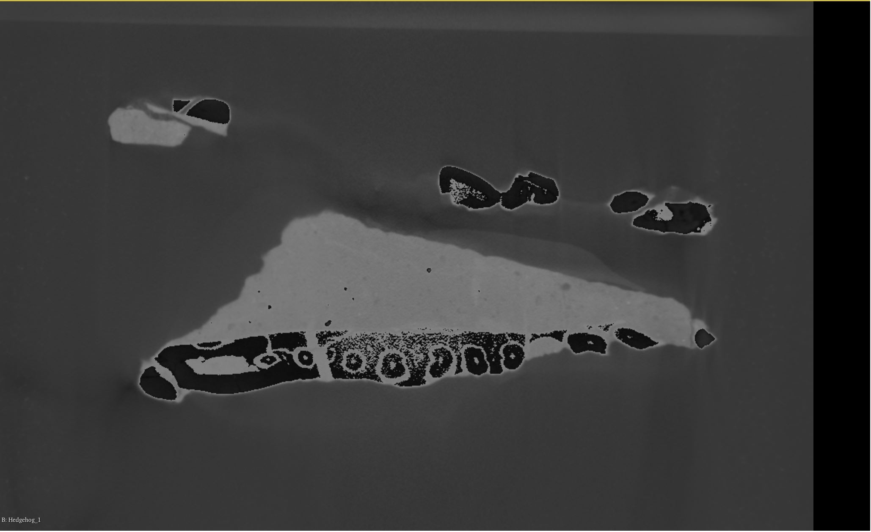
First Lower Incisor

Slide 15
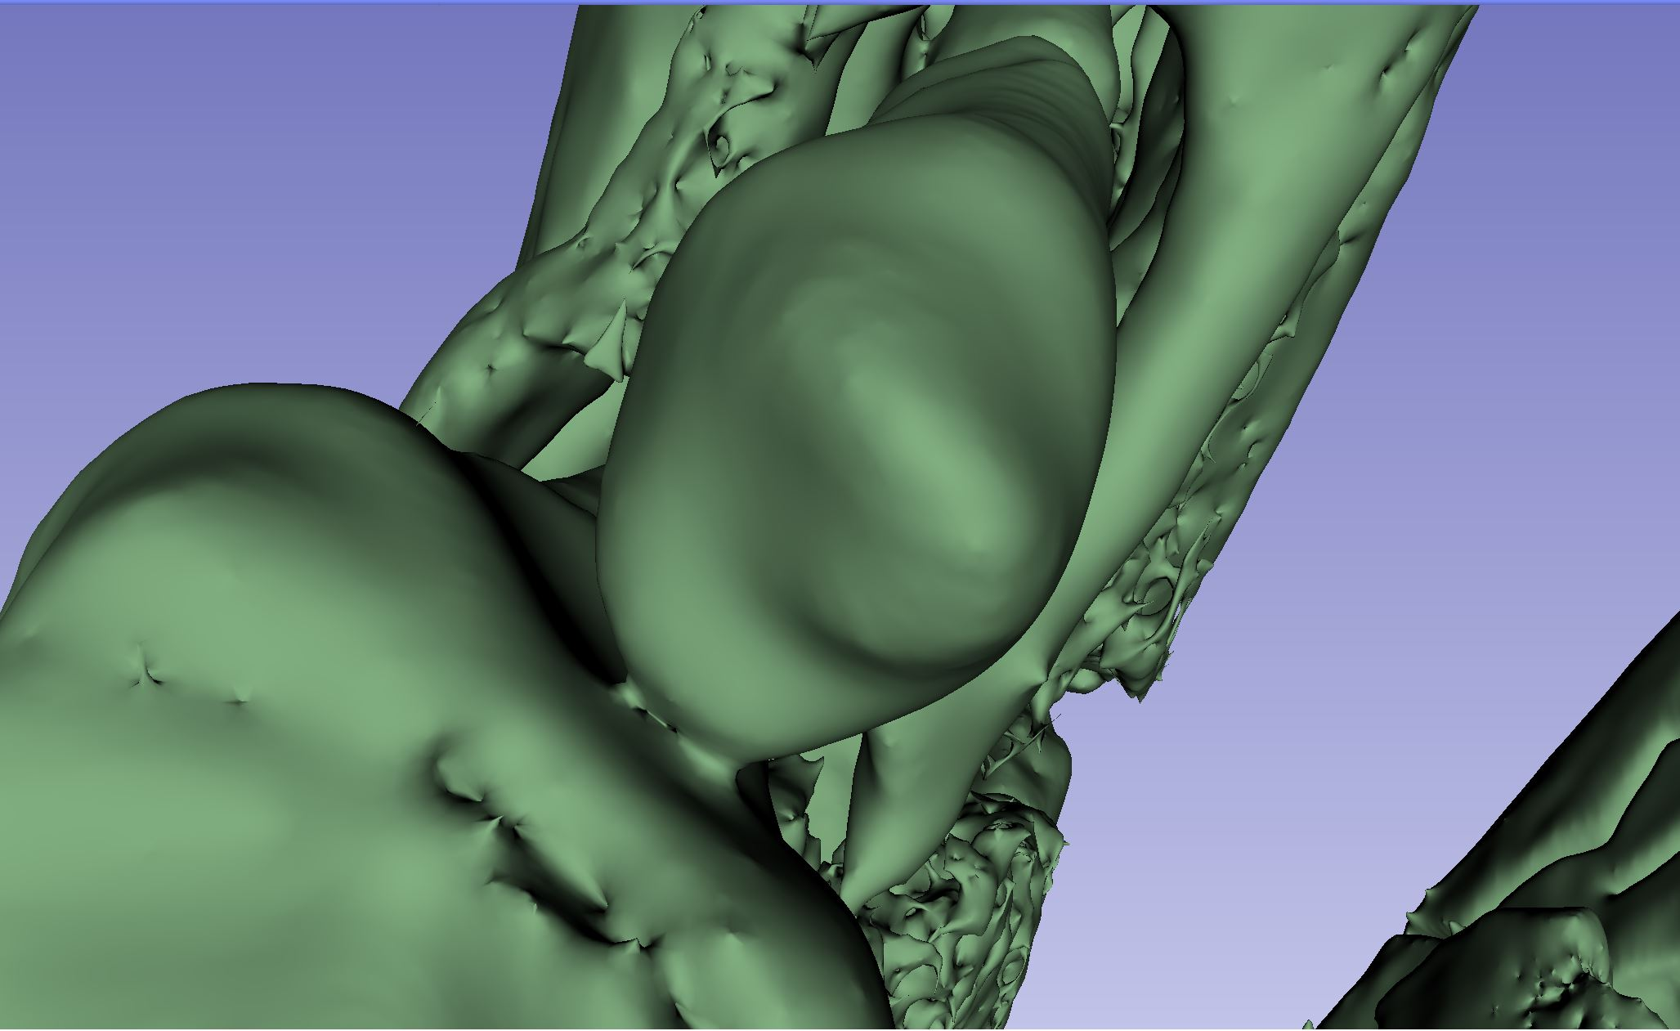
Third lower molar

Slide 16
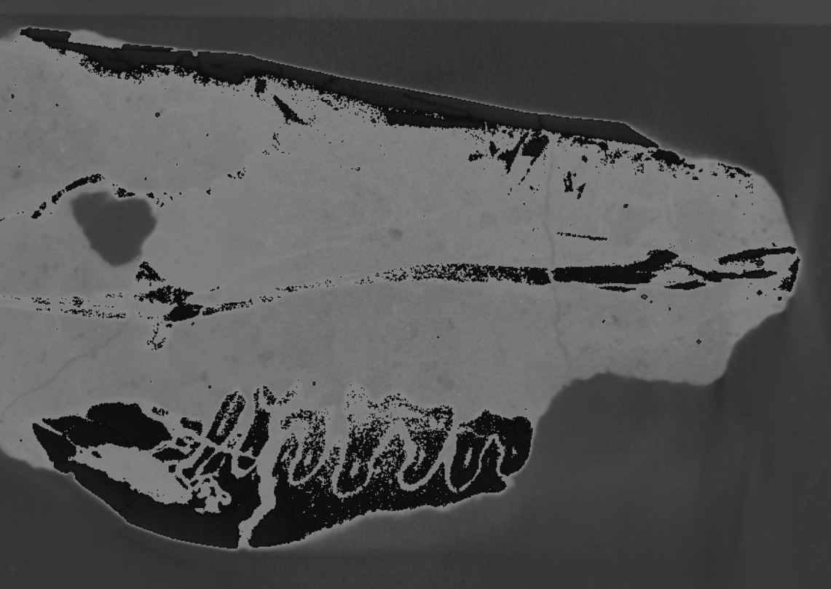
Third lower molar

Slide 17
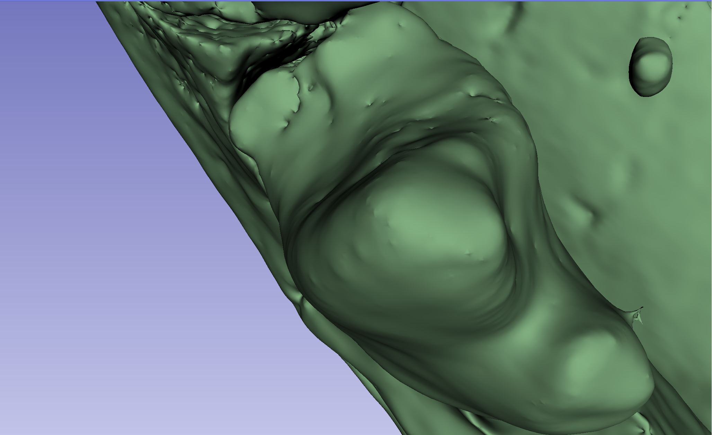
Fourth lower premolar

Slide 18
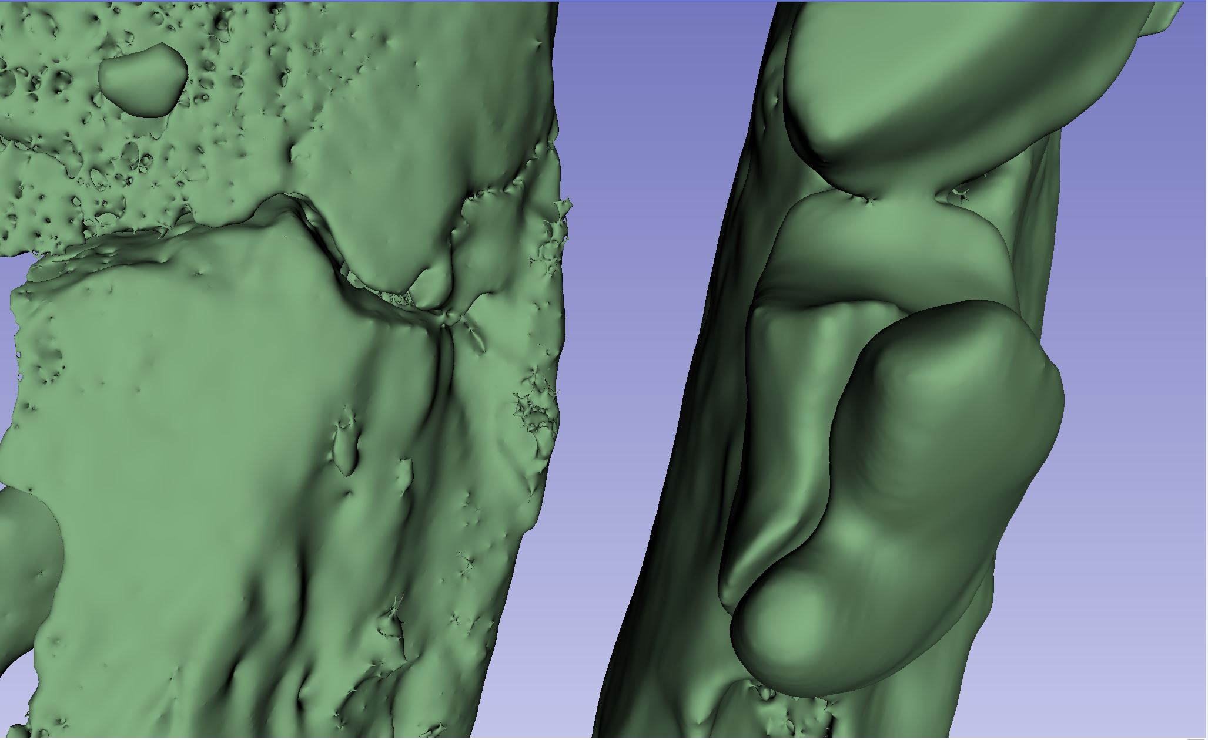
Fourth lower premolar

Slide 19
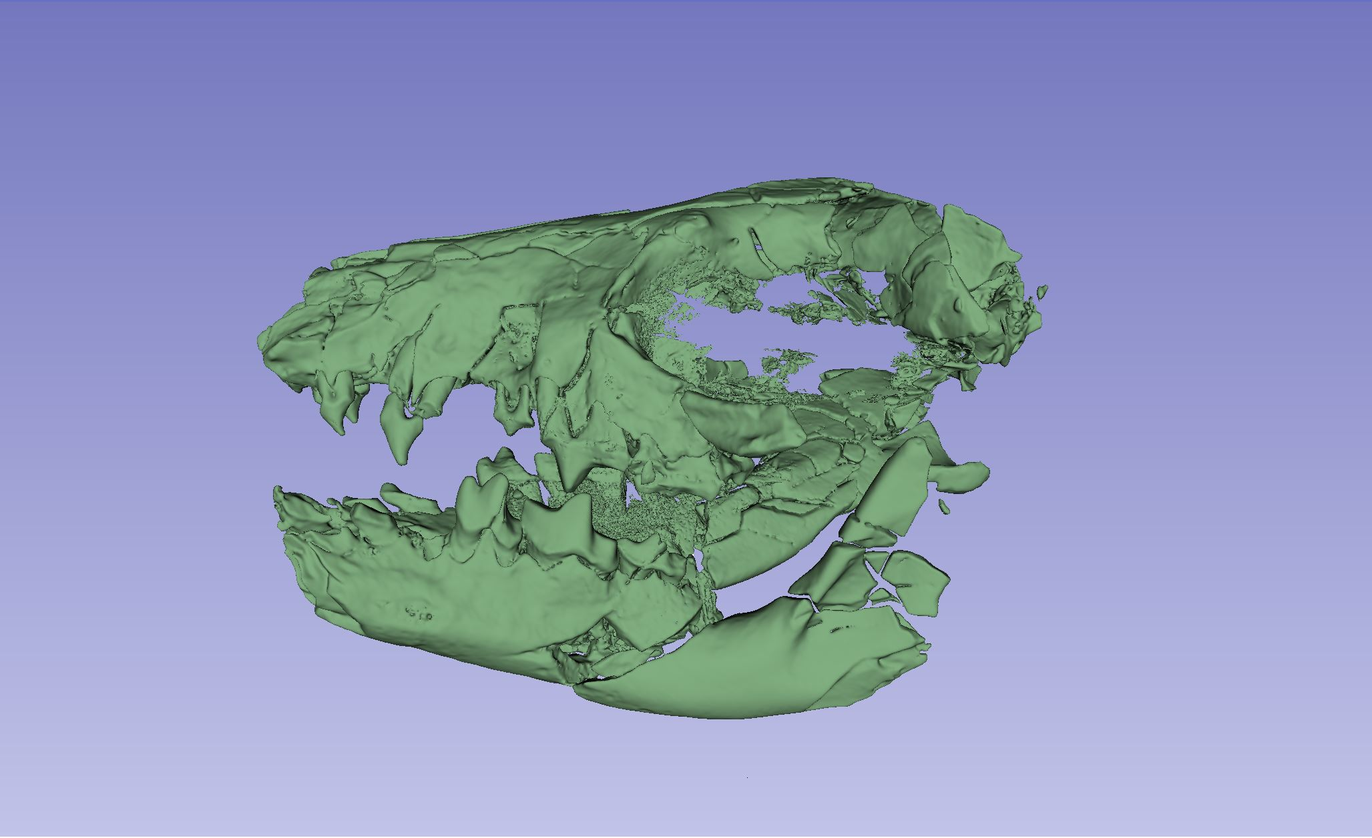
Upper fourth premolar

Slide 20
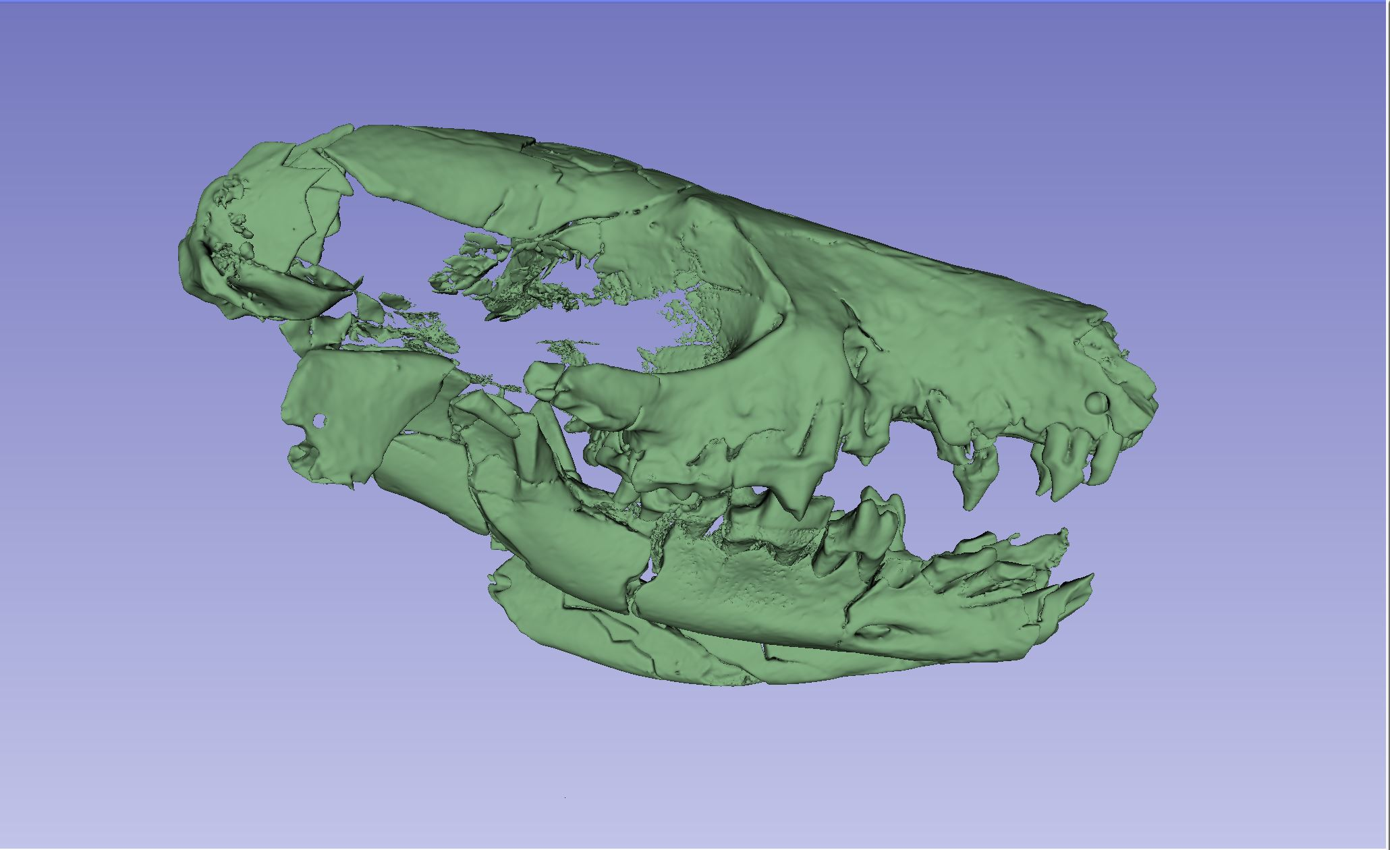
Upper fourth premolar

Slide 21
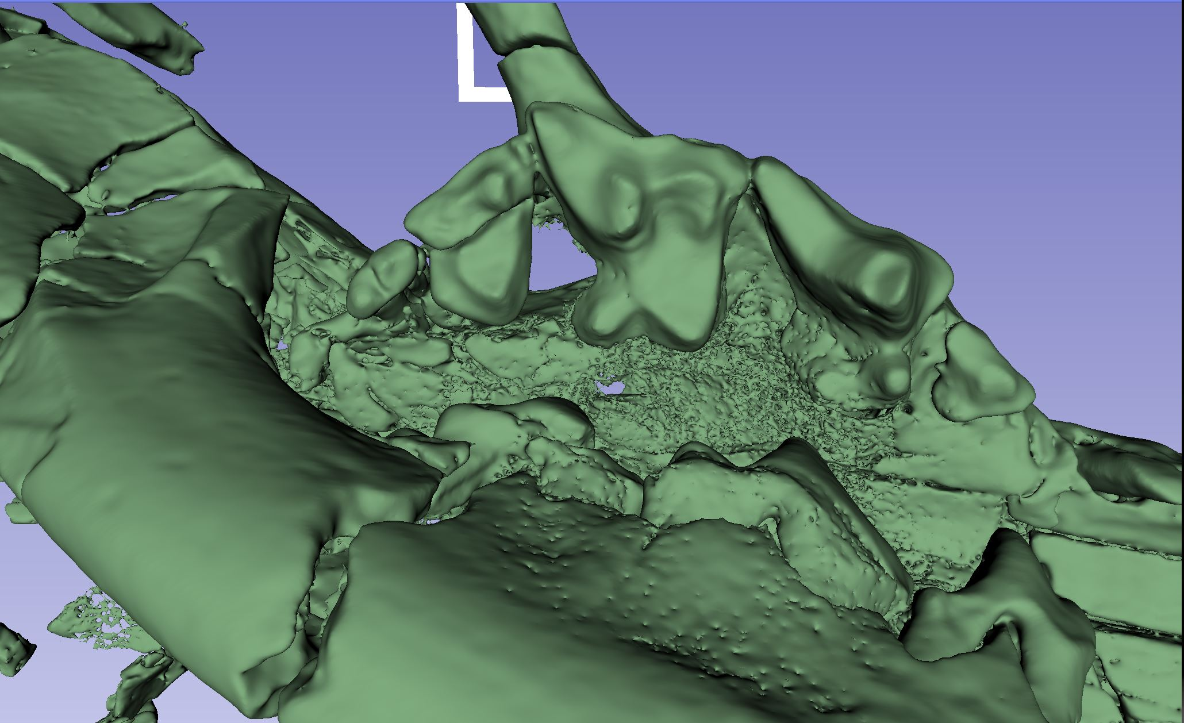
Upper teeth

Slide 22
Measurements (mm)
Specimen | I1L | I1W | I2L | I2W | I3L | I3W | C1L | C1W | P2L | P2W | P3L | P3W | P4L | P4W | M1L | M1W | M2L | M2W | M3L | M3W | p3L | p3W | p4L | p4W | m1L | m1W | m2L | m2W | m3L | m3W | jaw depth p4-m1
JODA 18944 (L) ct |  |  |  |  |  |  |  |  |  |  |  |  |  |  |  |  |  |  |  |  |  |  | 2.783 |  | 4.008 |  | 3.058 |  |  |  | 4.709
JODA 18944 (R) ct |  |  |  |  |  |  |  |  |  |  | 1.966 | 1.581 | 4.033 |  | 3.603 |  | 2.863 |  | 1.418 |  |  |  | 3.077 |  | 4.651 |  | 3.265 |  | 0.9362 |  | 5.344
JODA 18944 (L) |  |  |  |  |  |  |  |  |  |  |  |  | 4.24 |  | 3.84 | 3.92 | 2.41 | 3.68 |  |  |  |  | 3.34 |  | 4.78 |  | 3.08
JODA 18944 (R) |  |  |  |  |  |  |  |  |  |  |  |  |  |  |  |  |  |  |  |  |  |  | 2.77 | 1.75 | 4.651 | 2.46 | 3.57 | 2.15 |  |  | 5.75

Slide 23
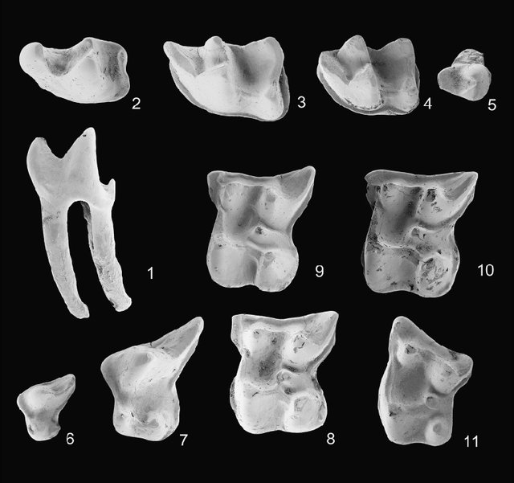
Taxon - Amphechinus
M1 long relative to width
M3 lacks metacone
p2 single-rooted
p4 paraconid slightly lower than protoconid
m1 trigonid A-P elongated
m3 lacks taloned/postcingulum
Mandibular angle elongate
Anterior surface of ascending ramus posteriorly inclined
Ziegler and Storch, 2007

Slide 24
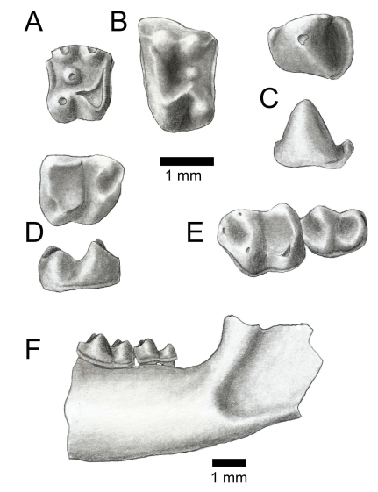
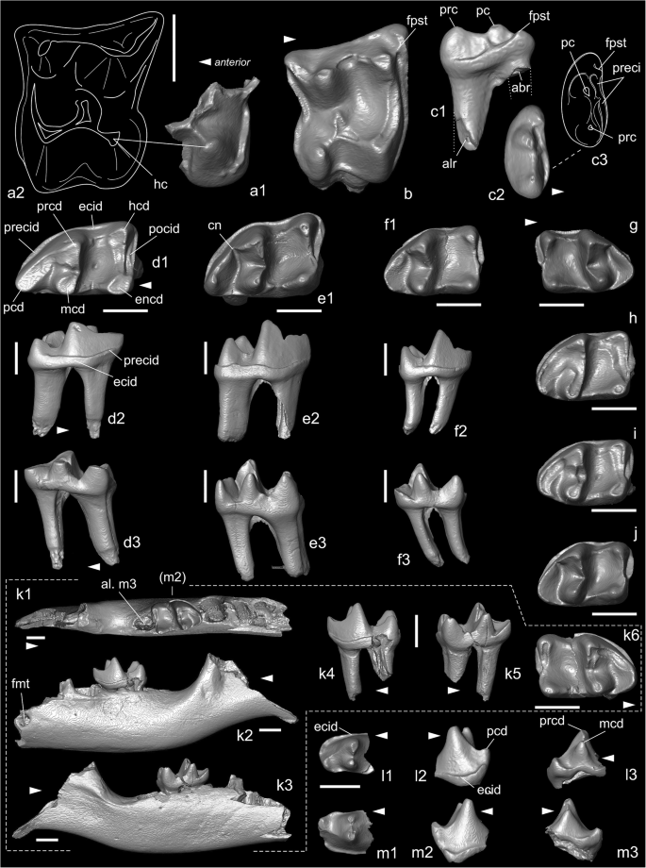
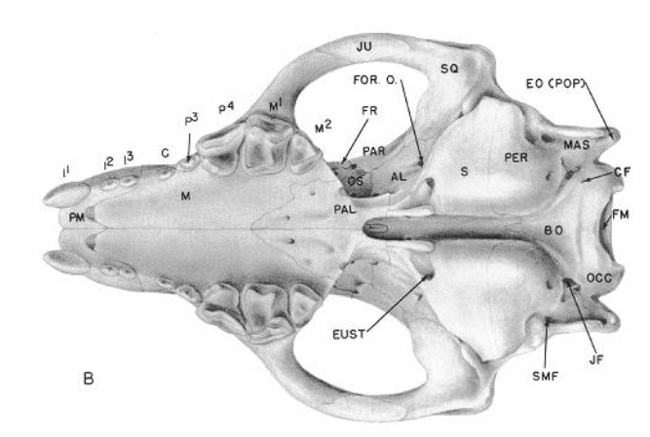
Other Taxa
Ocajila
  Smaller
Stenoechinus
  Similar size
Parvericius
  Larger
Brachyerix
Ocajila, Korth 2022
Parvericius, Voyta et al., 2022
Brachyerix, Rich and Rich, 1971

Slide 25
Acknowledgements
JODA Paleo 2019 field crew
Bureau of Land Management
Ryan Griffin (BLM Prineville District Office)
Ed Welsh

