Slide 1
Case for >1 Million-Year-Old, Ice-Age Megafloods in Eastern Washington
Bruce Bjornstad
Ice Age Floodscapes

Slide 2
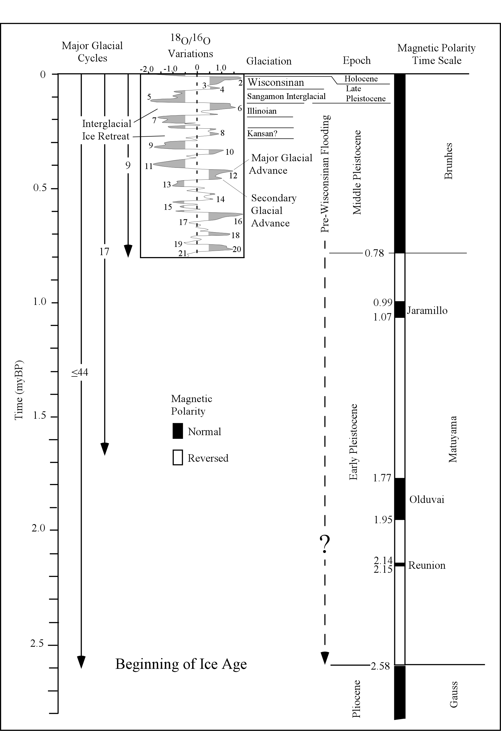
Quaternary Magnetic-Polarity Time Scale
Last period of reversed-magnetic polarity (Matuyama) ended 780 ka yrs ago. This interval defines the early Pleistocene Epoch.
Marine-
isotope
stages
Since 780 ka, each glacial-interglacial cycle lasted roughly 100,000 years based on marine O-18/O-16 variations.
Thus, the Matuyama reversed-polarity interval didn’t begin until Marine Isotope Stage 21 (MIS 21).

Slide 3
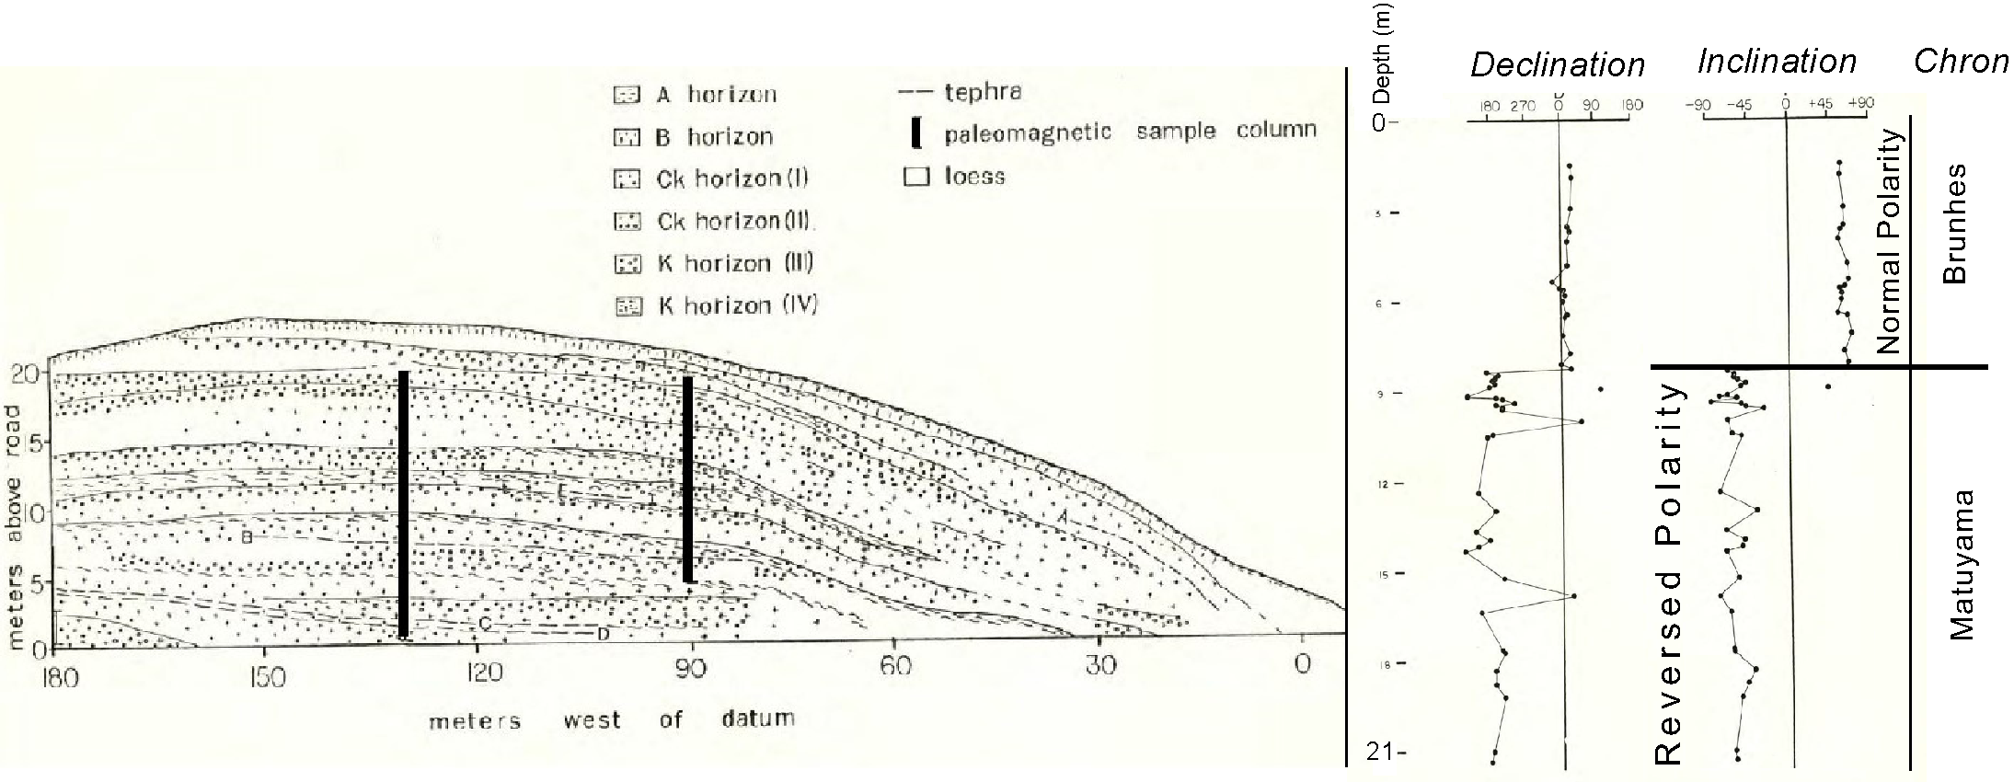
Loess Exposure near Washtucna (above flood level?)
Paleomagnetic Results
(Foley 1982)
780 ka
Roadcut #3
2 sampled transects
11 buried soils
5 tephra layers
25 paleomag samples from each transect
The lower 2/3 of both transects
ALL of reversed polarity and thus
> 780 ka (i.e., early Pleistocene).

Slide 4
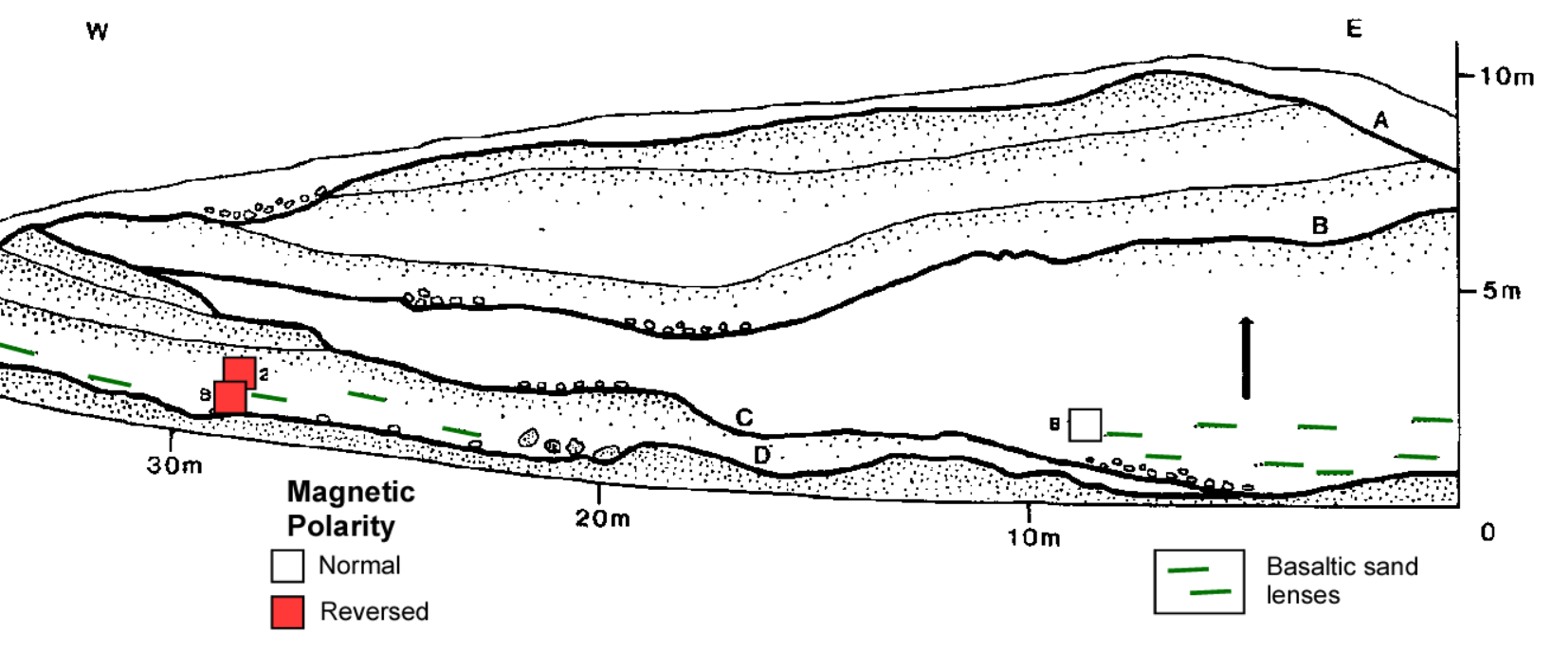
Loess Exposure Near Benge (within flood levels)
(McDonald and Busacca 1988)
Four, Ice-Age, flood-cut unconformities (heavy lines)
Reversed magnetic polarity exists beneath unconformity “C”.
Basaltic sand lenses and rip-up clasts indicate periodic Ice Age floods occurred during early to middle Pleistocene.

Slide 5
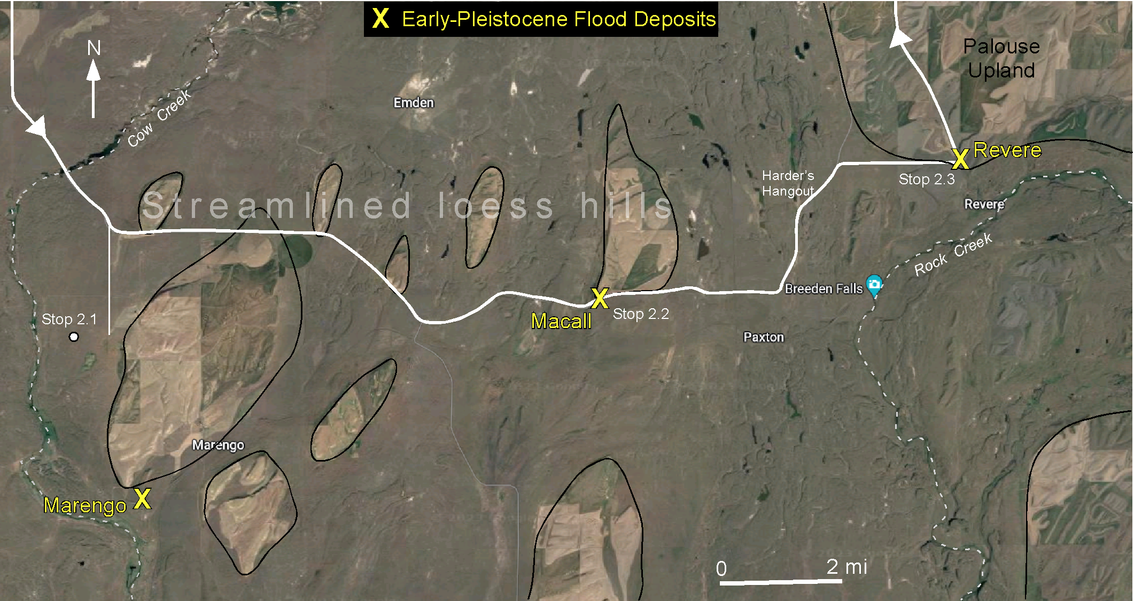
Further Evidence for Early Pleistocene Floods (>MIS 21) Within Cheney-Palouse Scabland Tract (Bjornstad et al. 2001, 2024)
Marengo, Macall and Revere
Three old-flood sites lie at the more-protected downstream ends of streamlined loess islands.
There was likely once much more evidence of older floods in the region, which has since been buried in loess and/or stripped away by younger floods.

Slide 6
Relative Timing of Loess and Ice Age Floods
At one time many assumed wind-blown loess in the Palouse developed first and Ice-Age floods came later.
But Ice Age flood deposits interbedded with or beneath loess sequences indicate the two processes were both active, periodically, throughout the Pleistocene.

Slide 7
Applicable Age-Dating Techniques on Ancient Megaflood Deposits
Absolute Dating
Relative Dating
Magnetic polarity of loess (before or after 780 ka)
Ratio of Th-230/U-234 isotopes (i.e., initiation of carbonate-rind development on flood-gravel clasts and petrocalcic nodules)
Degree/stage of calcic-soil development
Degree of weathering on basaltic, flood-gravel clasts

Slide 8
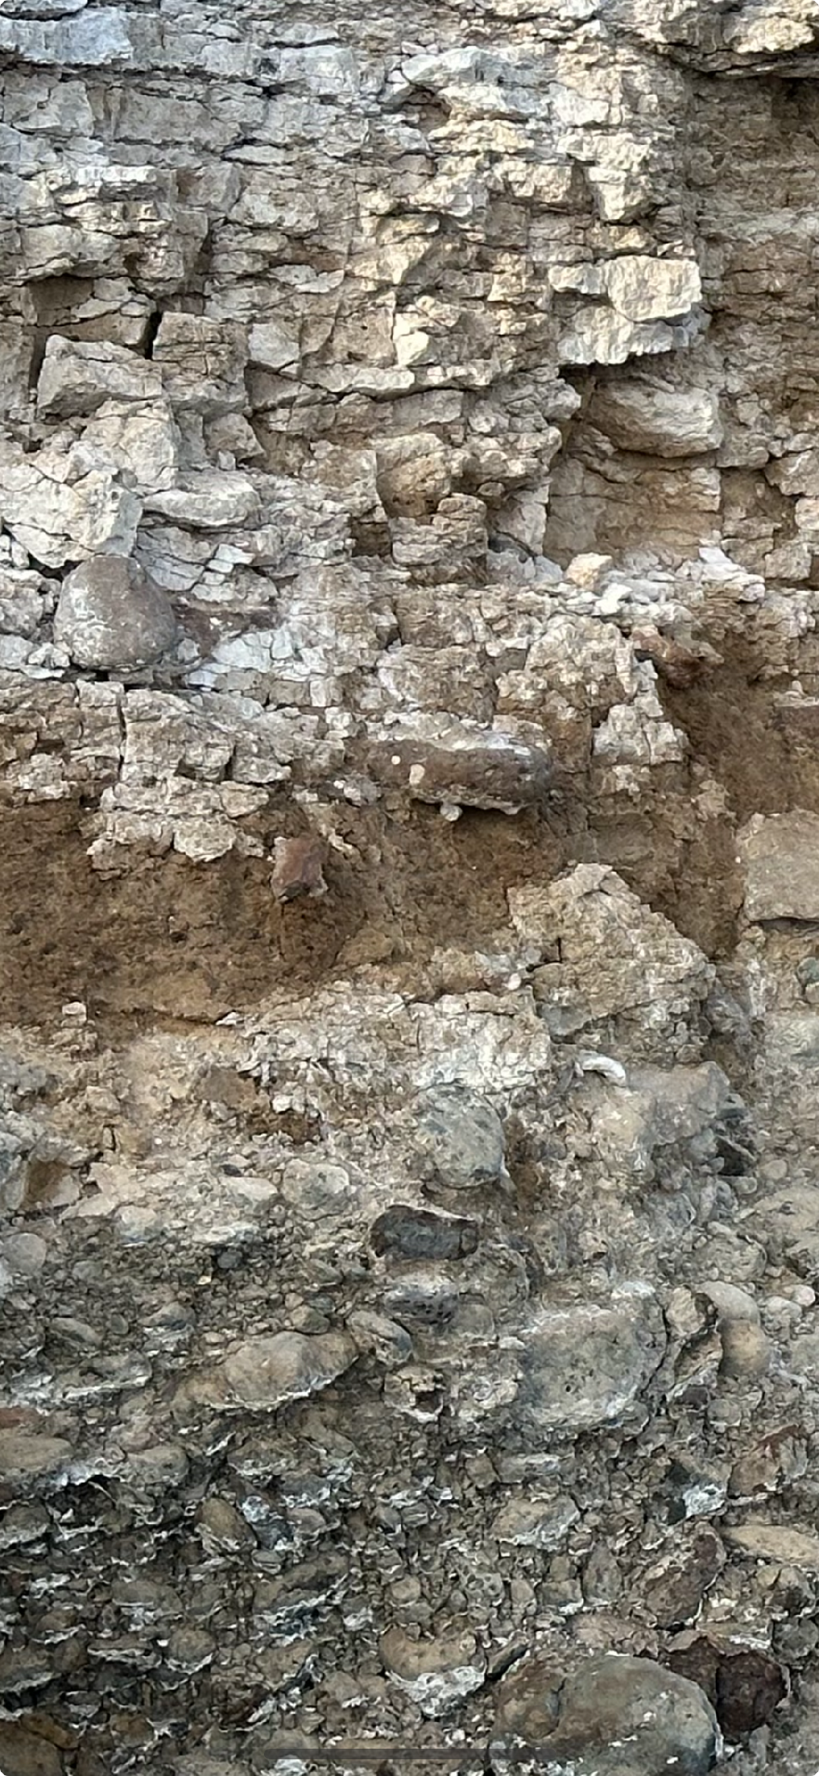
Radiometric (Th/U) Dating of Pedogenic Calcrete
Sampled in zones with the densest (Stage IV-V) calcrete.
Analysis performed on the innermost (i.e., oldest) precipitated CaCO3 rind on basalt cobbles and nodules within calcrete paleosols.
Analyzed by Ku (USC) in 1980’s.
Macall

Slide 9
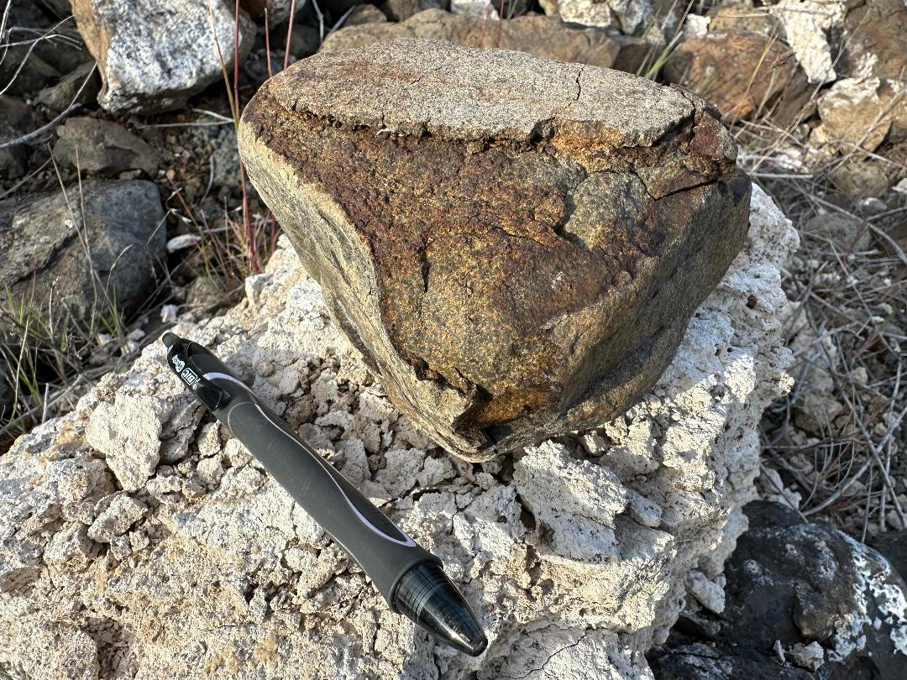
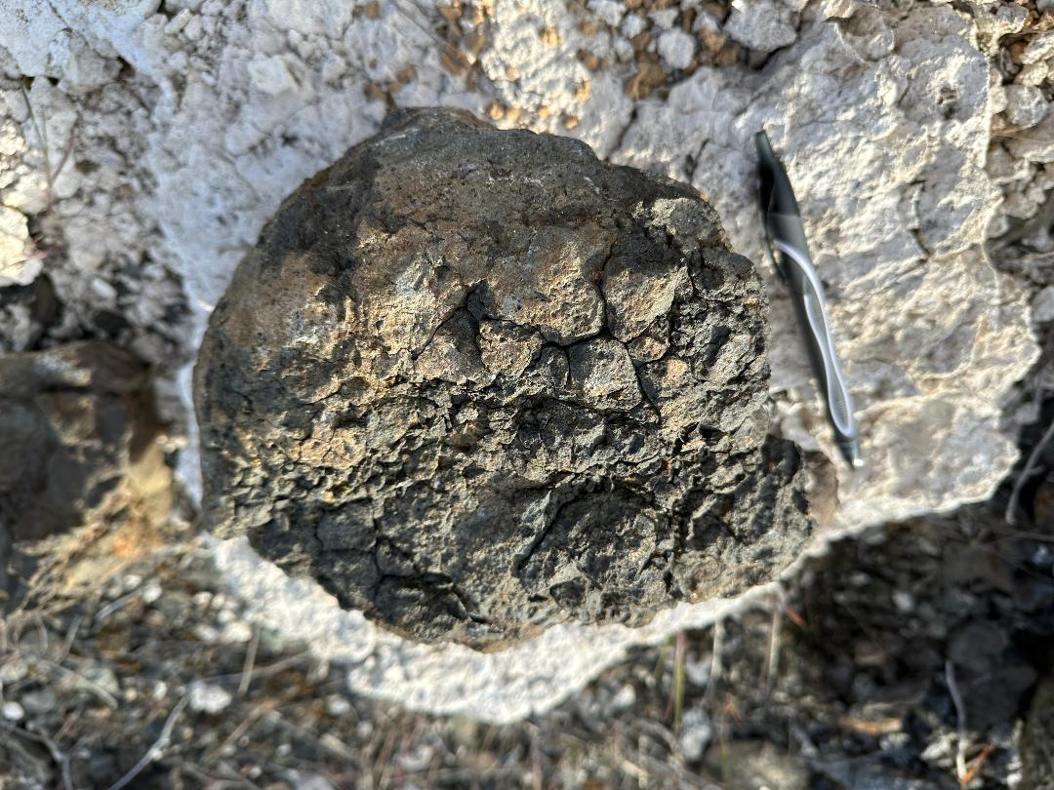
Advanced Stages of Weathering and Decomposition on Basaltic, Flood-Gravel Clasts at Macall

Slide 10
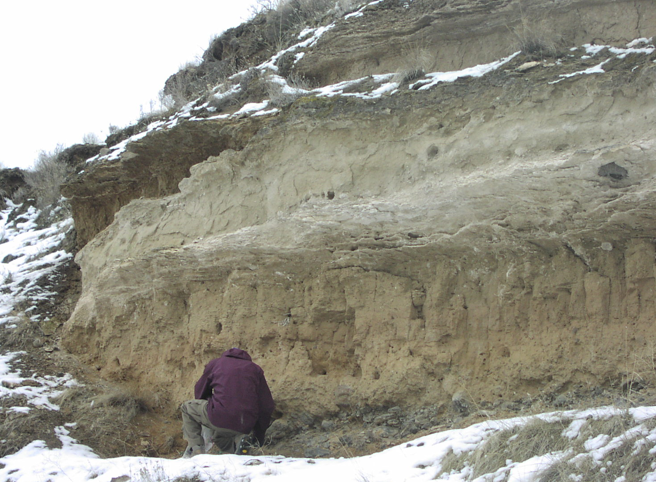
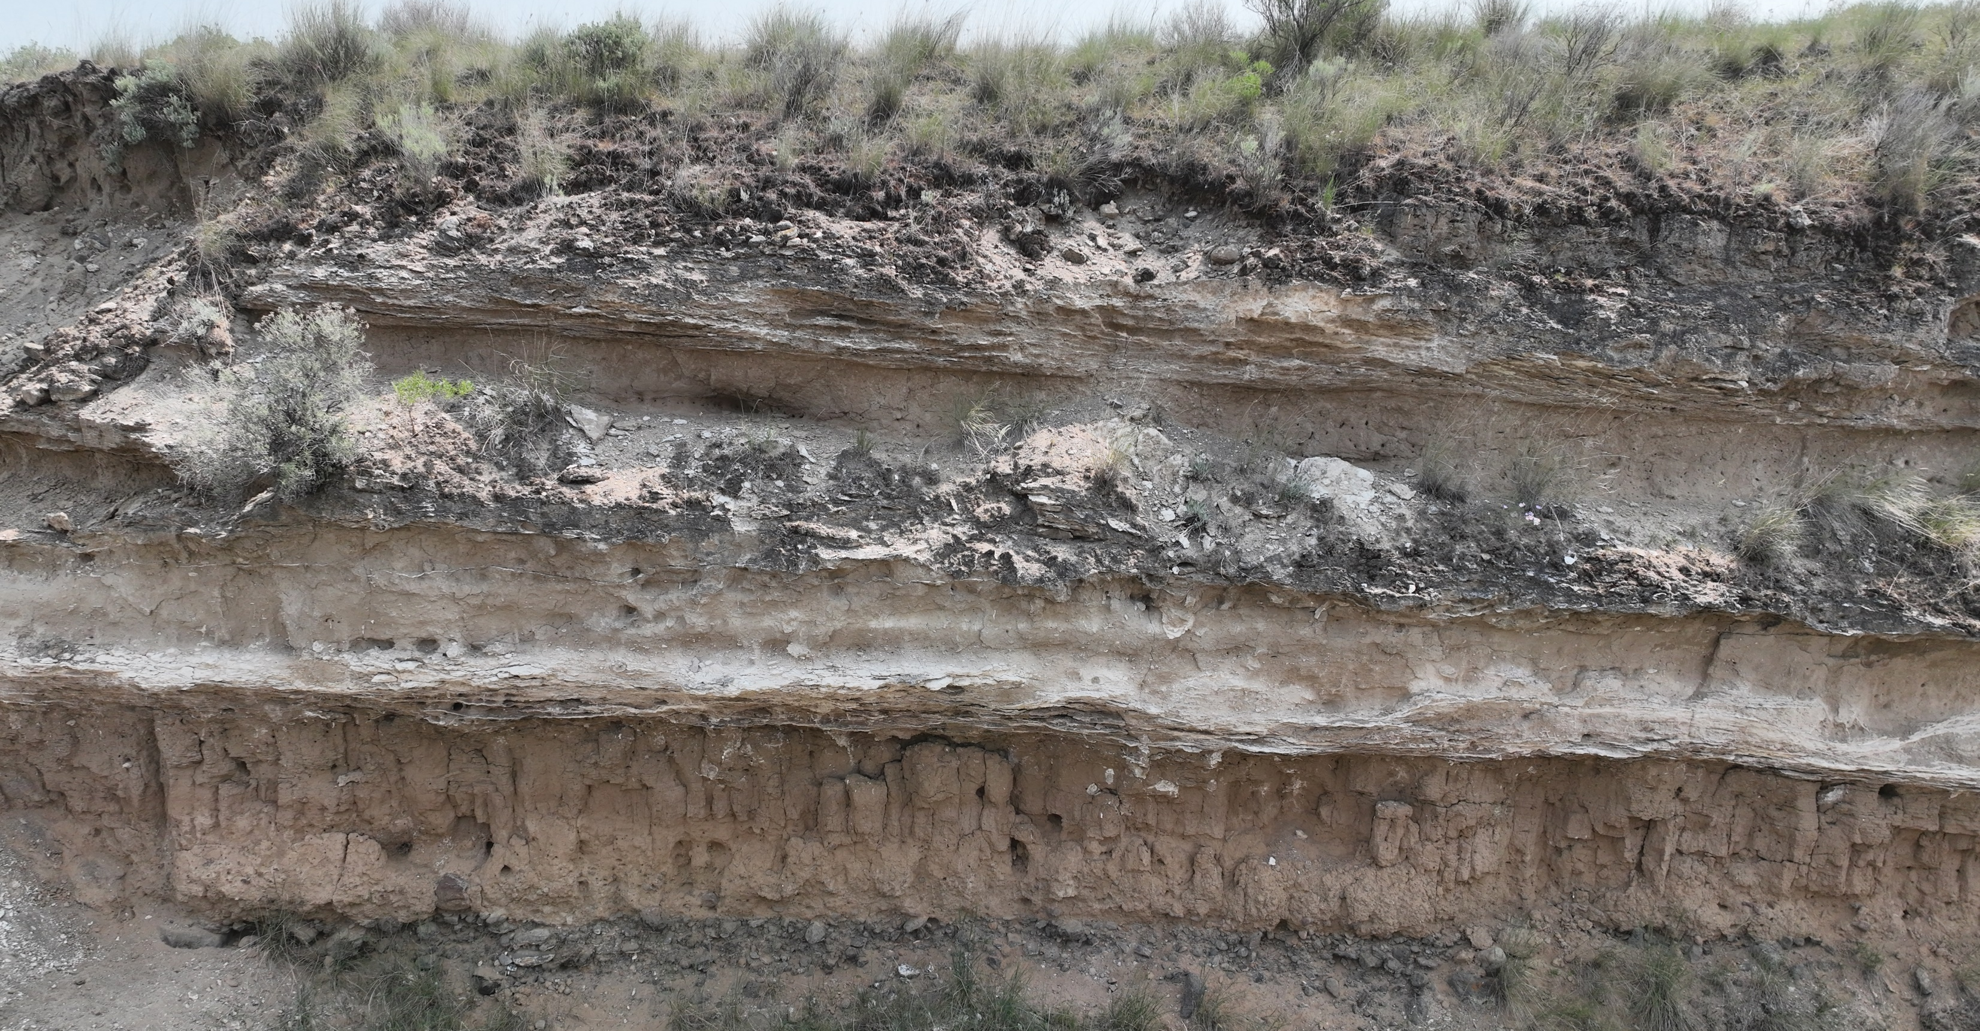
Lower Marengo Exposure
Calcrete
(glacial?)
Loess
interglacial?
Alternating sequences of loess and calcrete (Stage III-IV) likely represent climatic shifts between glacial and interglacial conditions.
Calcrete
(glacial?)
Loess
interglacial?
Calcrete
(glacial?)
If each glacial-interglacial cycle represents ~100k yrs, then 300k yrs of loess/calcrete accumulation could be represented here above the flood gravel.
Loess
interglacial?
Flood gravel

Slide 11
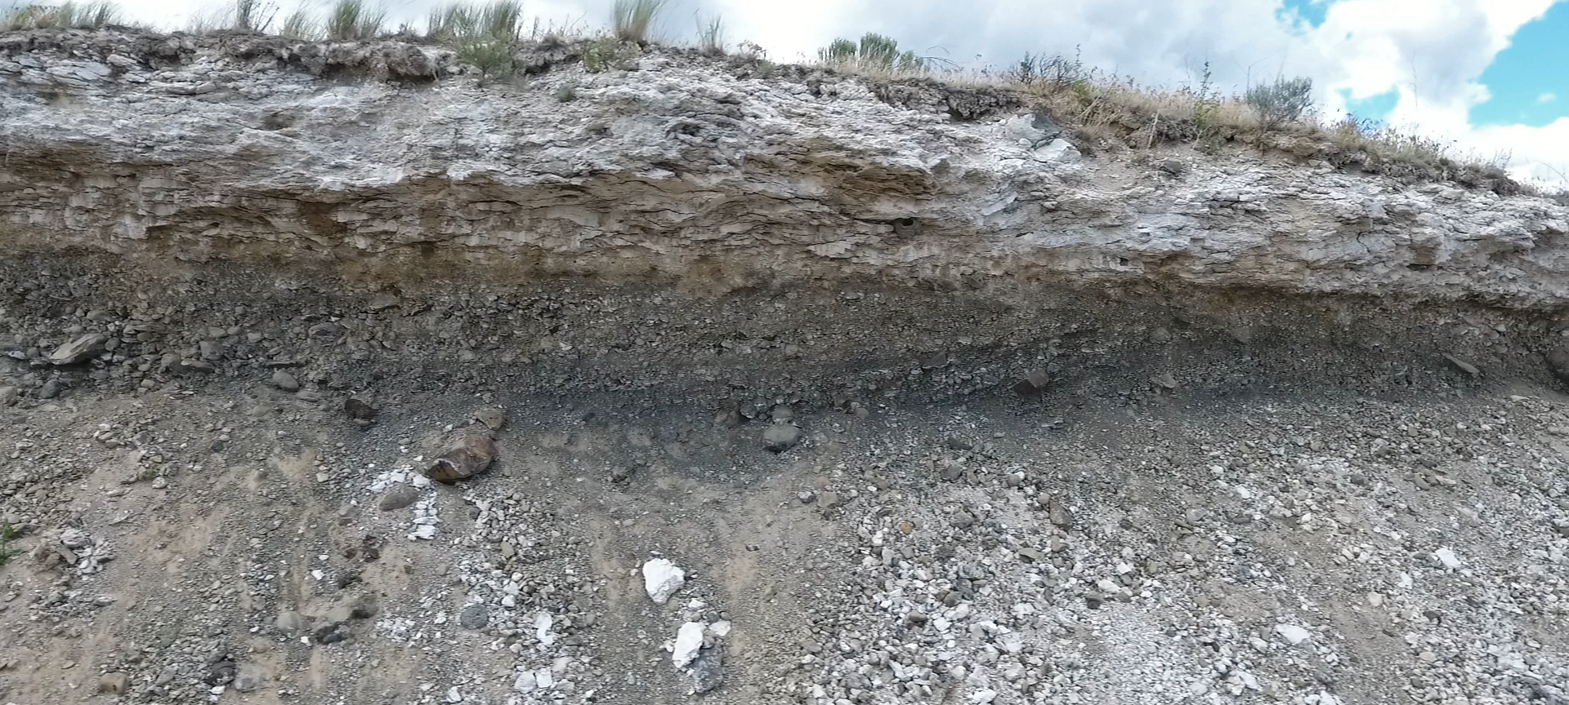
Macall Exposure Along Harder Rd.
Calcrete (Stage V)
R
Flood gravel
Talus

Slide 12
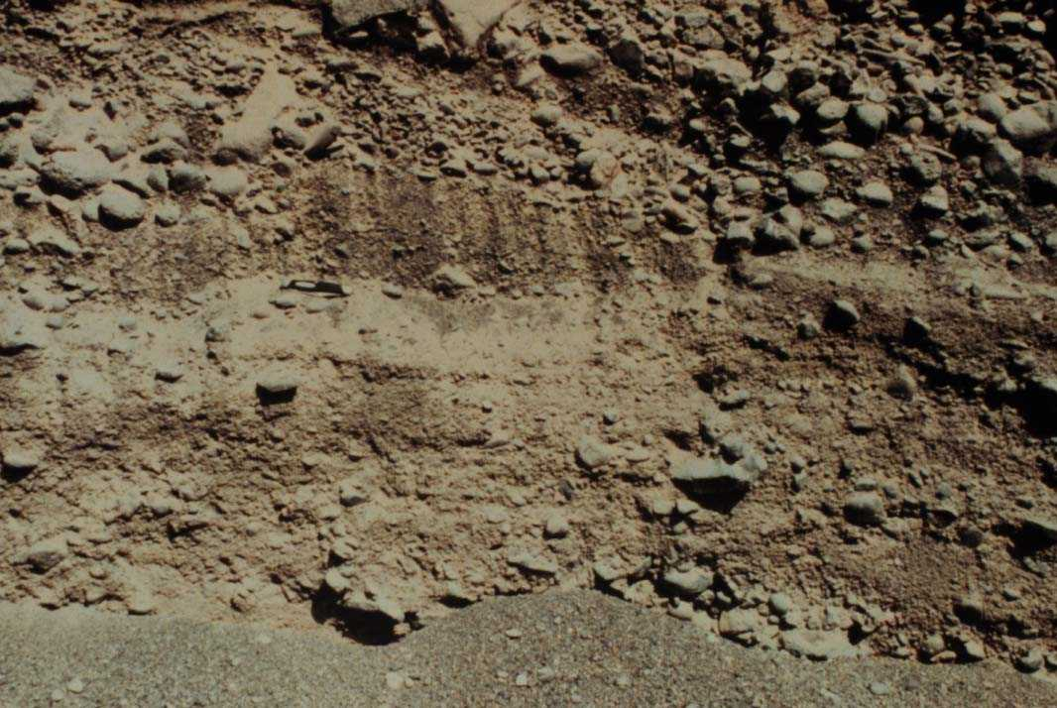
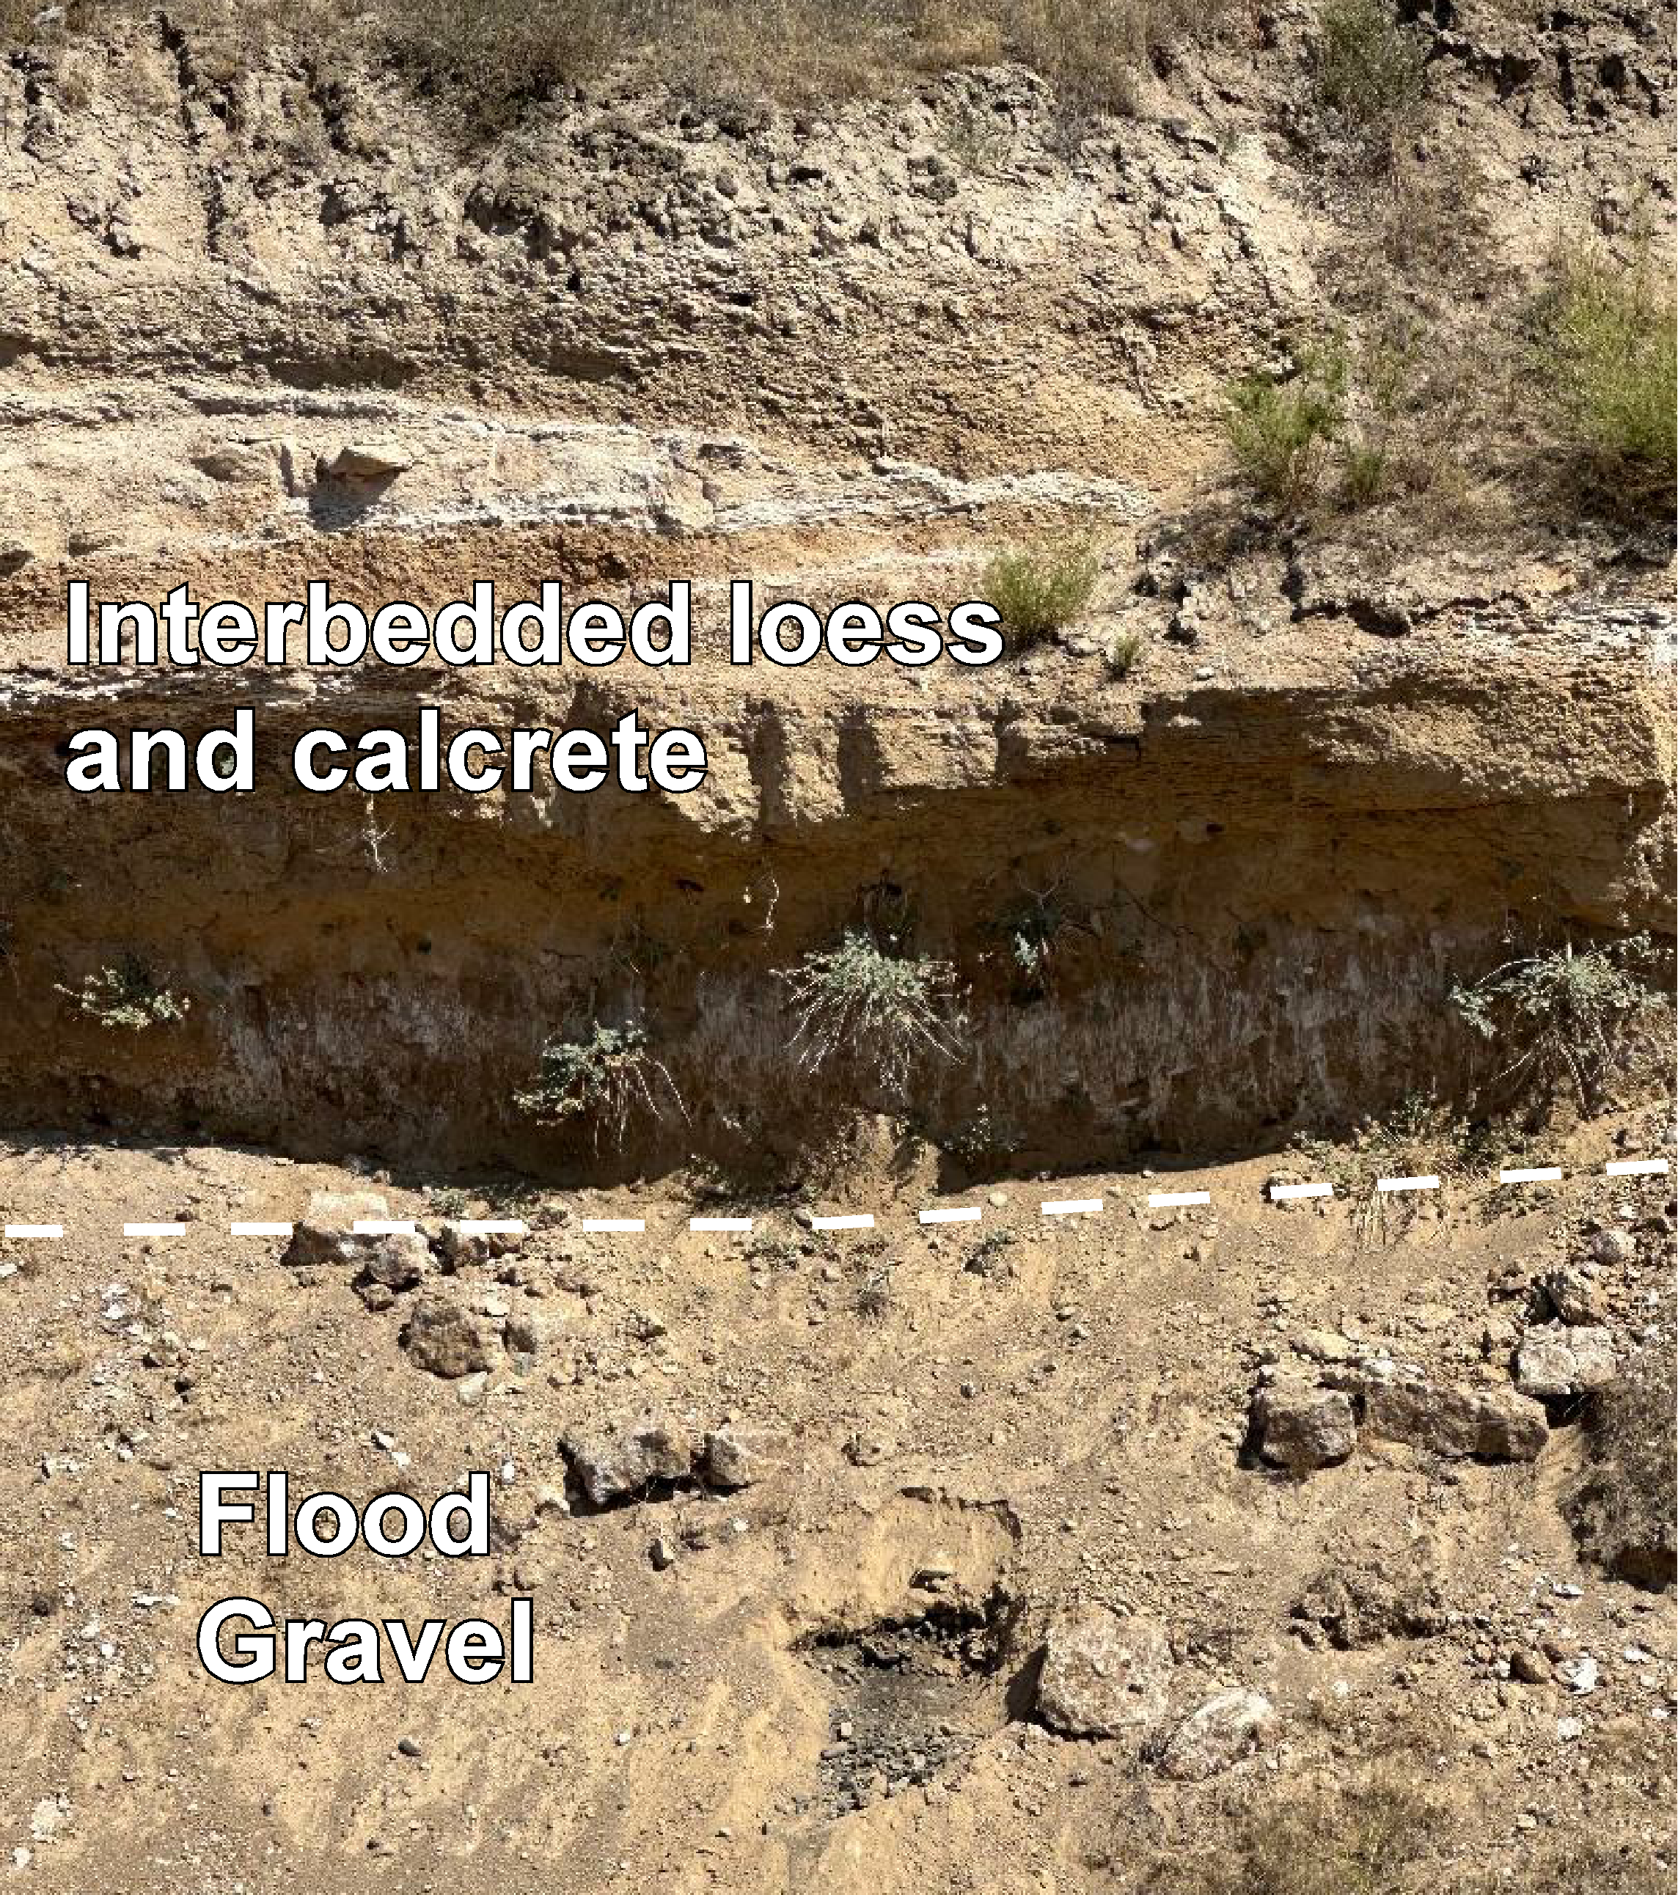
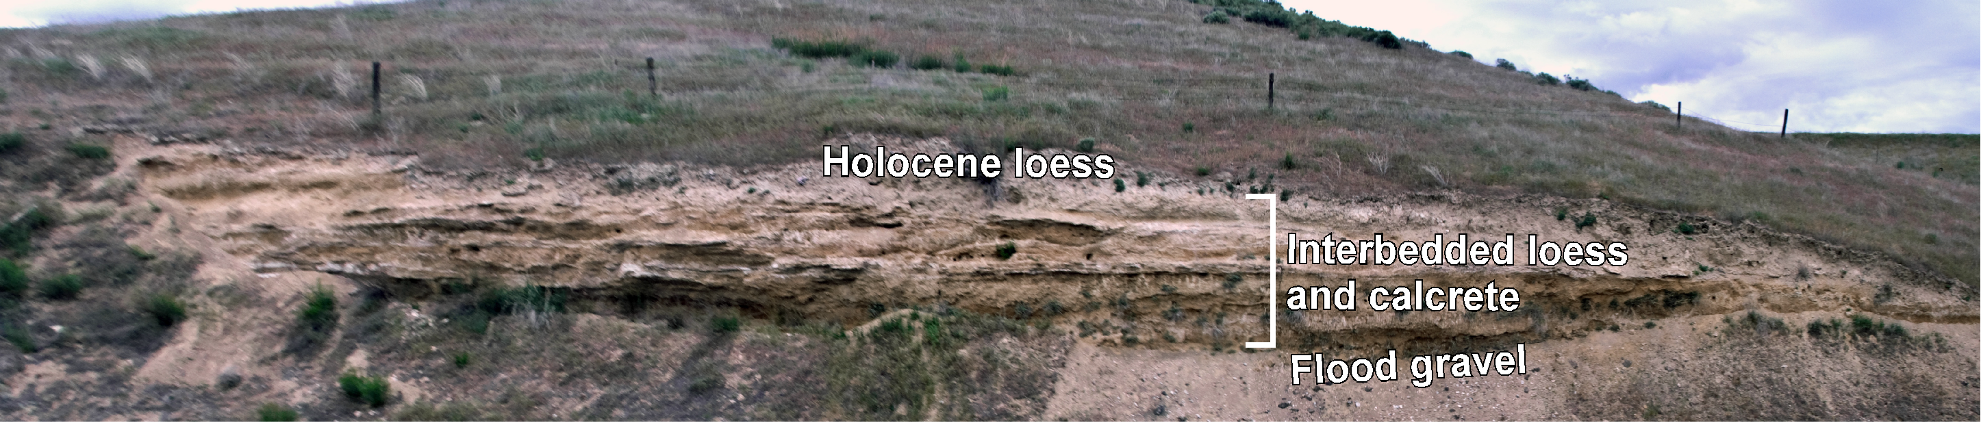
Revere Exposure
1983?
2023
Flood gravel
Interbedded loess and calcrete

Slide 13
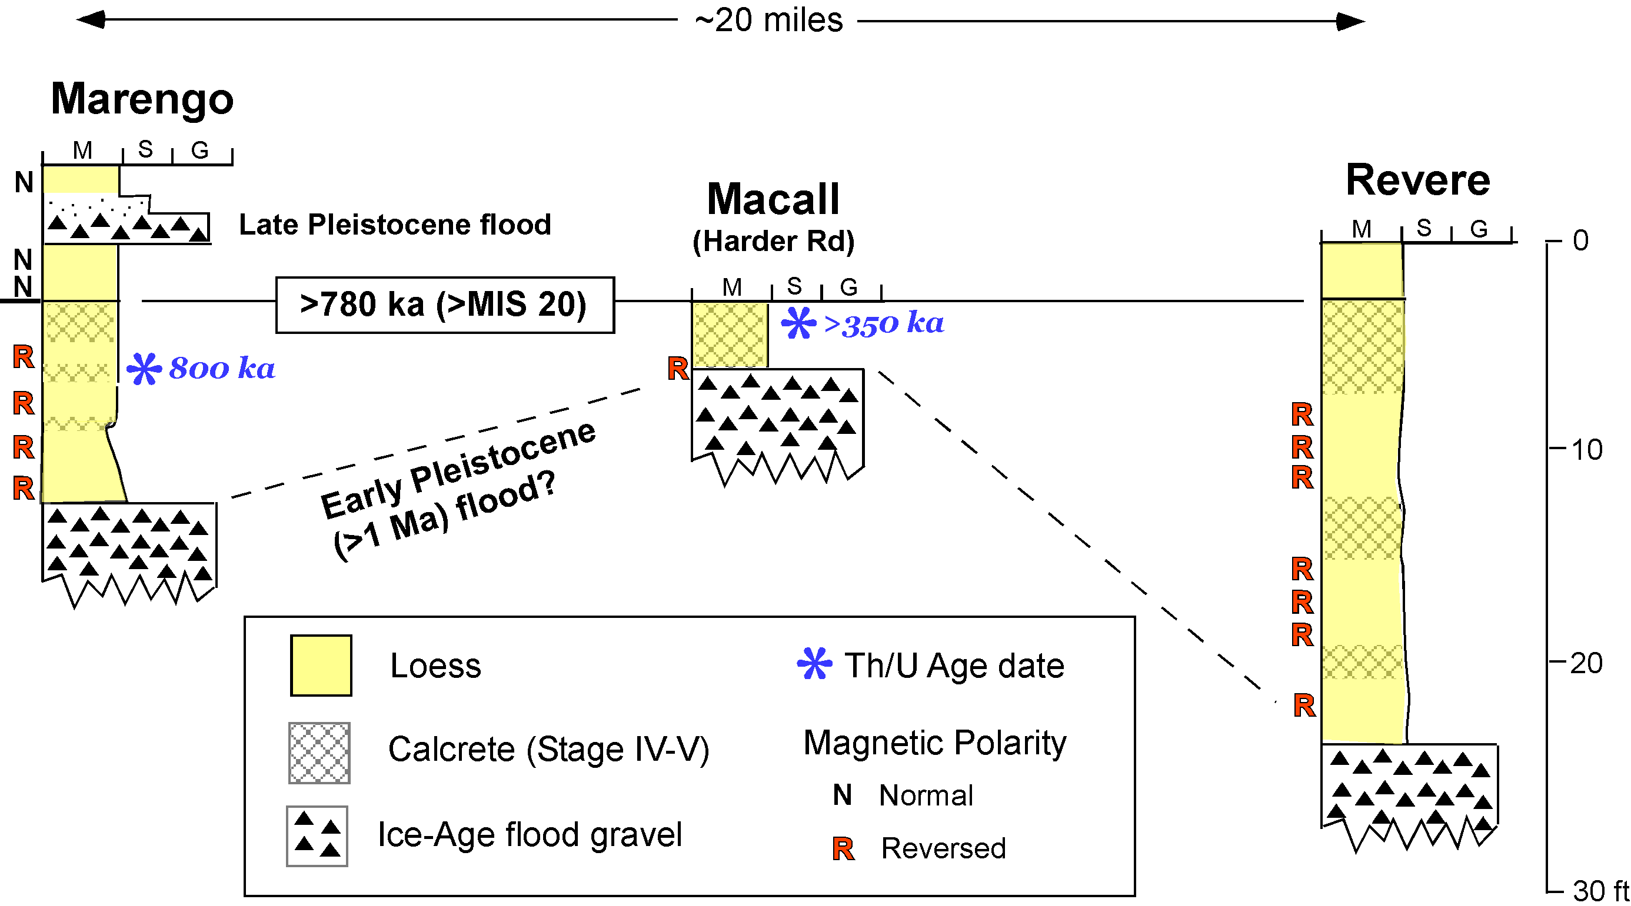

Slide 14
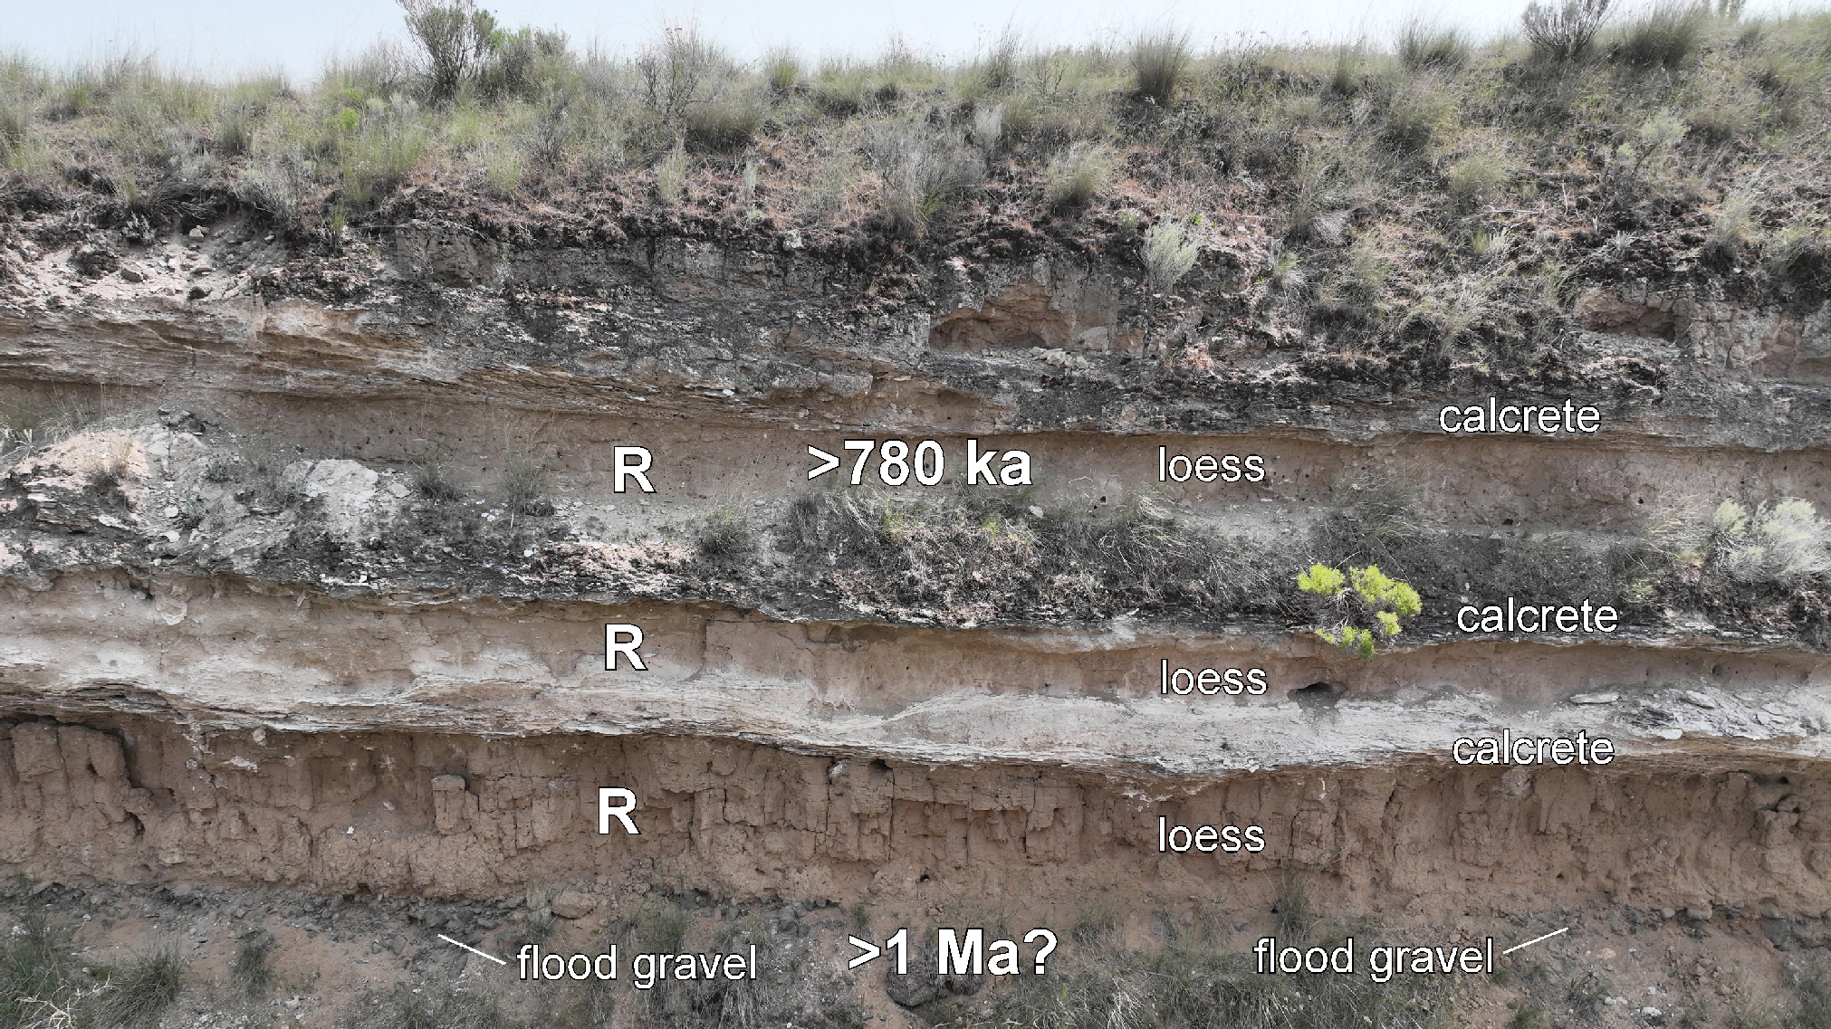
> One-million-year-old scabland flood?
If the uppermost calcrete-loess cycle at Marengo is of reversed polarity (>780 ka), then it follows that the lowermost cycle and flood gravel are likely >1 Ma.
Marengo

