Slide 1


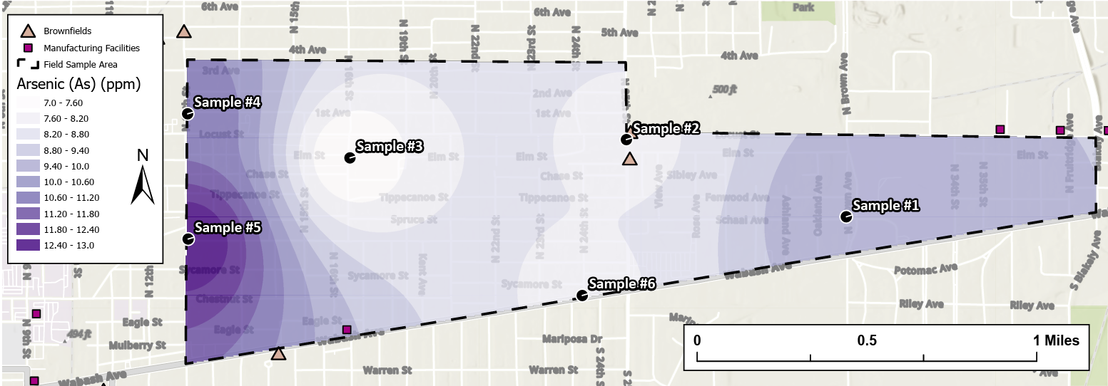
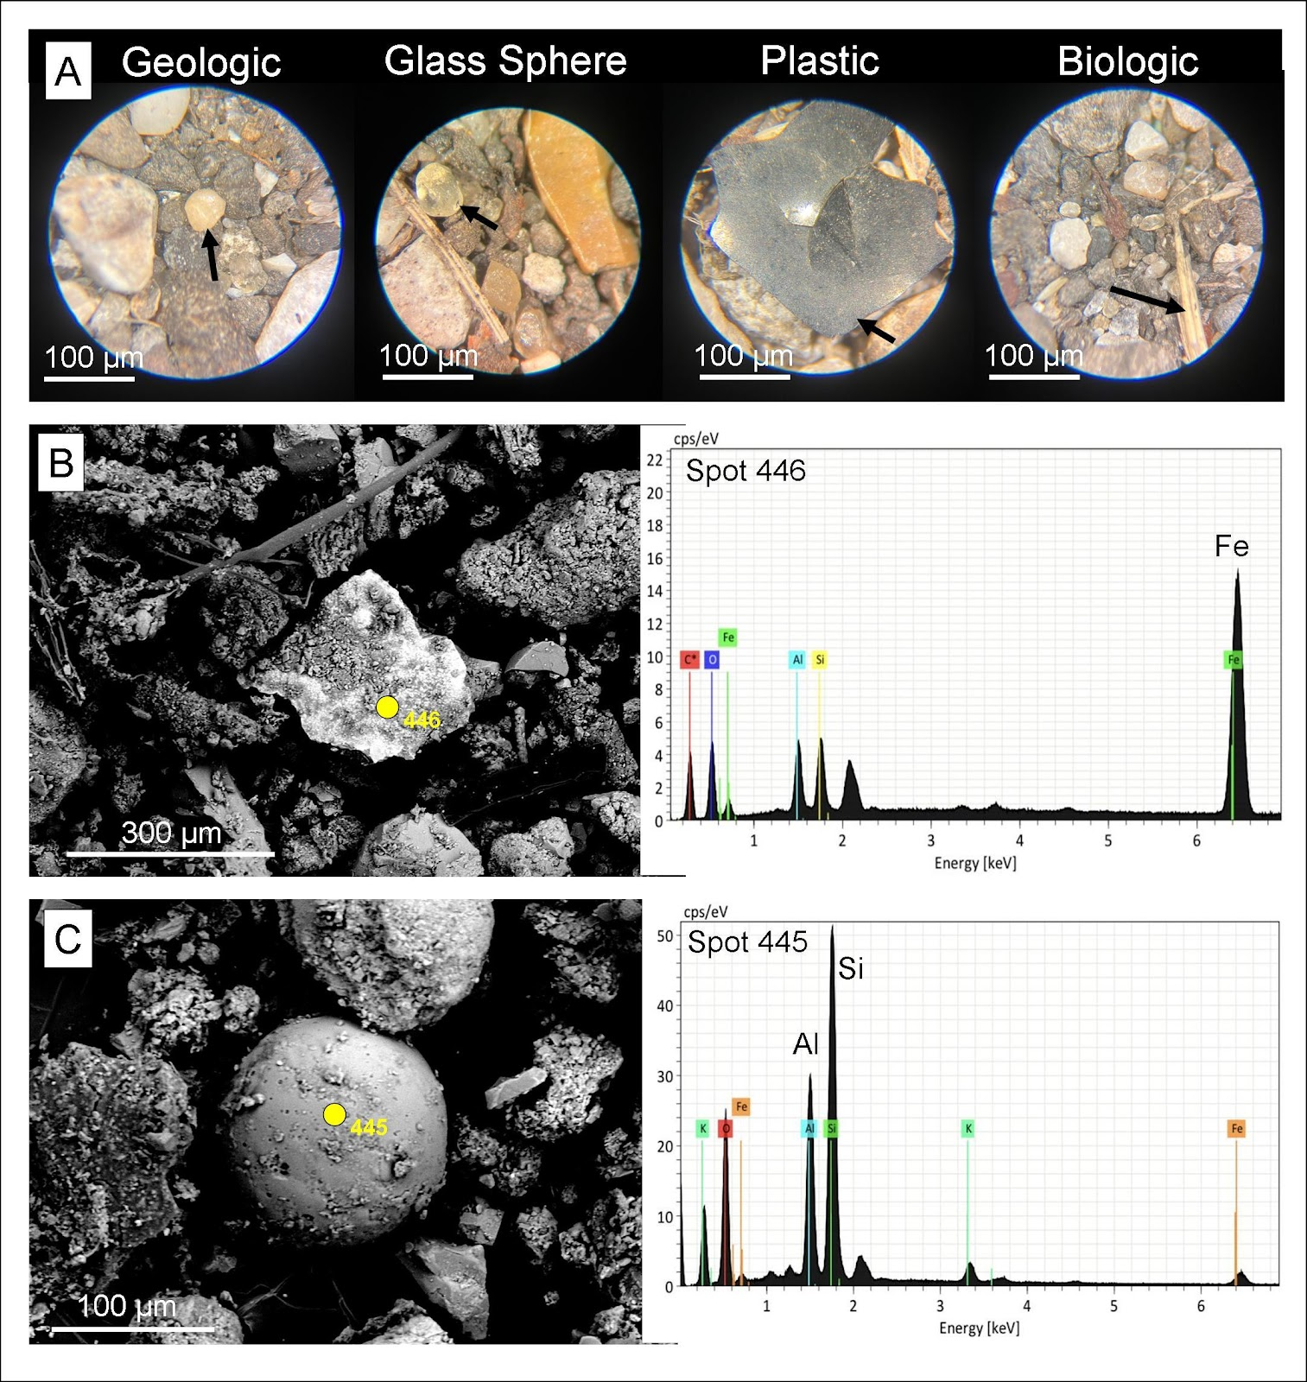
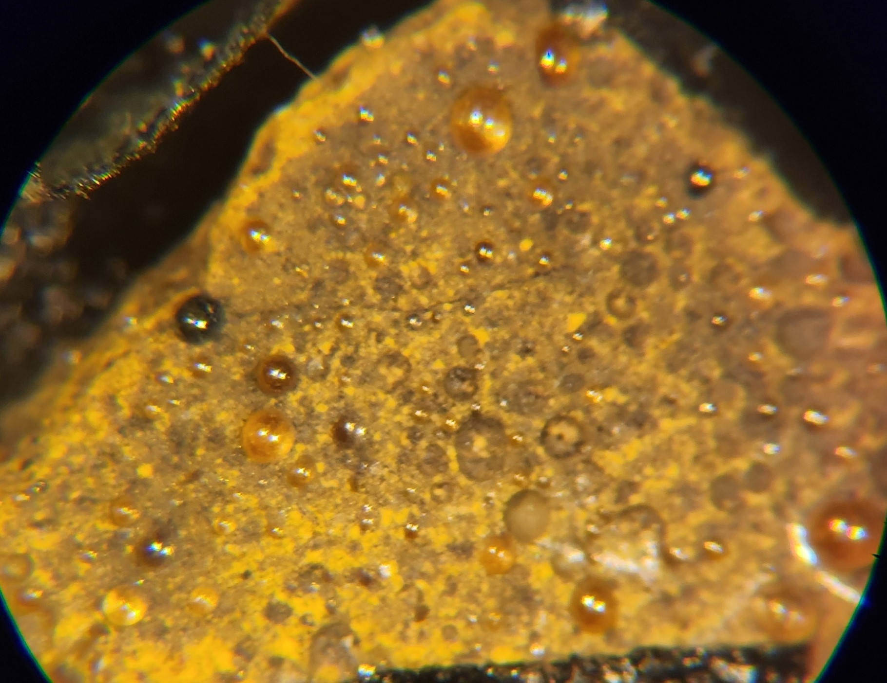
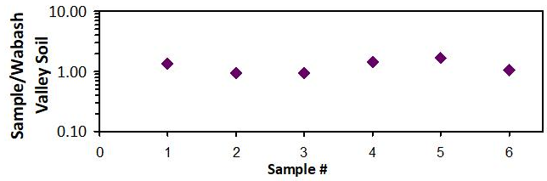
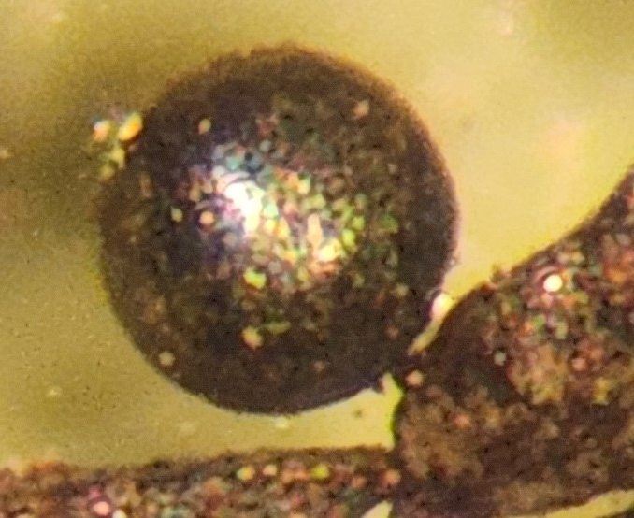
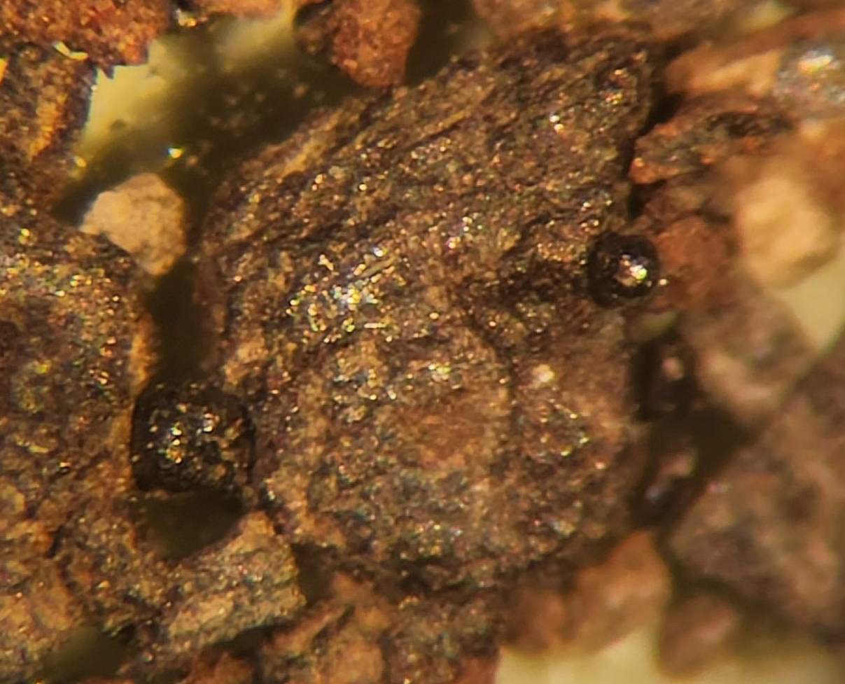
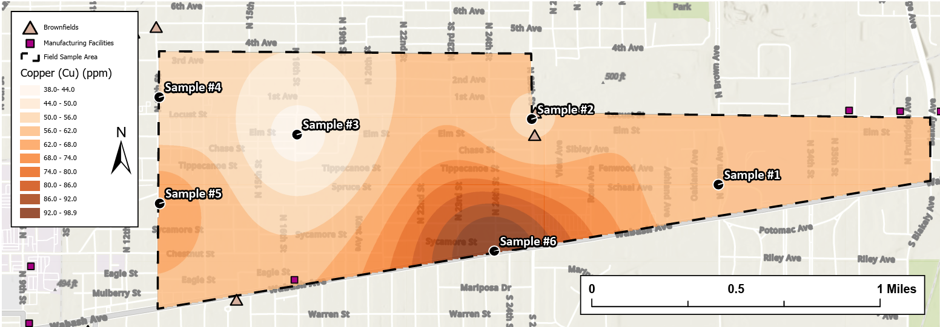
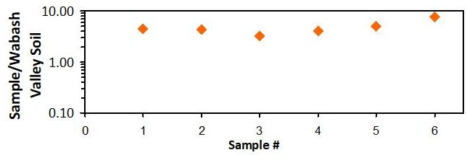
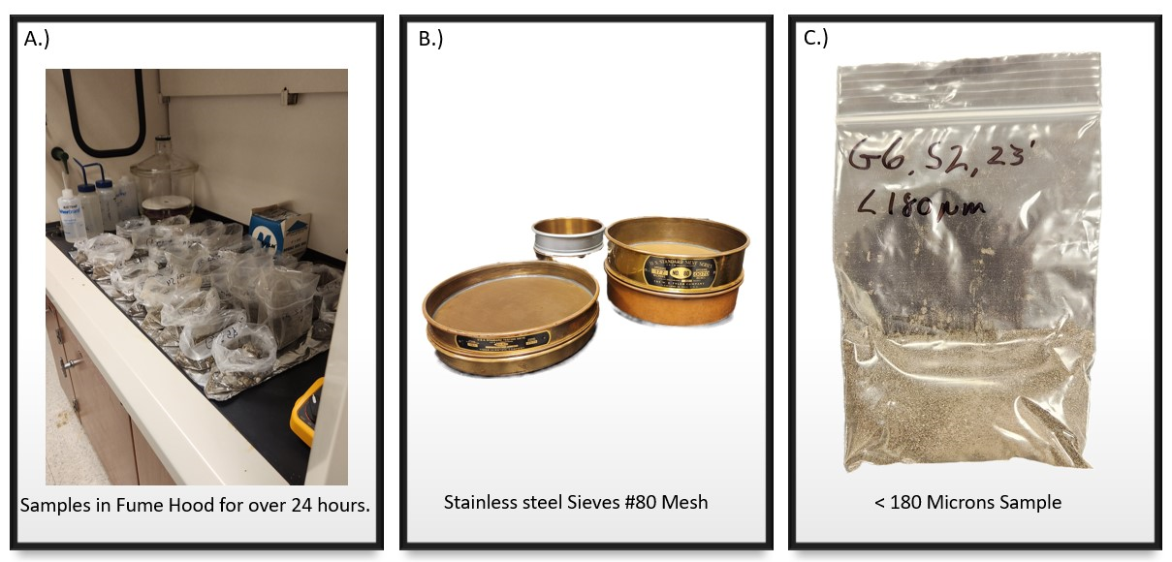
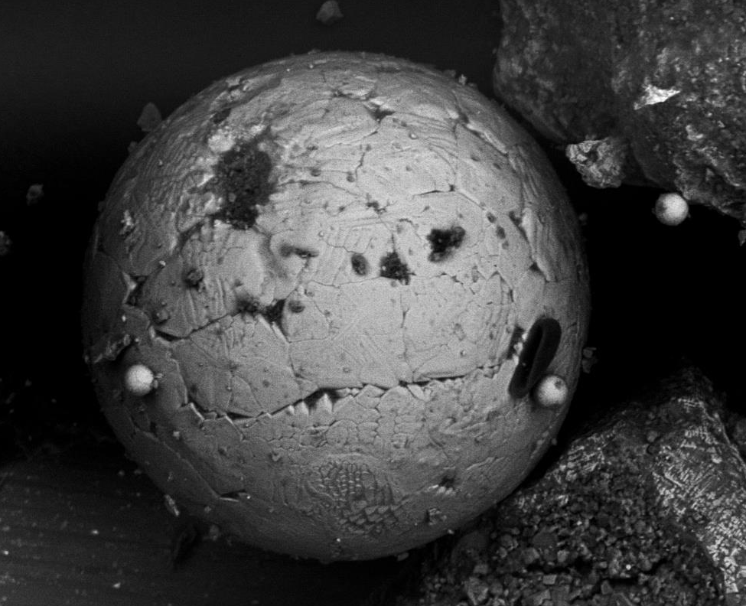
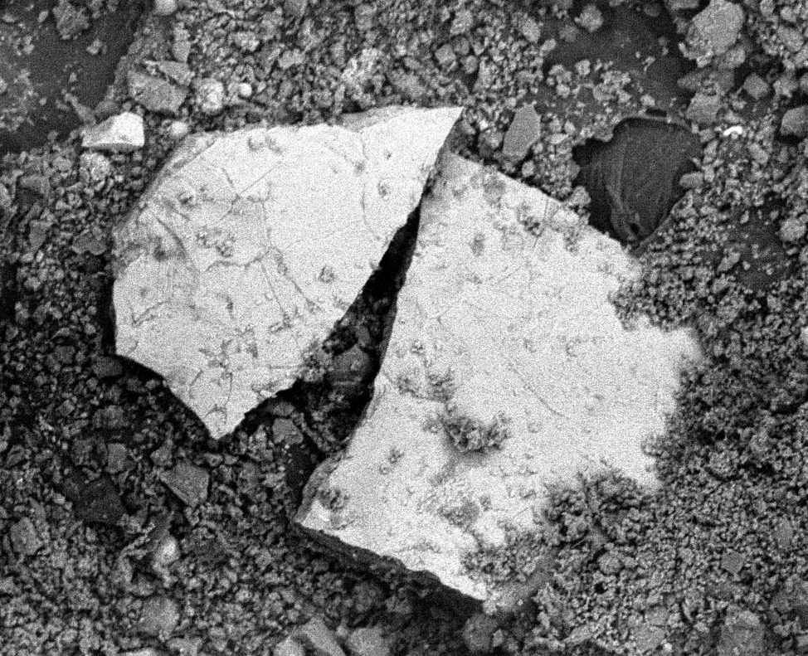
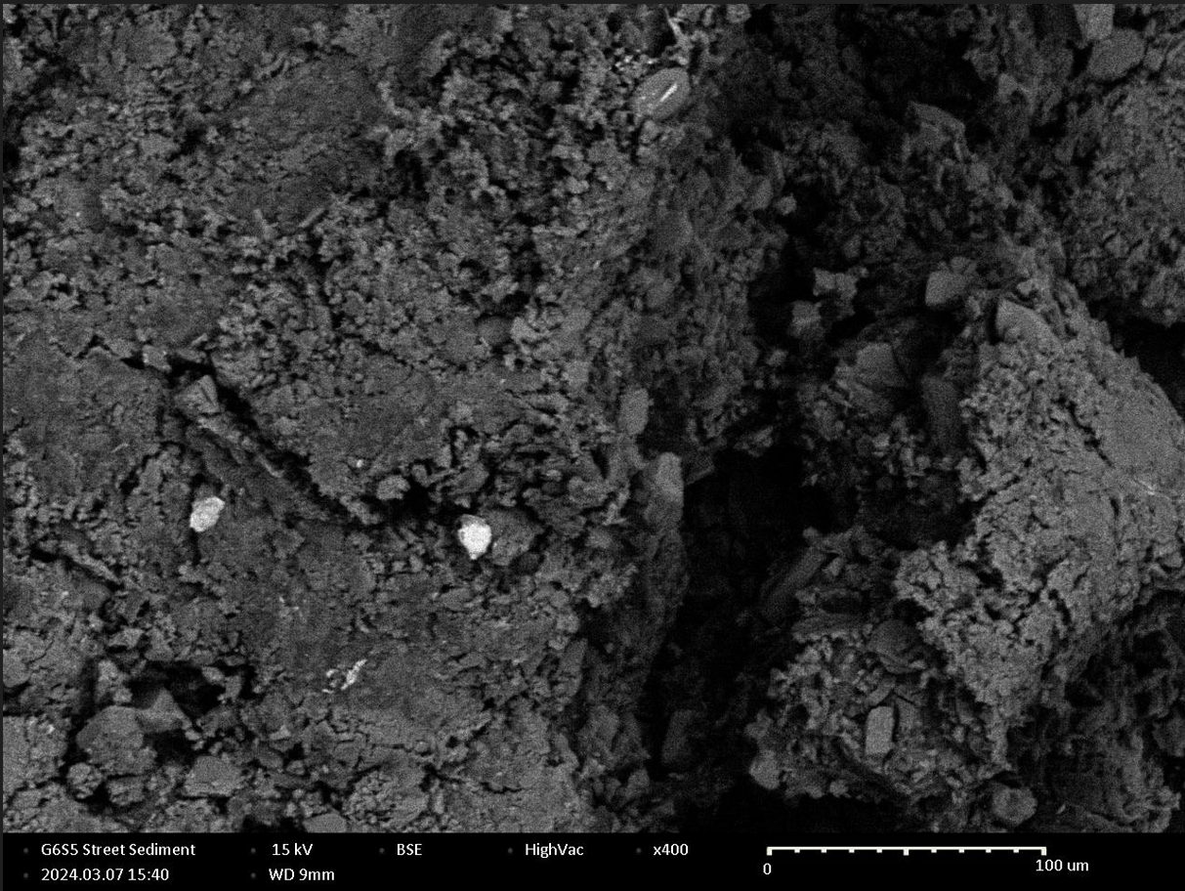
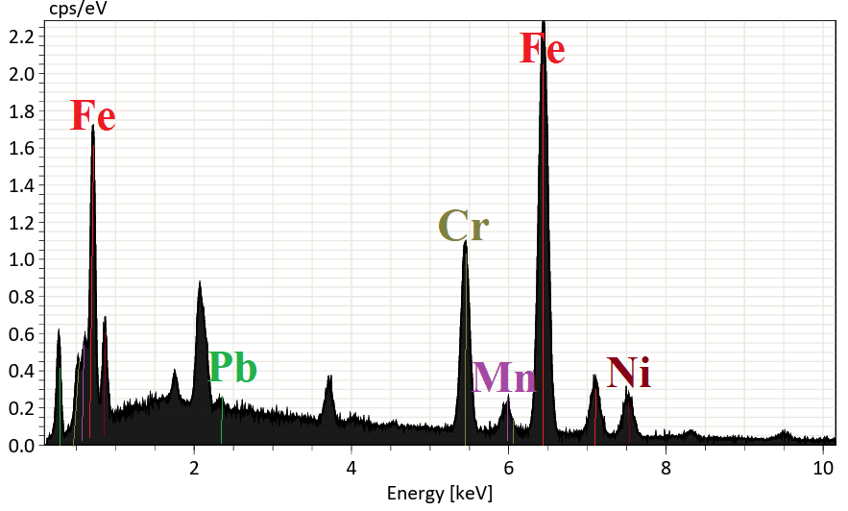
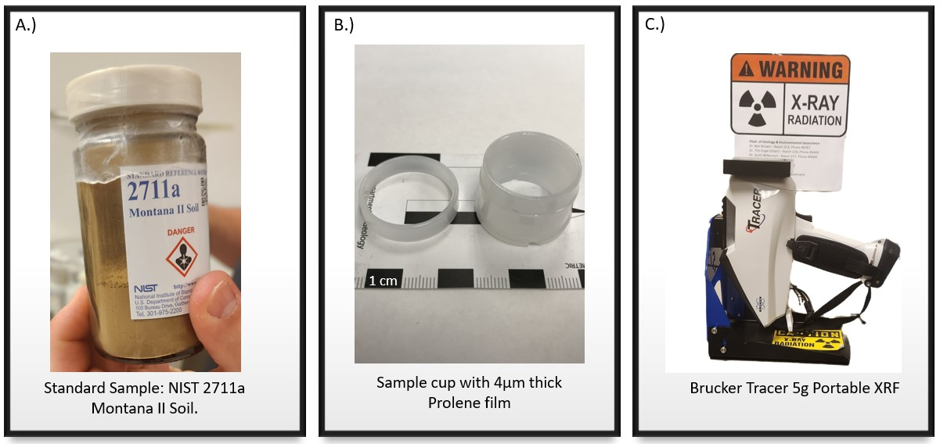
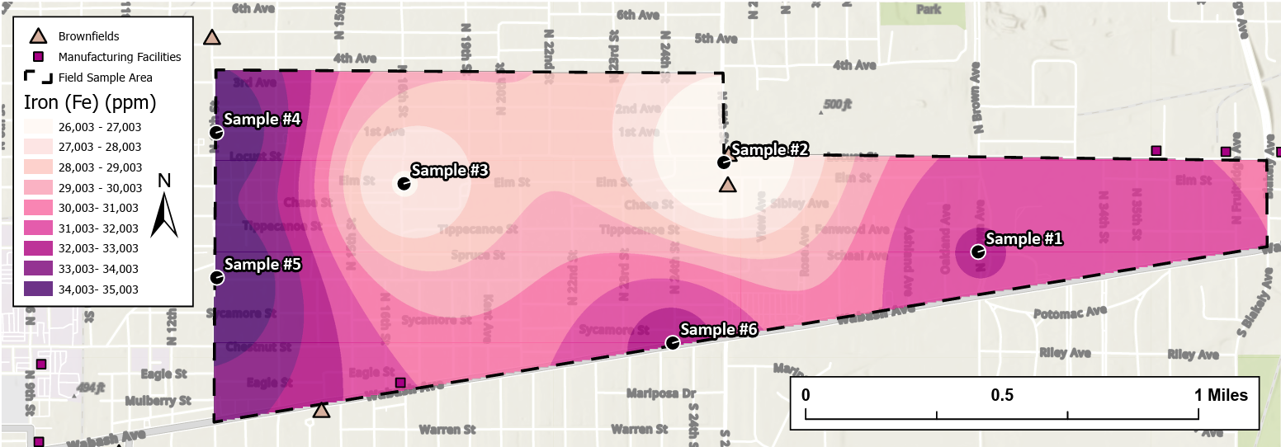
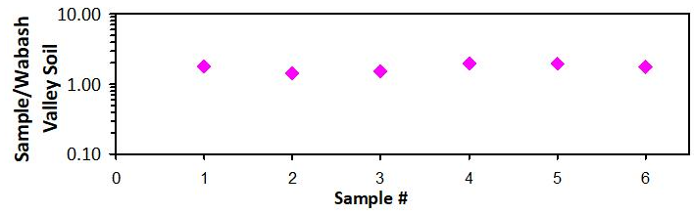
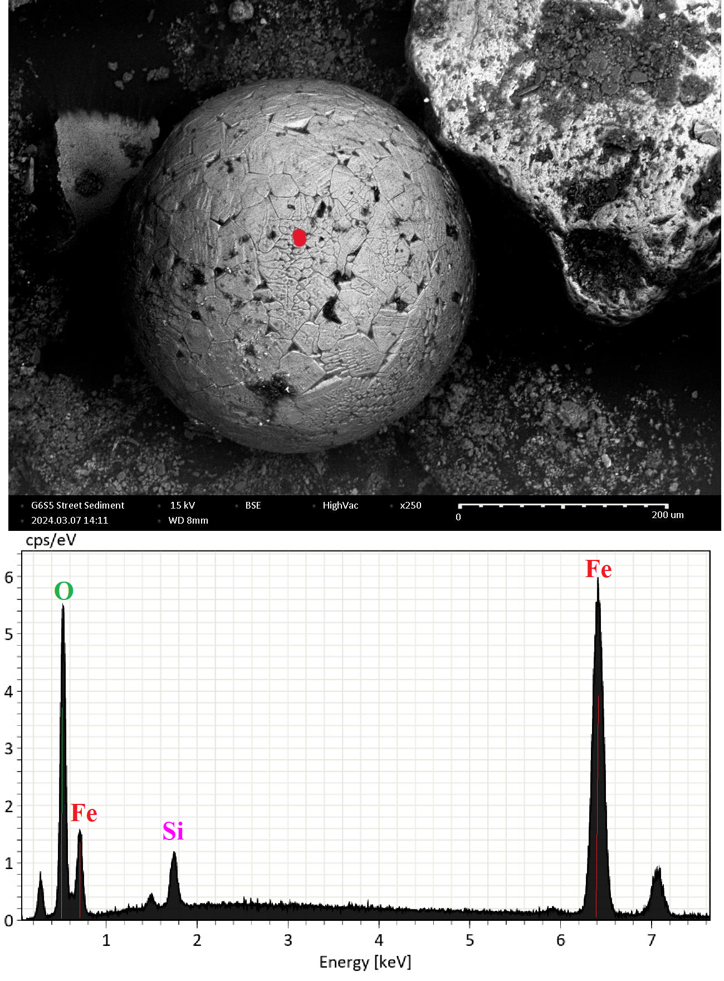
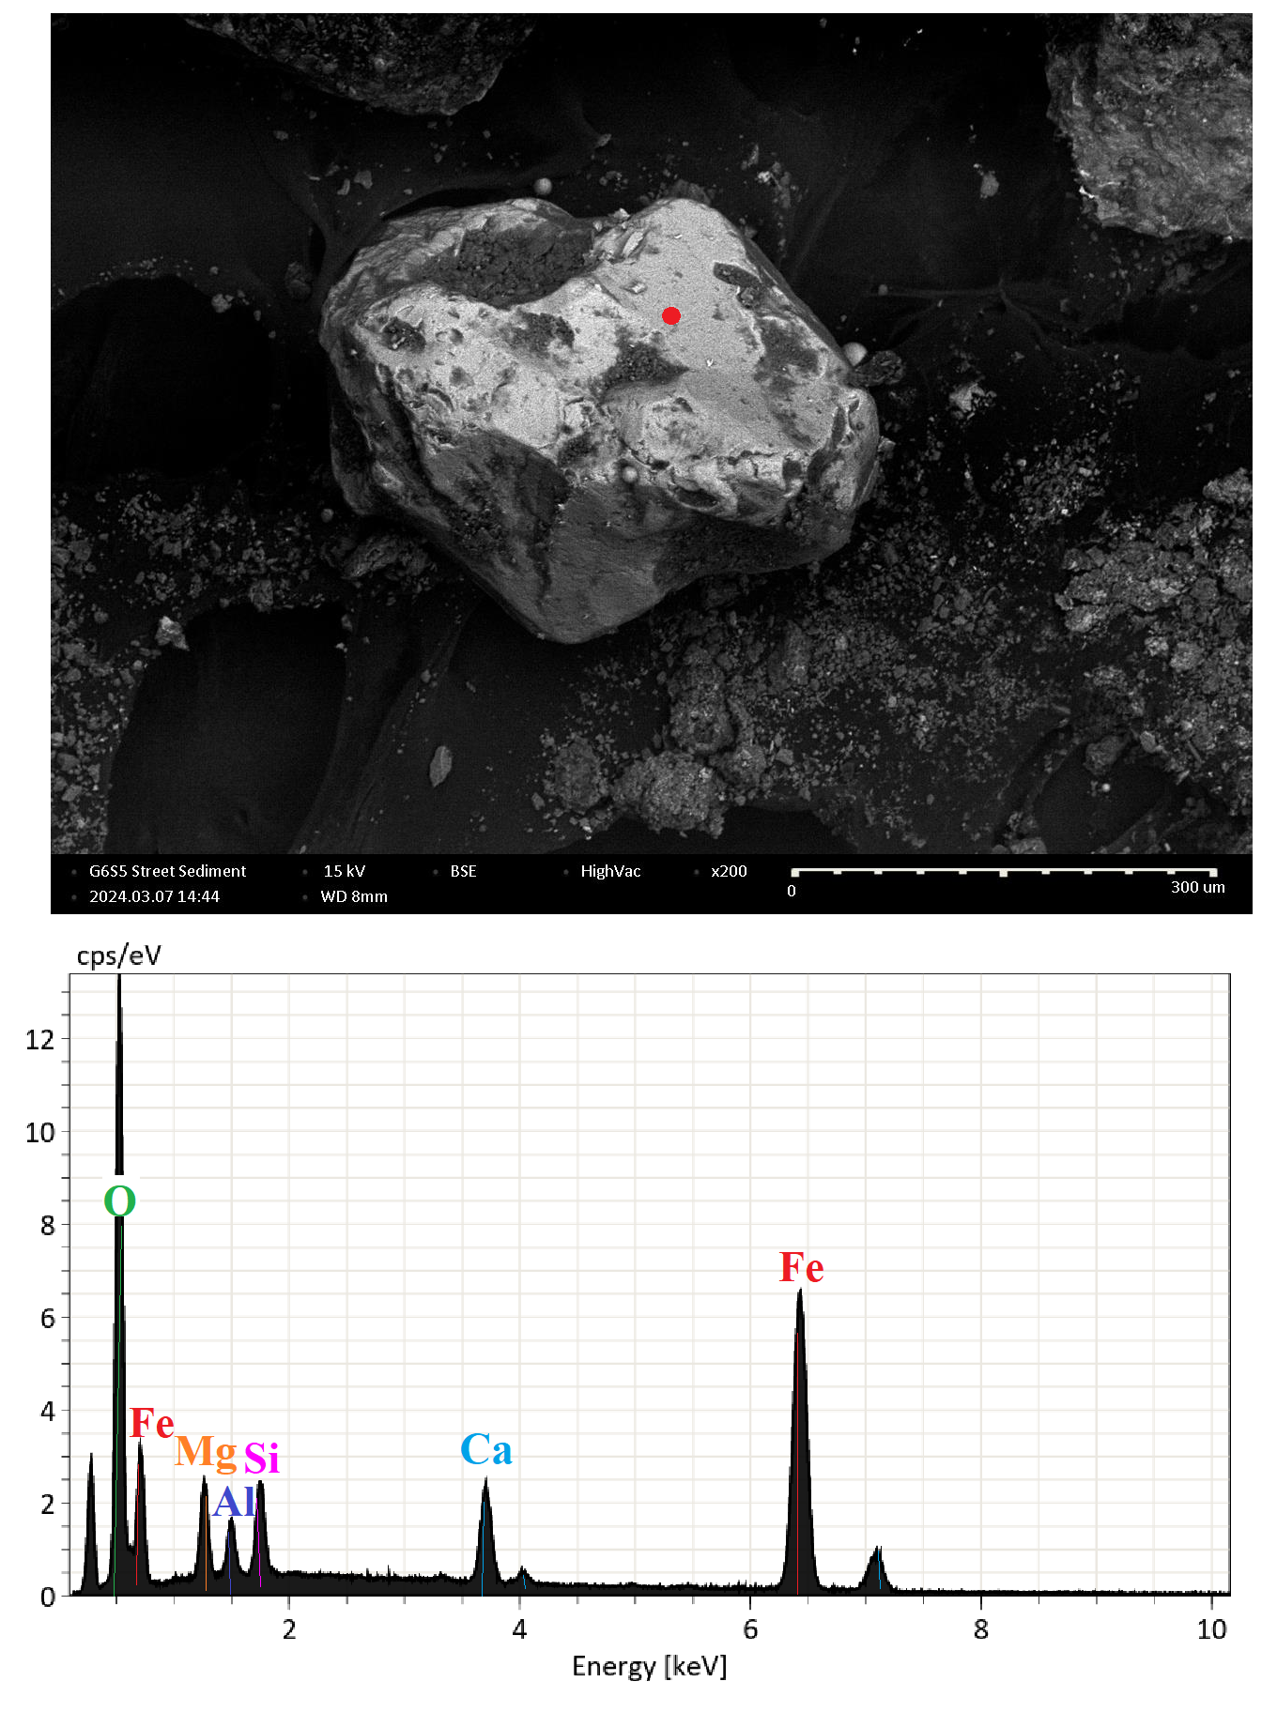
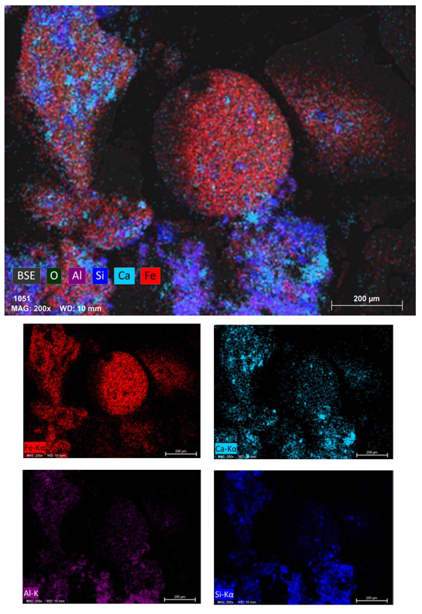
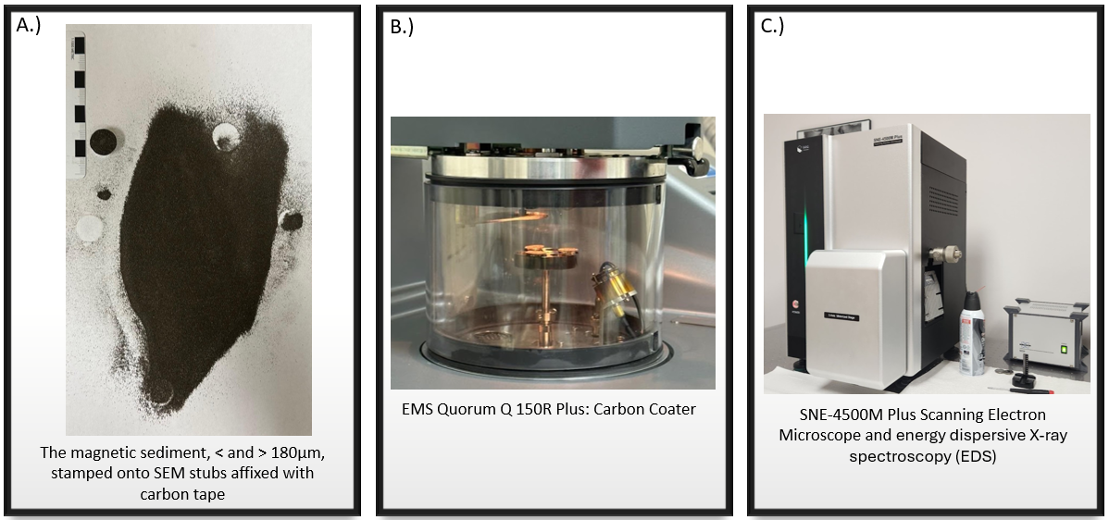
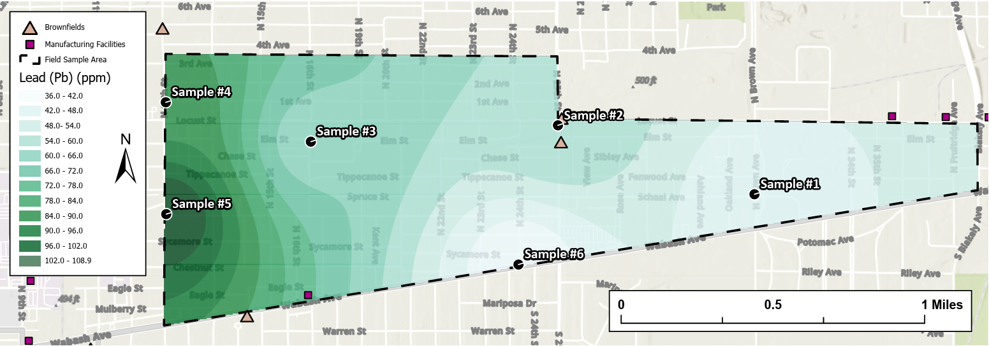
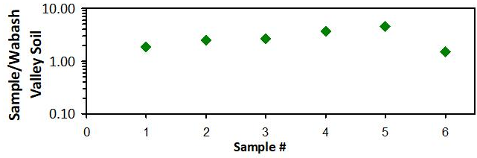
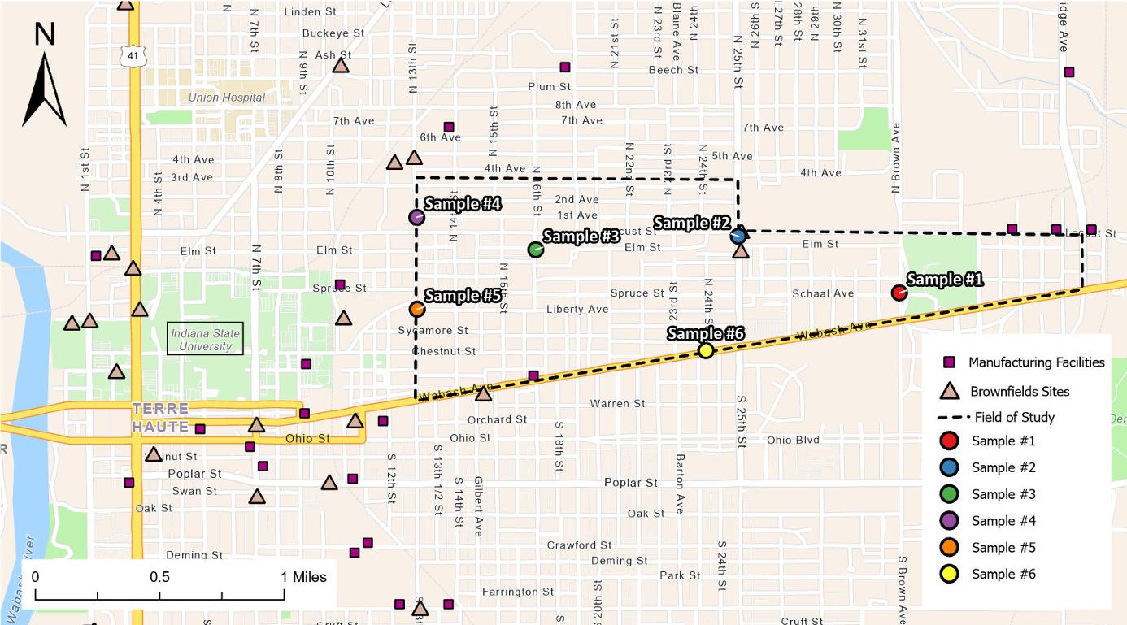
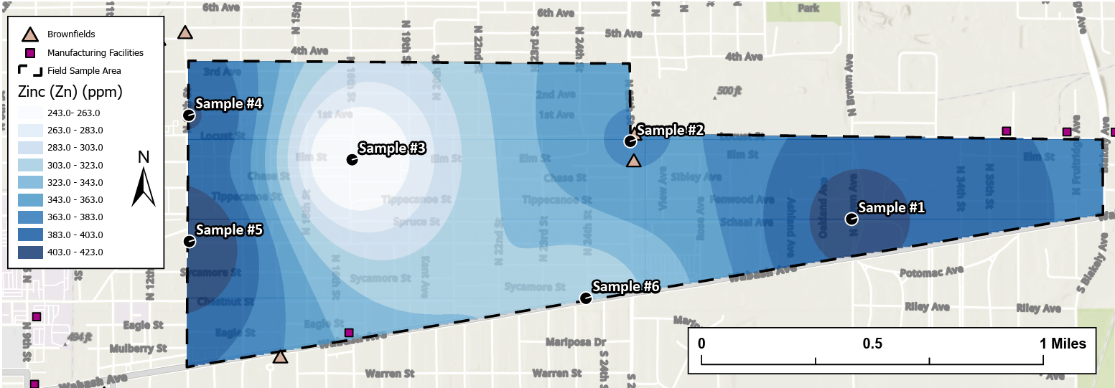
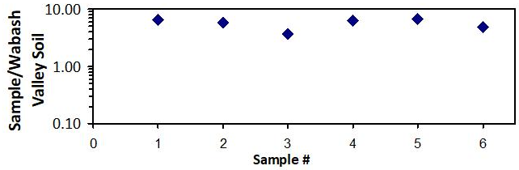

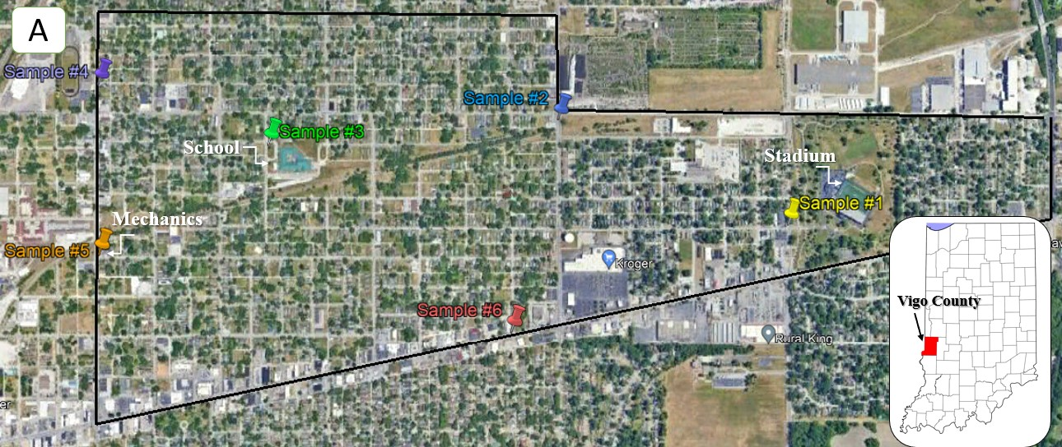

Investigations of Heavy Metal Pollution in Street Sediments from an Urban Community: A Case Study from Terre Haute, Indiana
Coté, L. (laurenncote@gmail.com), Brown, K., Faily, J., McCormick, A., Schrump, M., Troutman, M, and VanHaaren, E.,
DEPAUW
UNIVERSITY
Abstract:
4. Methods:
5. XRF Results:
6. Imaging Results:
Abstract
Urbanization combined with an increase in vehicle usage has led to elevated levels of pollution along roadways worldwide. Terre Haute, Indiana is an ideal location to explore road pollution because of its history of coal-fired power plants, steel manufacturing, roadways with high-traffic volumes, and older homes containing lead-based paint. To better understand this problem, this study examines pollution contained within street sediments found along Terre Haute’s Wabash Ave.
Heavy metal concentrations for six bulk street sediment samples were determined by pXRF at DePauw University. All six samples showed elevated concentrations of Pb , Zn, As, and Cu. The highest concentrations were found in close proximity to automotive shops and in the western portion of the study area.
Stereomicroscope observations reveal a variety of particle types that include geogenic sediment, organic matter, iron-rich particles, glassy spheres, paint particles, plastic material, and other debris. Detailed SEM/EDS analyses confirm the presence of technogenic Fe-rich spheres (~10 - 50µm), lead chromate (PbCrO₄) paint (~1-10µm), silica-glass micro-beads (<10 to >100µm), and other minor heavy metal particles (e.g., Mn, W, and Ti).
Although heavy metal concentrations did not exceed EPA risk screening levels, all six samples contained concentrations that exceed natural values found within soils in the Wabash Valley. Due to the proximity of the samples collected to residential neighborhoods, these particles may pose a public health concern for nearby communities.
All bulk street sediment samples were collected with plastic utensils and stored in plastic bags.
XRF Methods:
Bulk sediment XRF analyses used a soil calibration.
Accuracy and precision was monitored using a NIST standard (2711a - Montana II Soil).
Each sample was analyzed in replicate (5x).
SEM Methods:
Samples were placed on 1.5 cm Aluminum stubs covered in double sided carbon tape.
Samples were coated with carbon using EMS Quorum Q 150R Plus.
Sample were imaged using the SNE-4500M Plus SEM’s SE and BSE modes; compositions were obtained using a Bruker XFlash 630 EDS.
A.
D.
WVS = 8ppm
Arsenic (As)
Glass Spheres
B.
C.
Stereomicroscope Images
Iron-Rich Spheres
Abstract
2. Introduction & Hypothesis:
Urban environments are desirable residential areas due to their proximity to essential needs (e.g., markets, retail, jobs). Approximately 56% of the world’s population lives in urban environments and this number continues to increase (World Bank, 2023). Rapid urbanization combined with an increase in motor vehicle usage in urban environments has led to escalating levels of pollution along roadways worldwide (Albanese et al., 2012). Urban streets are impermeable, collecting debris and pollutants that can cause long-term health concerns (Dietrich et al., 2019). For example, anthropogenic lead is a toxic heavy metal originating from vehicular exhaust, leaded yellow paint, and coal-fired power plants (Legalley et al., 2013; Table. 1).
1). Lab Preparation Methods:
WVS = 13ppm
~100µm
~100µm
~1cm
Figure 6: (Above) Stereomicroscope photos of road sediment. A.) Common particle categories observed with a stereomicroscope. B.) Iron-rich sphere. C.) Irregular-shaped iron-rich particles along with iron-rich spheres. D.) Yellow Road Paint Chip showing imbedded reflective glass spheres.
Copper (Cu)
A.
B.
C.
Figure 2: Photos of sample preparation. A.) Dried. B.) Sieved. C.) Stored in labeled plastic bags.
Figure 8: Image of chemistry composition of anthropogenic particle.
2). XRF - Analytical Methods:
Hypotheses:
We hypothesize that street sediments can be a valuable material used to identify environmental pollutants in urban environments. We further hypothesize that these materials will provide constraints on the potential sources of these pollutants.
WVS = 1.8 wt%
100µm
200µm
100µm
D.
E.
Iron (Fe)
SEM Backscatter Images & EDS Analysis
Spot #2
F.
Figure 3: Photos of XRF preparation. A.) NIST Standard. B.) XRF Sample cup. C.) XRF Spectrometer.
Spot #1
Table 1. Sources of heavy metals in cities (after Albanese and Cicchella, 2012)
3). SEM - Analytical Methods:
Industry/Source | Cu | Pb | Zn | Sn | Cd | Ni | V | Cr | As | Sb
Mining (coal) |  | + |  | + |  | +
Iron & Steel Work | + |  |  | + |  | + | + | + | + | +
Metal Plating & Fining | + |  | + | + | + | + |  | +
Ceramics, Glass |  | + |  | + |  |  |  |  |  | +
Coal Powered Stations |  | + |  | + | + |  | + |  |  | +
Vehicles | + | + | + | + |  |  | + | +
200µm
300µm
Spot #1
Spot #2
WVS = 24ppm
Figure 4: Photos of SEM preparation. A.) Magnetic particles and SEM stub. B.) Carbon coating process. C.) SEM and EDS.
3. Background:
Lead (Pb)
200µm
Figure 7: (Above) A.) BSE image showing Iron-rich sphere. B.) BSE image showing irregular-shaped Iron-rich particle. C.) BSE image of yellow road paint with corresponding EDS analysis (inset), showing that these particles are rich in Pb and Cr (Crocoite - PbCrO4). D and E.) BSE images of Iron-rich particles with corresponding EDS analyses (below) and F.) EDS false color chemical map showing iron-rich particles.
Terre Haute (pop. 58,335, US census) is located in Vigo County, Indiana along the Indiana-Illinois border (Figure 1). Because of its close proximity to the Wabash River, this city has had a long history of industrial activity (U.S history et al. 2023). While this history led to improvements for the local economy, it has potentially yielded negative impacts on human health. This makes Terre Haute, Indiana an ideal location to examine urban geochemistry and human health issues. Bulk street sediment samples were collected from the Wabash Avenue community (Figure 1). Our sample locations include streets adjacent to schools, apartment complexes, and residential neighborhoods.
7. Conclusion & Future Work:
8. References:
Acknowledgements & References
Acknowledgements & References
References:
WVS = 63ppm
Conclusions:
We have identified the following conclusions from these preliminary results:
Cu, Fe, Pb, and Zn are elevated above natural background values.
Elevated concentrations of Iron (e.g., Iron spheres & particulates) could potentially be linked to past steel manufacturing in this area.
Heavy metal concentrations in the western portion of the community may be linked to Brownfield sites (Figure 1 & 5).
Road paint may be contributing Pb and Cr to the environment.
Future Work:
Investigate the connection between the observed heavy metals and public health concerns in this community.
Expand our work into adjacent areas, with particular attention to streets in populated areas (e.g., University) and near Brownfield sites.
Investigate the impact these metals may have on drinking water in this community and in adjacent communities. Collect water samples from local water sources.
Zinc (Zn)
Resume:
Figure 1: Street map of Terre Haute, Indiana showing the study area (dotted boundary), street sediment sample locations, nearby Brownfield sites, and present-day manufacturing facilities.
Figure 5: GIS Inverse Distance Weighting (IDW) maps of Arsenic (As), Copper (Cu), Iron (Fe), Lead (Pb), and Zinc (Zn). Inset graphs show log-normalized plots of sample concentrations normalized to natural background soil concentrations from the Wabash Valley. WVS = Wabash Valley Soil.
Notes:
Your poster should include the following Sections/Headings:
fix figure numbers
Abstract
Introduction
Background
Methods
Results (includes figures)
Conclusions/Future Work
Acknowledgements & References
The design and layout are up to each group. However, you should review the “Strategies for Posters” (in Moodle) to help you consider how to construct a quality, scientific poster.
Questions: should abstract state hypothesis is we have that in our introduction and highlighted?
Should we include captions if the captions state what's on the figure?
problem and why it is important and where it is done. Summary of results, our work shows that there are high concentrations of Lead, Zinc, and Copper.
Note: add the map on intro to background. Can introduction not have an image.

Slide 2
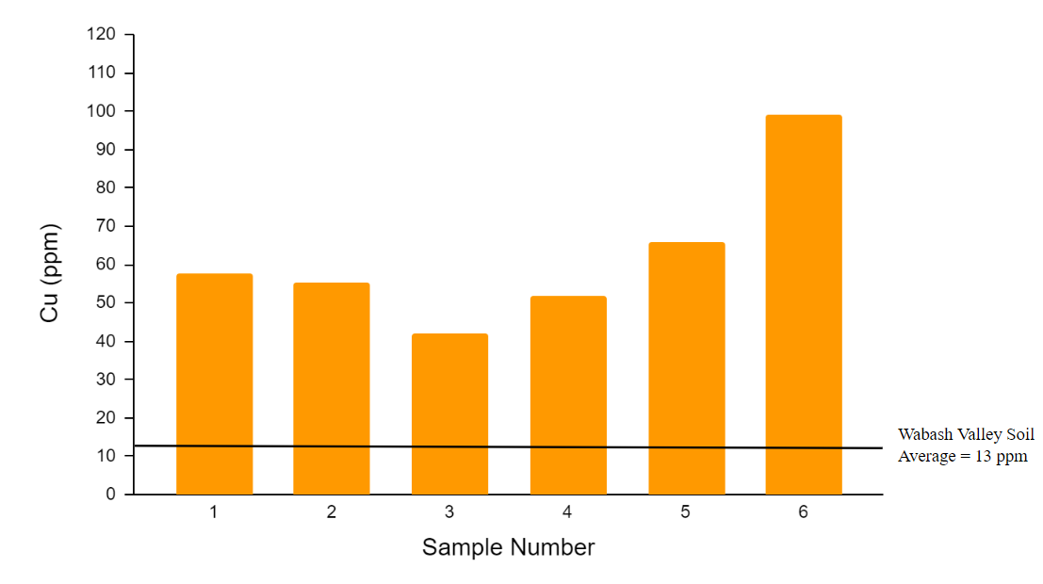
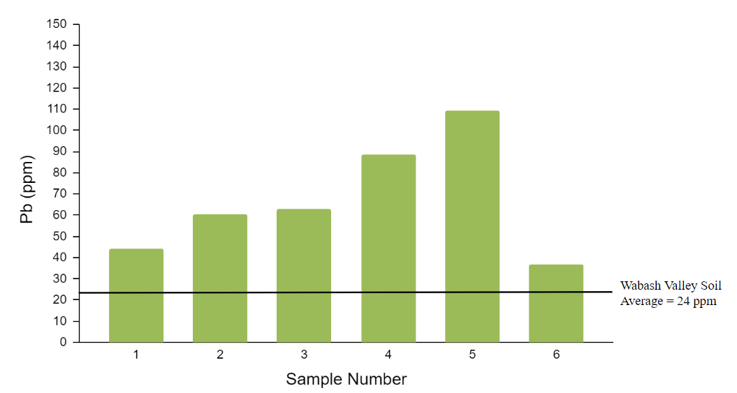
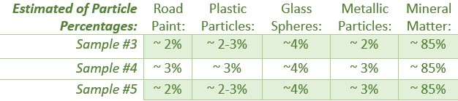
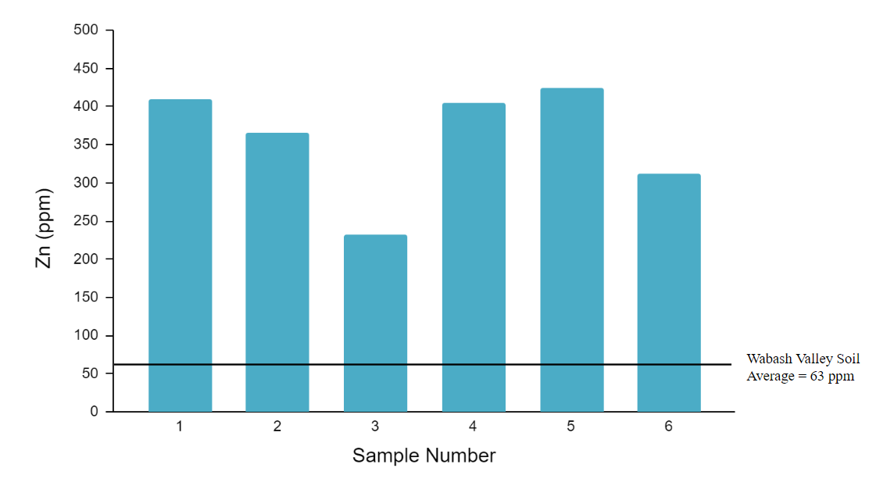

Investigations of Heavy Metal Pollution in Street Sediments from an Urban Community: A Case Study from Terre Haute, Indiana
Coté, L. (Laurencote_2025@depauw.edu), Brown, K., Faily, J., McCormick, A., Schrump, M., Troutman, M, and VanHaaren, E.,
DEPAUW
UNIVERSITY
Abstract:
4. Methods:
5. XRF Results:
6. SEM Results:
Abstract
Urban environments have become sinks for pollutants to collect, leading to daily interactions from local communities. Street sediment offers insight on the concentrations of pollutants and what is entering our drinking system as runoff. Heavy metal pollutants can lead to major health concerns at toxic levels. This study examines street sediment in the one highly instrutrial urban city of Terre Haute, Indiana. Analysis with an X-ray Fluorescence (XRF) and a Scanning Electron Microscope (SEM) was conducted on six samples from around the Terre Haute community. This contribution examines that high concentrations of heavy metals such as copper (42.0ppm - 99.2ppm), lead (36.6ppm - 109.4ppm), zinc (232.8ppm - 424.2ppm), iron (35004.8ppm - 25635.8), and arsenic (13.6ppm - 7.4ppm) are present within this city and are interacted with daily by the residents.
Samples collected with plastic materials along curbs.
XRF Samples:
Bulk sediment analyses utilized a soil calibration (soil nutrient/contamination method).
Accuracy and precision monitored using a National Institute of Standards and Technology (NIST) standard.
Samples were analyzed five times to assess reproducibility.
SEM Samples:
Samples stamped onto double sided carbon tape afflicted to 1.5cm Al.
Samples placed in EMS Quorum Q 150R Plus to be coated in carbon.
Sample images were taken and compositions were observed using SE, BSE, and EDS.
A.
E.
2. Introduction & Hypothesis:
B.
F.
Abstract
Urban environments are desirable residential areas due to their proximity to essential needs (e.g., markets, retail, jobs etc.). Approximately 56% of the population lives in urban environments and this number continues to increase (World Bank, 2023). Rapid urbanization combined with an increase in motor vehicle usage in urban environments has led to escalating levels of pollution along roadways worldwide (Albanese et al., 2012 ). Urban streets are impermeable, collecting debris and pollutants, which causes daily exposure and interaction that can potentially lead to long-term health concerns (Dietrich et al., 2019). For example, anthropogenic lead is a toxic heavy metal originating from vehicular exhaust, leaded yellow paint, and coal-fired power plants (Legalley et al., 2013; Fig. 1). While previous studies have examined water quality issues in Terre Haute (e.g., Barnard et. al., 2023), this research is the first street sediment study in this city. If the streets create polluted runoff, it can be detrimental to water quality and ultimately affecting human health.
Hypothesis:
It is hypothesized that samples collected in close proximity to industrial areas should exhibit higher concentrations of harmful pollutants compared to samples that were collected near public spaces like parks and schools.
1). Lab Preparation Methods:
SEM- Energy Dispersive Spectroscopy SEM - Backscattered Electron Microscope Picture
(EDS) Images and Graph: (BSE): >180µm:
200µm
100µm
Figure 8: Image of chemistry composition of anthropogenic particle.
C.
G.
Figure 2: Photos of Sample preparation. A.) Dried. B). Sieved. C.) Stored in labeled plastic bags.
A.
2). XRF - Analytical Methods:
200µm
300µm
Zinc: Lead: Iron: Copper: Arsenic:
D.
H.
B.
Figure 3: Photos of XRF preparation. A.) XRF Standard. B.) XRF Sample cup. C.) XRF Spectrometer.
3). SEM - Analytical Methods:
Figure 6: SEM images. A and E). showing photos under a microscope (particles >180µm). B and F.) showing BSE images of anthropogenic particles. C and G.) showing BSE images which were used to analyze the chemistry. D and H.) graphs showing chemistry of C. and G.
Figure 4: Photos of SEM preparation. A.) Magnetic particles and SEM stub. B.) Carbon coater. C.) SEM and EDS.
100µm
Figure 7: Photos taken of samples under microscope. A). showing different types of particles. B). estimations of particle percentage.
C.
3. Background:
Terre Haute is located in Vigo County, Indiana along the Indiana-Illinois border (Fig 1.) with a total pollution of 58,335 people (July 2022; US census). Due to proximity to the Wabash River, this city has a long history of industrial activity (U.S history et al.). Terre Haute is an ideal location to explore street sediment related to pollution because of its history of coal-fired power plants (e.g, 3rd largest coal producer and 5th largest iron producer in 1870; U.S history et. al.)., steel manufacturing, historic roadways with high-traffic volumes, and older homes containing lead-based paint. While this history led to improvements for the economy of Terre Haute, it yielded negative environmental impacts and concern for human health. Street sediment samples were collected from areas believed to be affected by pollution. These sample locations include streets adjacent to schools, apartment complexes, and neighborhoods.
B
Figure 9: SEM and microscope image (A.) of road paint, showing morphology with the BSE (B.) and the chemical composition (C.).
Conclusion & Future Work
References:
Acknowledgements & References
Acknowledgements & References
Conclusions:
Lead, Zinc, and Copper were all elevated above the natural background, posing a health concern for residents.
High concentrations of Iron and Magnesium were found, which may be due to the city’s steel manufacturing past.
The western-most samples revealed higher concentrations of heavy metals, which may be attributed to the proximity of Brownfrield and industrial sites.
Future Work:
Conduct research about the health impacts of the heavy metals and pollutants that were found in the sediment.
Collect samples around Indiana State University.
Research and see if there is a source of the pollution.
Collect water samples from local water sources and aquifers that provide drinking water to the community. Due to runoff the local water sources could be contaminated.
Figure 1: This Figure shows the field area, sample locations, brownfield sites, and manufacturing facilities.
Figure 5: GIS concentration maps of Arsenic (As), Copper (Cu), Iron (Fe), Lead (Pb), Zinc (Zn) in parts per million (ppm). Upper right corner displays normalized graph indicating the background and EPA thresholds.
Notes:
Your poster should include the following Sections/Headings:
fix figure numbers
Abstract
Introduction
Background
Methods
Results (includes figures)
Conclusions/Future Work
Acknowledgements & References
The design and layout are up to each group. However, you should review the “Strategies for Posters” (in Moodle) to help you consider how to construct a quality, scientific poster.
Questions: should abstract state hypothesis is we have that in our introduction and highlighted?
Should we include captions if the captions state what's on the figure?
problem and why it is important and where it is done. Summary of results, our work shows that there are high concentrations of Lead, Zinc, and Copper.
Note: add the map on intro to background. Can introduction not have an image.

Slide 3
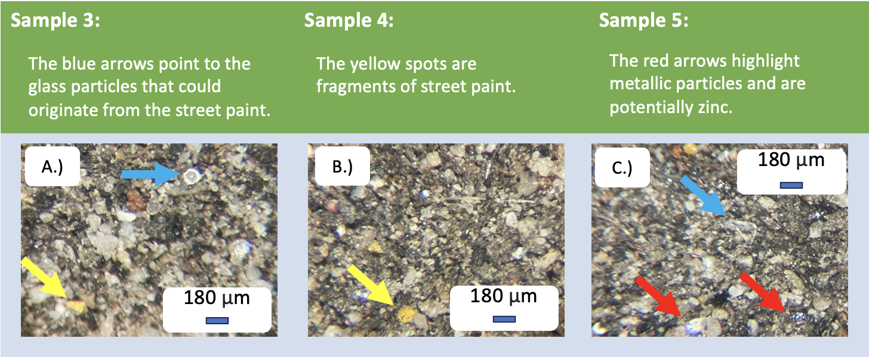
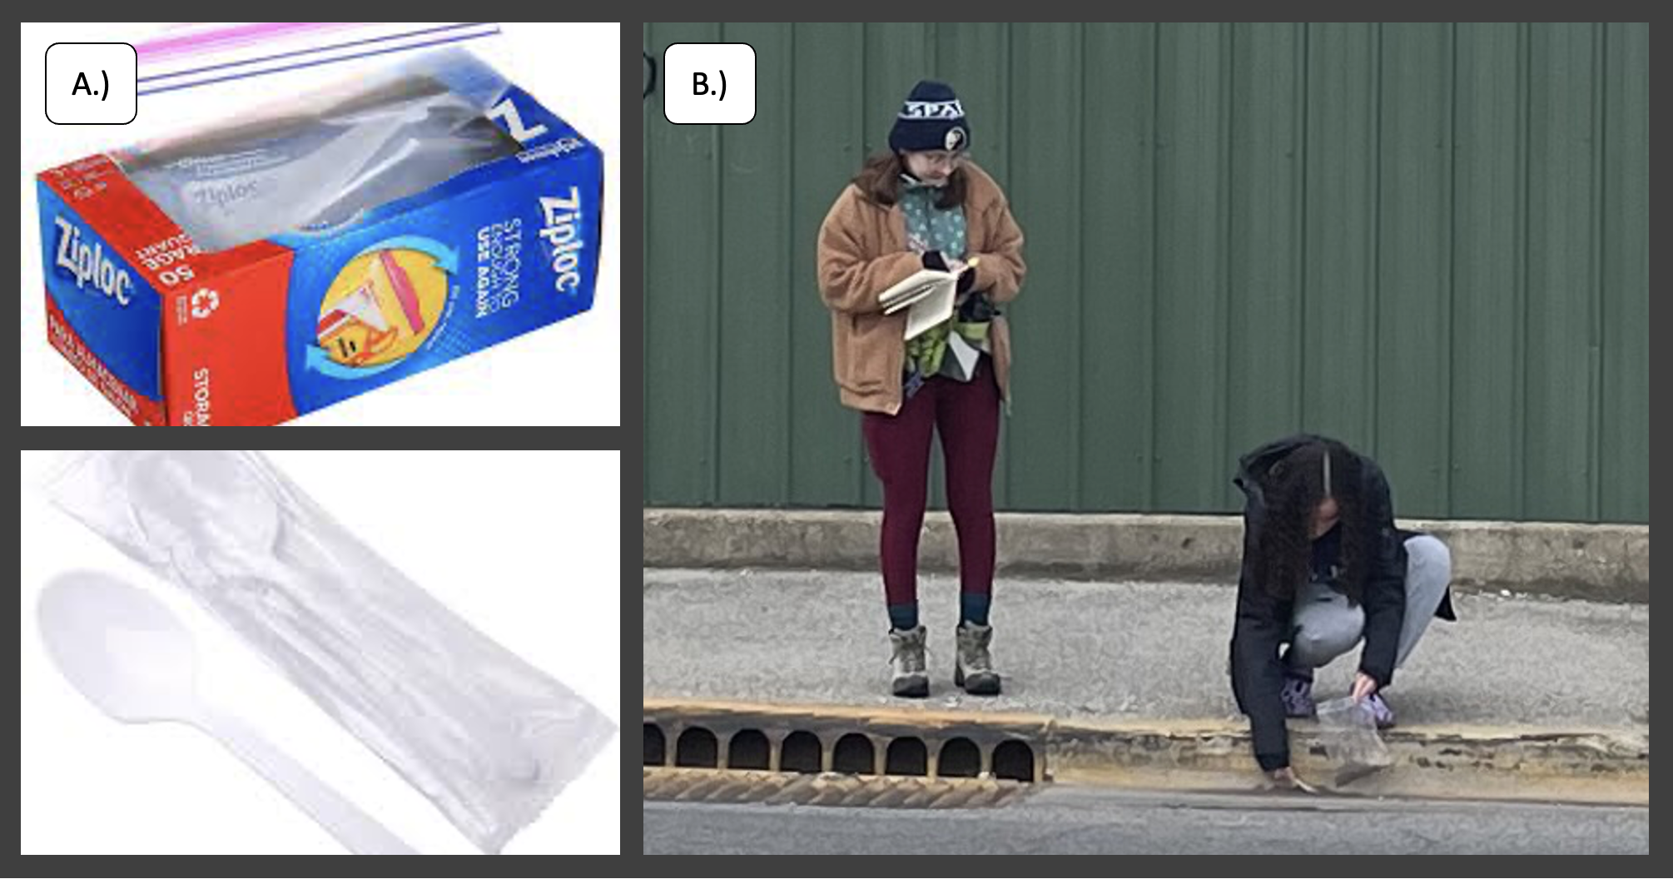
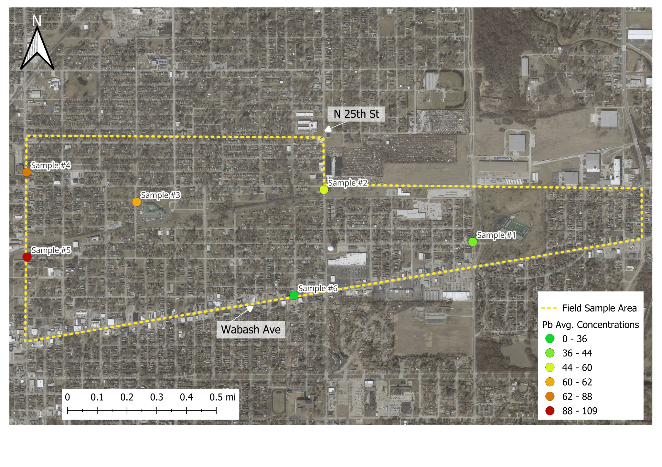
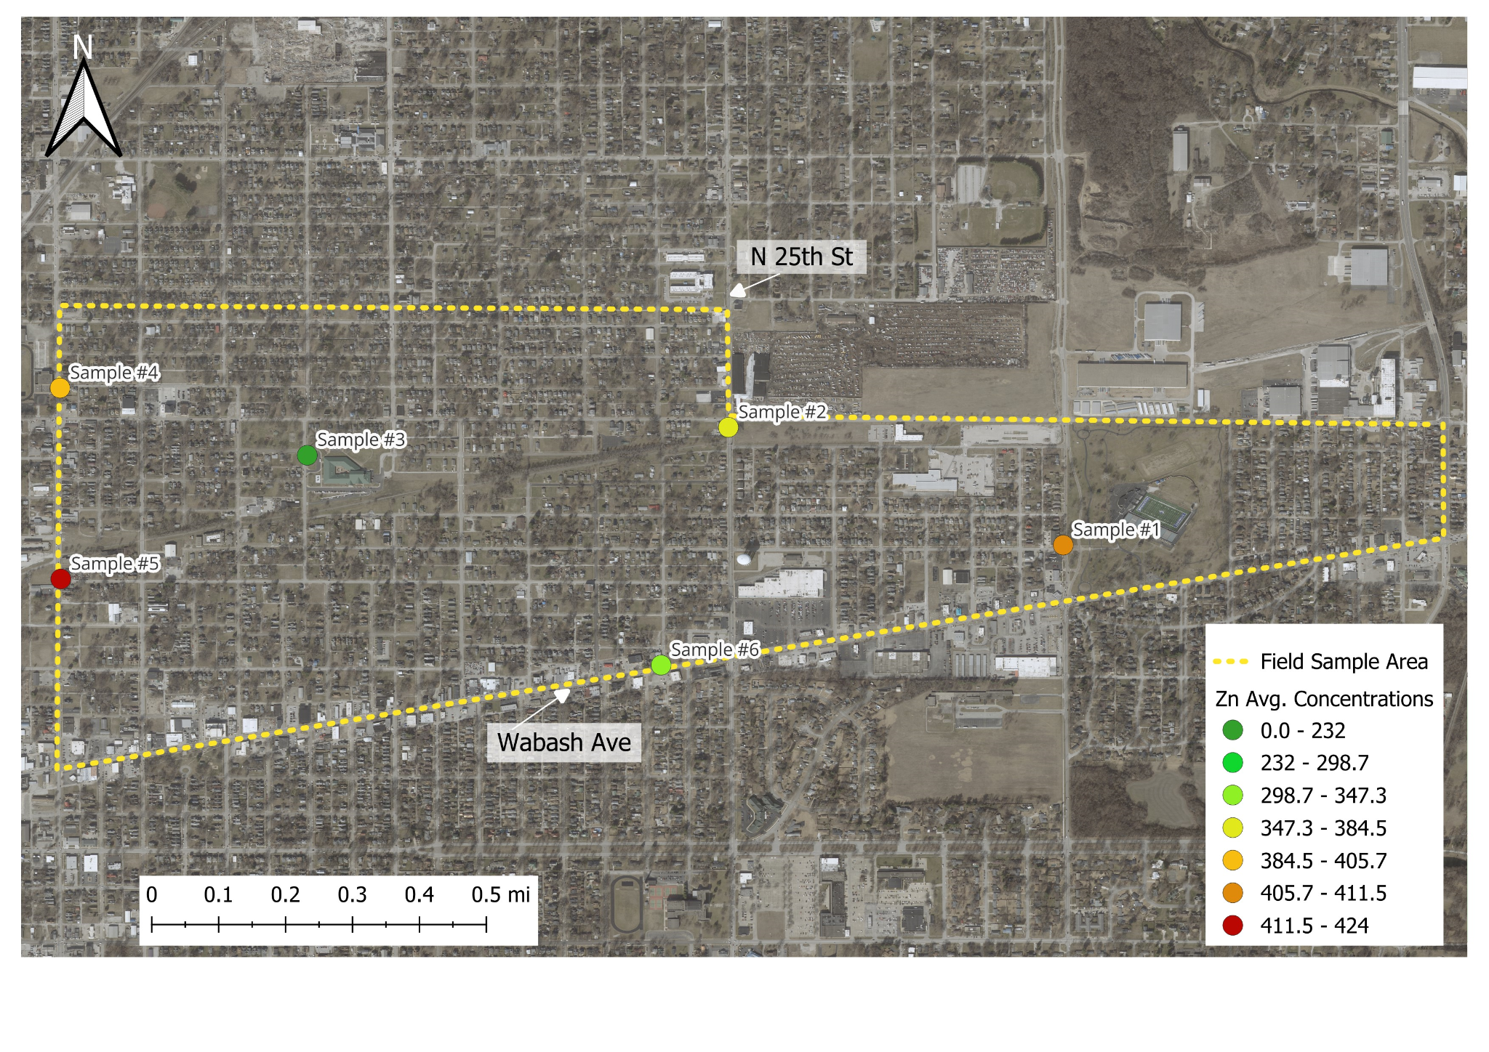
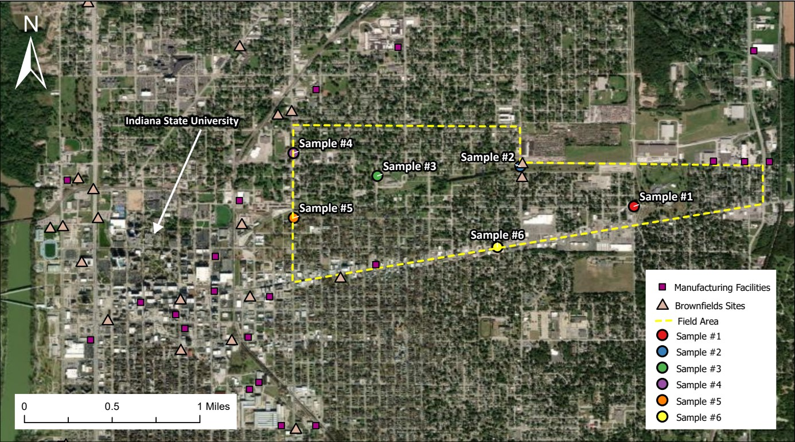
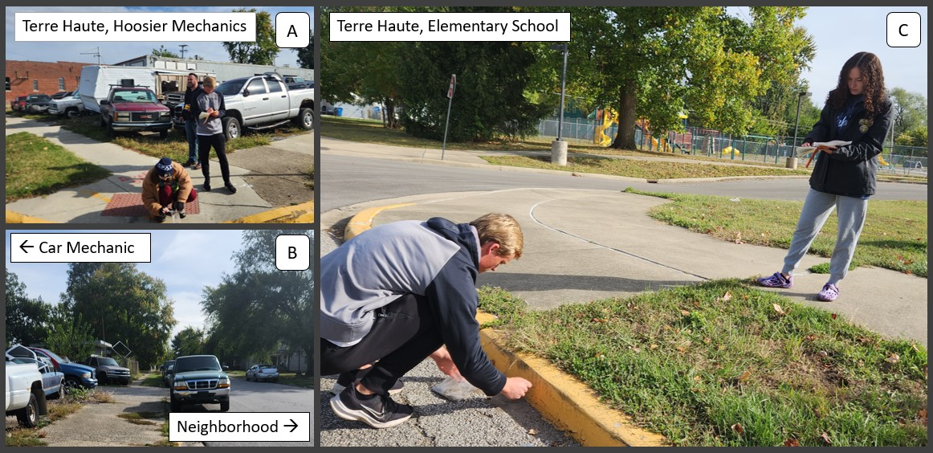
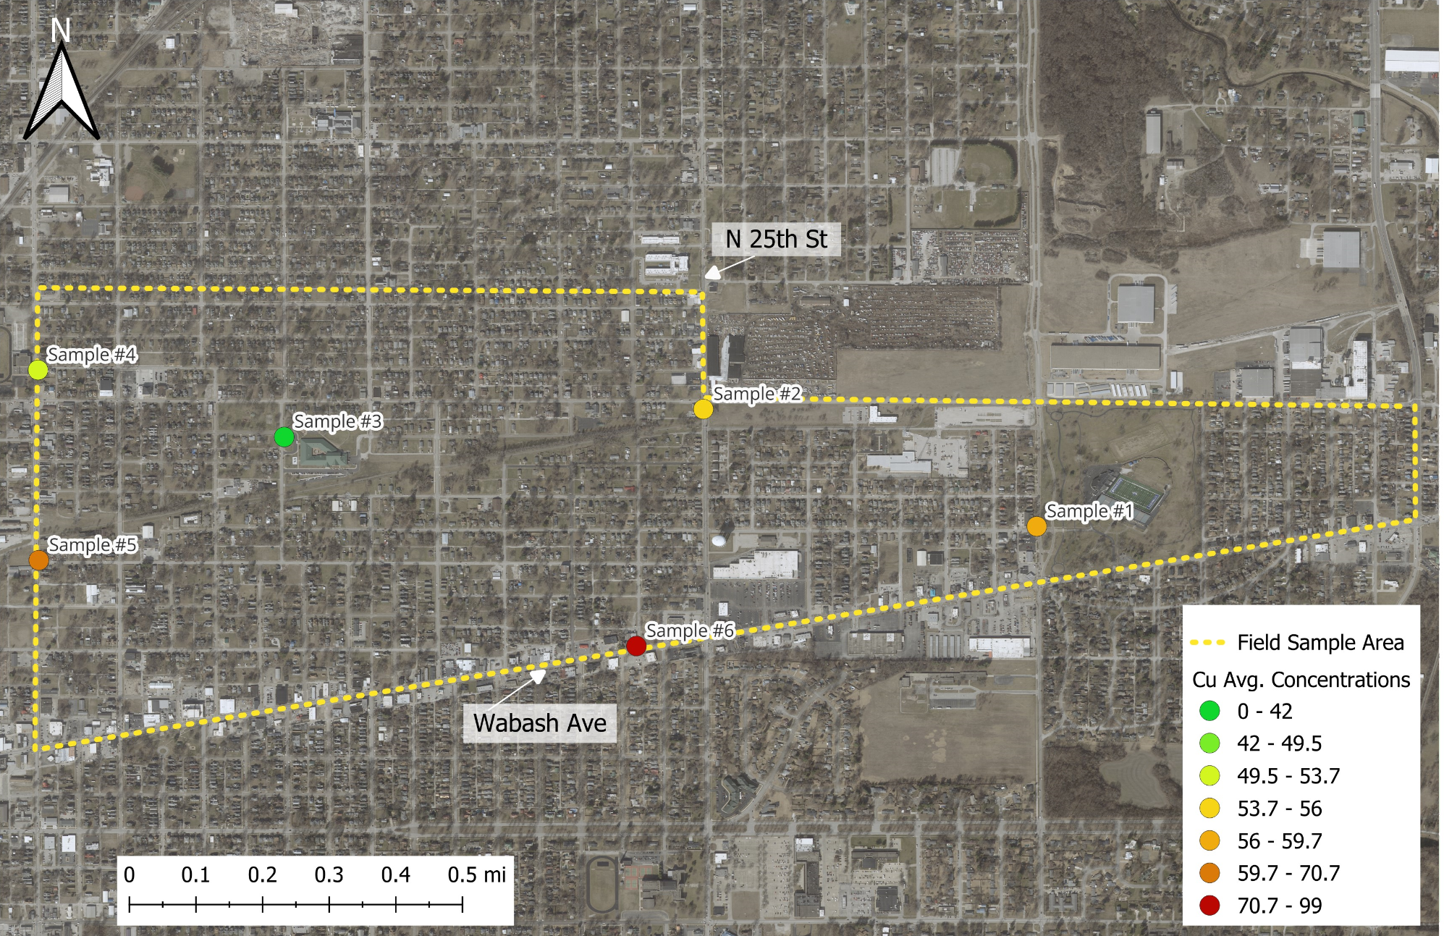

Terre Haute’s Street Sediment: A Sink Containing Contaminants Impacting Human Health
Eli VanHaaren, Jessica Faily, Lauren Cotè and Dept. Geology and Environmental Geoscience
DEPAUW
UNIVERSITY
Abstract:
Methods:
Results:
Abstract
Conclusions & Future work
Pollution is a major issue in urban environments due to high population. Street sediment offers insight to the pollutants that we are exposed to. This study examines the street sediment in the once industrial city of Terre Haute, Indiana. Our work shows high concentrations of lead (36.6ppm - 109.4ppm), zinc (232.8ppm - 424.2ppm), and copper (42.0ppm - 99.2ppm); this data was obtained using an X-Ray Fluorescence (XRF). After looking under a binocular dissecting scope, anthropogenic particles were found including yellow road paint and glass sphericals.
Street sediment samples were collected from the Wabash Street community in Terre Haute, Indiana.
Samples were collected along curbs (Fig. 3B).
Plastic materials were used to avoid contamination (Fig. 3A).
Sieves were cleaned with compressed air and acetone between
samples to reduce cross-contamination.
Bulk sediment analyses utilized a soil calibration (soil nutrient/contamination method).
The accuracy and precision of the analytical session was monitored using a National Institute of Standards and Technology (NIST) standard (Fig. 5A).
To assess reproducibility, each sample was analyzed five times. Each analysis took 60 seconds (30 sec. at 45kV; 30 sec. at 20kV.)
2). Lab Preparation Methods:
Furthermore, there are many different categories of particles among our samples shown in table 1. The glass spheres are anthropogenic particles originating from road paint (Fig. 9). Furthermore, the metallic particles were subtracted from the samples using a magnet and then observed.
Introduction & Hypothesis:
Table 1: Mineral Matter (e.g., Quartz, Feldspar, Muscovite)
Abstract
Urban environments are desirable residential areas due to their proximity to essential needs (e.g., markets, retail, etc.). Approximately 56% of the population lives in urban environments and this number continues to increase (World Bank, 2023). Industrial activity is common in urban environments, releasing toxic pollutants into the air, water, and soil (Albanese et al., 2012 ). Urban streets are impermeable, collecting debris and pollutants, which causes daily exposure and interaction that can potentially lead to long-term health concerns (Dietrich et al., 2019). For example, anthropogenic lead is a toxic heavy metal originating from vehicular exhaust, leaded yellow paint, and coal-fired power plants (Legalley et al., 2013; Fig. 1). While previous studies have examined water quality issues in Terre Haute (e.g., Barnard et. al., 2023), this research is the first street sediment study in this city. If the streets create polluted runoff, it can be detrimental to water quality as well as human health. Terre Haute is an industrial city in Indiana that has many large plastic, chemical, and food manufacturing and processing plants (“Industry Sectors” et al., 2023). It is hypothesized that samples collected in close proximity to industrial areas should exhibit higher concentrations of harmful pollutants compared to samples that were collected near public spaces like parks and schools.
Figure 4: Photos of Sample preparation. A.) Dried. B). Sieved. C.) Stored in labeled plastic bags.
1). Field Methods:
3). Analytical Methods:
Figure 3: Photos of field work. A.) Plastic spoons/bags. B.) Sediment collection process.
Figure 5: Photos of XRF preparation. A.) XRF Standard. B.) XRF Sample cup. C.) XRF Spectrometer.
Background:
Results:
Figure 9: Photos taken of samples 3, 4, and 5 using a binocular dissecting scope.
Terre Haute is located in Vigo County, Indiana along the Indiana-Illinois border (Fig 1A). Due to proximity to the Wabash River, this city has a long history of industrial activity (U.S history et al.). Of particular importance was the production, extensive railroad system, and mining of raw materials, namely coal (e.g, 3rd largest coal producer and 5th largest iron producer in 1870; U.S history et. al.). Abundance of coal and iron led to major improvements for the economy of Terre Haute, yet yielded negative environmental impacts and concern for human health. Demographically, this city is estimated to have a total population of 58,335 people (July 2022; US census). Furthermore, people living in Terre Haute have a higher likelihood of having a disability under 65 and living in poverty compared to the state average. These issues combined with the fact that this is an industrial city producing pollution puts these people at risk for major health issues. Street sediment samples were collected from areas believed to be affected by pollution (Fig. 2 A and B). These sample locations include streets adjacent to schools and apartment complexes.
Within all of the samples, there are an array of heavy metals. The ones that are considered heavy metals are the ones that are the most toxic to humans. The concentration of these heavy metals depends on the human activity that concentrated it. We focused on the trace metals of Lead (Pb), Copper (Cu), and Zinc (Zn). These three elements are elevated in each of our samples compared to the Wabash valley soil average. Toxic levels of zinc in soils is 400 ppm (Paula Milner et al., 2014) which is exceeded by half of the samples (Fig. 7C). Sample 5 has the highest concentration of heavy metals compared to sample 3 containing the least (Fig. 7D). In addition, the data had a trend of having higher concentrations of heavy metals to the west of Terre Haute (Fig. 6B., 7D.).
A.)
B.)
Conclusion & Future Work
Acknowledgements & References
Our results confirm our hypothesis and indicate that the concentrations of heavy metals are higher near industrial areas (and even exceed the background reference concentrations in some cases).
Take away points:
Lead, Zinc, and Copper were all elevated above the natural background.
Similar study using street sediment in Gary Indiana yielded high concentrations of zinc and other trace metals.
While these harmful elements have collected in the street sediment, it is highly likely that these elements are also present in waterways, soils, and the air in the city.
Therefore, it is important for citizens to know that these harmful elements are present in their city. It is important to think about what pollutants and heavy metals you are exposed to on a daily basis.
If given the opportunity to go collect samples from Terre Haute again, an interesting place to collect samples from would be around Indiana State University. The university shares close proximity with our samples which contained the highest concentrations of pollutants. In addition, it resides near many factories, brownfield sites, and pollution producing companies, so it would be interesting to see if there are high levels of pollution in the sediment and how the pollution could affect student health (Fig. 9). Analyzing samples with the Scanning Electron Microscope (SEM) would show exactly what particles are in the sediment.
Figure 6: Histogram and Map of lead (Pb) concentrations. The EPA threshold value is 400 ppm.
Figure 1: This Figure shows our field area and sample locations.
C.)
D.)
Figure 7: Histogram and map of zinc (Zn) concentrations. Zinc threshold value from Milner (2014) is 400 ppm.
Figure 2: Selected photos of the sampling process. A.) Showing the collection of a sample near a local mechanic shop. B.) Showing the close proximity of the mechanic’s shop to a residential neighborhood. C.) Showing samples being collected near an elementary school.
E.)
F.)
Scan for references:
Figure 8: Histogram and Map of copper (Cu) concentrations Histogram illustrating the Cu concentrations.
Figure 9: Map highlighting future work and areas of interest.
Notes:
Your poster should include the following Sections/Headings:
fix figure numbers
Abstract
Introduction
Background
Methods
Results (includes figures)
Conclusions/Future Work
Acknowledgements & References
The design and layout are up to each group. However, you should review the “Strategies for Posters” (in Moodle) to help you consider how to construct a quality, scientific poster.
Questions: should abstract state hypothesis is we have that in our introduction and highlighted?
Should we include captions if the captions state what's on the figure?
problem and why it is important and where it is done. Summary of results, our work shows that there are high concentrations of Lead, Zinc, and Copper.
Note: add the map on intro to background. Can introduction not have an image.

