Slide 1


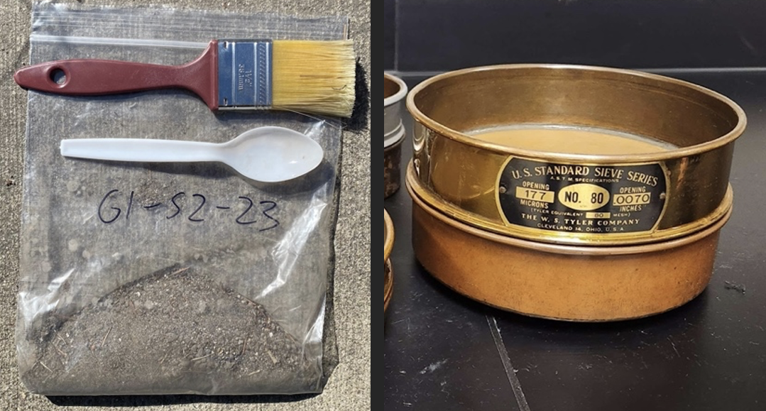
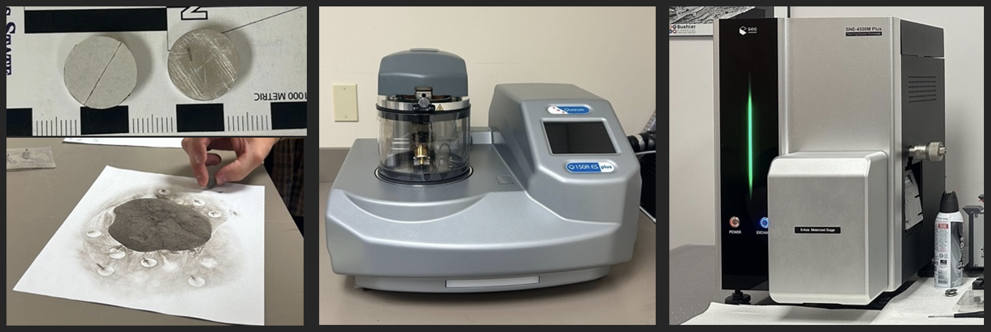
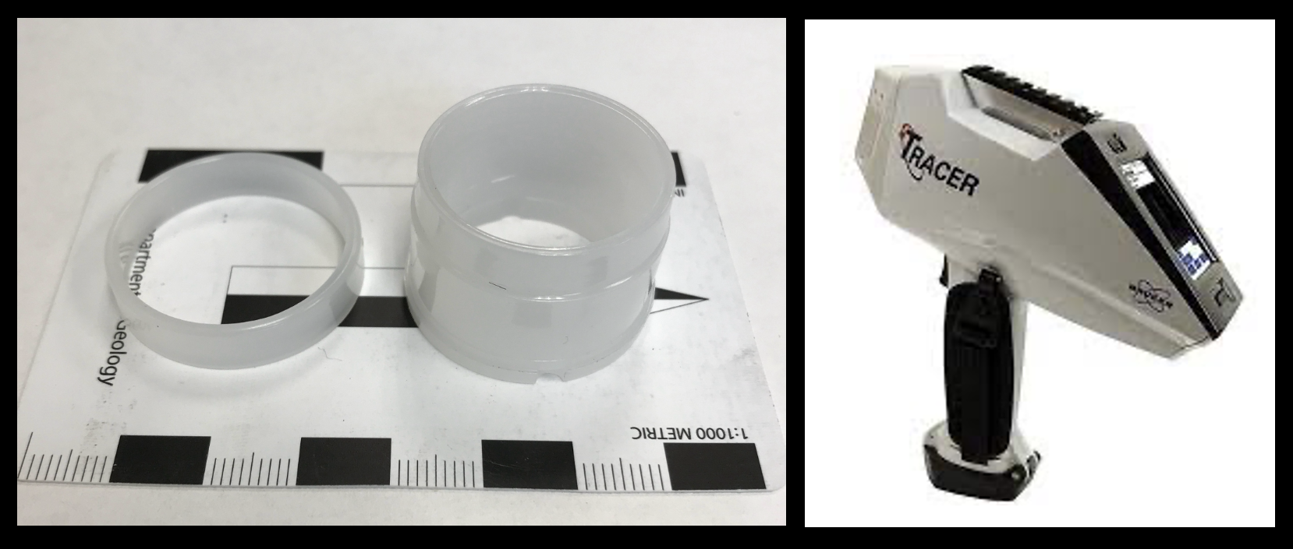
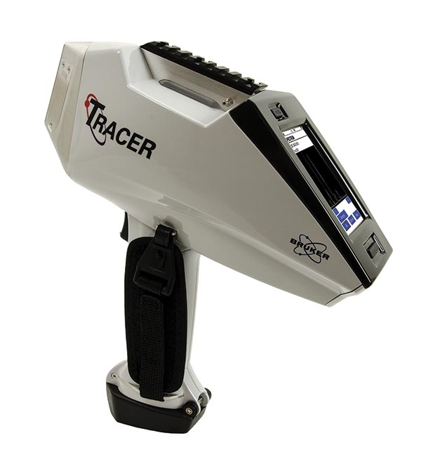
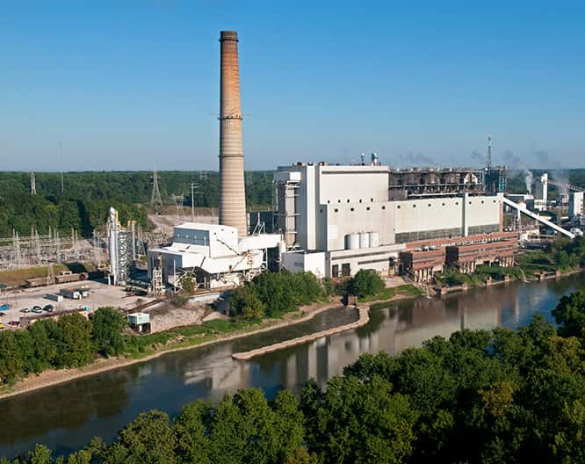
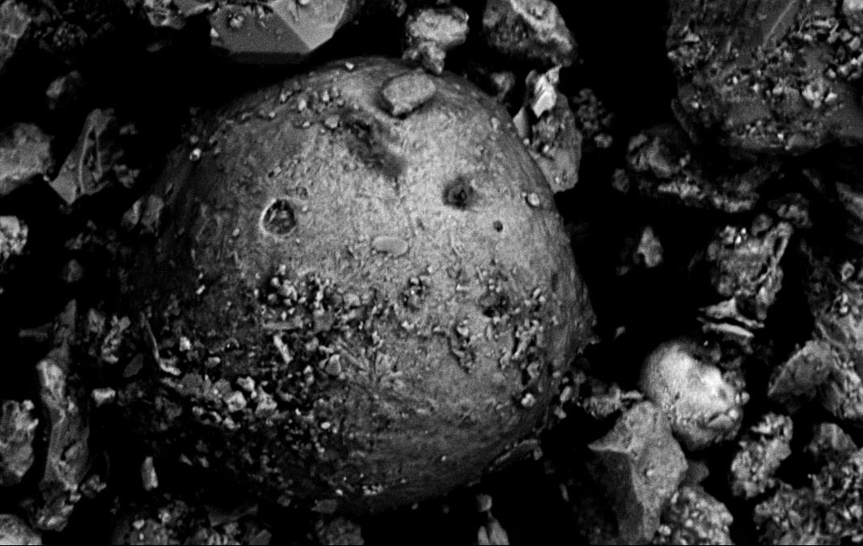
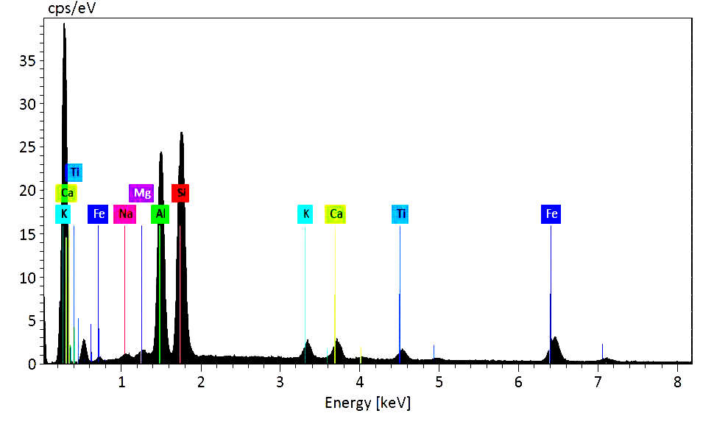
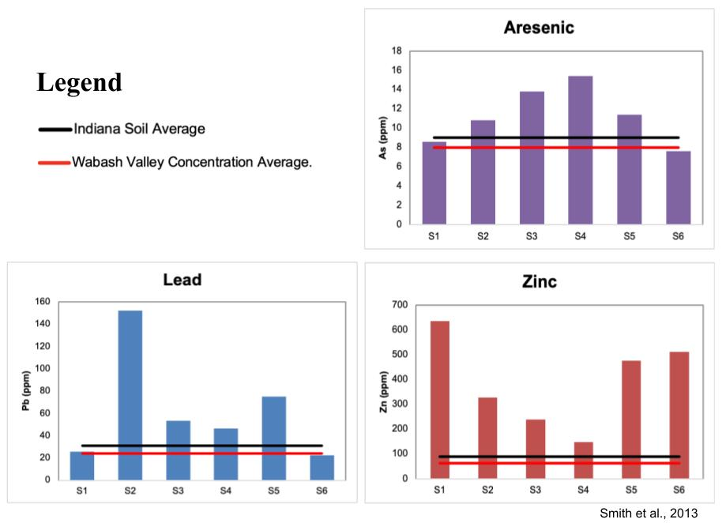
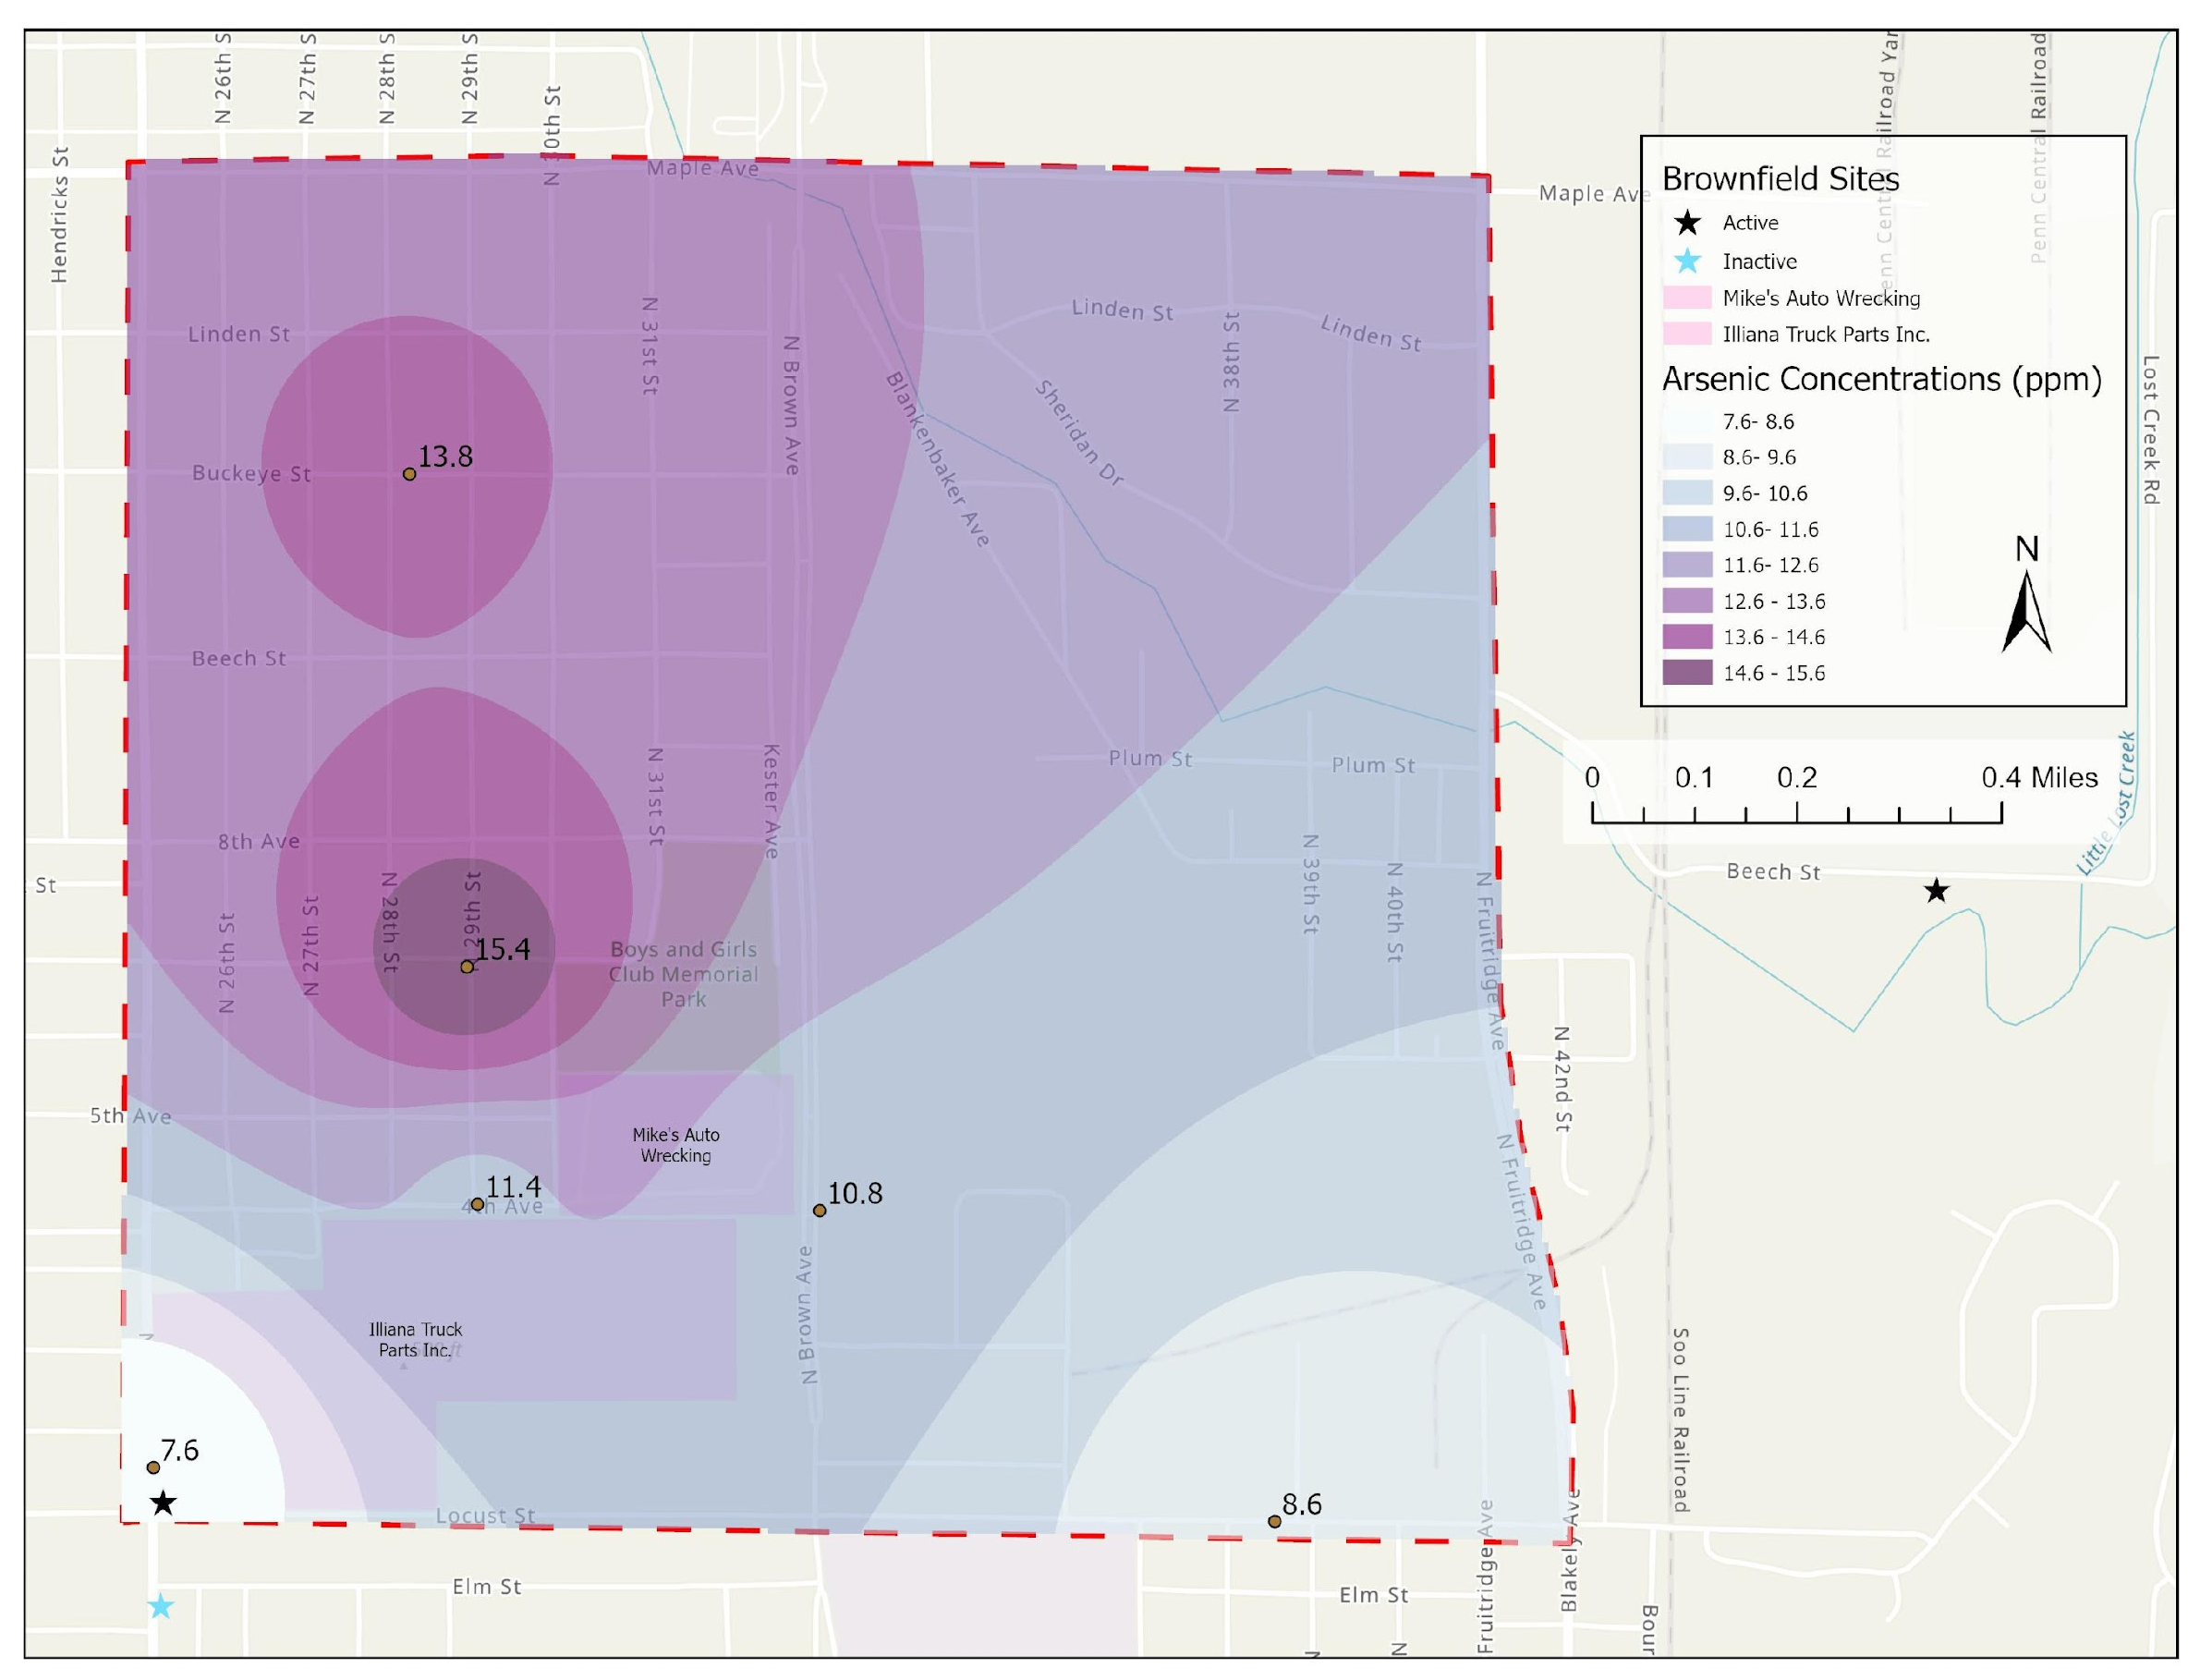
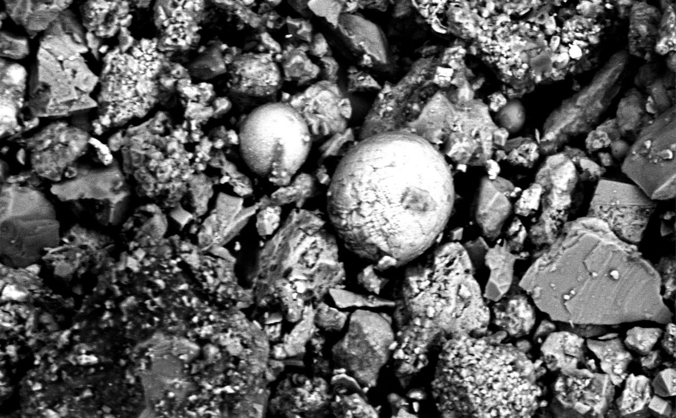
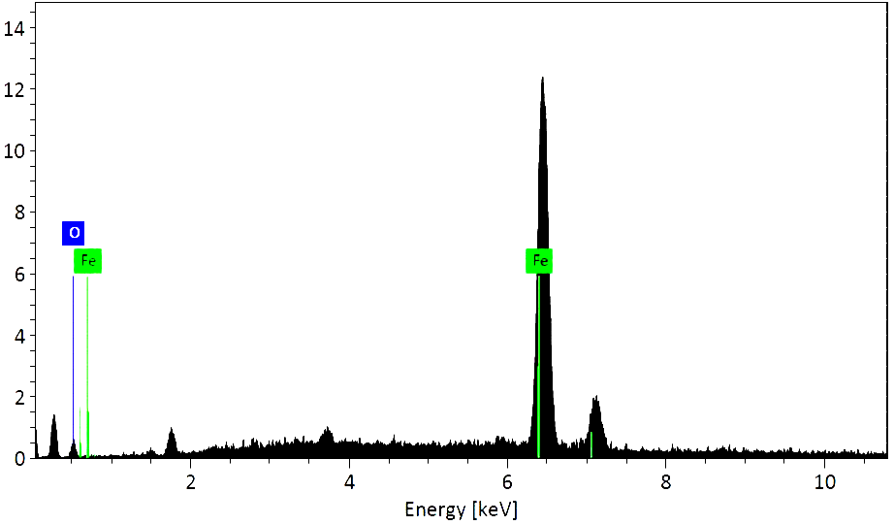
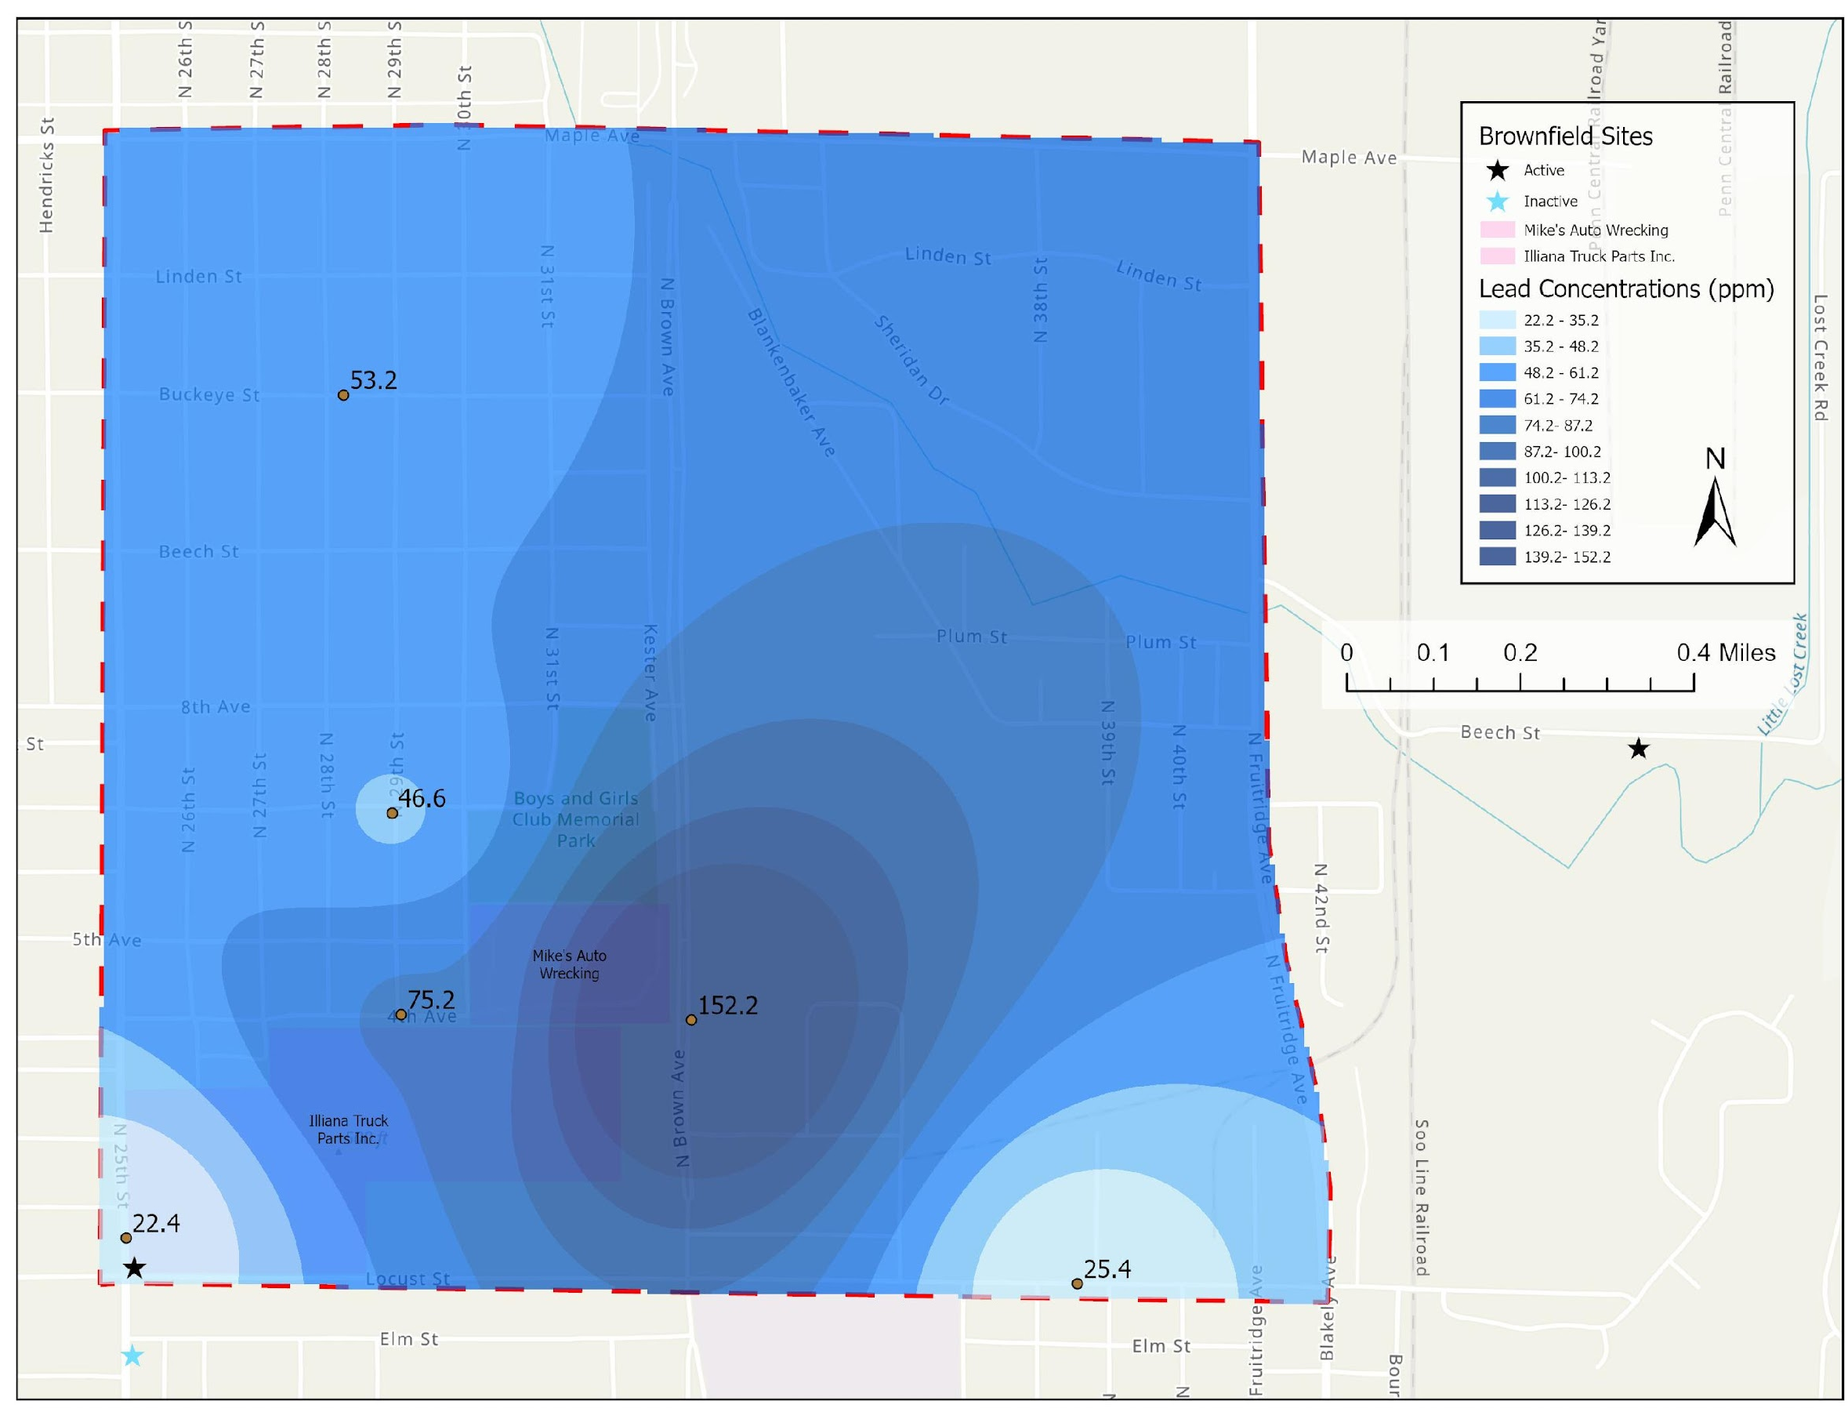
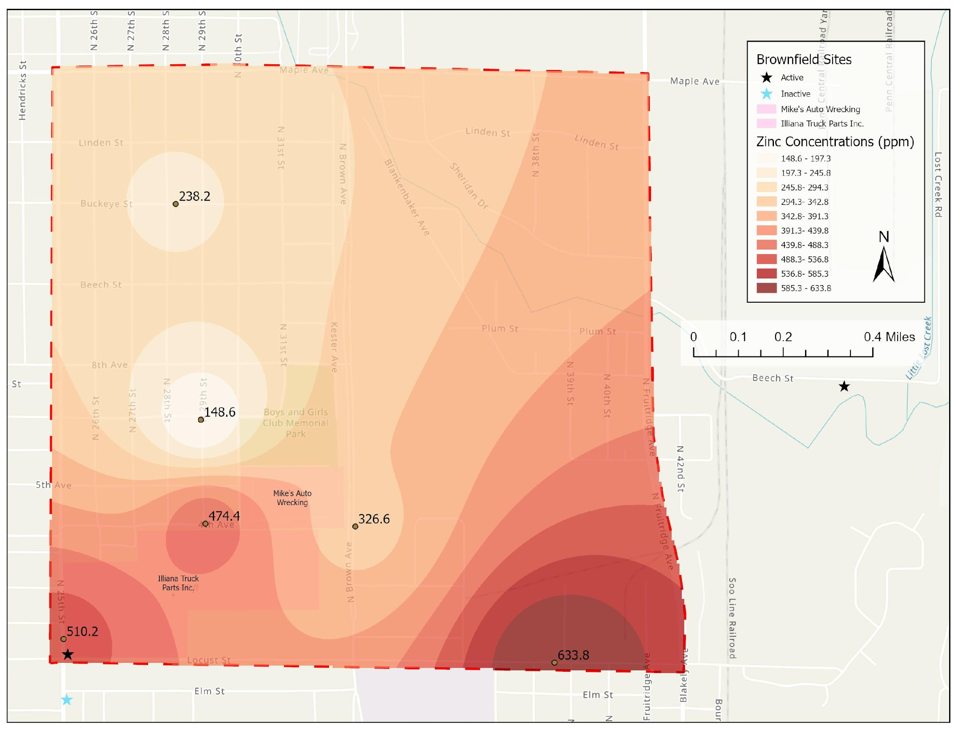
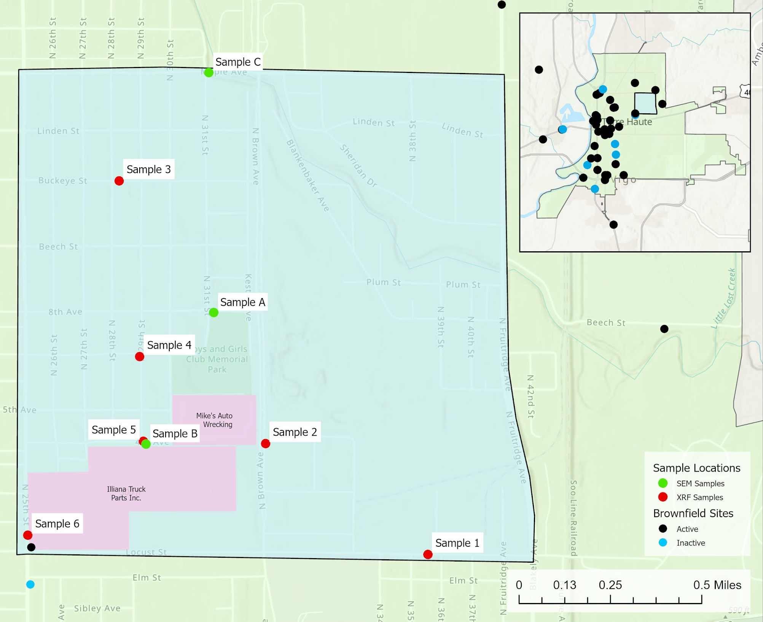
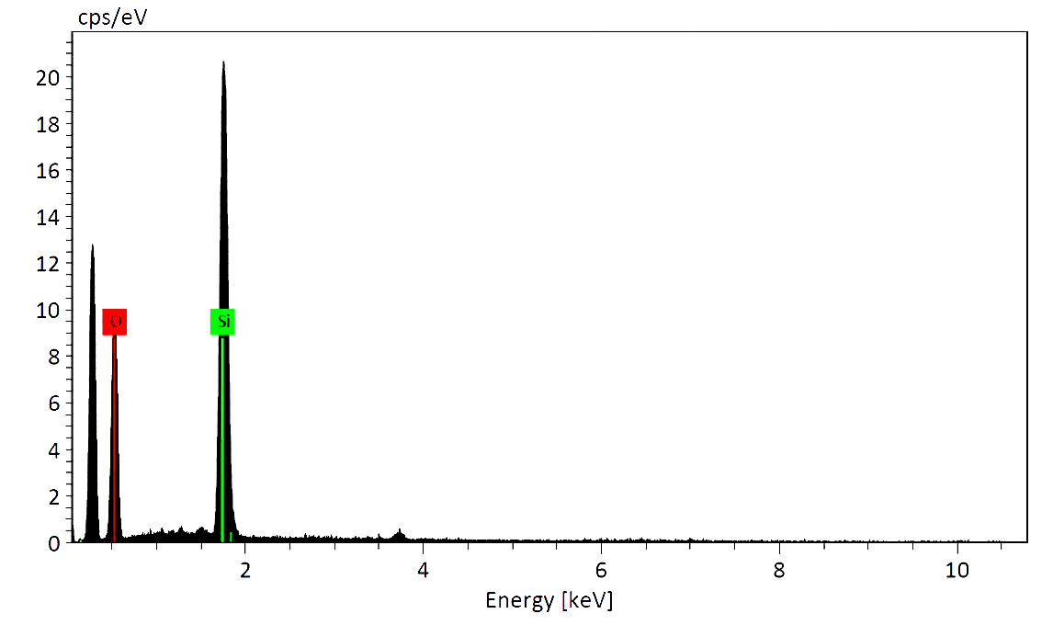
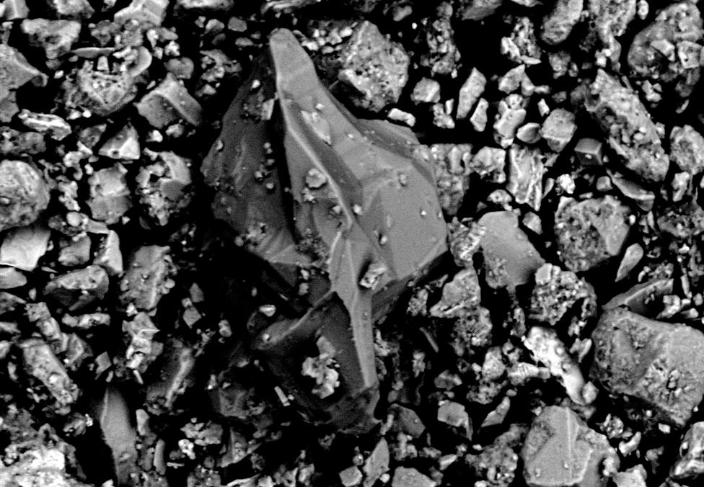

A Community-Level Investigation of Heavy Metal Pollution in Street Sediments from Terre Haute, Indiana Copp, K.¹ (kyracopp_2025@depauw.edu), Brown, K.L.¹, Bedwell, N.¹, Brown, C.¹, Dugan, V.¹, Rivera, M.¹, Simmons, Q.¹
¹ Department of Geology & Environmental Geoscience, DePauw University
DEPAUW
UNIVERSITY
Abstract
Methods
Urban environments contain environmental legacy issues that can have long-term negative public health consequences. Investigating these legacy issues can help constrain potential sources and their impact on communities. This study focuses on street sediment found in Terre Haute, Indiana, a city with an extensive history of coal-fired power production, high-traffic volumes, steel manufacturing, and Pb-based paint usage. This research specifically focuses on Terre Haute’s Sheridan Park community. Six bulk street sediment samples were analyzed by pXRF at DePauw University. This analysis revealed elevated concentrations of Pb (22-152 ppm), As (8-15 ppm), Cu (35-237 ppm), and Zn (149-634 ppm) in all six samples. Street samples collected near automotive buildings had the highest concentrations of heavy metals, with some concentrations seven times higher than background concentrations reported for natural soils in the area.
Particle types found within the street sediment were identified using a standard stereomicroscope. This revealed four main categories: geogenic sediments, organic matter, anthropogenic debris (e.g., plastic), and metal particles. A more detailed investigation of the particle types was completed using scanning electron microscopy (SEM) and energy dispersive spectroscopy (EDS). This analysis revealed Fe-rich spheres, silica-rich micro-beads, and other minor heavy metal-bearing particles. This study confirms the presence of heavy metal pollution within this community. Present-day sources of these metals include the automotive industry (e.g., mechanic shops) and vehicle transportation. The Fe-rich spheres may be a byproduct of past steel manufacturing and coal-combustion within the city.
Nine samples were collected; three for SEM analysis and six for XRF analysis (Fig. 2). All samples were collected with plastic utensils, dried for 72 hours, and sieved with a #80 mesh sieve (Fig. 3).
SEM samples (A, B, C) were mounted to SEM stubs with carbon tape, carbon coated, and imaged/analyzed using Secondary Electron (SE), Backscatter Electron (BSE), and Energy Dispersive Spectroscopy (EDS) (Fig. 4).
XRF samples (#1 - #6) were placed in a plastic Chemplex container and analyzed using a Bruker p-XRF. Accuracy and precision of the analysis was monitored using NIST standard 2711a (Montana II soil) (Fig. 5).
A
B
A
B
C
A
B
#80 Mesh Sieve (180 µm)
EMS Q150R Plus
Fig. 3. Sample Collection: A) Plastic utensils used to collect bulk street sediment samples. B) #80 mesh sieve.
Fig 4. SEM and EDS Analysis: A) SEM stubs (top) and sample mounting process (bottom). B) EMS Q150R Plus carbon coater. C) SNE- 4500M Plus tabletop SEM equipped with a Bruker XFlash 630 EDS.
Fig 5. XRF Analysis: A) Chemplex container with a 4µm Prolene thin film. B) Bruker Tracer 5g Portable X-Ray Fluorescence Spectrometer (p-XRF).
Introduction & Hypothesis
SEM Results
XRF Results
Introduction
Heavy metal contaminants, such as lead, generated by manufacturing and industrial activities have a large impact on human health in urban environments (Filippelli et al., 2012). Many industries in the Midwest are known for releasing pollutants such as Pb, Ni, Cr, Cu, and Zn, causing potential health concerns (Dietrich et al., 2018). Brownfield sites may be a local source of these pollutants. Coal-fired power plants can also disperse heavy metals over a broader region (Fig.1). While it is known that Brownfield sites, manufacturing sites, and coal-fired power plants can increase the concentrations of harmful heavy metals in the environment, this study intends to investigate the impact of these industries within the Sheridan Park Community in Terre Haute, Indiana (Fig.2).
Hypothesis:
We hypothesize that street sediments contain valuable geochemical clues that can be used to identify the sources of heavy metal contamination.
Spot 447
A
B
Spot 447
cps/ev
Ti
Mg
*
Ca
Fe
Si
K
Ca
Ti
Fe
K
Na
Al
*data from Smith et al. (2013)
*
100 µm
Fig. 6 (Above): Backscatter electron image (BSE) for a silica-rich sphere covered in soil particles from Sample A (left). EDS-spot analysis (Spot 447) showing the chemical composition of the silica-rich sphere (right).
Fig. 1: Photo of the retired Wabash River Coal-fired power generating station in Terre Haute, IN.
Spot 456
Spot 456
cps/ev
O
Fe
Background
Fe
C
D
Background
This project is focused on characterizing the pollution found within street sediment located within the Sheridan Park Community of Terre Haute, IN.
Terre Haute is located in Vigo County. It is home to 19 existing Brownfield sites, with two located in Sheridan Park (Fig. 2).
The city is home to ~58,450 people, with 82% of the total population being under the age of 62 (US Census Bureau, 2021).
40% of homes in the city likely contain lead paint due to being constructed prior to 1950.
The city has a history of heavy metal contamination. Specifically, Pb testing in community gardens revealed highly variable concentrations in different garden plots, requiring remediation (Latimer et al., 2016).
50 µm
A
B
Fig. 7 (Above): Backscatter electron image (BSE) (left) and EDS spot analysis of iron-rich sphere (right) from Sample B.
Spot 451
Spot 451
cps/ev
O
Si
100 µm
Fig. 8 (Above): Backscatter electron image (BSE) of a glass particle (left) and its corresponding EDS spot analysis (right) from Sample C.
Fig. 9. A) Histogram plots showing the As, Pb, and Zn concentrations for six street sediment samples. Samples are compared to average natural background soil concentrations from the Wabash Valley soil (Smith et al.,2013). B) Inverse distance weighting (IDW) map of bulk As concentrations (in ppm). C) IDW map of bulk Pb concentrations (in ppm). D) IDW map of bulk Zn concentrations (in ppm).
Conclusions & Future Work
Conclusions:
Industrial silica-rich spheres were identified by SEM analysis (Fig. 6). These spheres were likely weathered from road paint chips. These paint chips may be an additional source of Pb and Cr.
Iron-rich spheres were the most prevalent metal identified by SEM analysis (Fig 7). These spheres were prominent in Sample B, which is adjacent to the Illiana Truck Parts Inc (Fig. 2). This is also a former steel-manufacturing site.
Pb concentrations from Sample 2, located near Mike’s Auto Wrecking & Junkyard, were 7.5 times higher than the Indiana soil average. The adjacent junkyard may be a potential source of the Pb contamination.
Samples 1, 5, and 6 showed elevated Zn concentrations. Sample 1 was collected adjacent to GE Aviation (aerospace manufacturing). Samples 5 and 6 were collected adjacent to Illiana Truck Parts. These may be potential sources of Zn.
Future Work:
Expand our collection of samples in residential areas to place better constraints on the heavy metal concentrations within these areas.
Conduct a water quality study on Little Lost Creek, which flows through the study area to evaluate if heavy metals are entering surface water systems.
Fig. 2: (A) Street map of Sheridan Park Community showing XRF and SEM sample locations. (B) Inset map of Terre Haute showing the location of the Sheridan Park Community along with active and inactive Brownfield sites within city limits.

