Slide 1
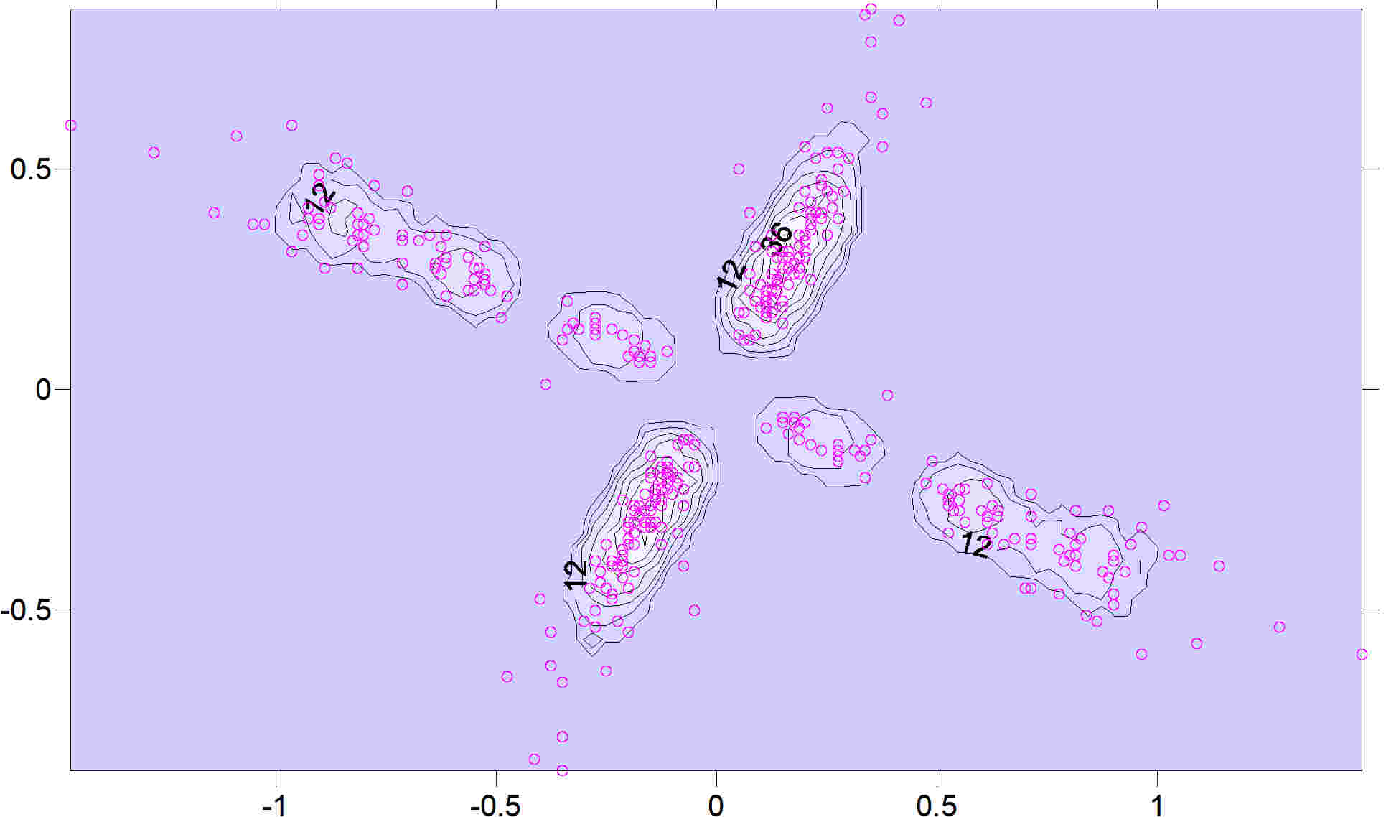
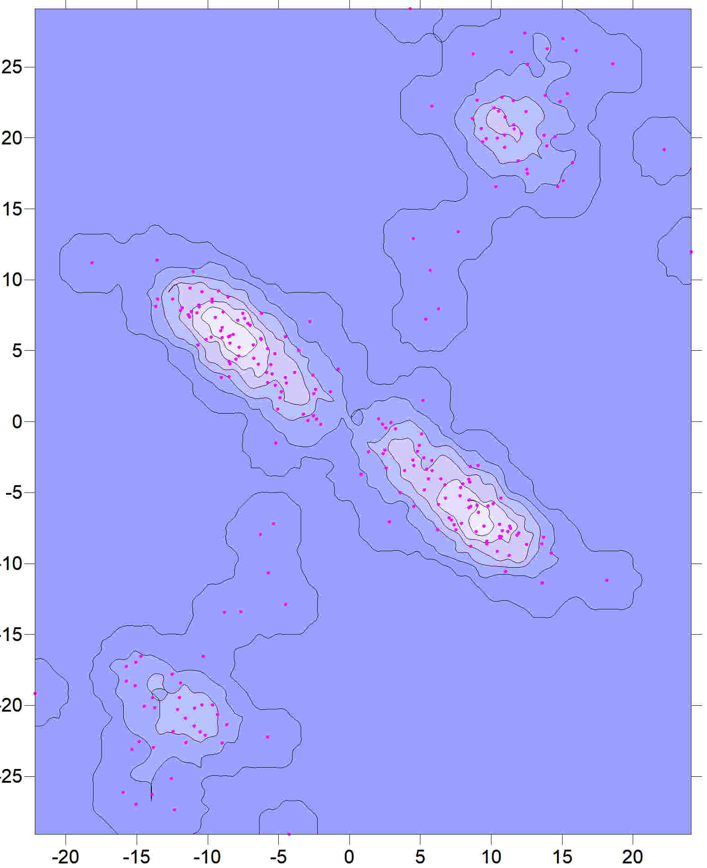
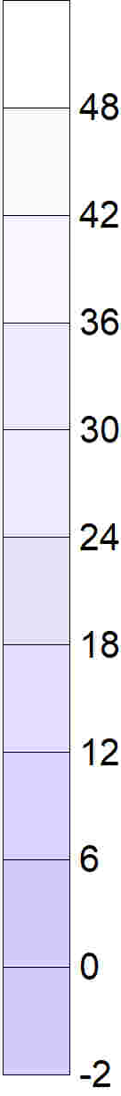
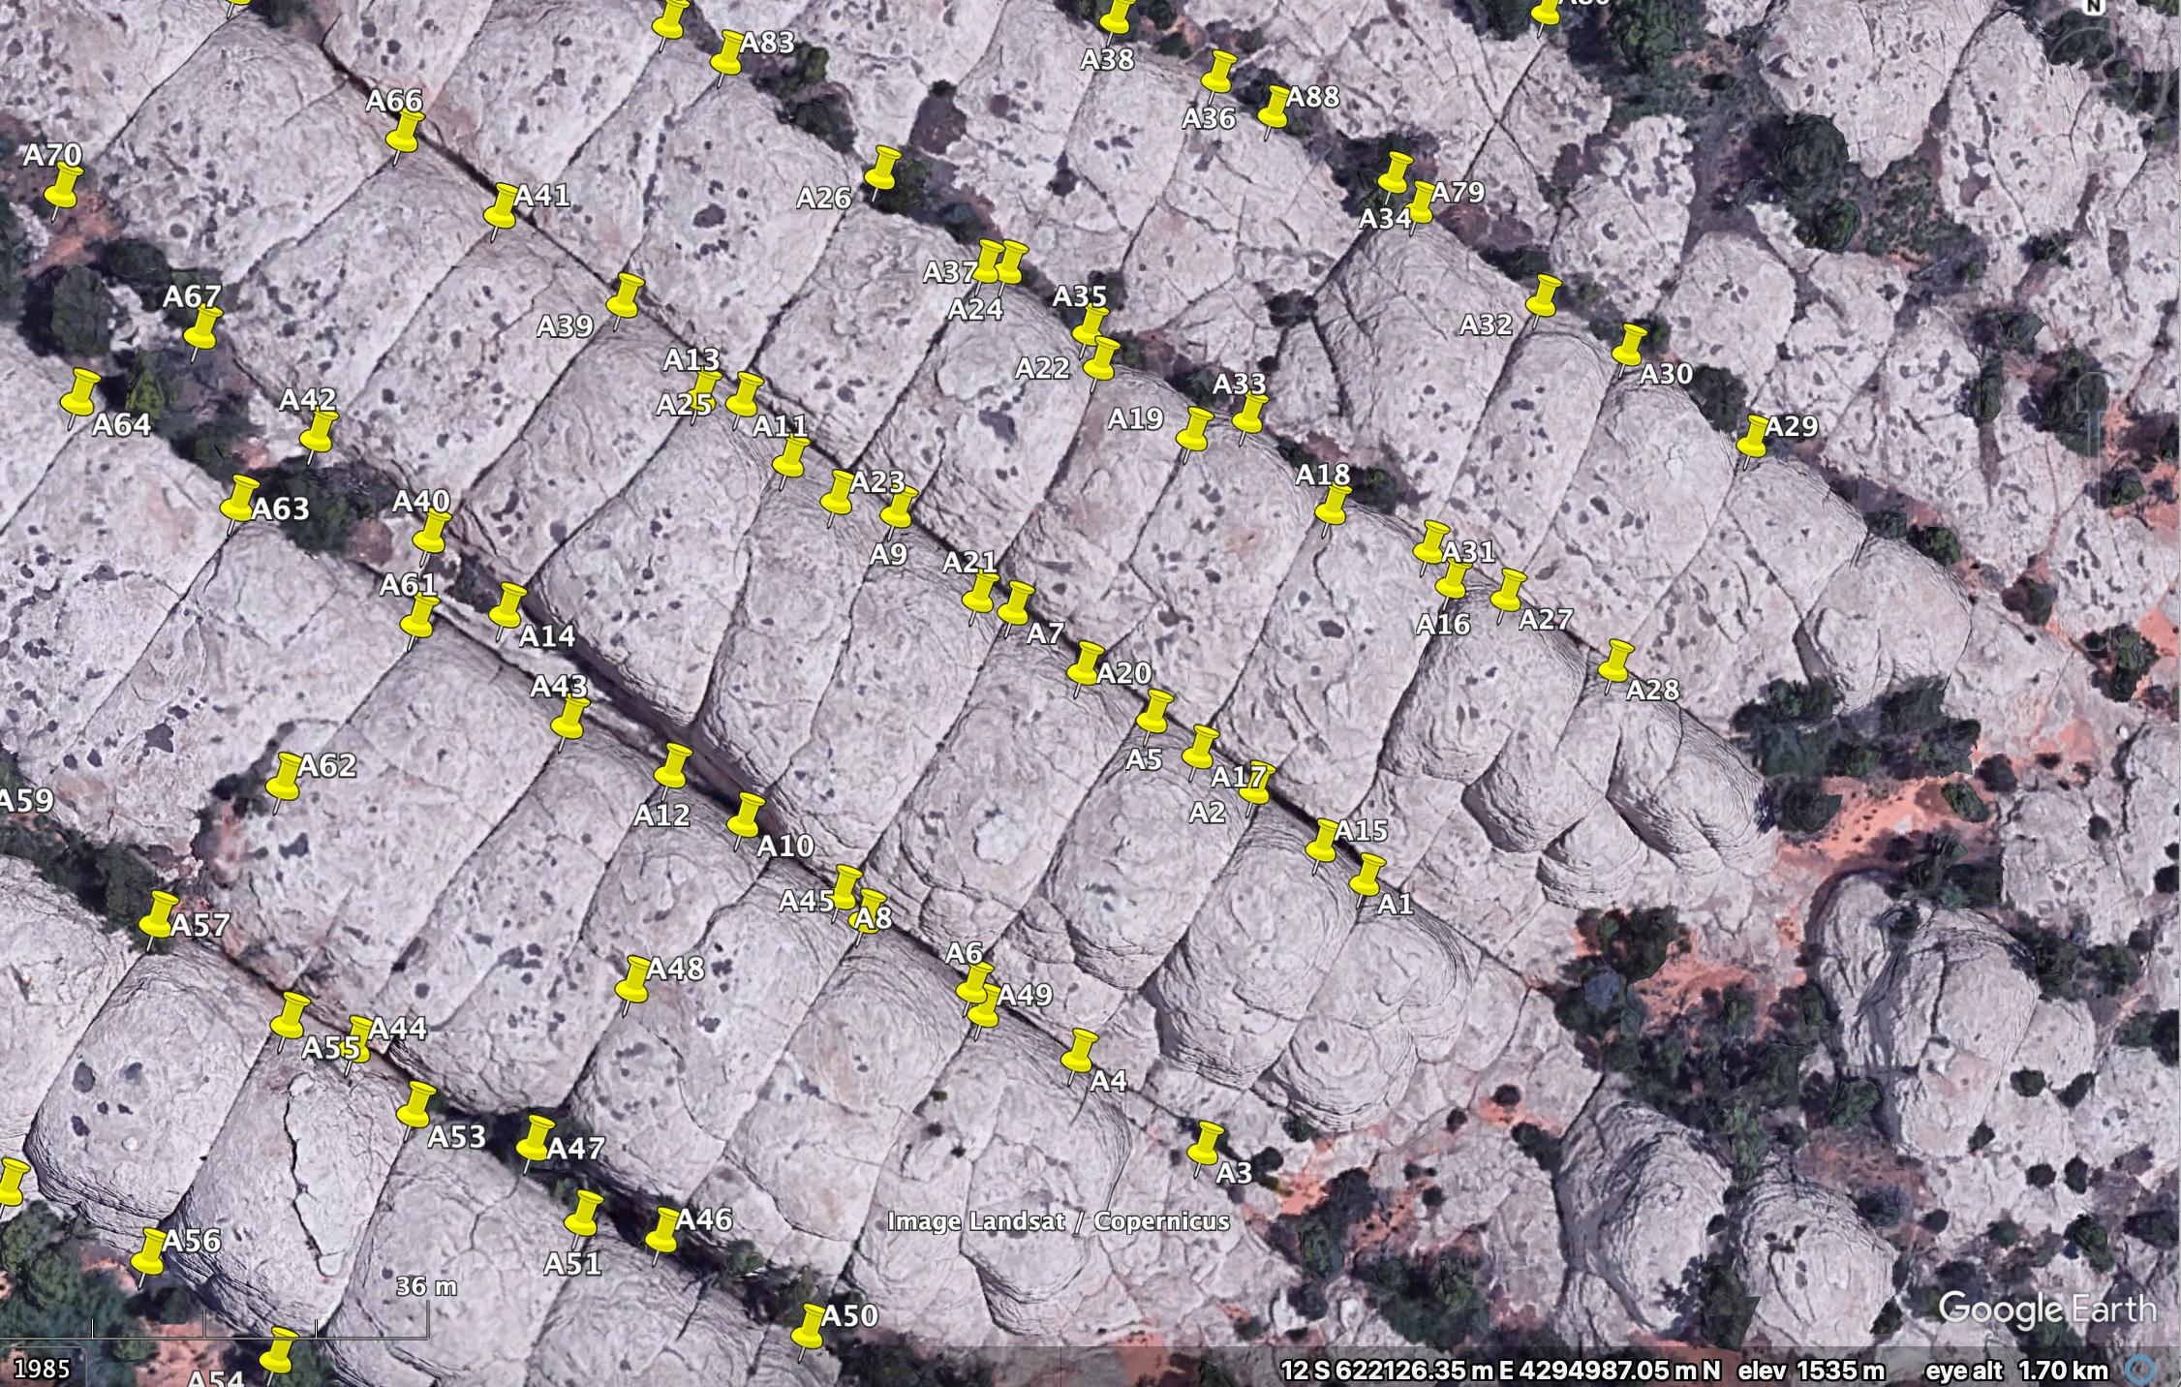
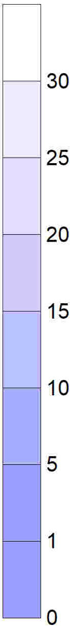
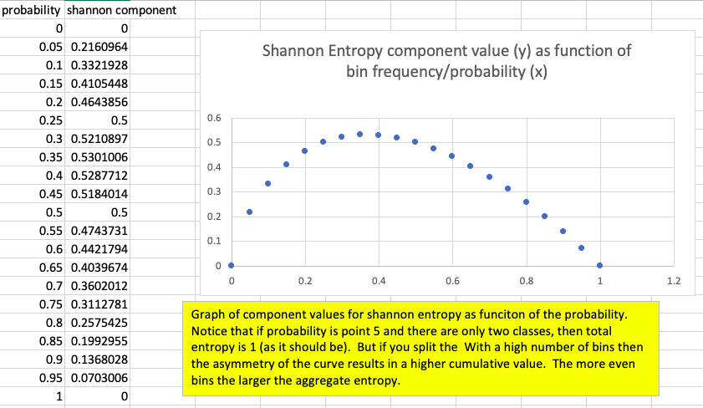
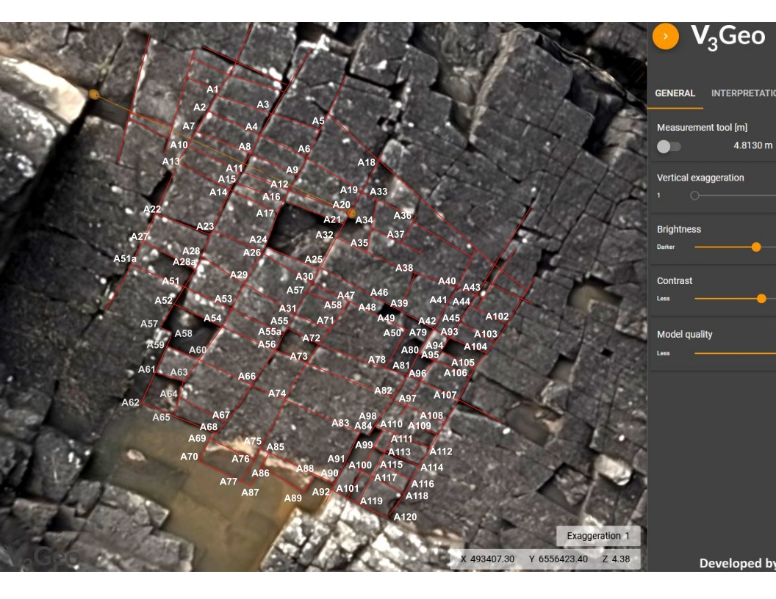
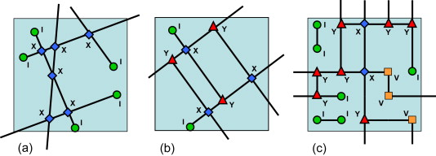
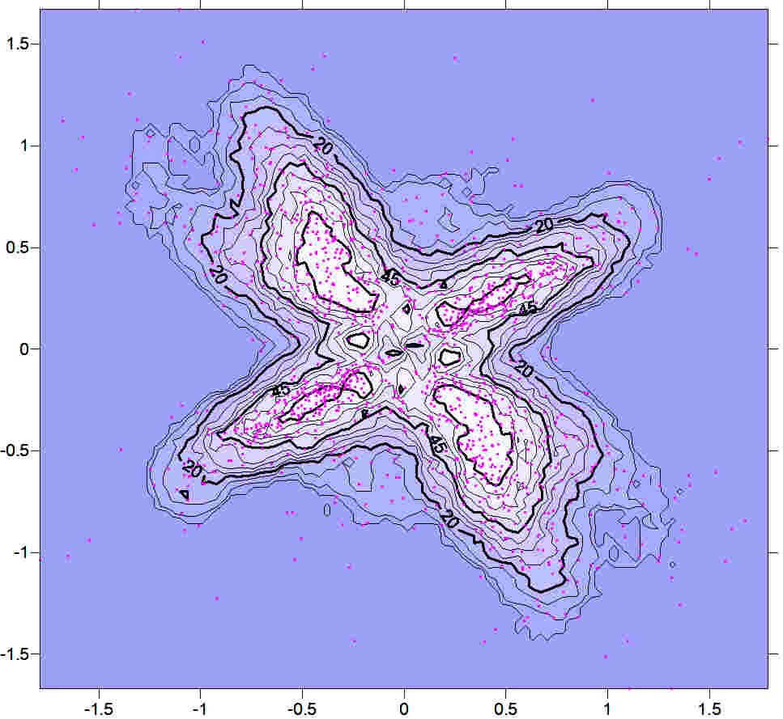

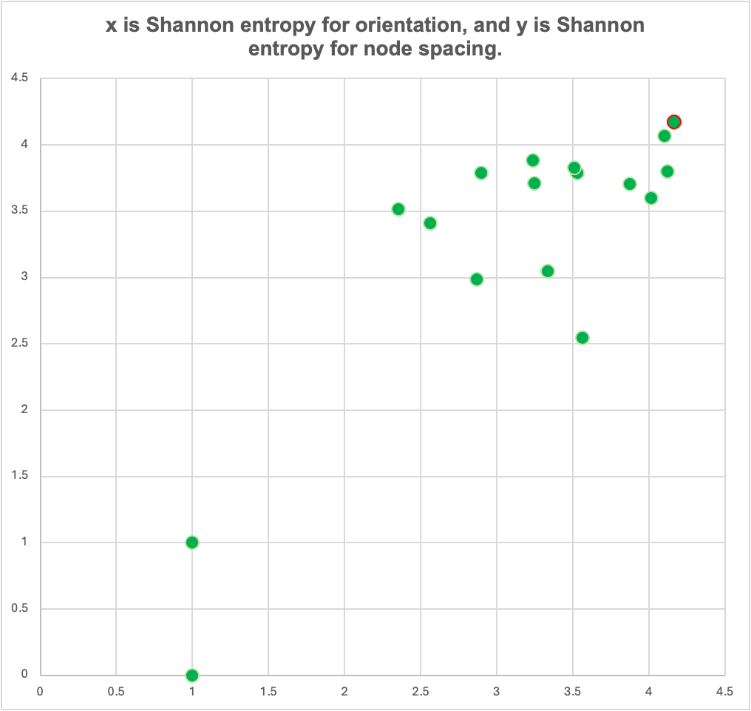
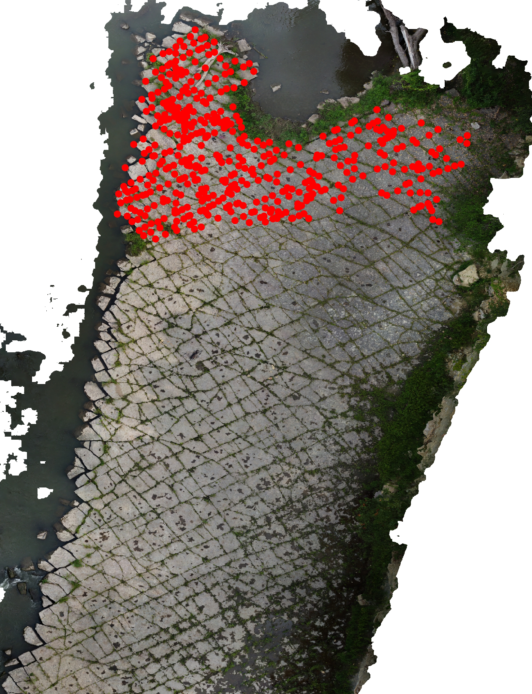
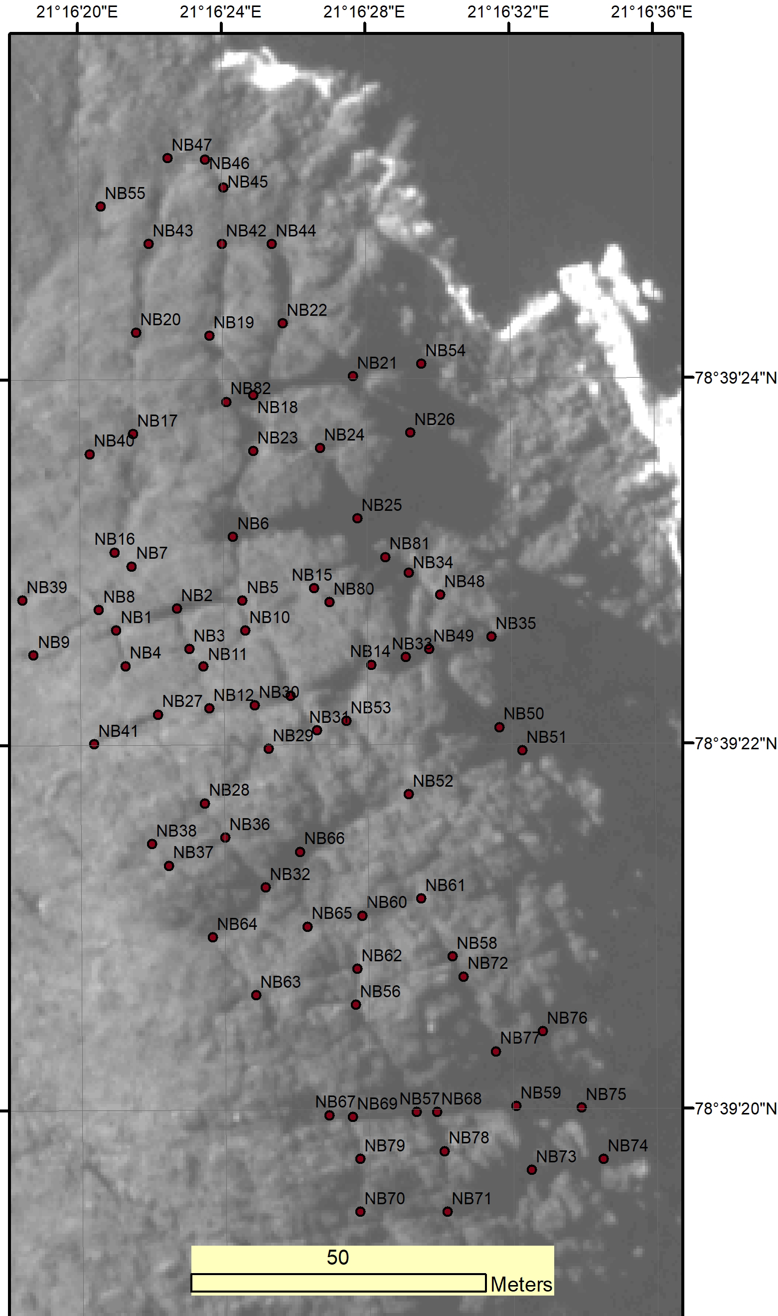
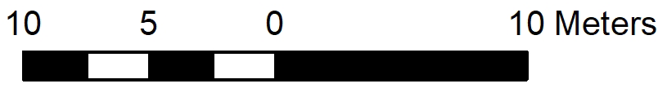
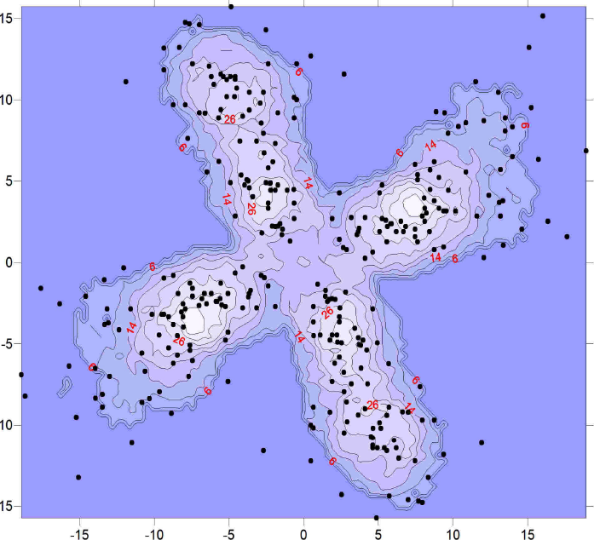

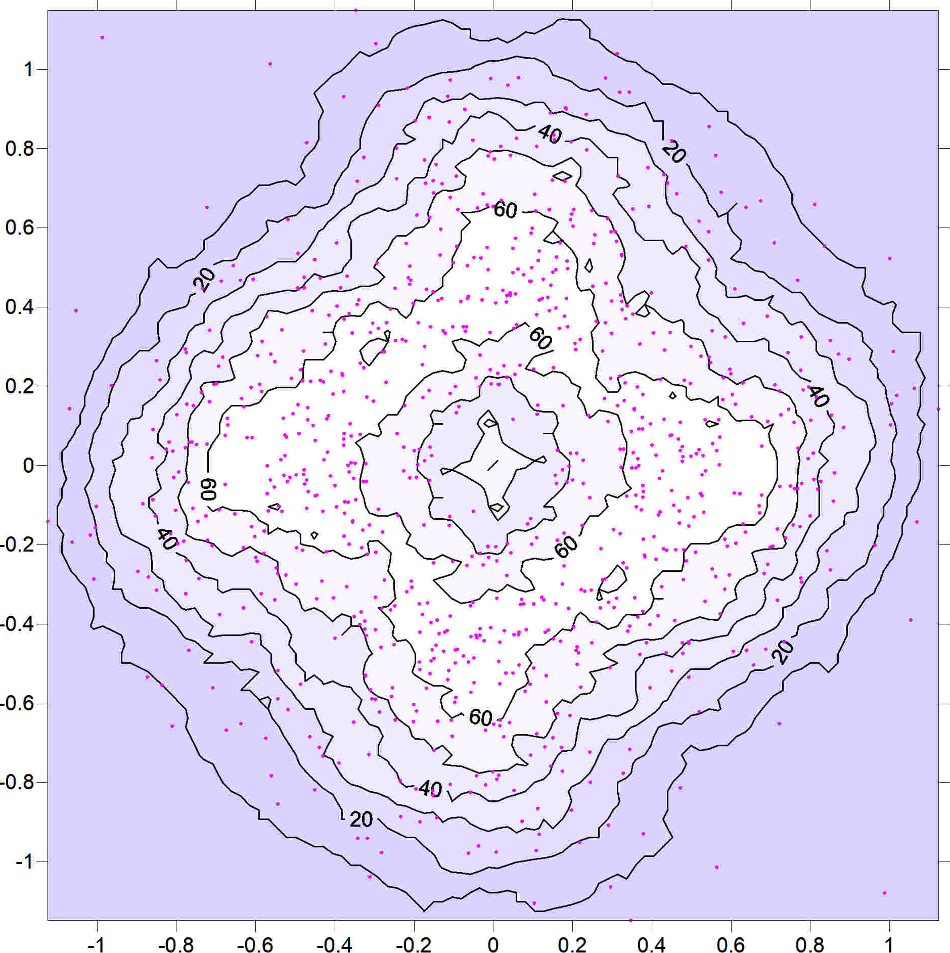
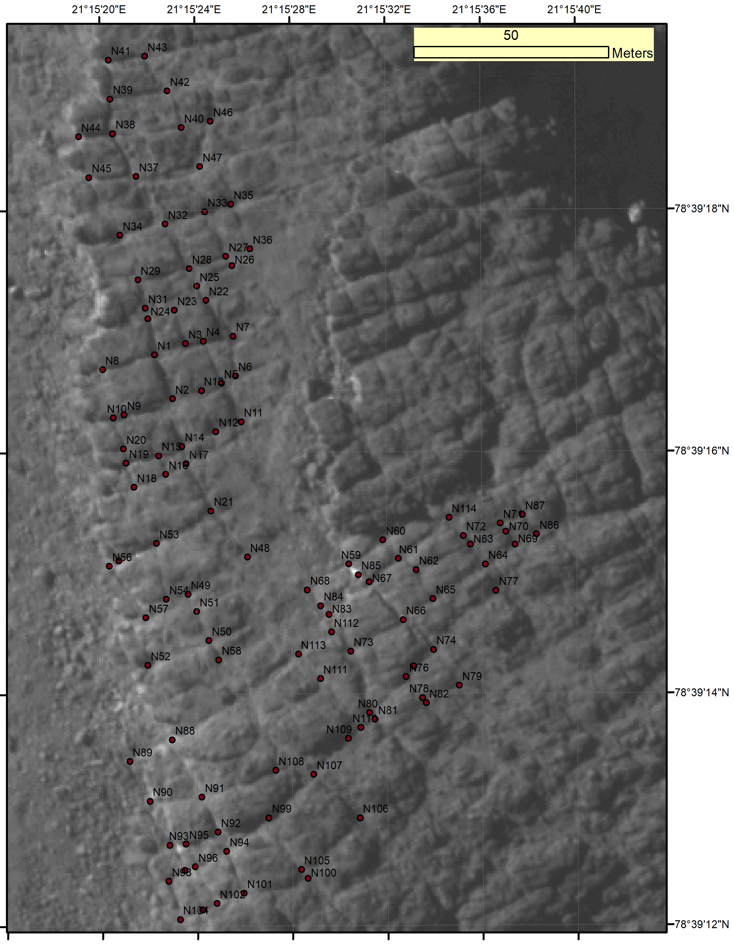
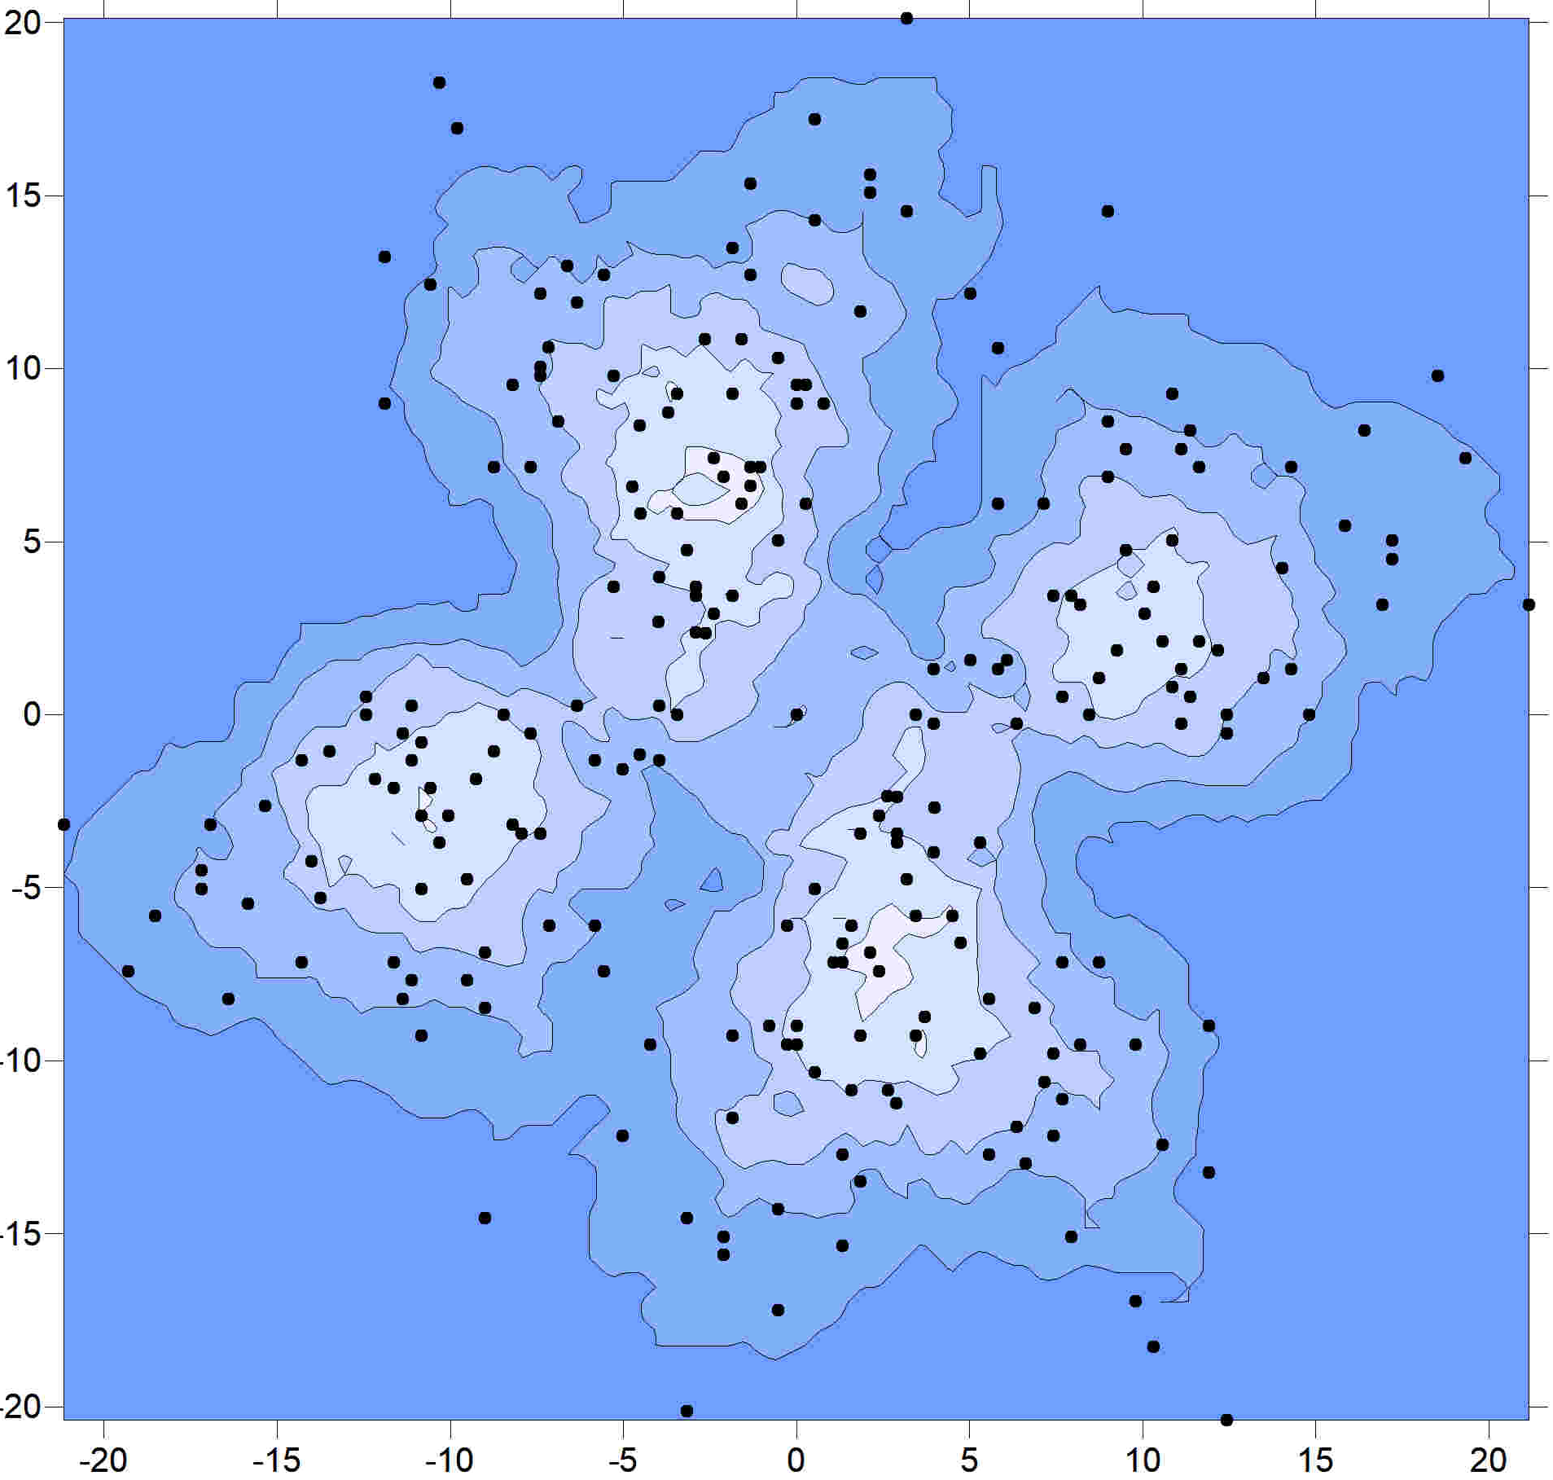
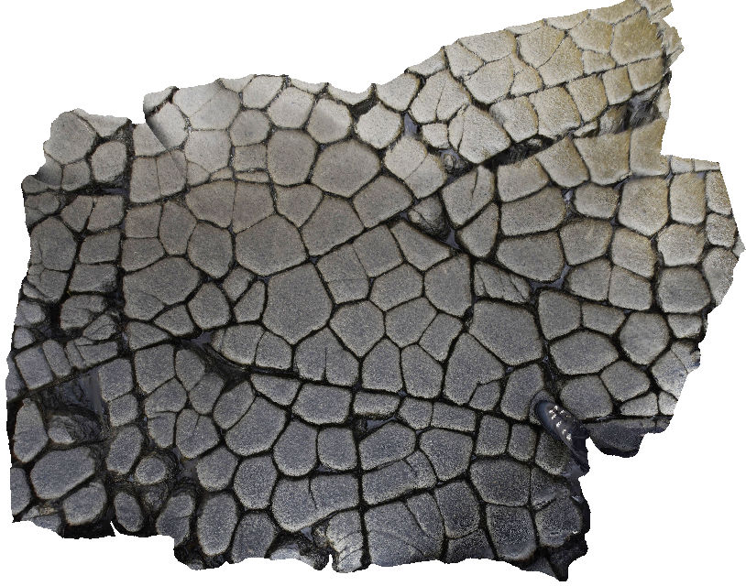
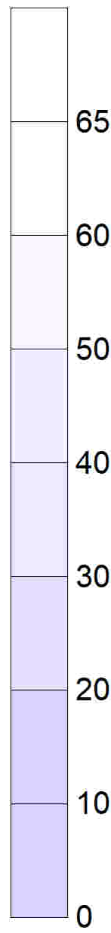
Using relative position direct-link node point clouds to analyze fracture patterns in 2D
Harmon D. Maher, Jr. (harmon_maher@unomaha.edu), Ashley Johnson, and Hazel Higgs
Department of Geography and Geology, University of Nebraska at Omaha
Abstract
Fracture patterns display different types and degrees of organization of both orientation and spacing as influenced by stress fields, stress field evolution, layer thickness, temperatures, and material anisotropies. As an approximation, many fracture patterns in 2D can be characterized by fracture intersection (node) positions and linkages instead of by line segments. Scatter plots of the relative position of directly linked nodes for each node create point clouds, “node fingerprints”, that carry qualitative information about both fracture pattern orientation and spacing in the same plot. Heat maps of point cloud data density aid interpretation. A distinct cluster represents a preferred orientation with consistent spacing. As node spacing variance increases the clusters elongate into a ray or petal. Patterns with random linking orientations but even spacing create more concentric cloud shapes. Patterns also have different degrees of organization manifest as how concentrated or diffuse the cloud points are. Many pattern combinations exist, and plots from different fracture patterns appear visually distinct. The degree of organization of the linking orientations and of the node spacings can be quantified by comparing an observed distribution against a random/uniform distribution in some manner. At present we are using Shannon (information) entropy values applied to discrete bins of observed values of linked node orientations and distances. Since results are a function of bin architecture, for comparison purposes we consistently use 18 bins. For the spacing distribution the bin structure and hence results are sensitive to selected range and to larger outliers. An overall Shannon entropy value for the point cloud can be computed, but looking at spacing and linking-orientation separately has utility given these two parameters are influenced by different factors. These plots and Shannon entropy values provide qualitative and quantitative spaces for comparing different fracture patterns, or the change of a fracture pattern within an area. Results from real world fracture patterns suggest that significant amounts of disorganization exist in many fracture patterns, especially in node spacing.
more organized?
How to quantify the degree of organization?
Shannon entropy, H
H(x)​=−∑_{i=1 to n​}[P(x_{i}​)⋅log_{b}​P(x_{i}​)]
=∑_{i=1 to n​}[P(x_{i}​)⋅log_{b}​(1/P(x_{i}​)​]​
where:
∑_{i=1 to n​} is a summation operator for probabilities from i to n.
P(x_{i}) is the frequency of a single event/bin in a discretized distribution.
If b is 2 (base 2) then units are Shannons, the units used here.
Sensitive to # of bins & bin range.
Basically, the entropy measure is for that specific bin array.
18 bins are used here, with a max value entropy of 4.1368.
Romna, Orkney site, 126 nodes, heat map search radius .2 m
Arches ladder plot
91 nodes
heat map search radius = 2 m
Node plot for a grid-like orthogonal joint pattern in Devonian sandstones coast outcrops at Romna, Orkney. Imagery from V₃Geo website, 124 nodes.
quantify?
N
Graph of contribution of a bin proportion to overall H. 2 bins at 50% is 1, 5 bins at 20% is 2.32. Bin value uniformity = max entropy.
Node plot for a ladder pattern of longitudinal and cross joints in the Moab Tongue Member in Arches National Park, Utah.
Factors that influence orientation H?
stress field, loading history
# of fracture episodes, saturation?
previous anisotropy
Factors that influence spacing H?
layer thickness, thinner lower H.
propagation mode (critical vs. sub-critical, Olson ??)
initial spacing distribution of ‘seed’ micro-flaws
fracture interaction (grow through or not)
nodes?
East Nishnabota, Iowa, thick limestone bed, 477 nodes, heat map search radius .2 m
NodeID | NodeLinkA | NodeLinkB | NodeLinkC | NodeLinkD | UTMX | UTMY
N2 | N1 | N5 | N7 | N35 | 324523.871 | 4573824.836
N1 | N2 | N3 | N17 | N15 | 324525.121 | 4573823.791
N3 | N1 | N8 | N9 |  | 324524.112 | 4573822.927
N5 | N2 | N8 | N39 | N37 | 324523.088 | 4573824.443
N7 | N2 | N6 | N34 |  | 324524.453 | 4573825.266
Node types (terminations as I, X, Y I type) or bend (V type) taken from Sanderson and Nixon 2015 (their figure 2).
Example of portion of data set for East Nishnabotna River outcrop in Iowa (plot to right) used to calculate relative position of paired nodes, linked strikes & distances.
maximum entropy 18 bins
Arches ladder
Kunashir
Romna Orkney
comparing?
Nishnabotna
Svalbard diabase sill
heat map search diameter 5 m
minimum entropy for a rectangular grid
Node plot of more complicated fracture pattern with 3 well developed preferred orientations. Resolution of 3D model is several cms.
minimum entropy for a square grid
exclusion zone
possible spacing node?
Kunashir
heat map
305 nodes
search radius .2 m
less organized?
Graph comparing 14 different fracture patterns Shannon entropy values.
nodes plots?
Conclusions
Point clouds of relative positions of directly linked fracture nodes help characterize fracture preferred orientations, node spacing distributions, and the degree of organization.
Fracture patterns vary considerably in their degree of organization.
Shannon Entropy may provide a quantitative measure of the degree of organization in a suite of histogram bins derived from some aspect of a fracture pattern, such as orientation or spacing, allowing for fracture pattern comparison.
Binned distributions from natural fracture patterns often indicate substantial entropy. Fracture patterns may be less ordered than often assumed.
different patterns
Above: node ‘fingerprint plot. Contours are data density ‘heat maps’. Green dashed lines - point cloud ‘rays’ of a preferred orientation, here a sub-orthogonal set. The ray spread (green arcs) reflects variance of a preferred orientation. Larger variance is a lower degree of organization. The points along a ray reflects the node spacing distribution, with a cluster (e. g. dashed blue circle) reflecting a mode. A zone of exclusion at the origin reflects either imagery resolution (likely in this case), or fracture and node ‘avoidance’ of other nodes.
same unit
Acknowledgments: This work was supported by American Chemical Society Petroleum - Research Funding. PRF# 59648-UR8. Rebecca McDougal and Olivia MacArthur helped with data collection, University of Nebraska at Omaha provided travel support. Thanks to V3GEO (https://v3geo.com/) for providing access to a rich array of 3D models.
Image from online 3D model: Sergey Kotov (https://imaggeo.egu.eu/user/kotov/), CC BY 3.0 <https://creativecommons.org/licenses/by/3.0>, via Wikimedia Commons
References
Olson, Jon E.. “Predicting fracture swarms — the influence of subcritical crack growth and the crack-tip process zone on joint spacing in rock.” Geological Society, London, Special Publications 231 (2004): 73 - 88.
David J. Sanderson, Casey W. Nixon, The use of topology in fracture network characterization, Journal of Structural Geology, Volume 72, 2015, Pages 55-66, ISSN 0191-8141, https://doi.org/10.1016/j.jsg.2015.01.005.
Danielle Pedretti & Marco Bianchi, 2022, GEOENT: A toolbox for Calculating Directional Geologic Entropy; Geosciences, 12, 206,
Node plot for columnar joints. Interpretation of a high-resolution 3D model (Sergey Kotov). Polygon sides of variable length. Perhaps weak preferred orientation from more through going fractures.

