Slide 1



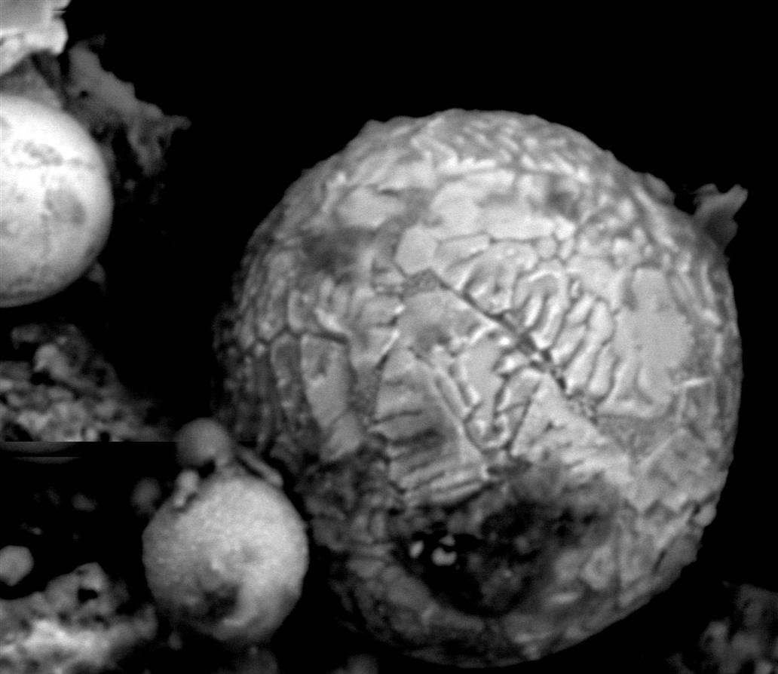
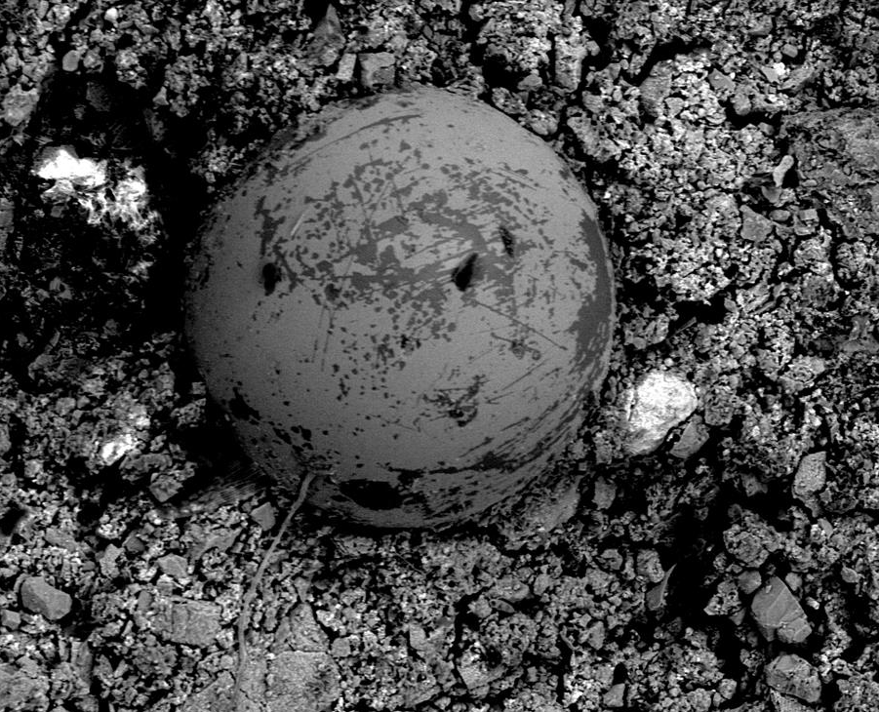
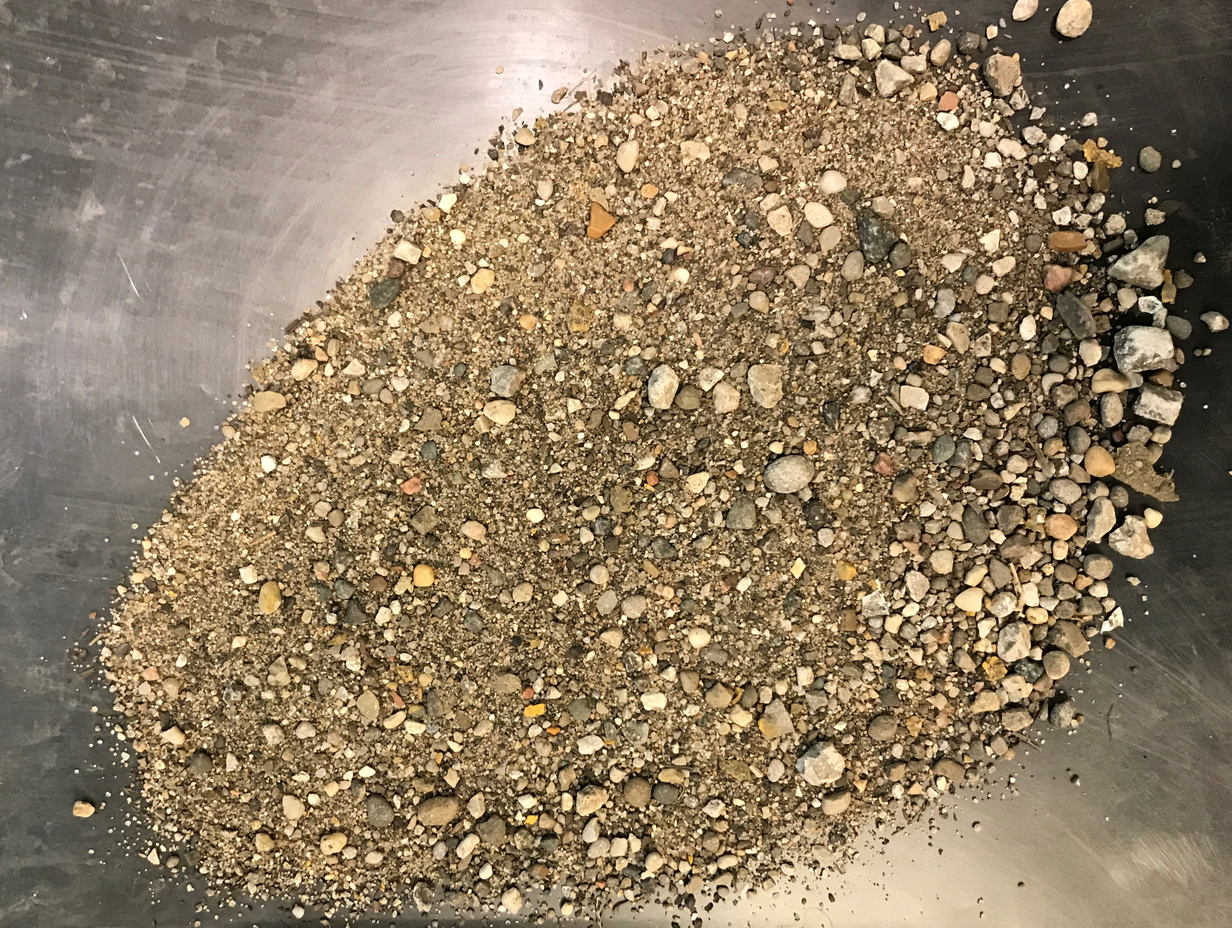
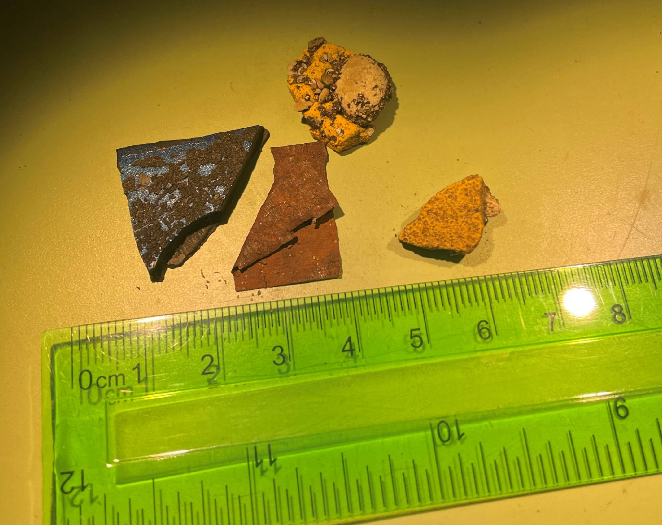
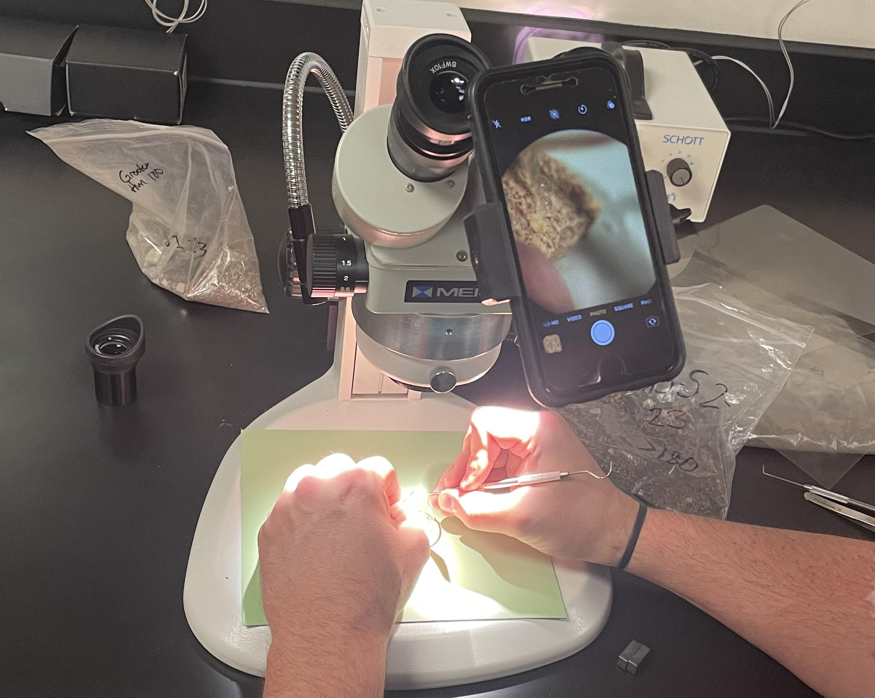
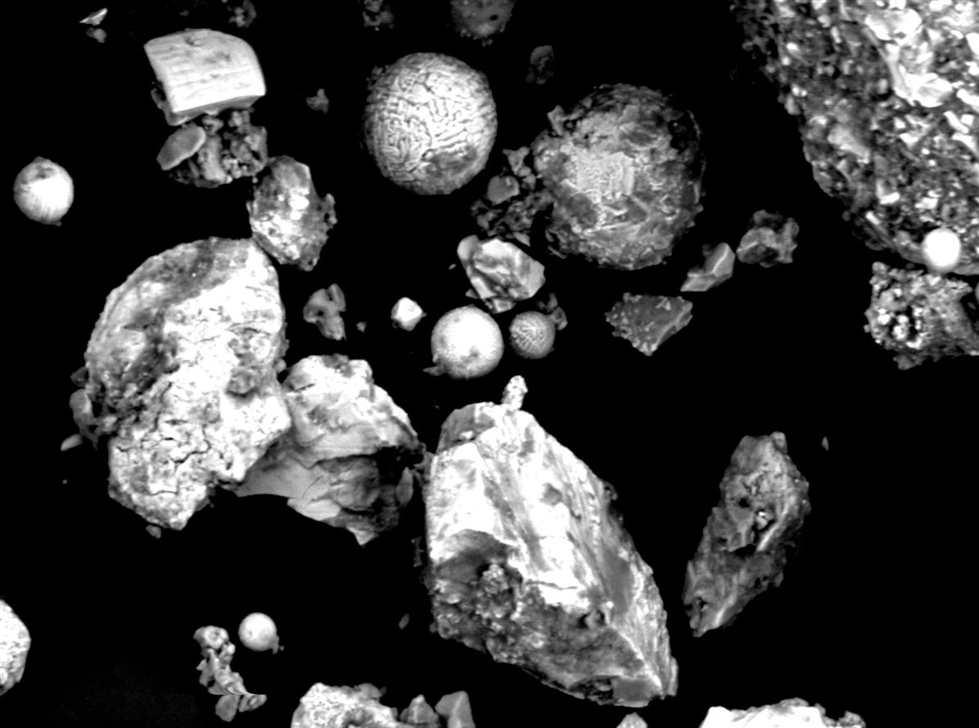
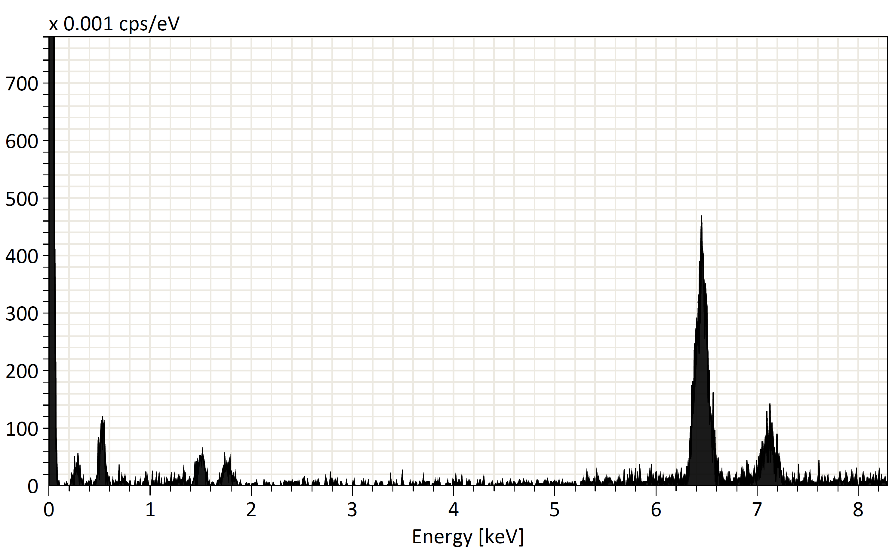
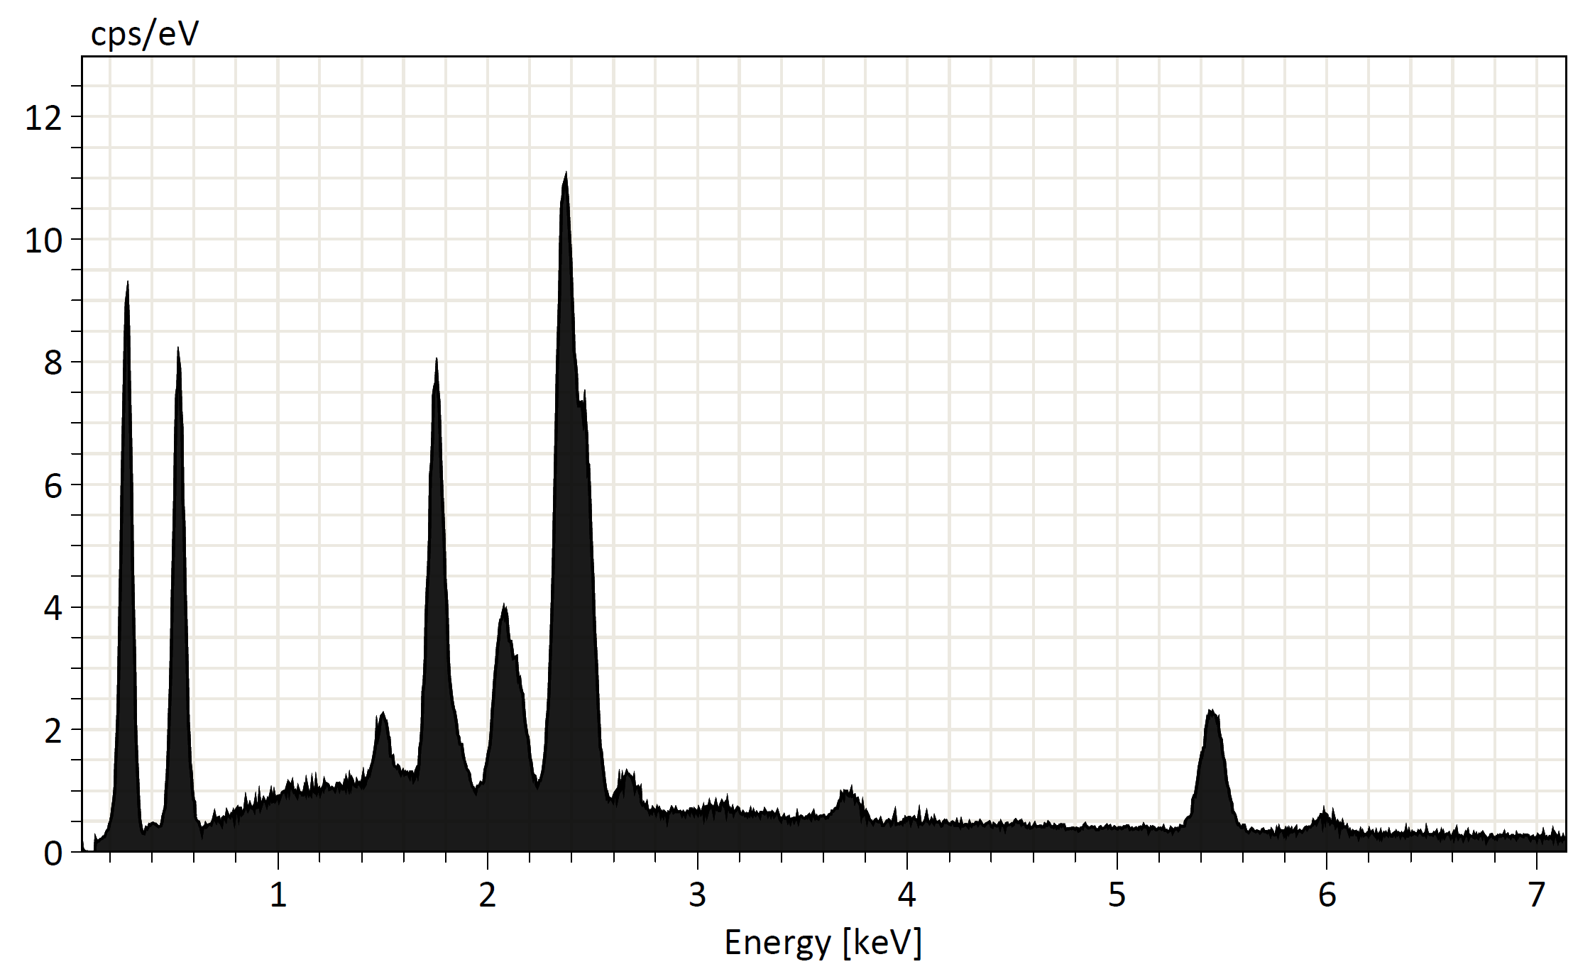
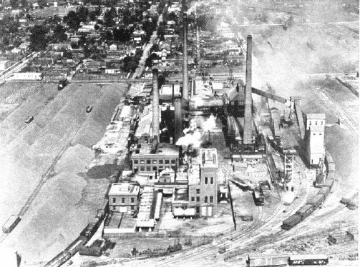
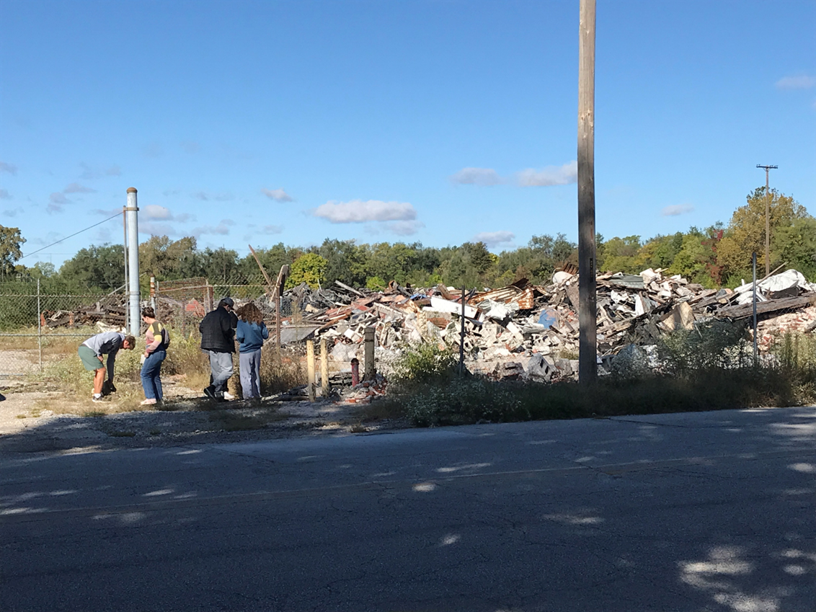
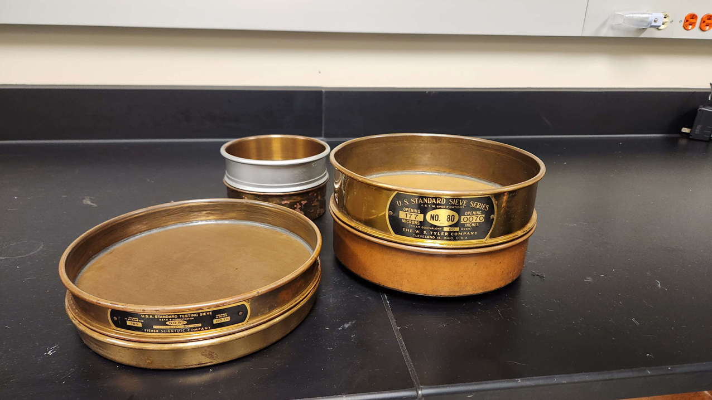
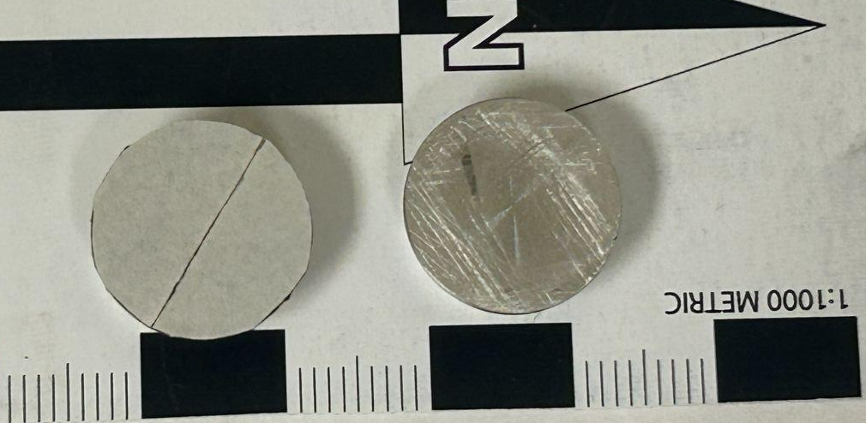
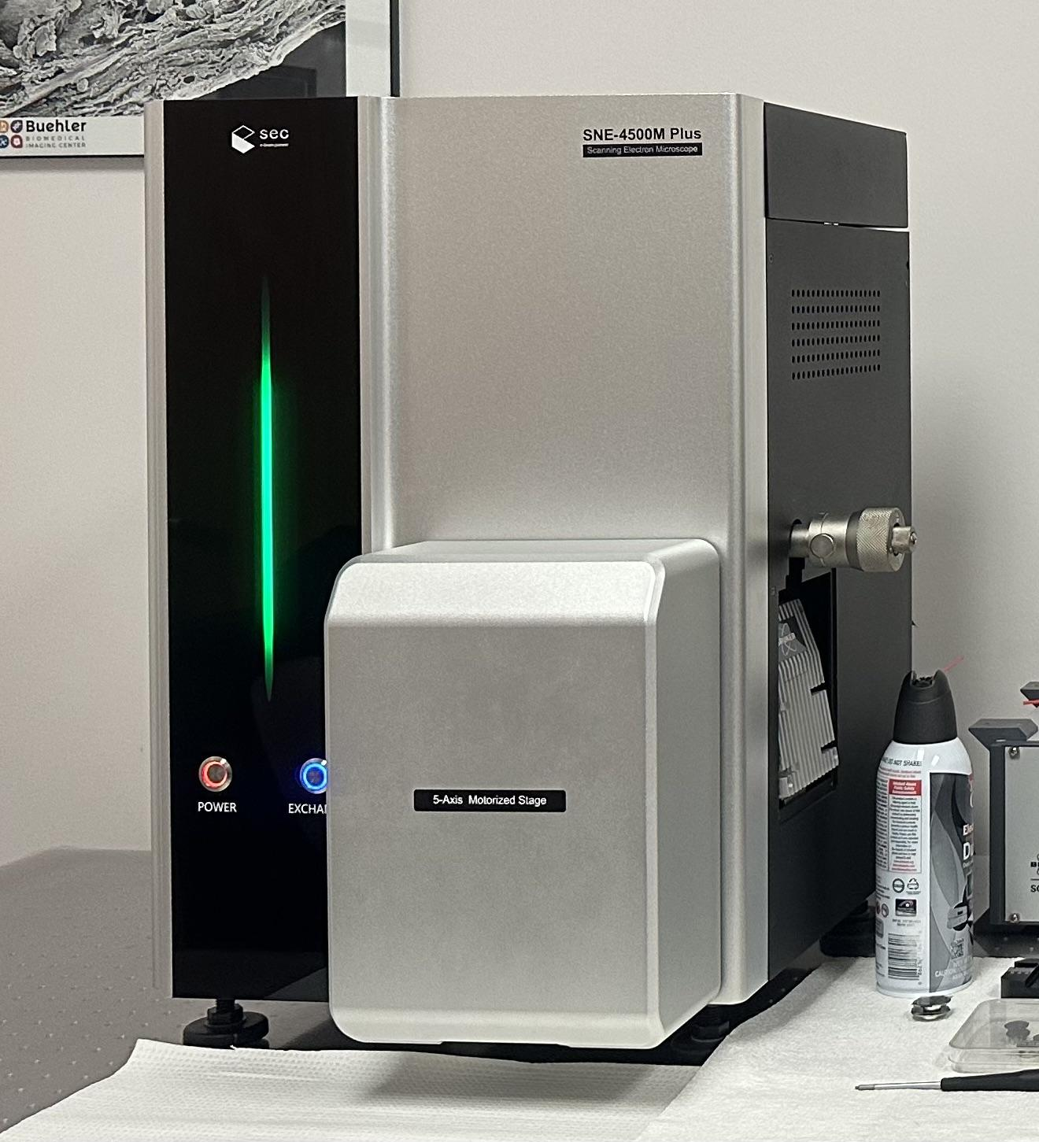
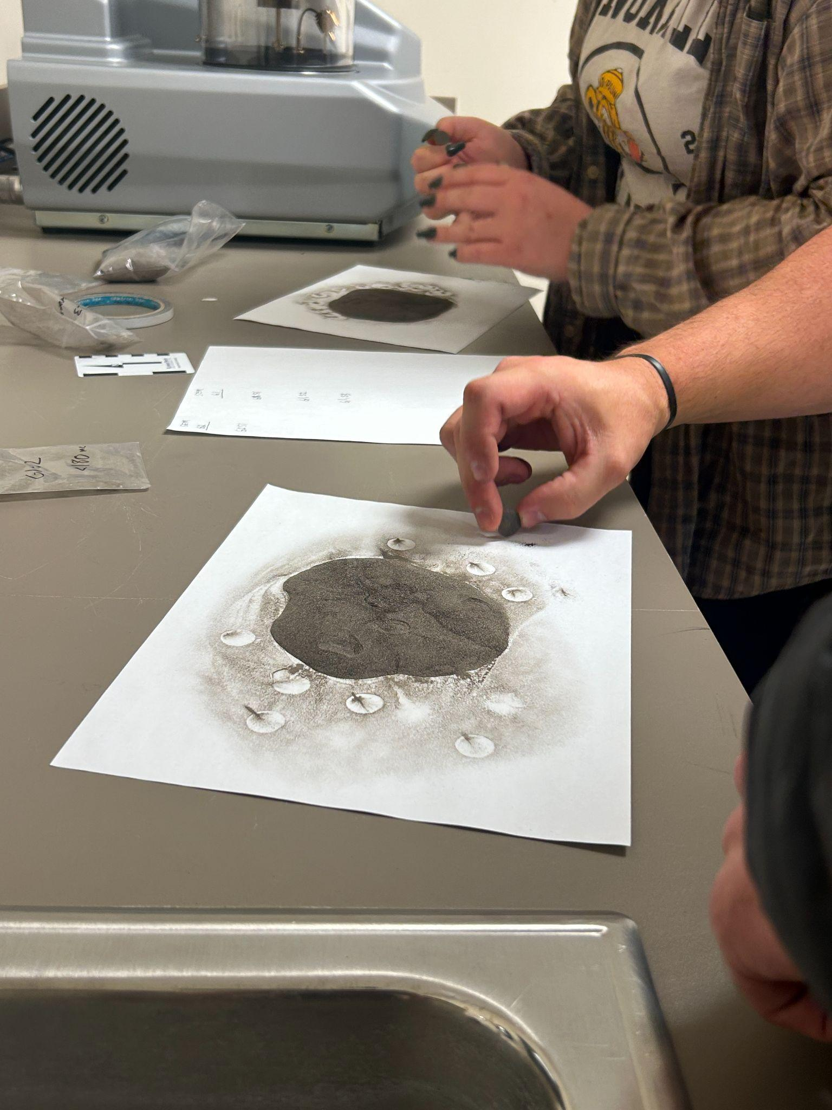
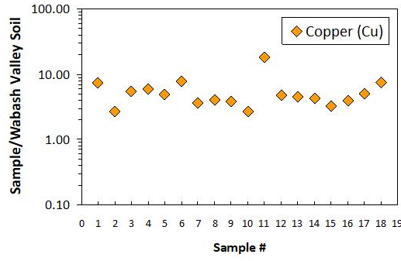
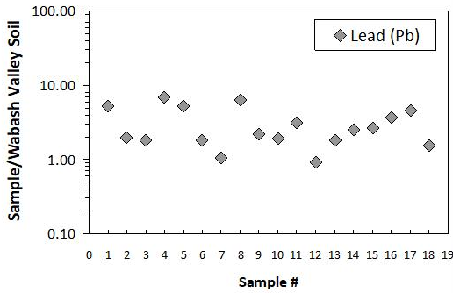
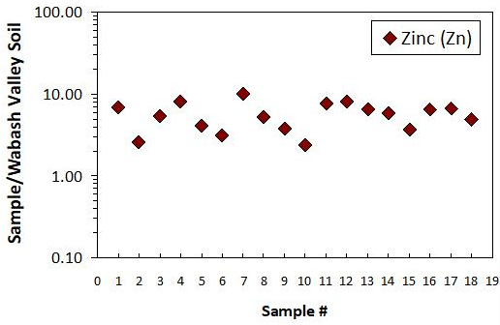
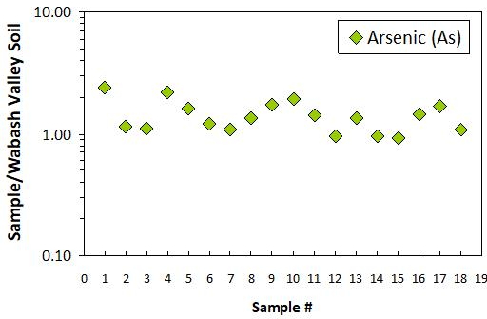
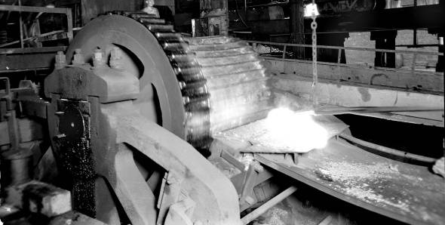
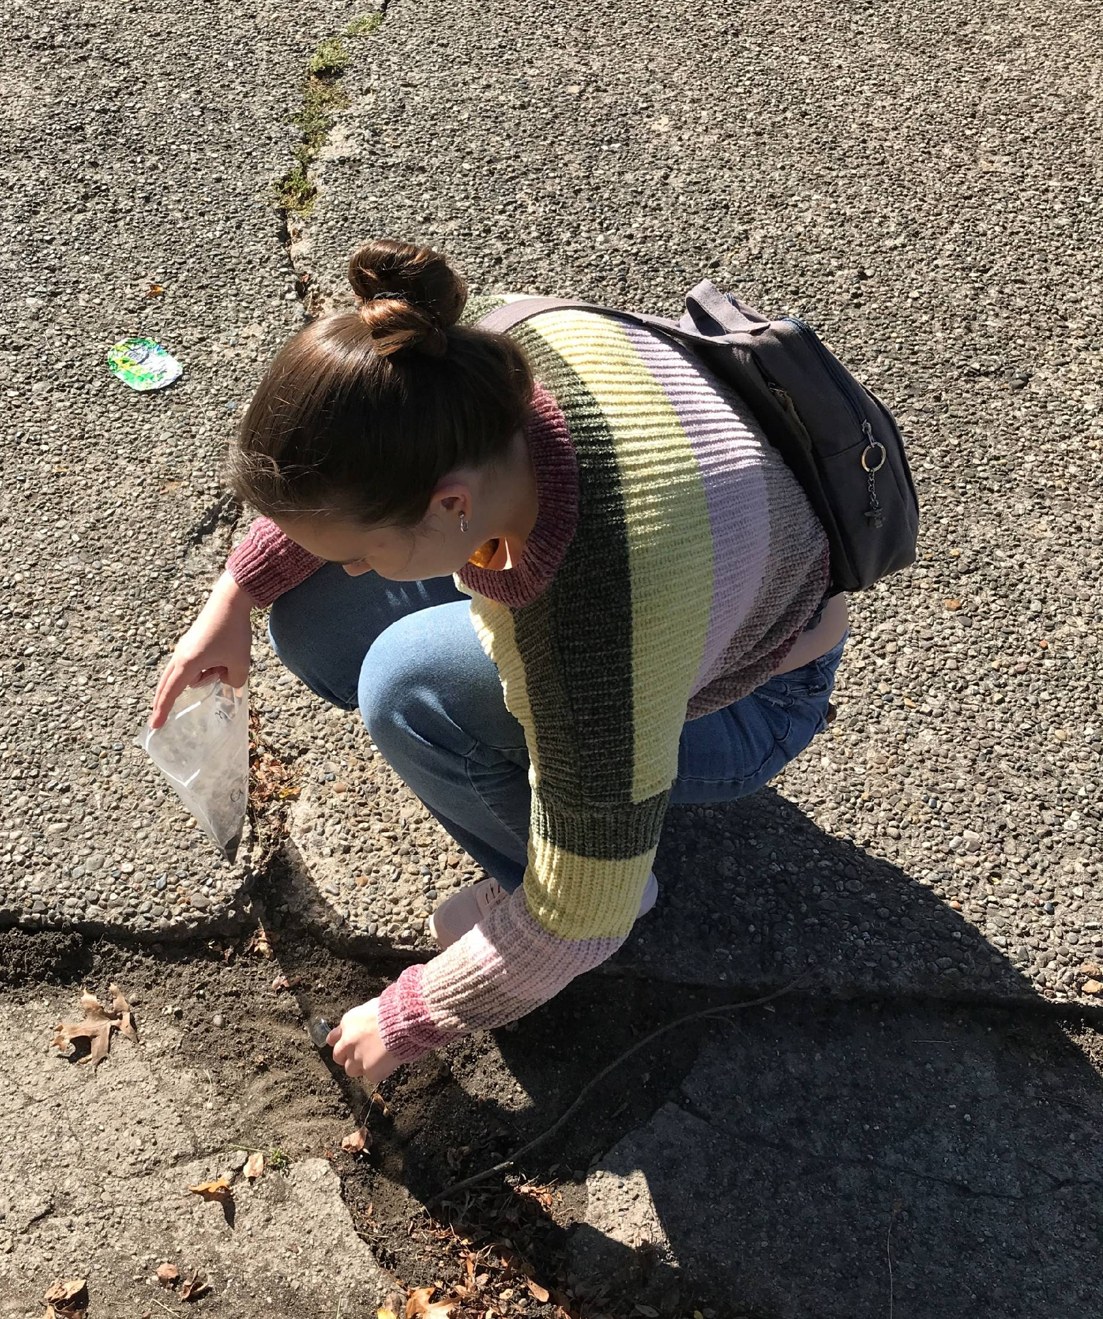
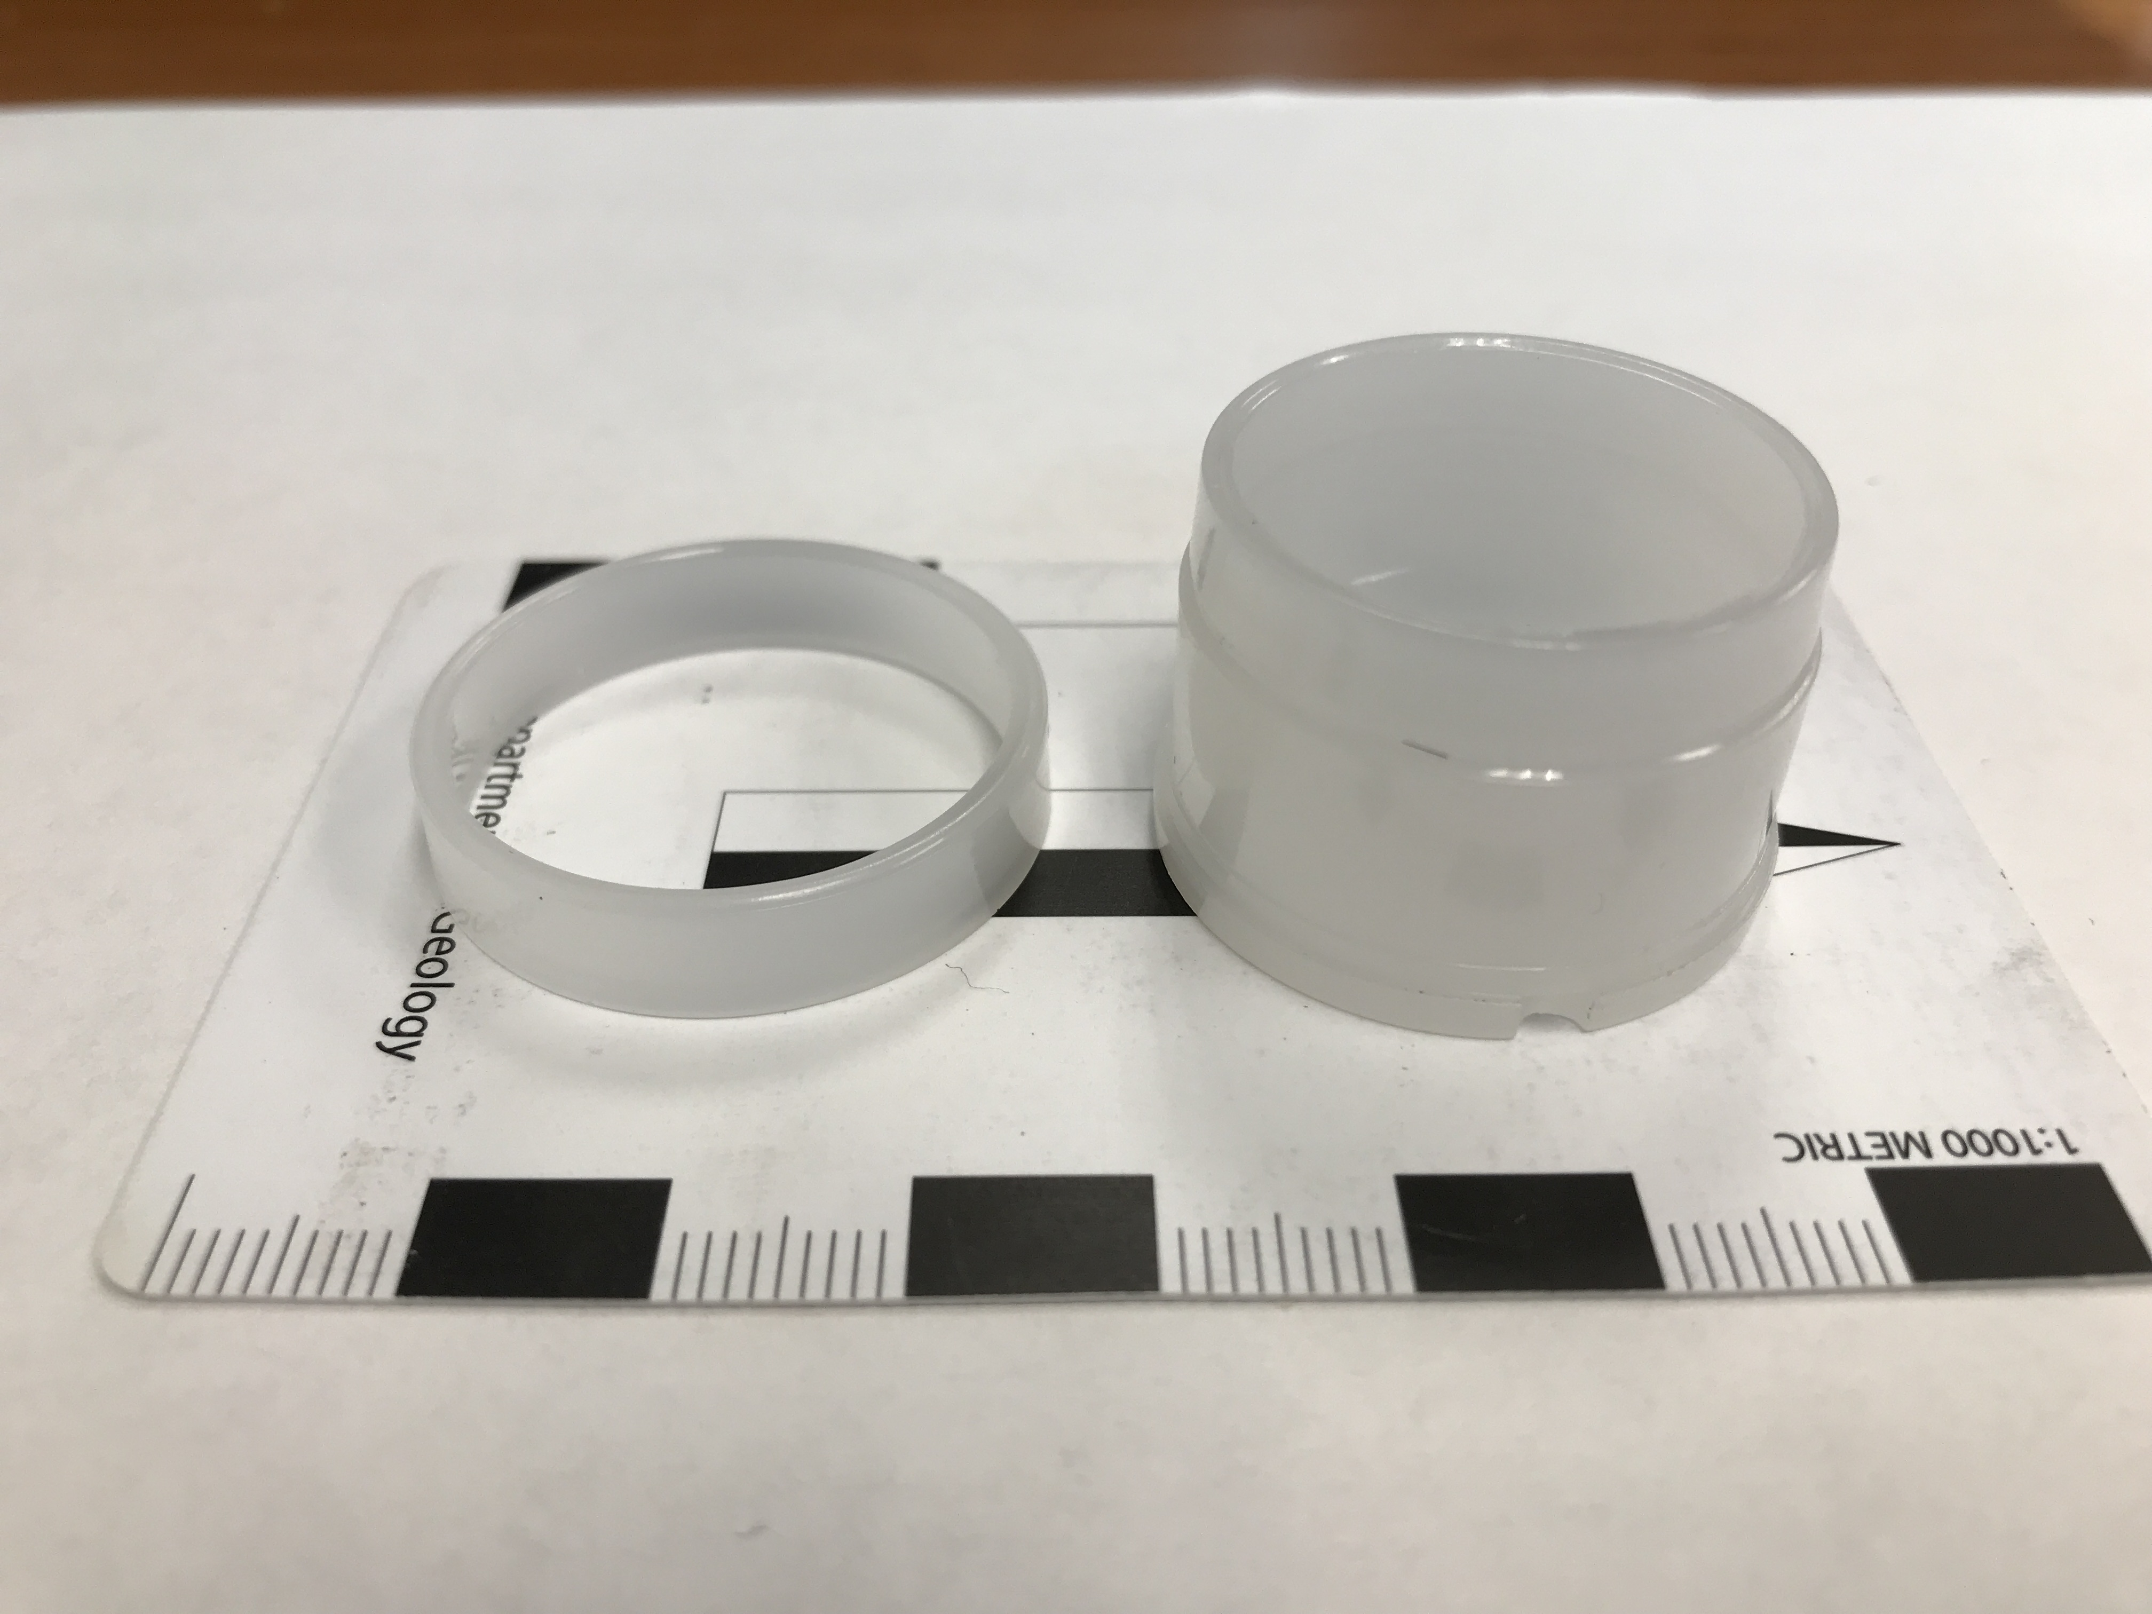

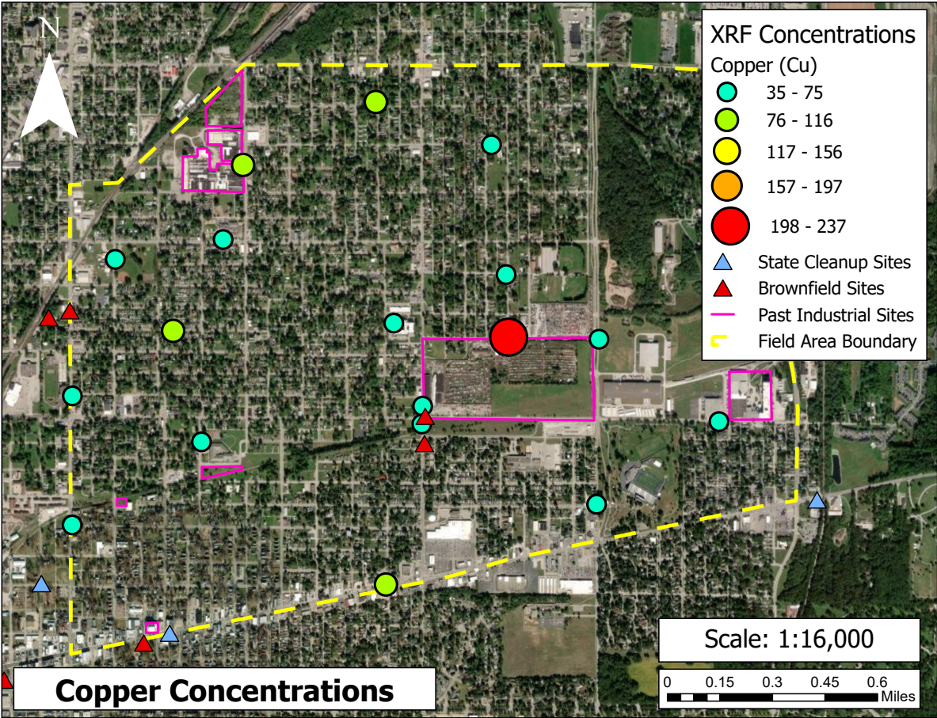
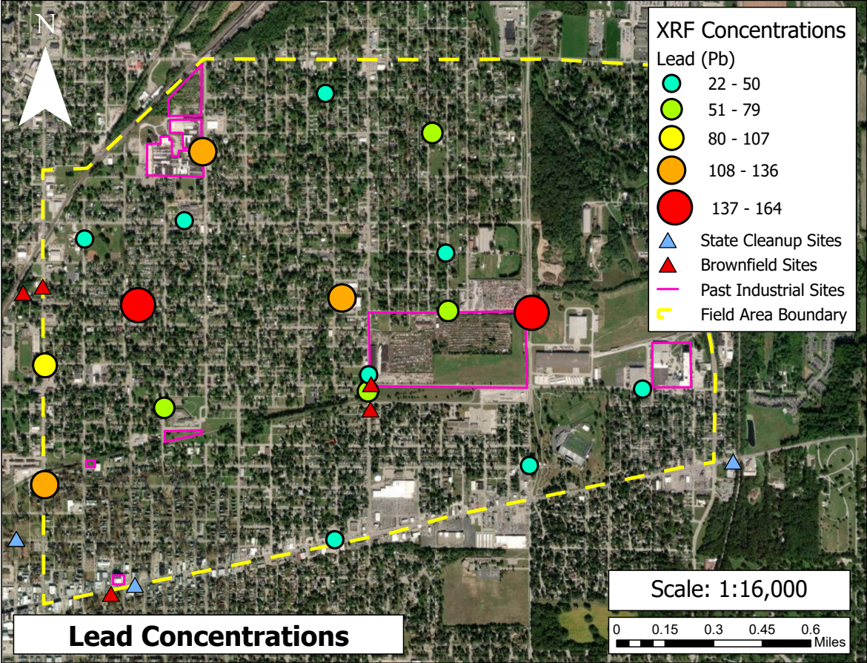
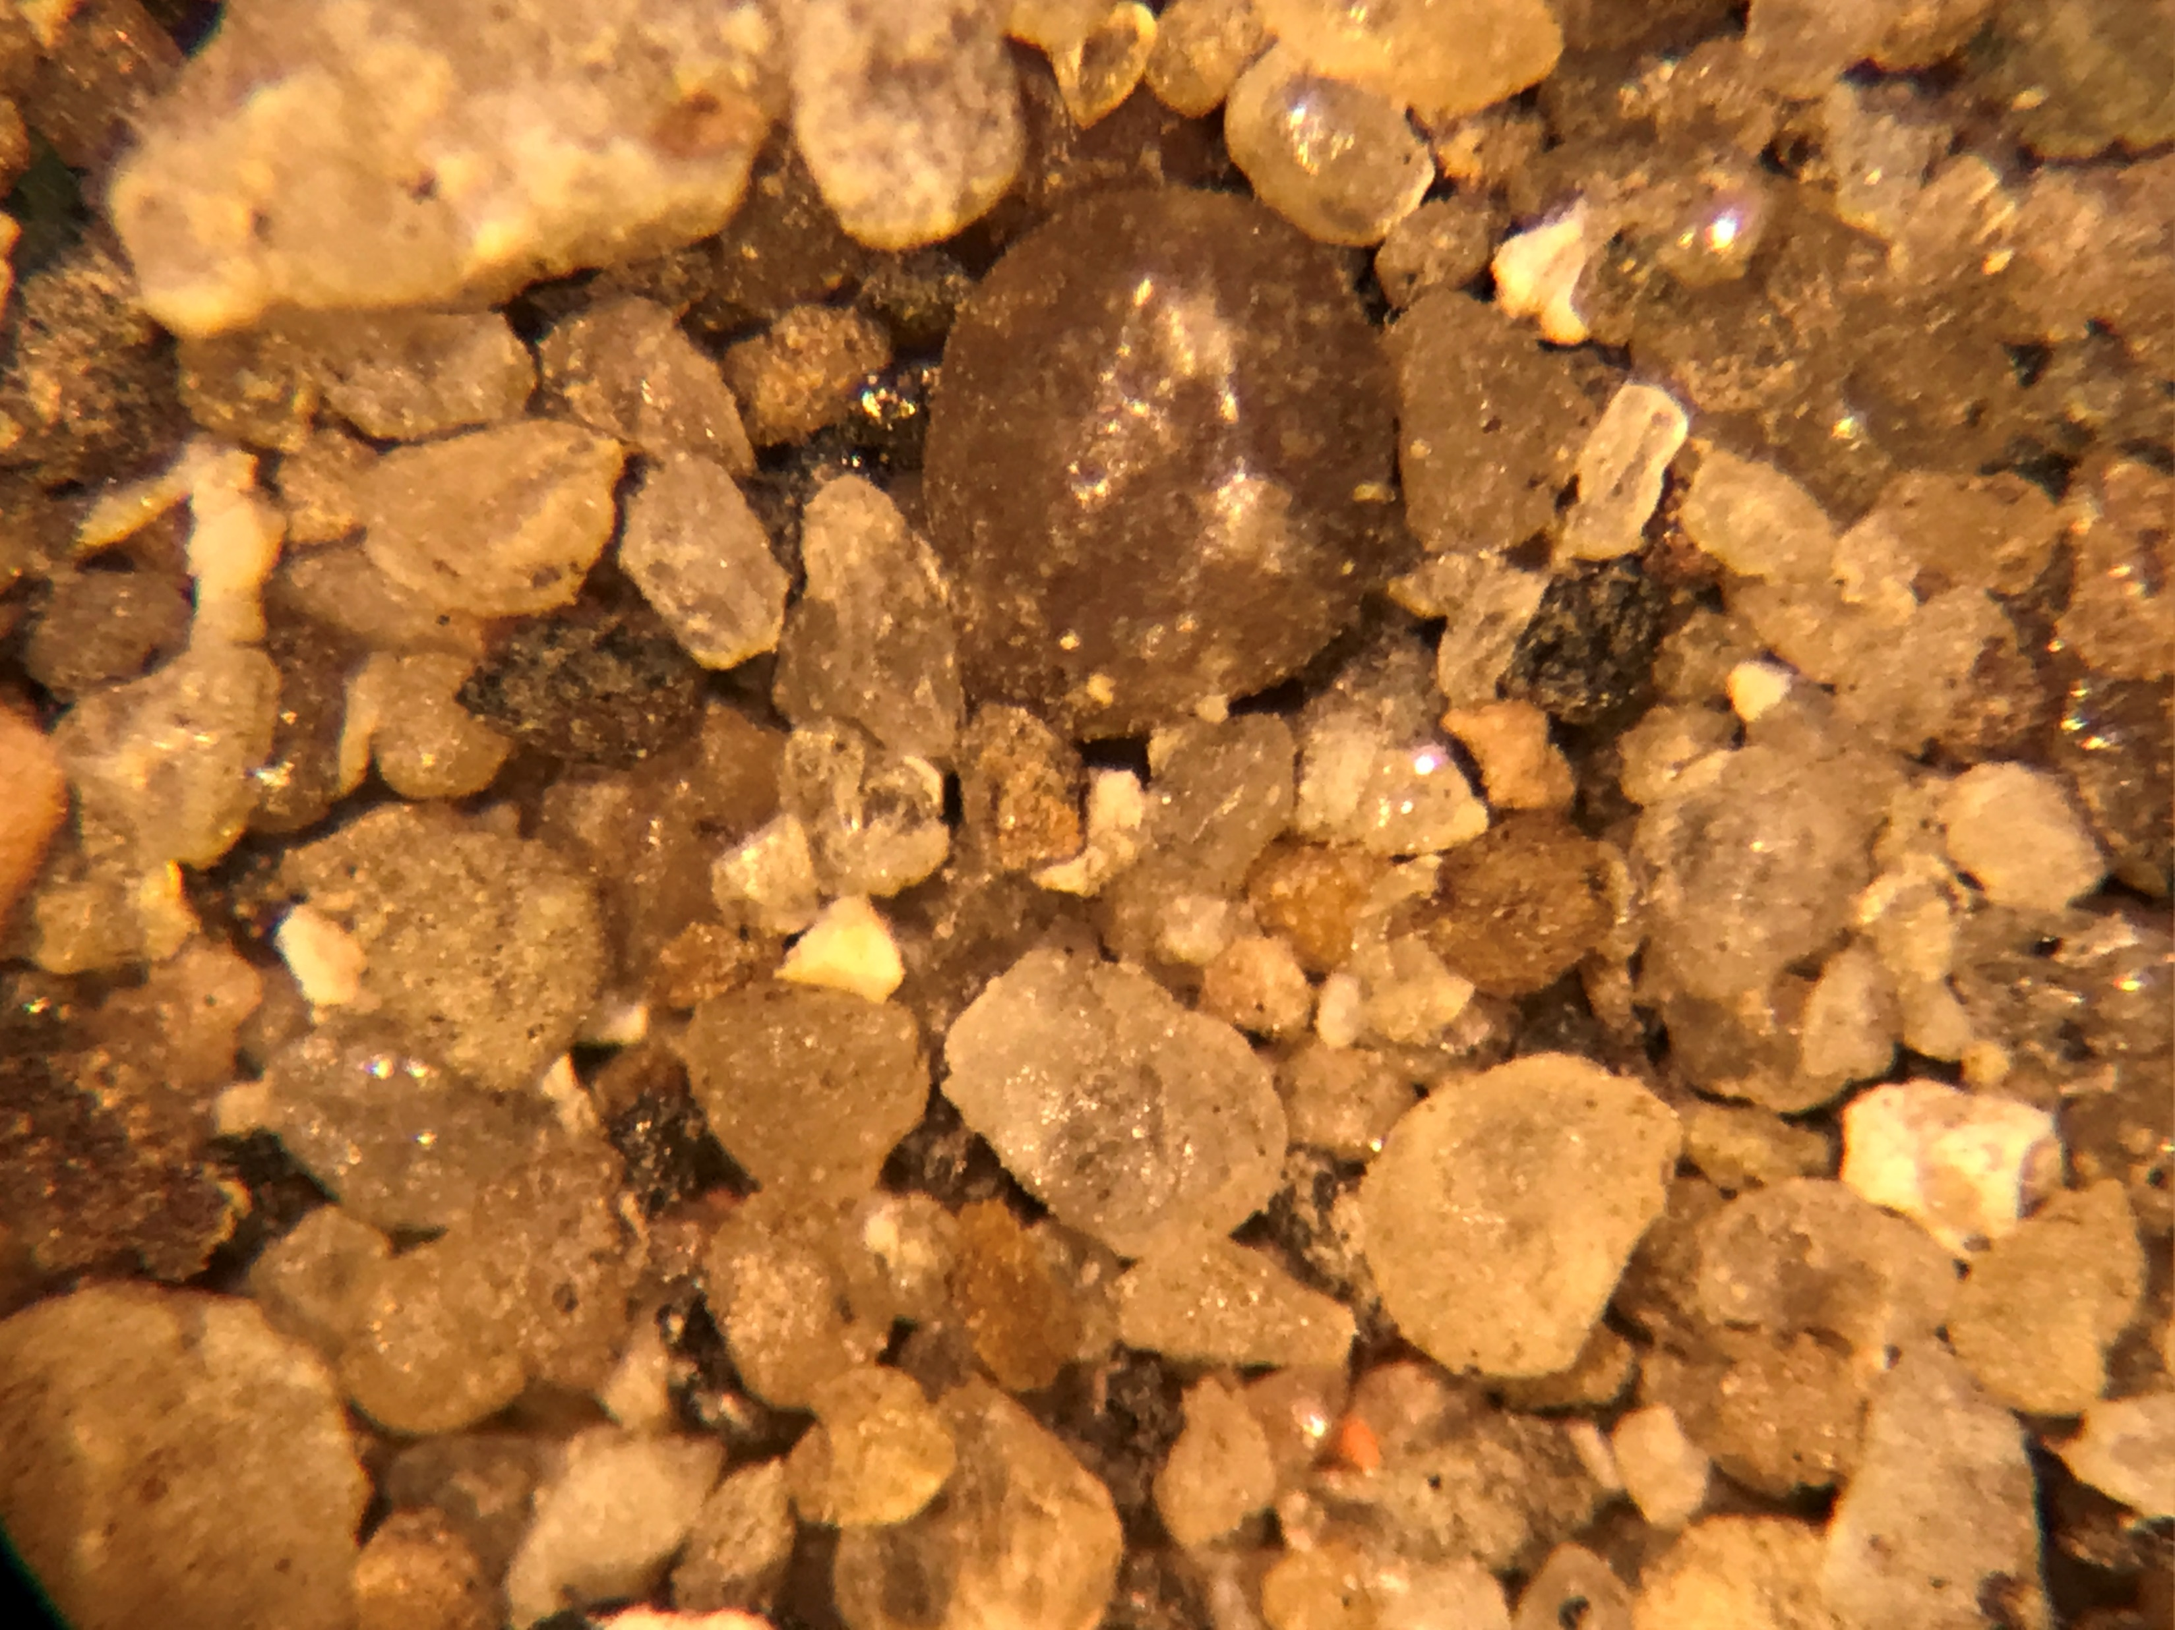
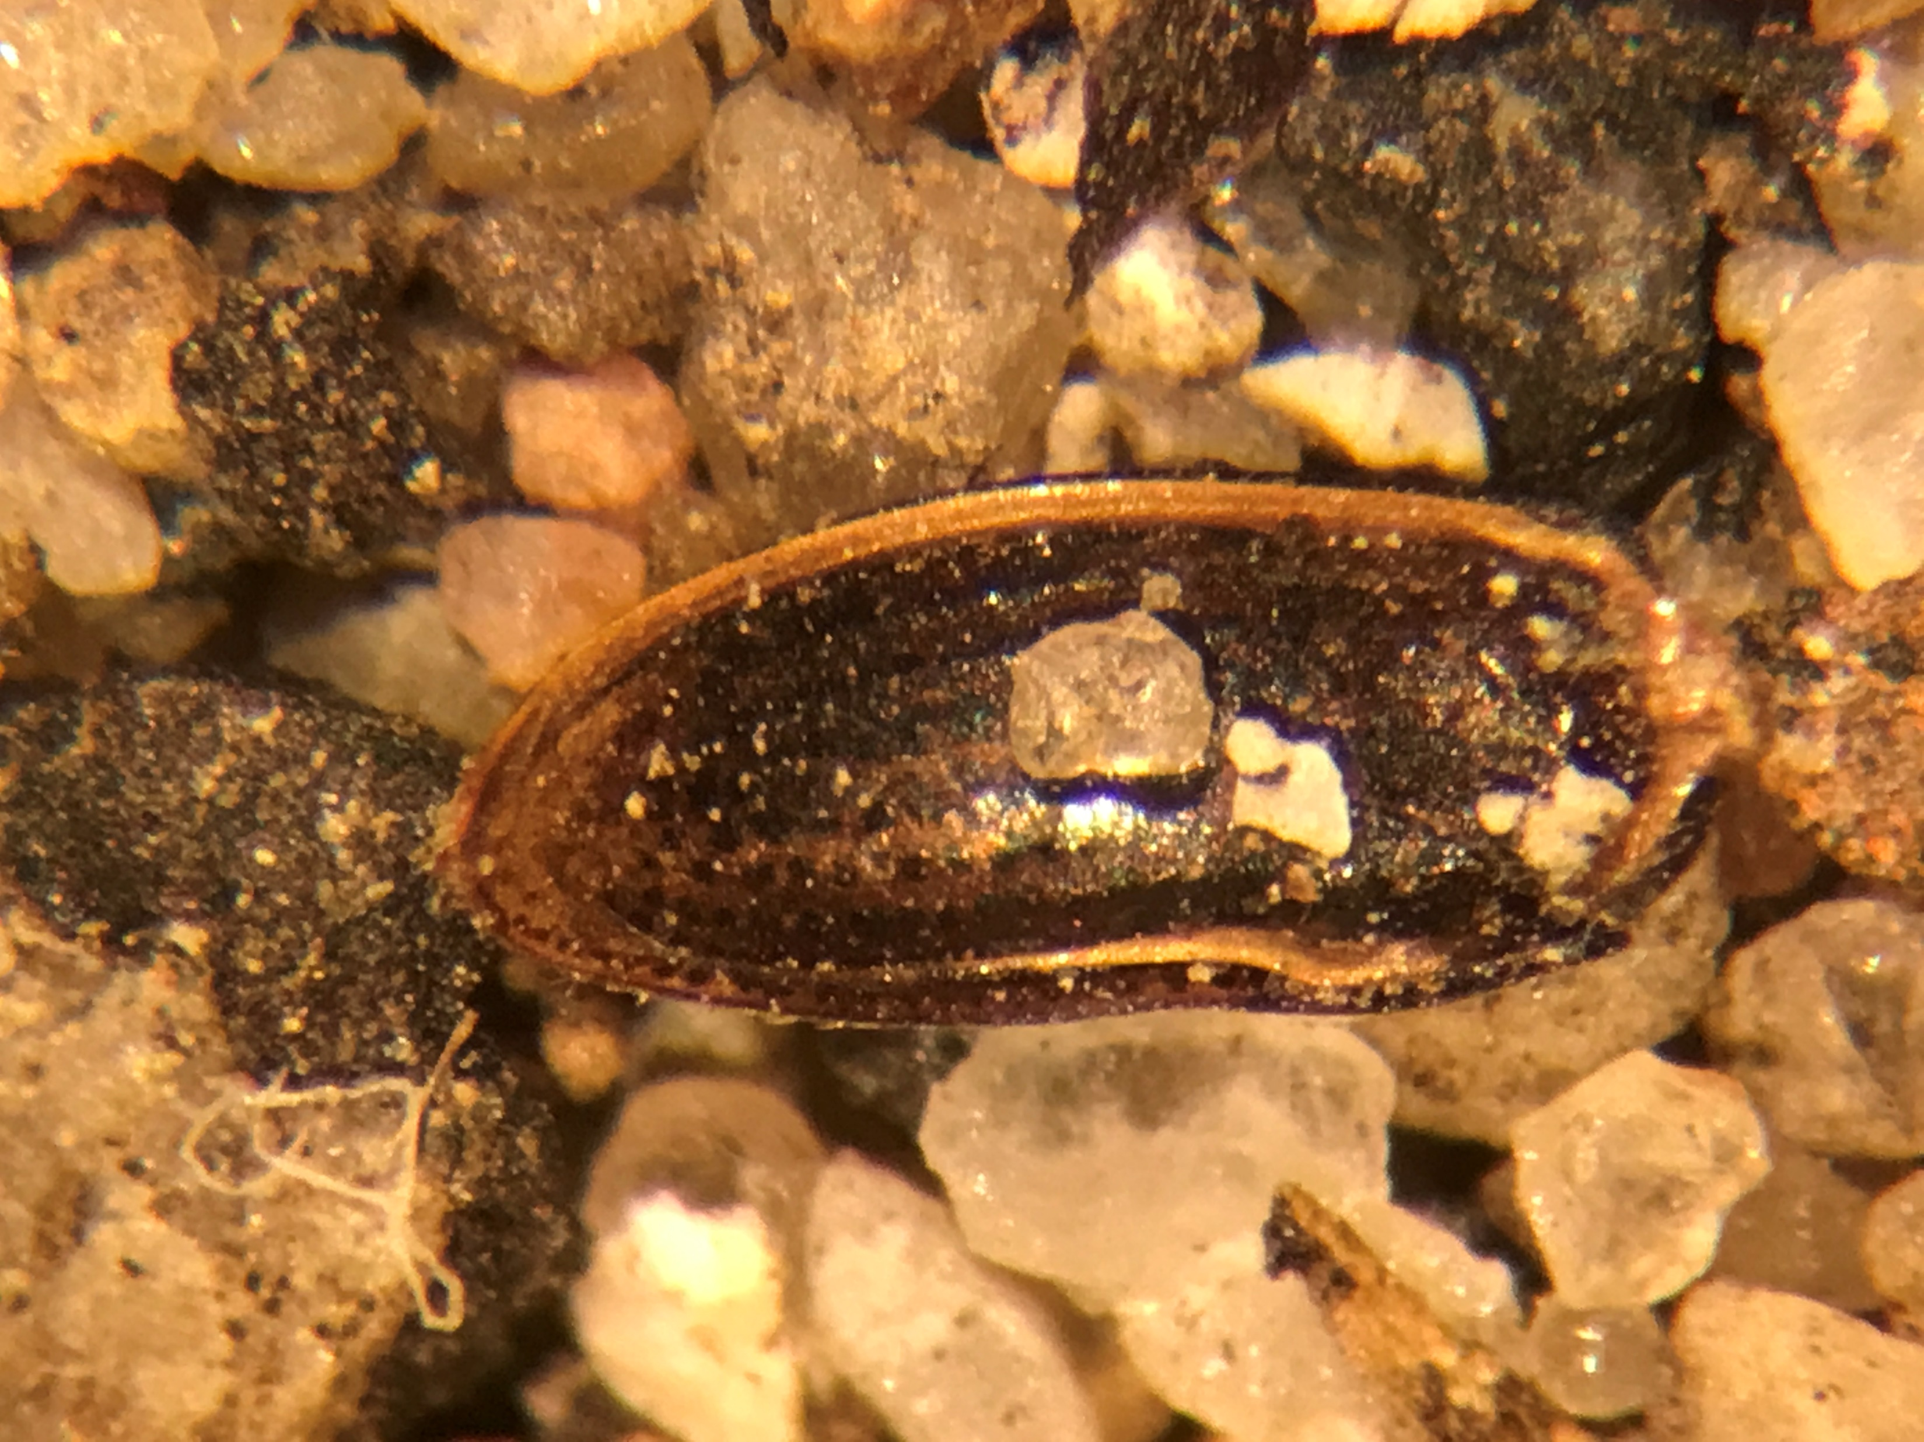
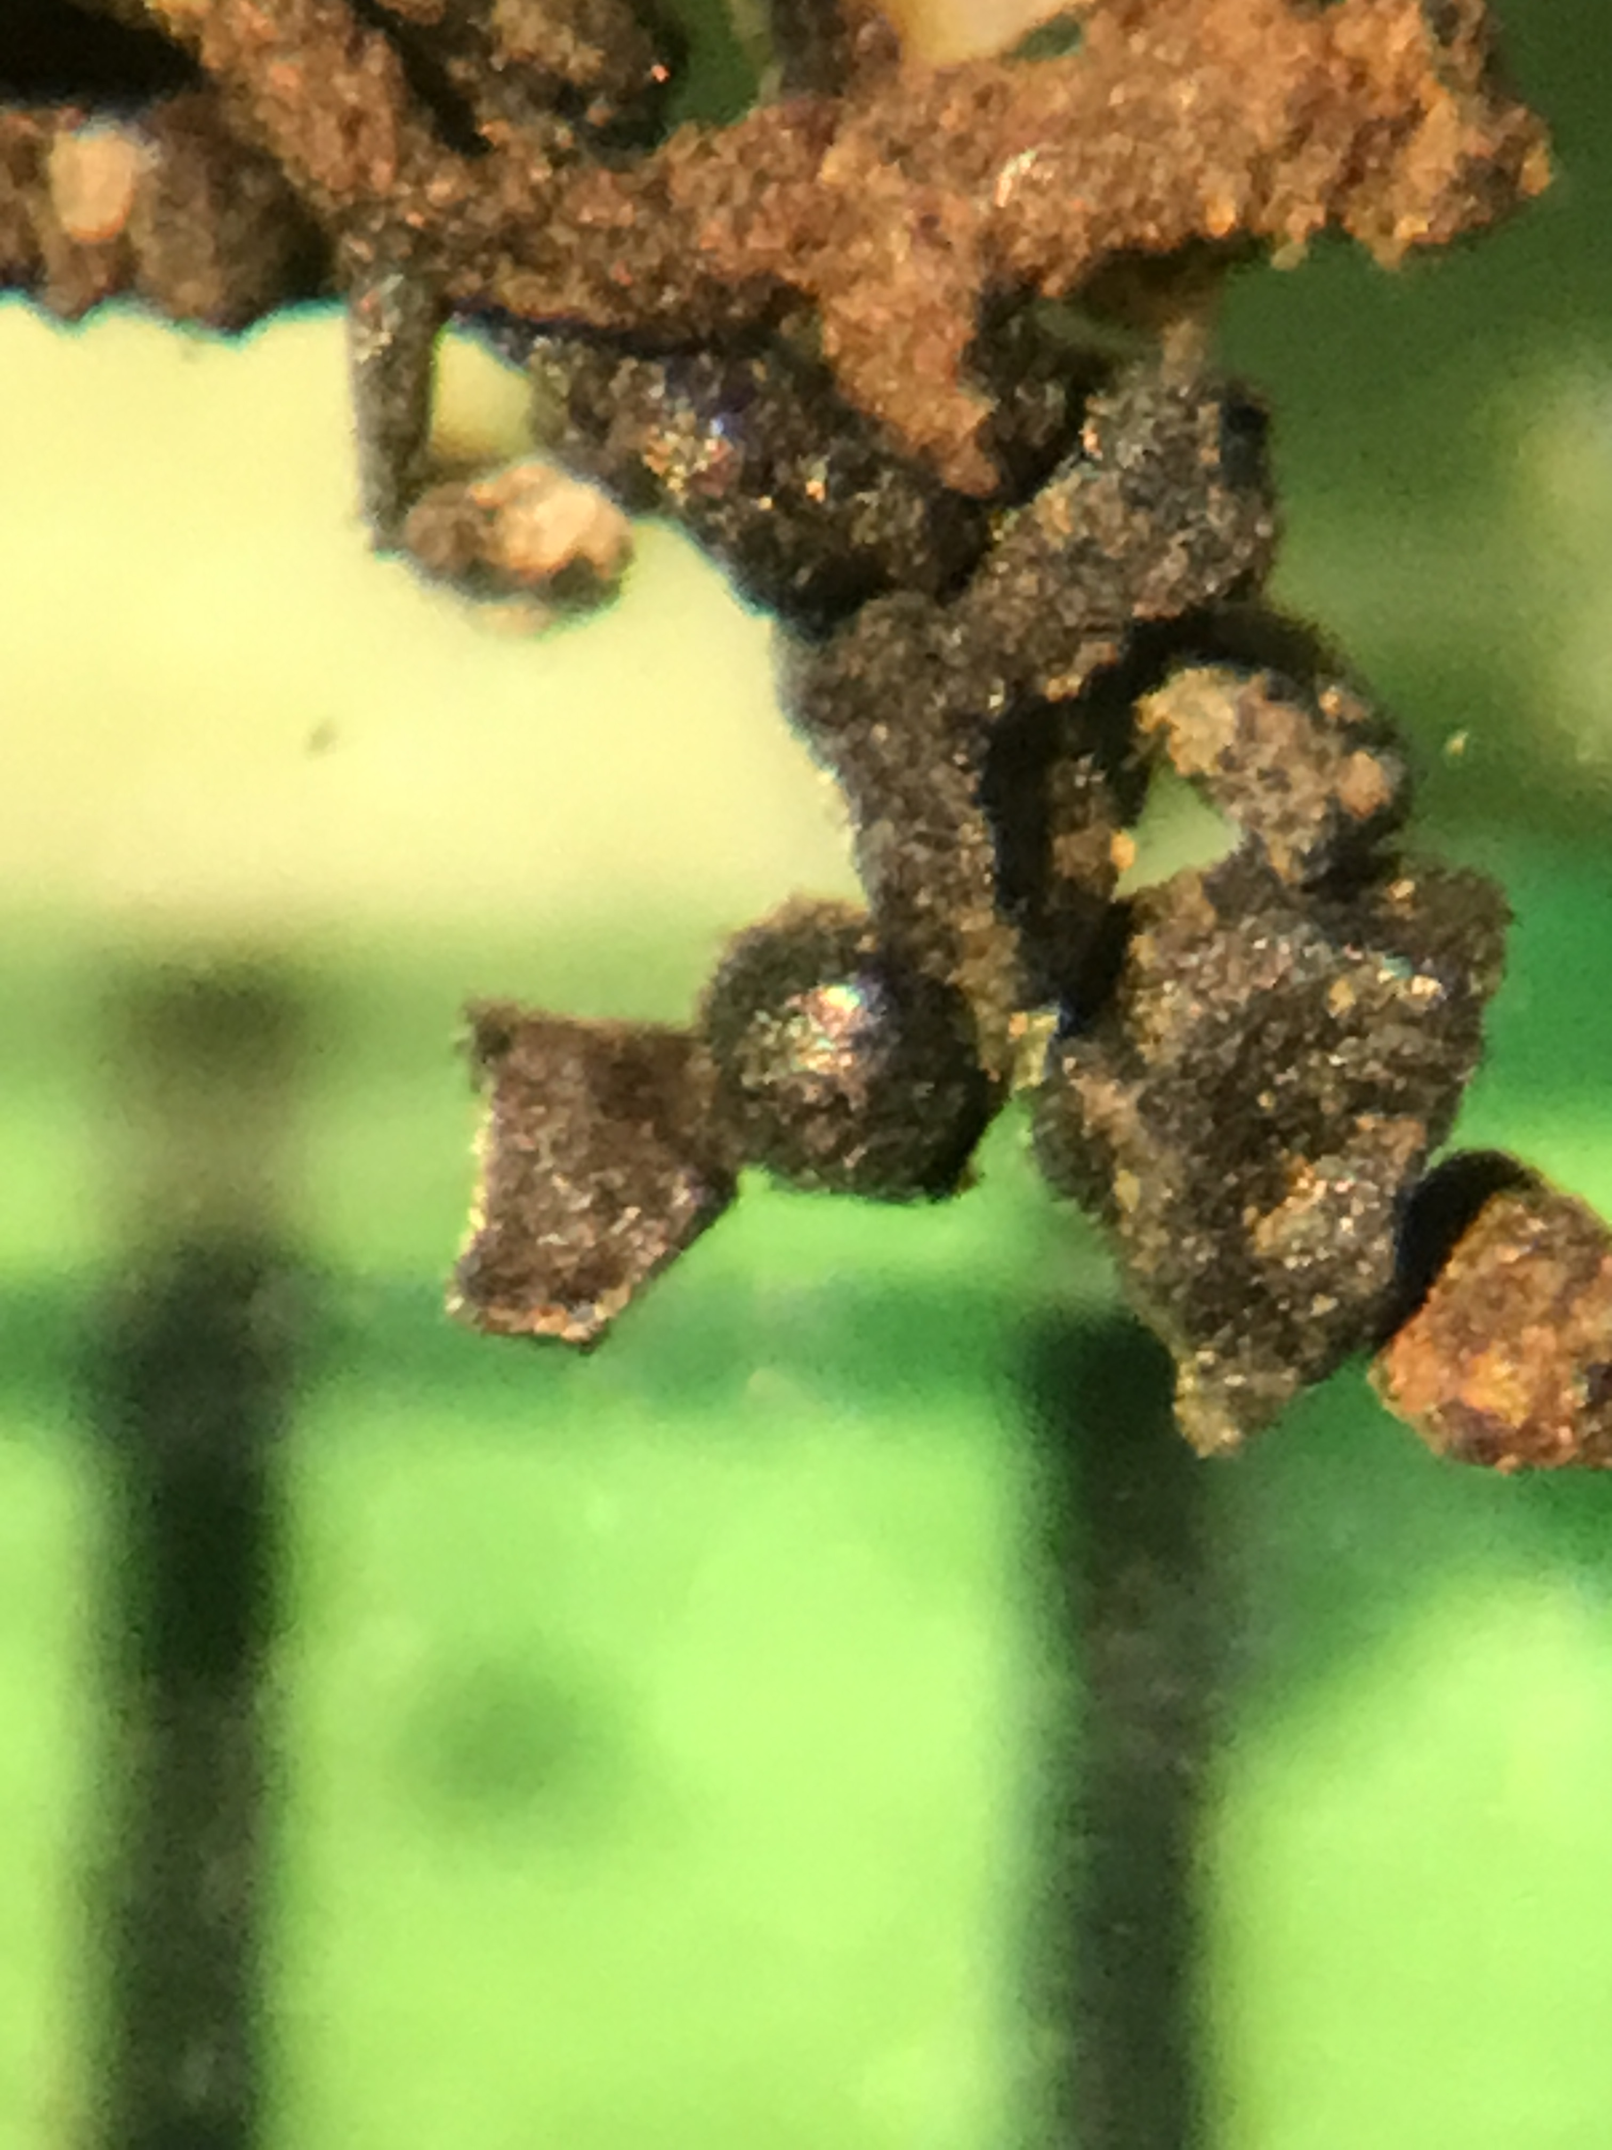
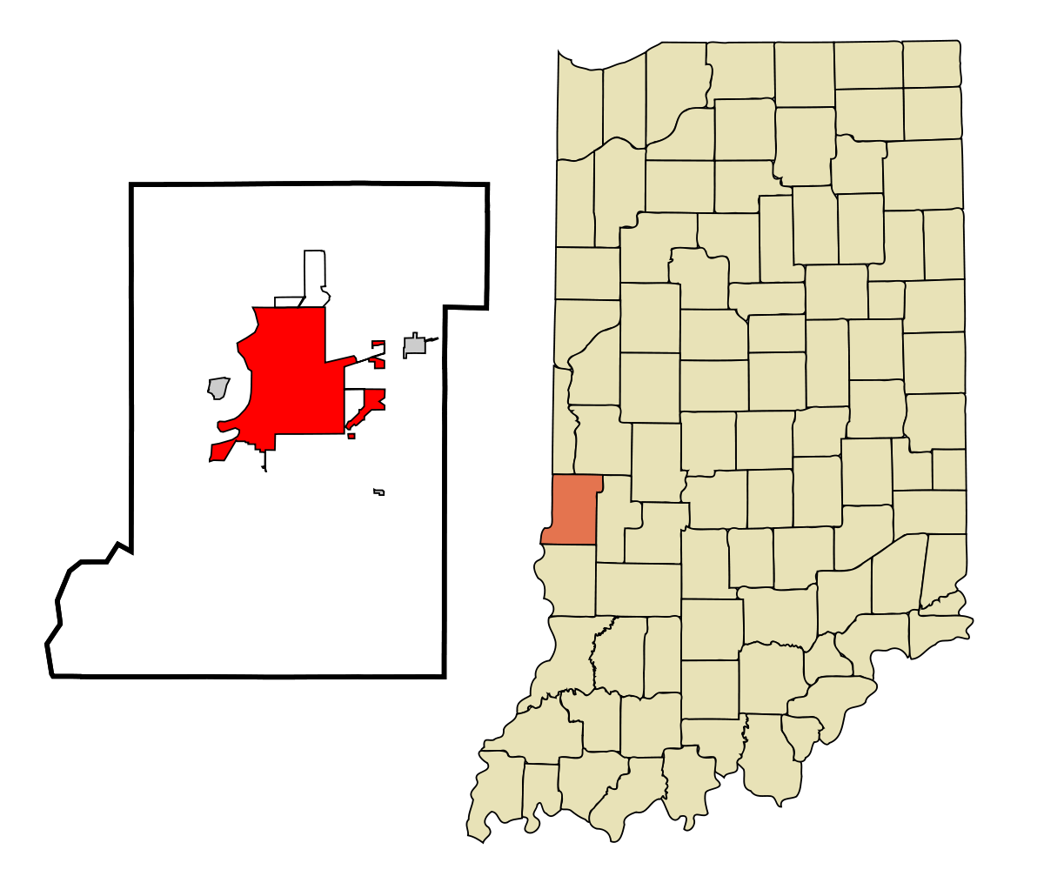
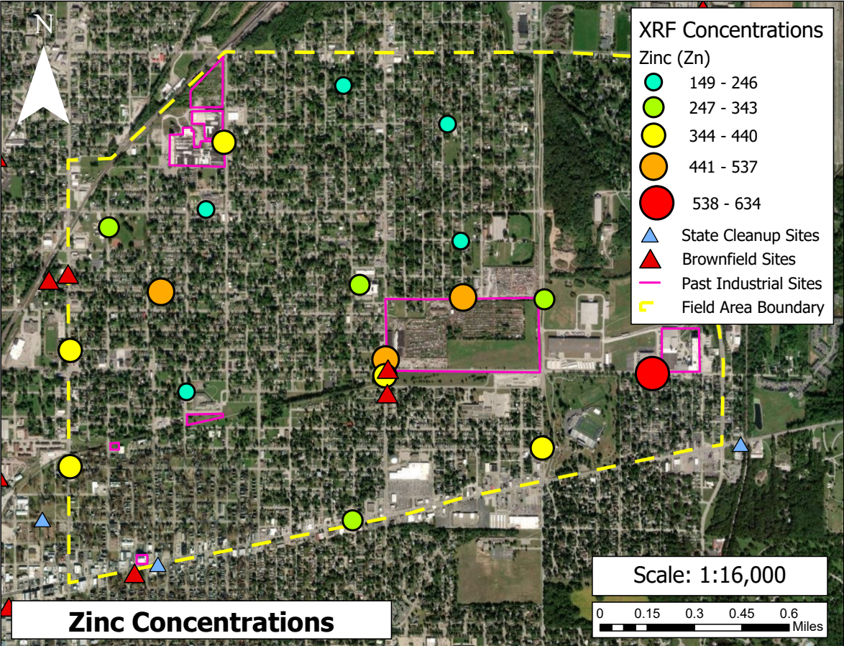
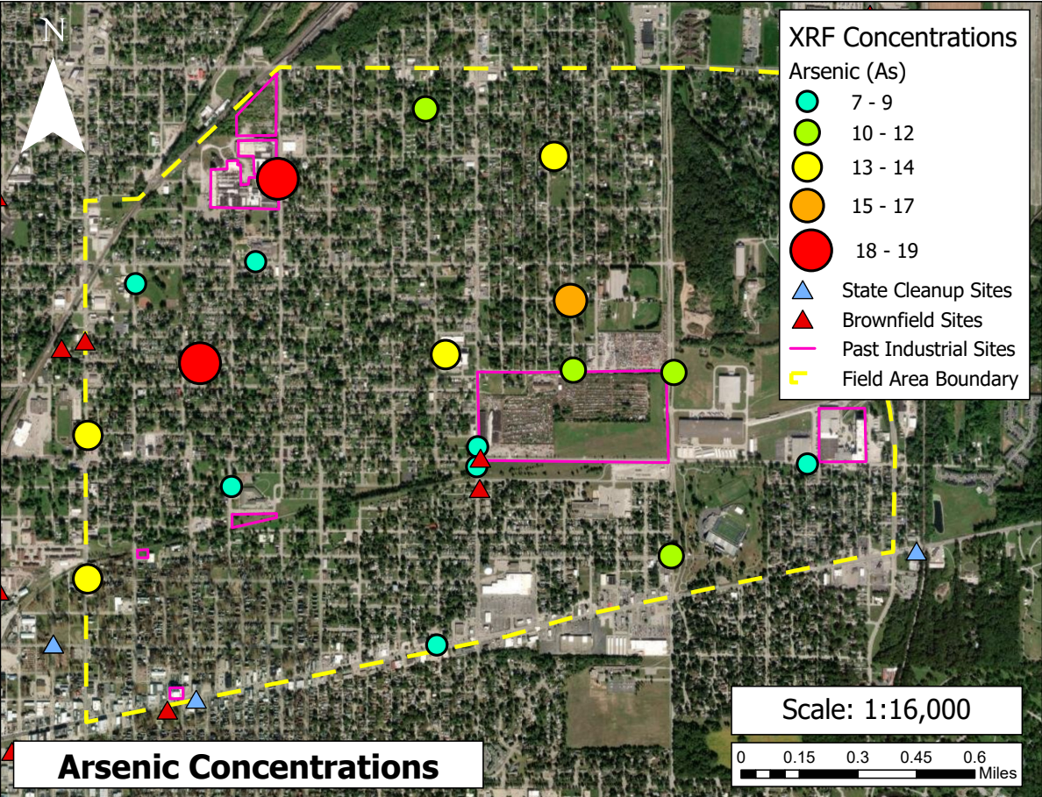
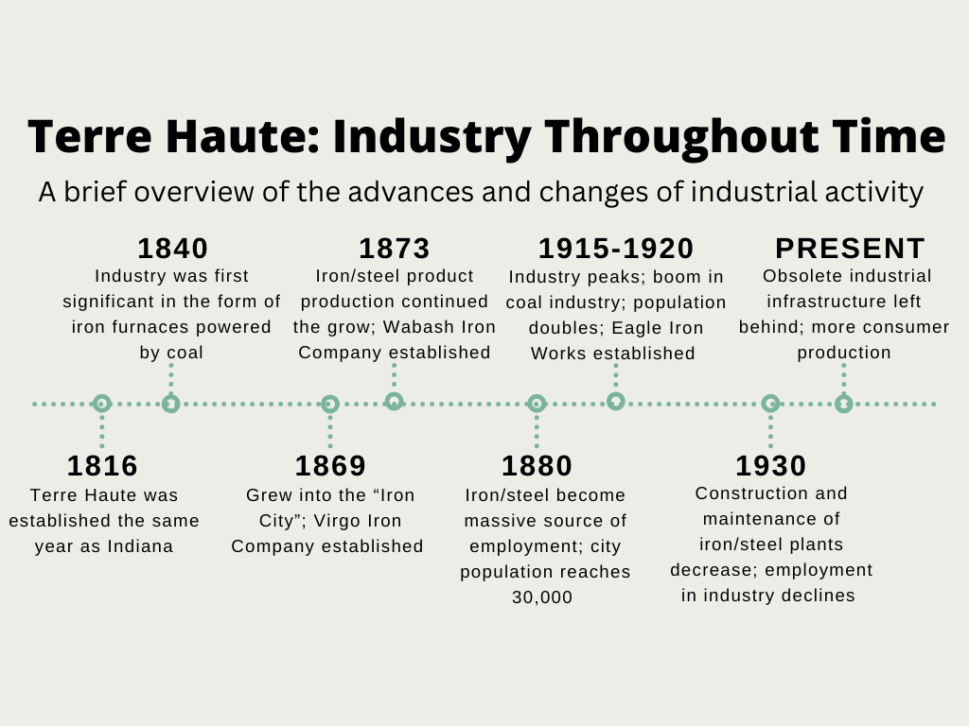
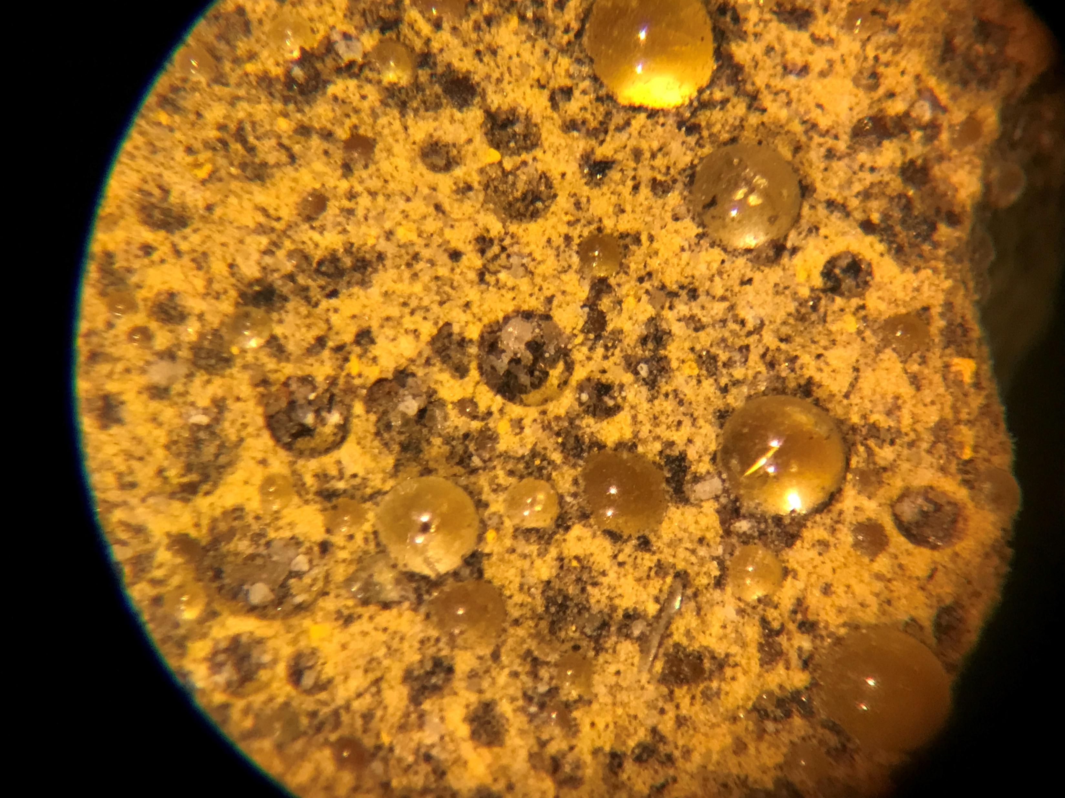
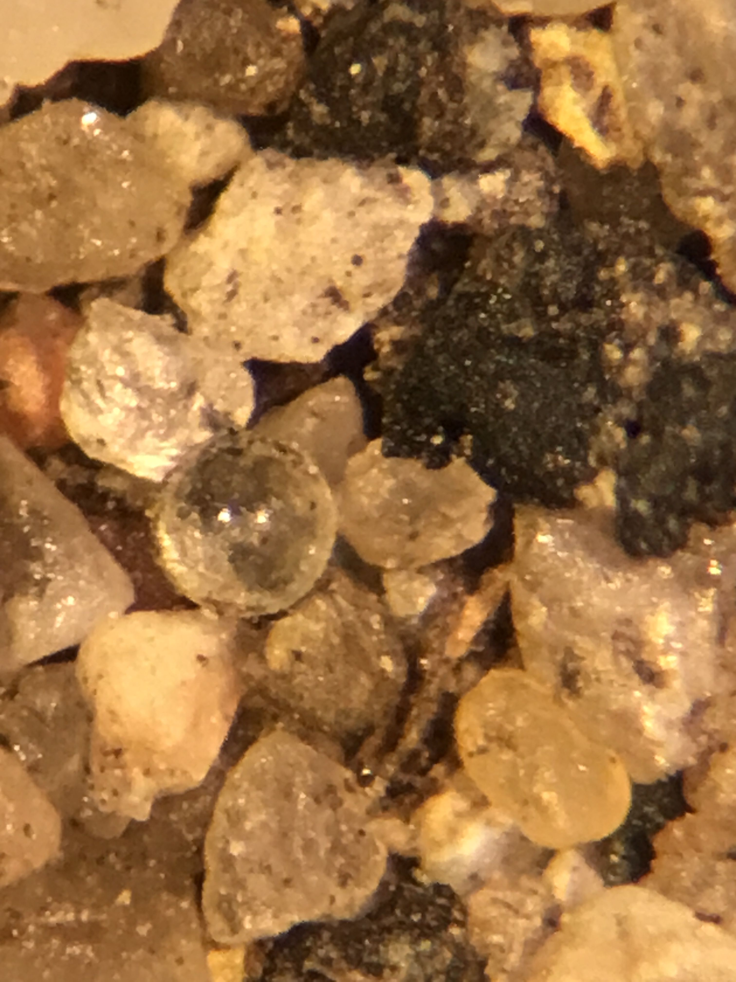
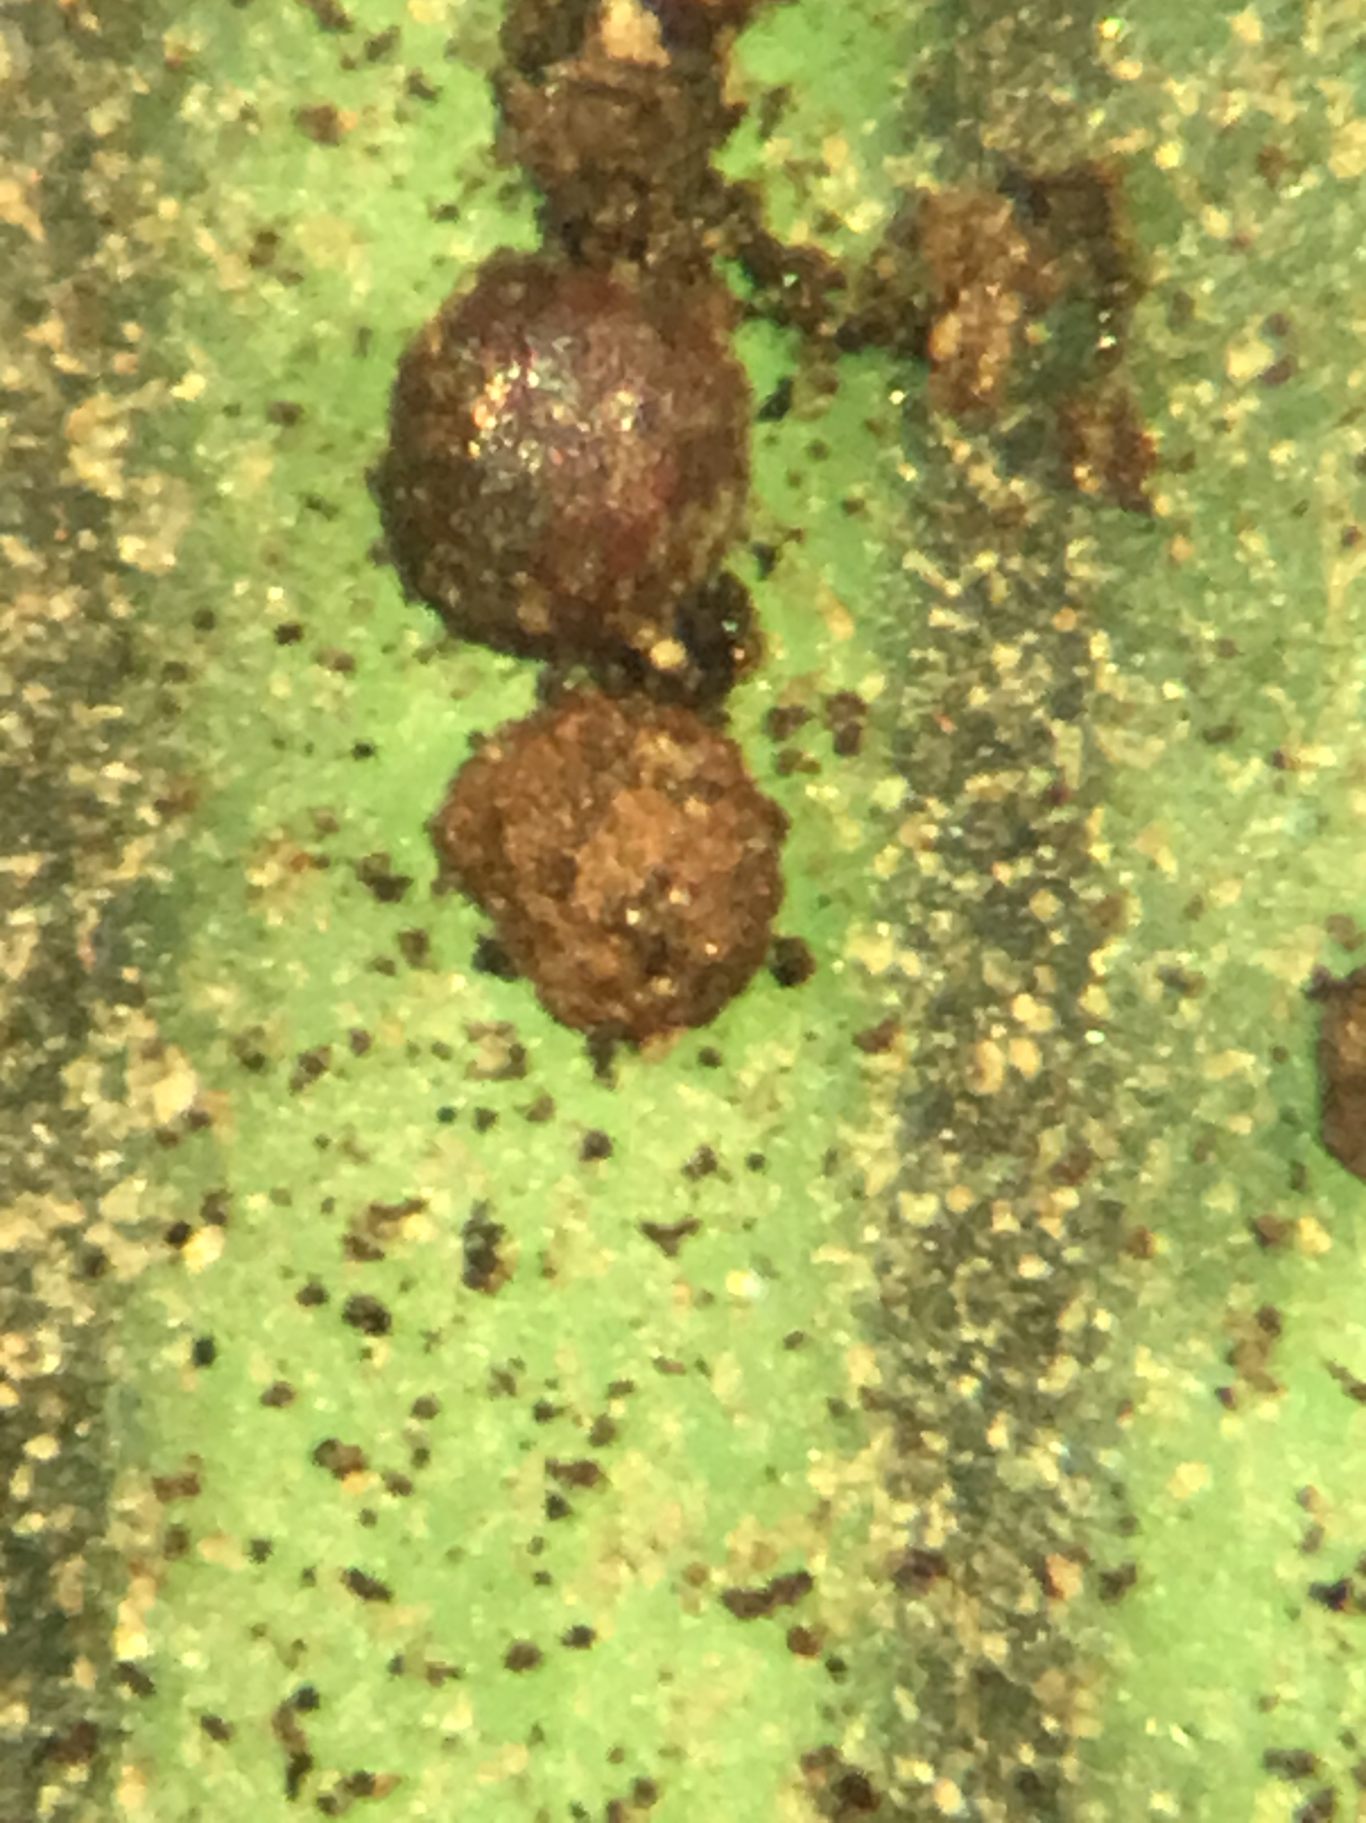
Characterizing Potentially Harmful Environmental Legacy Issues within a Declining Midwest City: A Street Sediment Study of Northeastern Terre Haute, Indiana
Katelyn Adams (katelynadams_2024@depauw.edu) and Ken Brown
DePauw University Department of Geology and Environmental Geoscience
Abstract
Methods & Materials
SEM & XRF Results
Urban settings face unprecedented environmental challenges that include legacy issues as well as emerging pollution problems (e.g., micro-plastics) that continually impact the public health of its communities. Determining the baseline abundances of potentially harmful contaminants in soil, sediment, air, and water is essential to protecting residents. This study examines anthropogenic pollution in street sediments collected from three neighborhoods located in northeast Terre Haute, Indiana. Using stereomicroscopy, SEM/EDS, p-XRF analyses, and geospatial analysis (GIS), the goal of this work is to characterize the types of pollutants present and place important constraints on their potential sources.
Stereomicroscopy on nine street sediment samples reveals several particle categories that include Fe-rich particles, glass spheres, organic matter, geogenic sediments, and other anthropogenic pollution (e.g., plastics). SEM/EDS analysis reveals Fe-rich spheres (~10 - 50µm), lead chromate (PbCrO₄) paint chips, glass micro-beads (<10 to >100µm), and other minor heavy metal particles. The Fe-rich spheres are consistent with technogenic spheres created by past steel manufacturing activities and possibly coal-fired power generation. We confirm that the lead chromate and glass micro-beads are sourced from weathered road paint chips.
Eighteen bulk street sediment samples were analyzed by pXRF at DePauw University. Combined with GIS spatial analysis, we observe high concentrations of heavy metals (Pb, Zn, Cu, and As) that correlate with areas of past and present industrial and manufacturing activities (e.g., Terre Haute Malleable & Manufacturing Co.).
Understanding the types of particulates and their potential sources can be used to safeguard residents within these communities from the potential health hazards associated with long-term exposure to these pollutants.
Sample Collection and Preparation:
A total of 27 street sediment samples were collected (18 for XRF analysis; 9 for SEM analysis) (Figs. 4 & 5). At each location, approximately 10-15 grams of street sediments were collected using plastic utensils. Samples were processed and analyzed at DePauw University using a stereomicroscope, Scanning Electron Microscopy (SEM), and portable X-ray Fluorescence (p-XRF).
SEM Results:
BSE Image
Spot #1
Fe
BSE Image
EDS False Color Map
No coating
Stereomicroscope Analysis
Sieving (> 180µm) and Hand Picking
Stereomicroscope Imaging
Spot #1
cps/eV
Spot #3
Spot #4
O
Si
50 µm
C
Al
Ca
BSE Image
Spot #2
Spot #2
150 µm
200 µm
No coating
Fe
O
Si
Spot #3
C
Pb
Spot #4
Introduction
Fig. 3: A stereomicroscope was used to image and document particle categories using the >180 µm sample fraction.
x0.001 cps/eV
Pt coated
cps/eV
O
Si
Pt coated
Scanning Electron Microscopy (SEM) Sample Analysis
O
Al
Si
cps/eV
Na
Al
Pt
Cr
As a multidisciplinary field that bridges geology, environmental science, and public health, medical geology and the study of urban geochemistry permit the identification and assessment of environmental health risks (Filippelli et al., 2012). Medical geology studies can help shape regulations related to land-use planning, water quality standards, and protecting communities from geological hazards.
There is growing public concern for heavy metal exposure as anthropogenic activities increase. Street sediments can serve as a repository for pollutants and contaminants that have the potential to negatively impact human health. Environmental quality assessments help communities understand the state of their surroundings and identify emerging issues. Understanding the types of harmful particulates and their potential sources can be used to safeguard residents within these communities from the potential health hazards associated with long-term exposure to these pollutants.
C
C
Mg
Ca
Ca
A
Sample Collection (N = 9)
Sieving Process (180 µm)
SEM Stubs - Carbon Tape
SNE 4500M SEM & Bruker EDS
50 µm
Pt
Stub with Carbon Tape
SEM Stub
Fig. 7: Backscattered electron (BSE) images showing an example of reoccurring particles with a spherical shape. Many of these particle are around 10-50 µm. EDS analysis indicates iron-rich compositions. We interpret these to be technogenic spheres.
Fig. 8: BSE image and EDS analysis confirm that the glassy spheres embedded in road paint are silica-rich glass. Frequent irregular, small particles high in lead and chromium are also present in the road paint. We interpret these to be Crocoite (PbCrO₄).
1 cm
XRF Results:
Fig. 4: Samples were imaged using SE and BSE modes. Chemical analyses were conducted using EDS at DePauw University
WVS = 13ppm
WVS = 24ppm
WVS = 63ppm
WVS = 8ppm
B
X-Ray Fluorescence (XRF) Spectrometer Analysis
Sample Collection (N = 18)
Sieving Process (180 µm)
Chemplex XRF Cup & Prolene (4µm) Film
Bruker 5g p-XRF
Research Question: Can street sediments from urban environments provide a reliable record of past and present anthropogenic activities?
Hypothesis: By collecting particulate data from street sediment, we hypothesize that we will observe street sediment composition linked to industrial activities, vehicle pollutants, and urban development
Fig. 9: Normalized log plots for bulk street sediment concentrations, showing Cu, Pb, Zn, and As. Samples are normalized to average Wabash Valley Soil (WVS) (Smith et al., 2013).
Fig. 1: A) Historical photo of the Coke & Carbon plant in Terre Haute, Indiana (from Tribune Star, 2012) B) Steel manufacturing plant from Highland Iron & Steel. (Indiana Historical Society, 2008)
Fig. 5: Approximately 2-3 grams of each street sediment sample (<180µm) was analyzed by p-XRF at DePauw University. Accuracy and precision of the analysis was monitored using NIST 2711a (Montana II Soil).
Fig. 10: GIS maps of the study area showing the XRF concentrations of copper (Cu), lead (Pb), zinc (Zn), and arsenic (As) for the eighteen bulk street sediment samples. Concentrations are reported in parts per million (ppm). The symbol size for each sample is proportional to its concentration (larger symbols = higher concentrations). Sample concentrations are also color coded (blue = low; red = high concentrations).
State cleanup sites (blue triangles), Brownfield sites (red triangles), and the locations of past industrial sites (pink boxes) are also shown in each map.
Background
Stereomicroscope Results
Terre Haute is located in Vigo County, Indiana with ~58,000 residents (Fig 2A; U.S. Census Bureau, 2022). Terre Haute has a high population density for the state of Indiana. Furthermore, there is a significant correlation between the city’s growth and its industrial opportunities (Fig. 2B). Additionally, the poverty rate in Terre Haute is 112.3% higher than the Indiana average and 102% higher than the US average.
Geologic Particles (~70-90%)
Biologic Particles (~10-15%)
Metal Particles (~2-5%)
The flat landscape combined with the close proximity of the Wabash River made Terre Haute an ideal location for industry and manufacturing. The geology of Terre Haute is primarily characterized by industrially useful sedimentary rocks (i.e. sandstone, limestone, and coal). Mining of Pennsylvanian coal is particularly important to Terre Haute and its surrounding areas. Terre Haute also has an extensive railroad system that has been active since the mid-1800s.
A
Metal Sphere
Vigo County, IN
B
1mm
1mm
250µm
Road Paint Chips (~1-2%)
Glass Spheres (~1%)
Other (~1%)
Glass Spheres
Conclusions
Street sediments can record past and present anthropogenic activity in urban environments.
Using stereomicroscopy & SEM, we can reliably identify particle shape, texture, and composition and relate these characteristics to potential sources.
Heavy metals concentrations are elevated above natural backgrounds concentrations, suggesting a clear anthropogenic contribution.
Lower concentrations were observed in residential areas; higher concentrations were generally observed near industry/manufacturing
Continued exposure to these heavy metal particles can pose a public health risk (e.g., PbCrO₄ - Pb⁺² and Cr⁺⁶ in water systems)
500µm
300µm
300µm
Figure #. Spatial analysis of XRF concentrations with potential sources sites indicated. Using ArcGIS software, conclusions were based on the aggradation of results provided. S
Fig. 6: General categories of particle types and the approximate proportions observed with the stereomicroscope (images are from the >180 µm sample fraction). Broad categories are natural materials (e.g., geo and bio) or particles interpreted to be from anthropogenic sources (e.g., metal particles, road paint chips, glass spheres, and other). Geologic materials are primarily composed of quartz, feldspars, calcite, minor iron-oxides, and lithic fragments of limestone.
Fig. 2: A) Map showing the location of Terre Haute and Vigo County, Indiana. B) Timeline representing aspects of Terre Haute’s long history of industrial activity and population growth (from Cutshall, A. 1941, Bailey, G.L., 1984).
ACKNOWLEDGEMENTS: We would like to thank DePauw’s Buehler Biomedical Imaging Center (BBIC) and the Department of Geology and Environmental Geoscience for the resources and guidance during this research. We would also like to thank the GEOS 230 (Env. Geology) class for their contribution to sample collection.
Notes:
1

