Slide 1
Team- and Skills- Focused Approaches to Internship and Research Opportunities Between High School Students and Professionals
Chris Thomas and Gerri Cole
Extended Learning, North Carolina School of Science and Math
Lori Tyler
Math & Science Education Center, Appalachian State University
Kelly Ruff
Hickory High School, Hickory, NC

Slide 2

Overview of NCSSM’s Outreach
Challenges of Geoscience Recruitment
Teamship
Agenda
1
INSPIRE
2
Summer Ventures
3
Reimagined Internship
What it is
What it offers
The Value Add
Outcomes
STEM Research/Industry Career Exploration
Interdisciplinary STEM REU/CURE
All are free outreach programs
Notes:
Talk about programs that have a different design that I commonly see at universities
Talk about the set of of description
Talk about it’s free outreach, not tied to our boarding schools

Slide 3
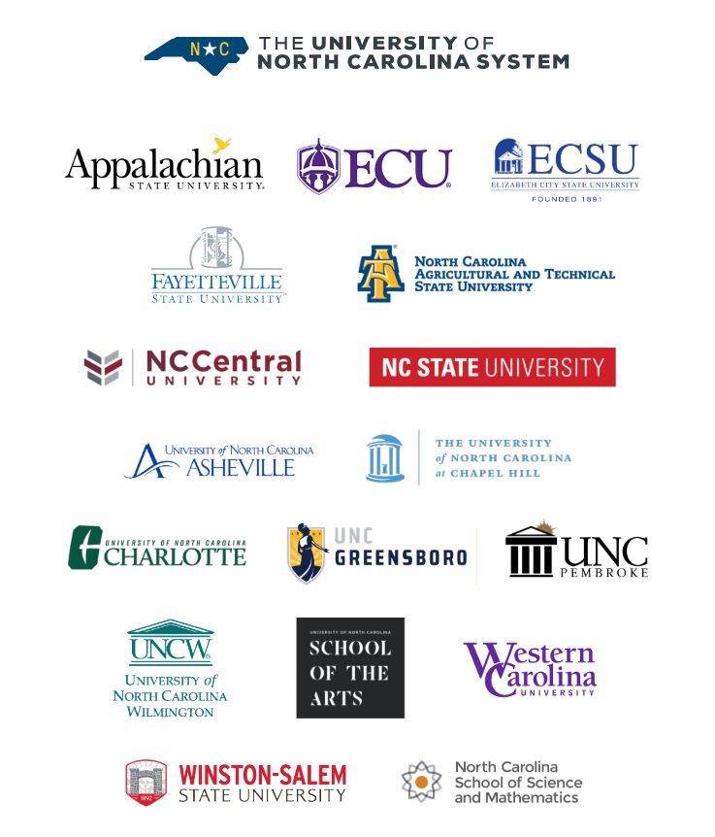
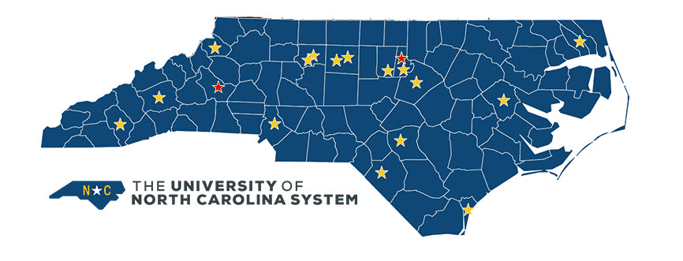
UNC System Locations
100 counties
Two boarding schools, two online program, summer, outreach programs
~3700 reached in direct services
Notes:
Mention we are a boarding school as we serve the whole state
Our outreach serves the whole state and is not focused on the regions near our campus

Slide 4
Interdisciplinary STEM
Why this matters to geosciences
(+)5
<1
0.5
(-)5
courses
projects
interests
Notes:
0…number of geoscience courses we offer across the 3500 students we serve
0.5 number of geoscience projects in the Summer Ventures program I will describe (it used to be 5)
+/- 5 Explain the 5 Things Activity in Mentorship, geology often showed up in the 5 things they would not want to study

Slide 5
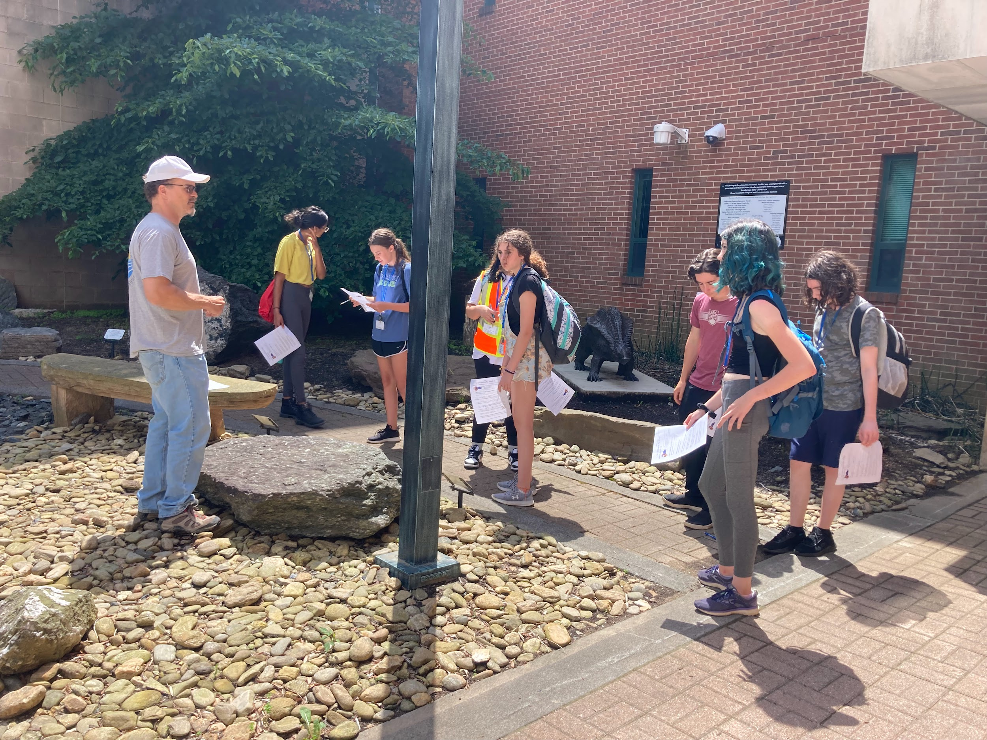
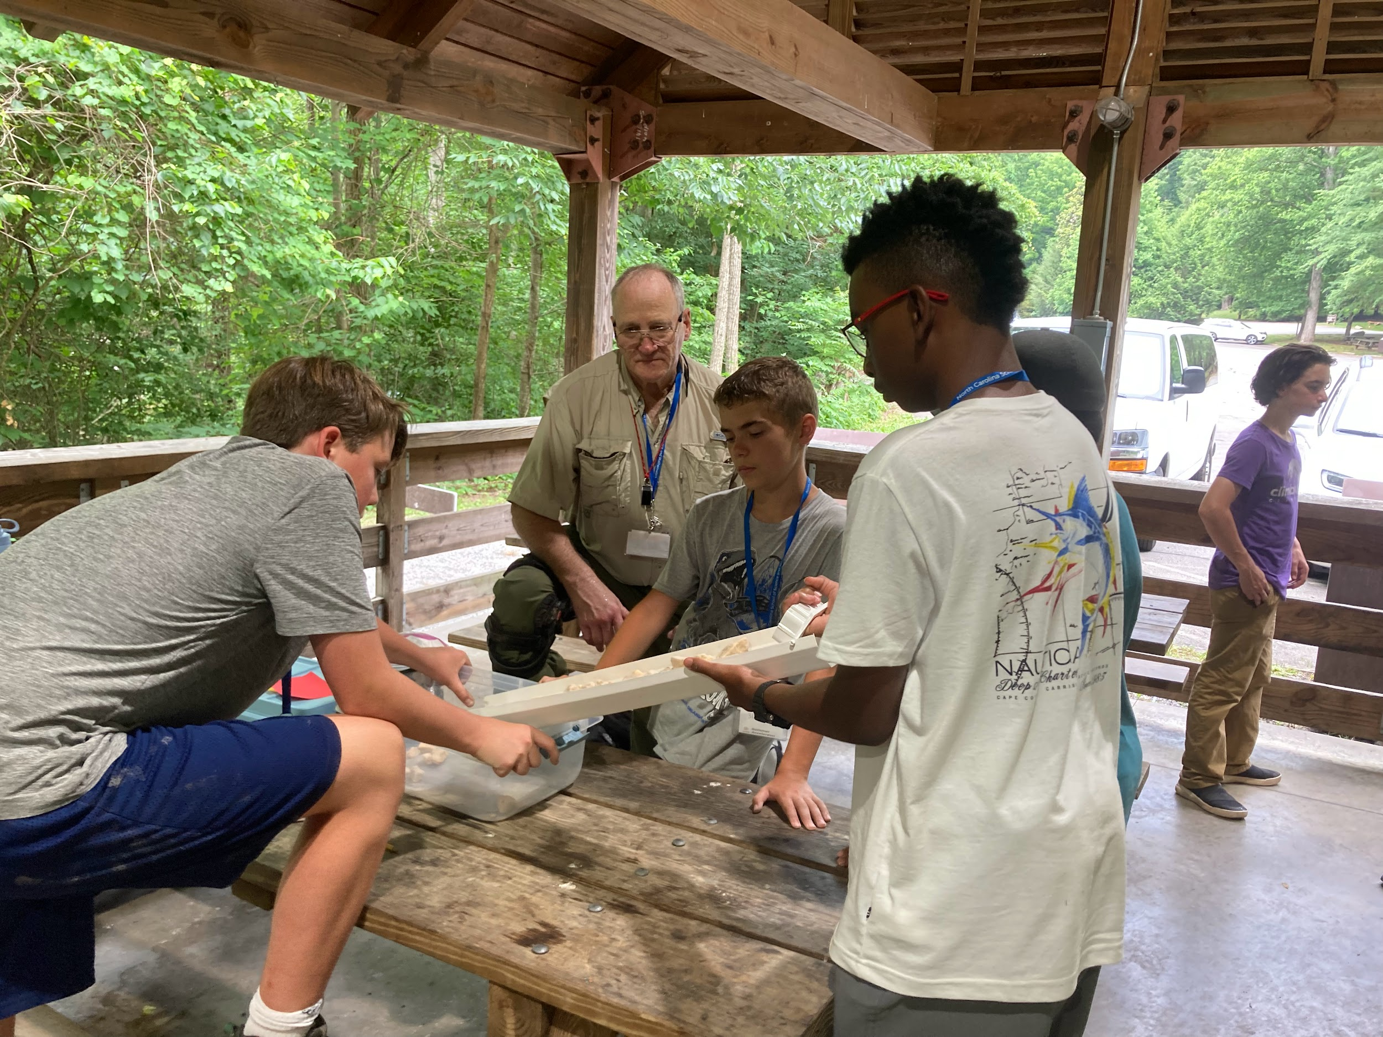
Problem
High School Student and Adult Learner consideration of geosciences
Student misperceptions of geosciences and geoscience careers
Students perceptions of geosciences between middle and high school
Notes:
Discuss offering a geoscience course offering in middle school or high school (and Ken and Andy Heckert)
How does geoscience stay relevant if students already have low consideration?

Slide 6
Solutions?
TEAMS
PROBLEMS
SKILLS
Engagement in team-based Interdisciplinary STEM programs
Get Interdisciplinary. Engagement in problem (not topic) focused projects
Focus on transferable skill building

Slide 7
Teamship is a reimagined internship experience that prepares students for modern work.
District C Teamship
www.districtC.co
Notes:
Teams of students solve real problems for real businesses, all with the support of an expert coach.
Program is rooted in NC but expanding nationally

Slide 8
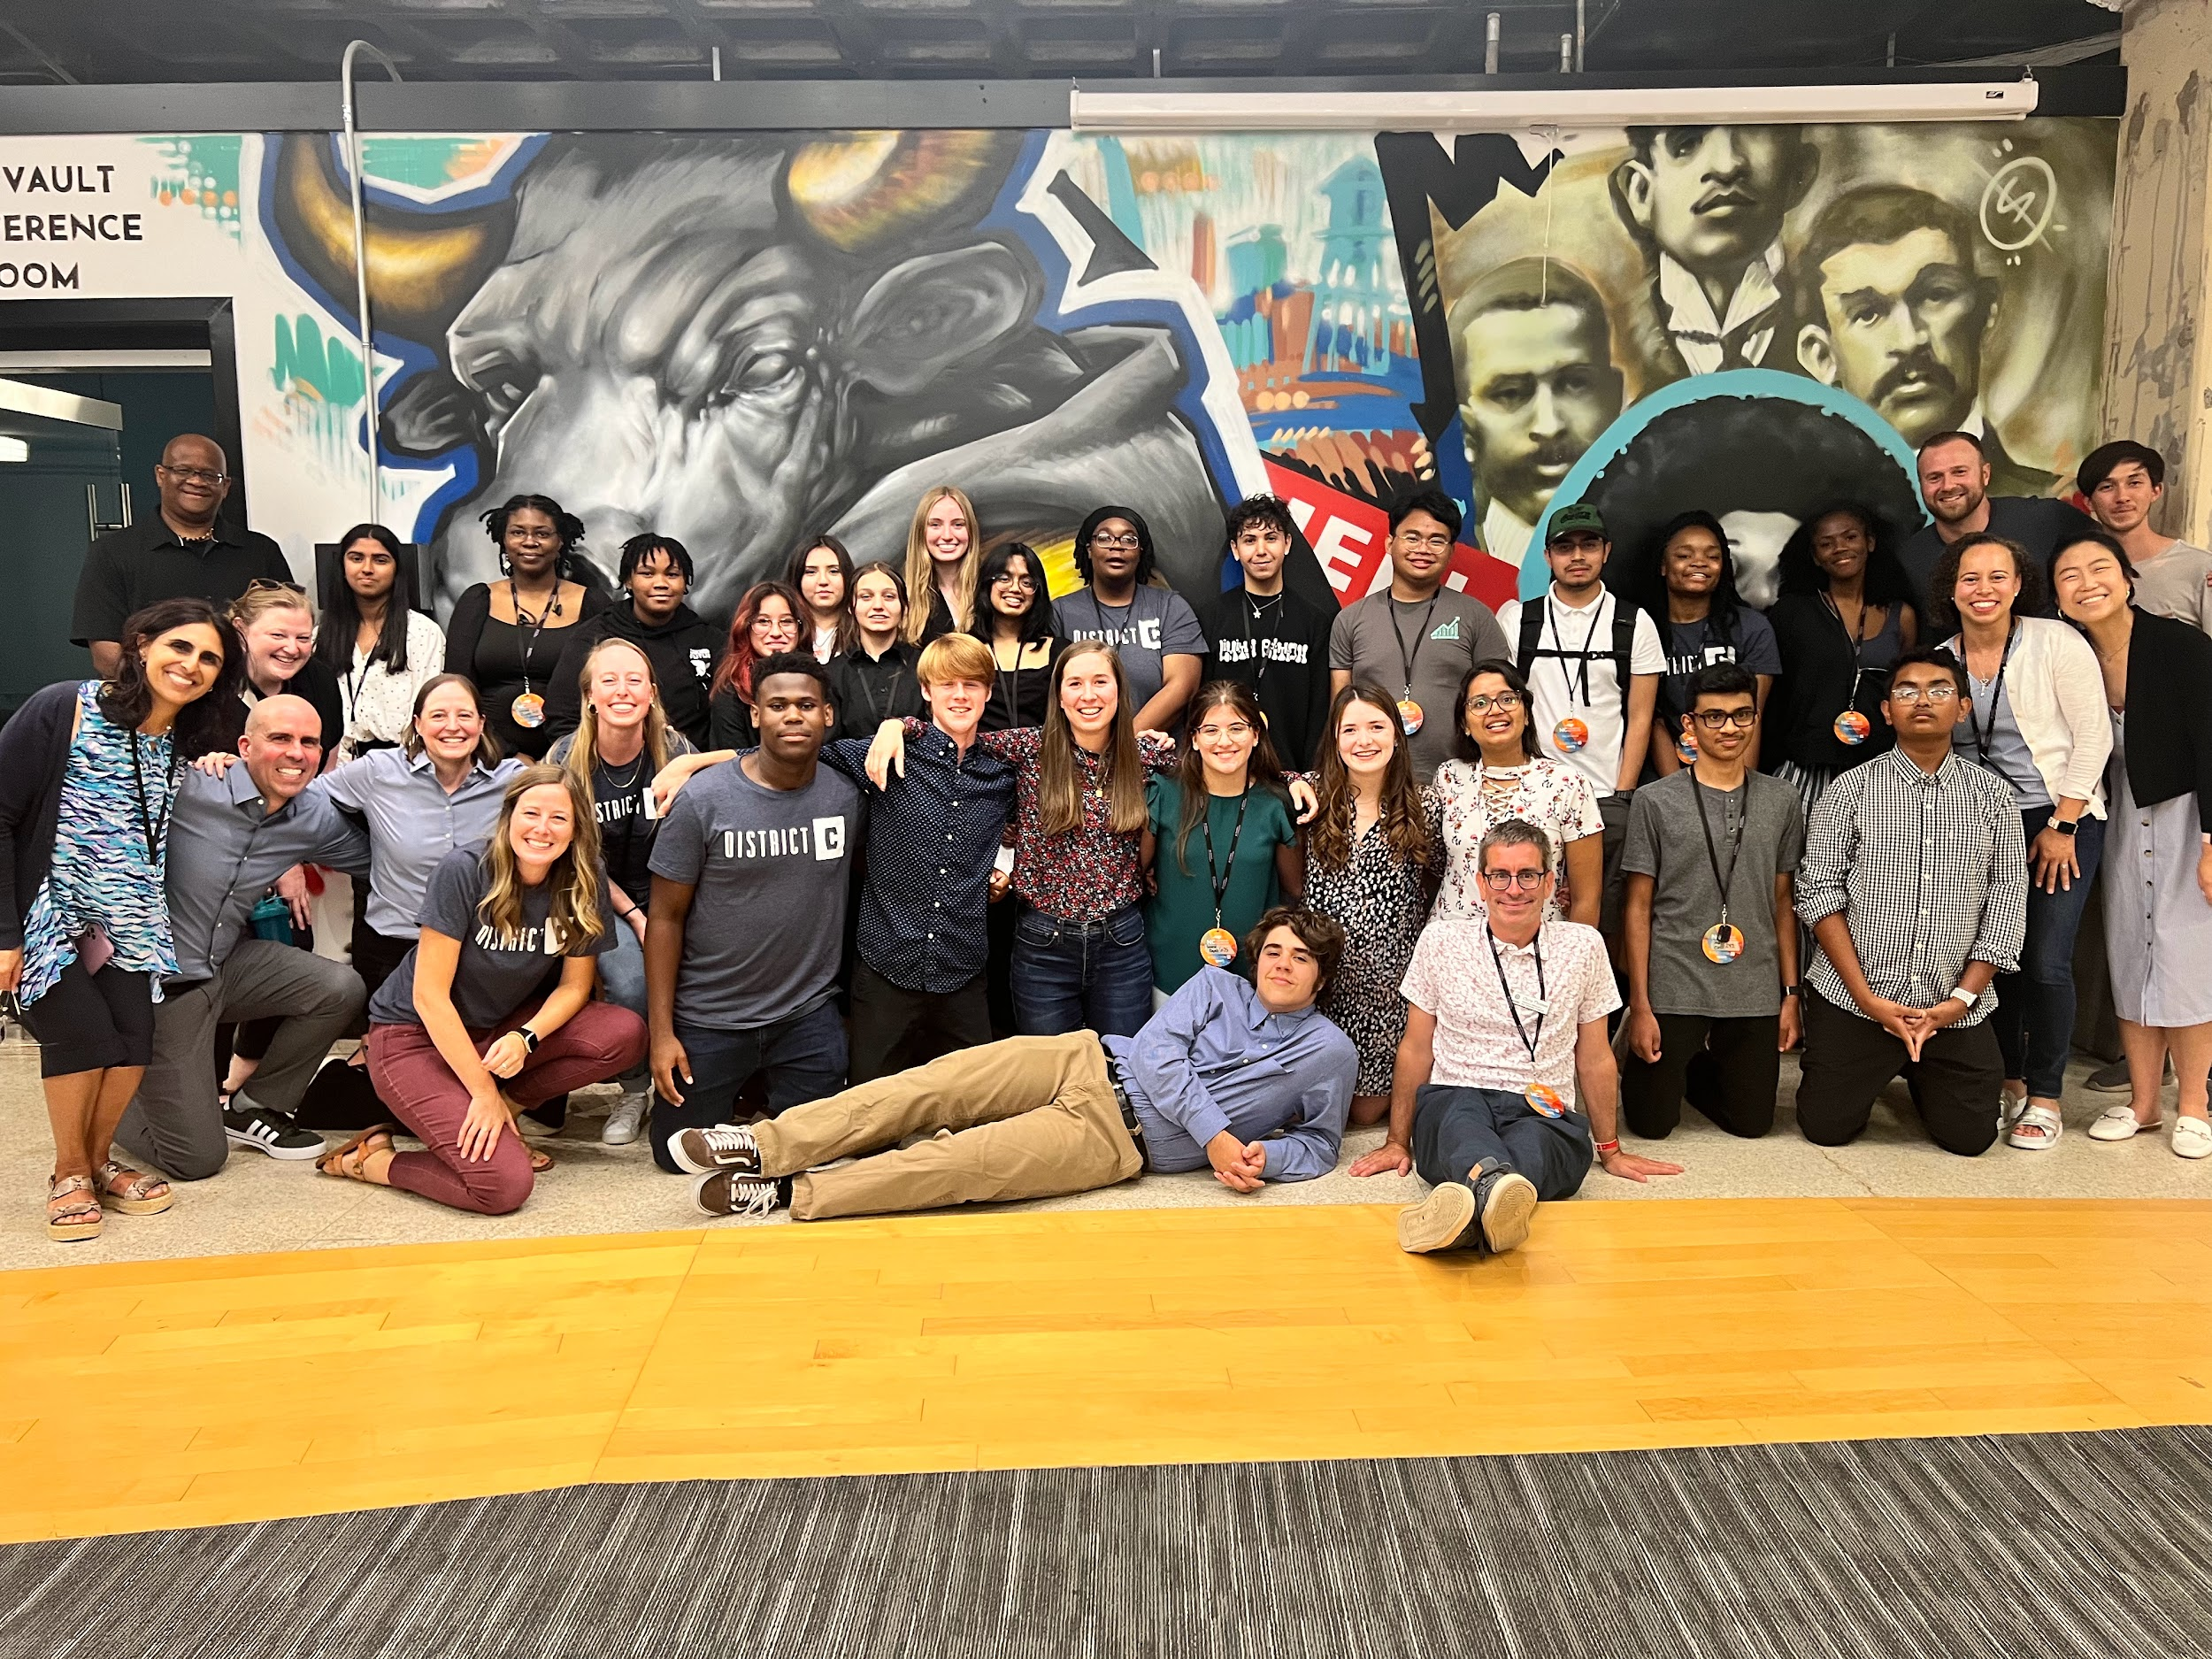
Teamship Is…
Participants: High School (or Adults)
Timeline: Varies 1 week to 1 month
Teams of students solve real problems for real businesses
Teams supported by an expert coach.
Work in diverse teams to solve complex problems
Notes:
Explain photo. Six teams, two teams per business partner
This is not entrepreneurship. This is not a business-focused curriculum
Talk about the typical business problems (communication, marketing, logistics, organization/people)

Slide 9
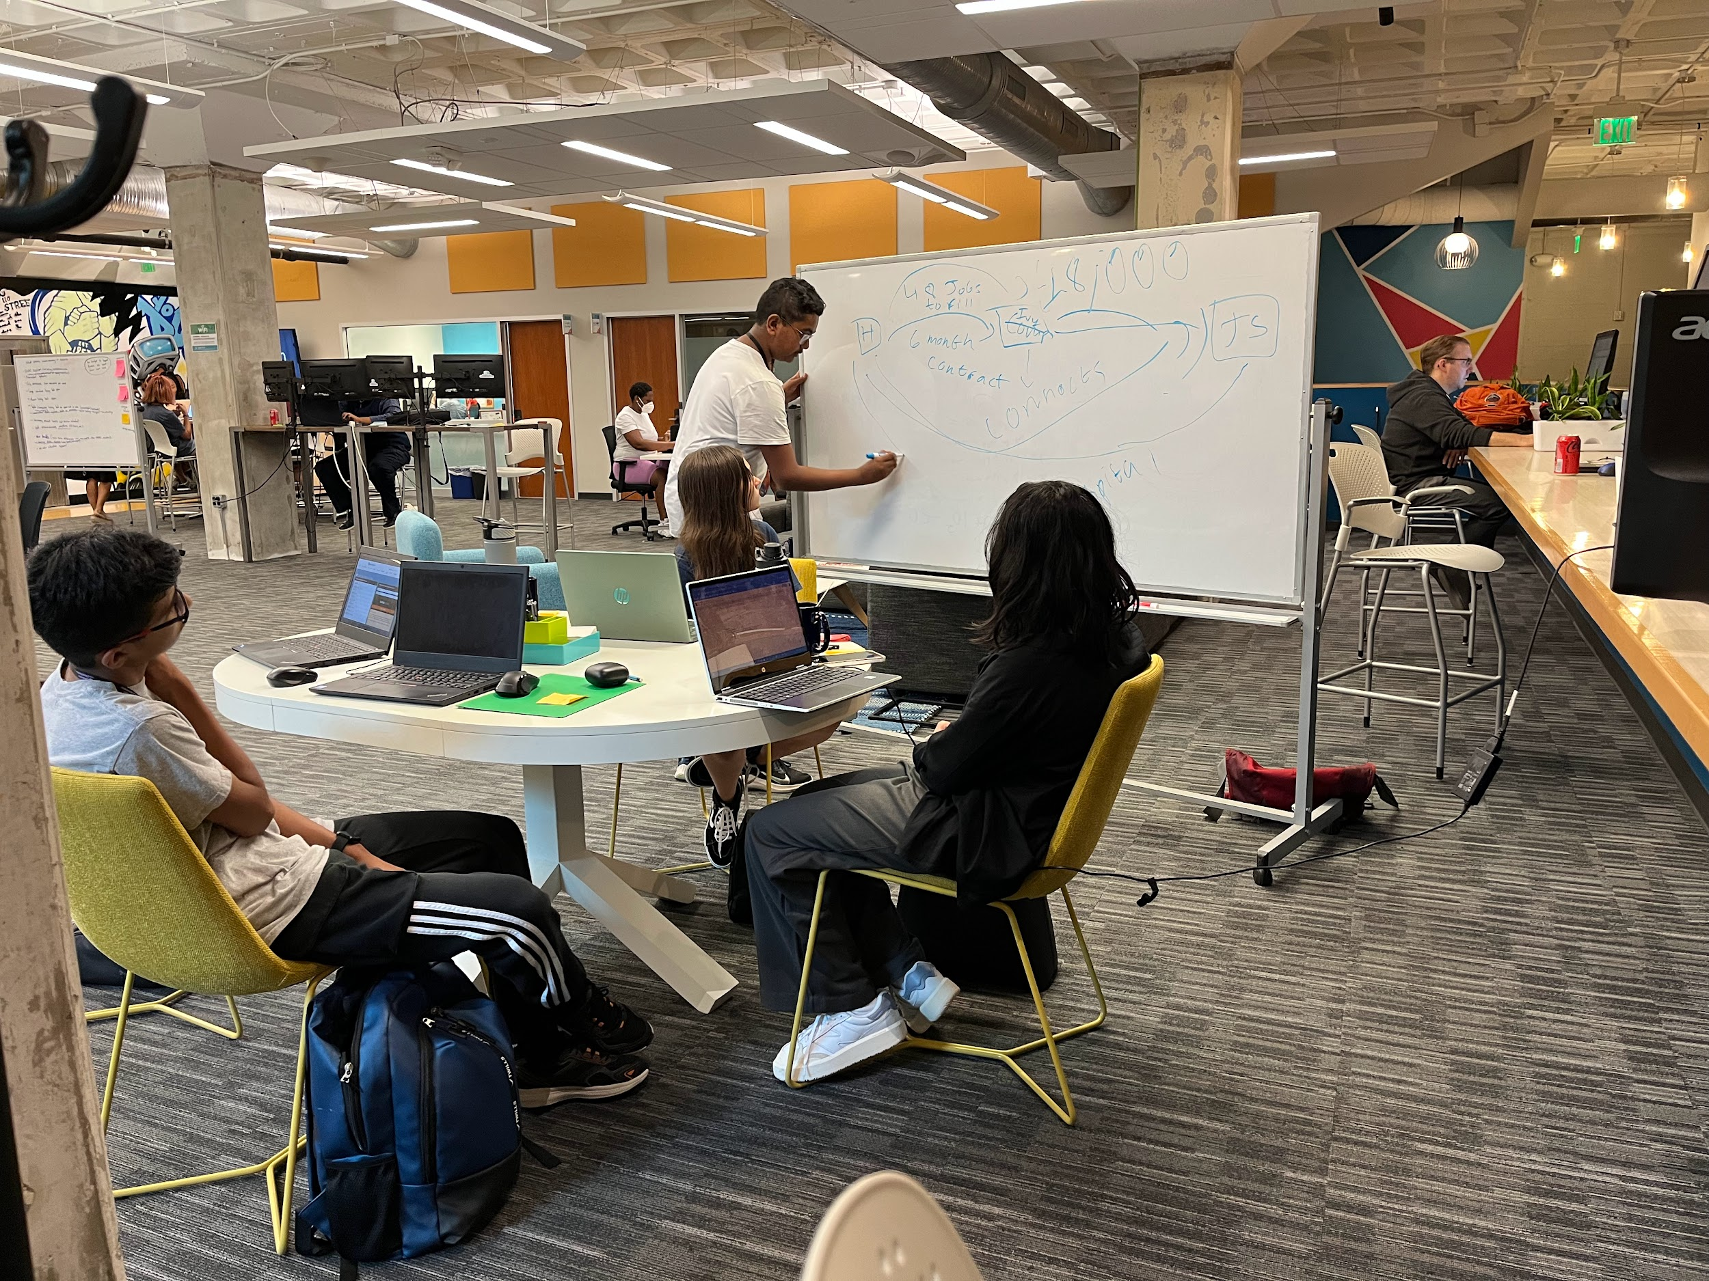
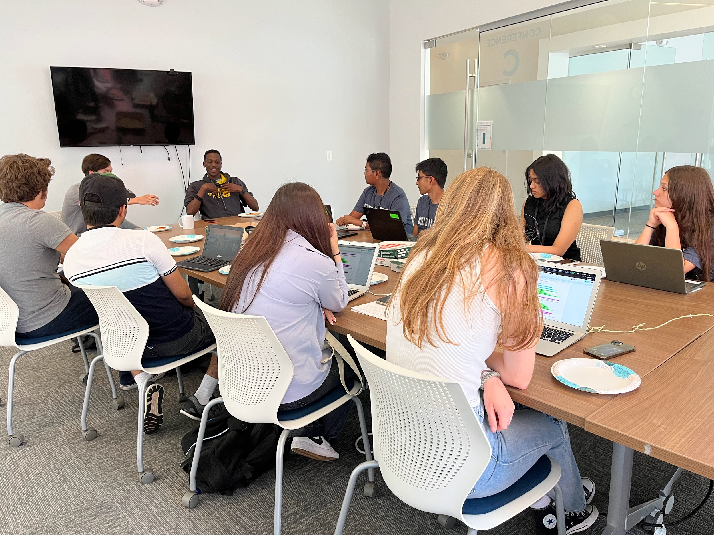
Teamship Offers
Coaching not Teaching
Teamship
A Vetted Partner with a Real Problem
Coach Tools to Problem Solve and Work as a Team
Coach 4 Mindsets of Effective Teams
Notes:
Explain how District C manages the business partner vetting and recruitment
Example Mindset: Design Mindset.
Example Tool: Take 5 (cannot interject, only additive questions)

Slide 10
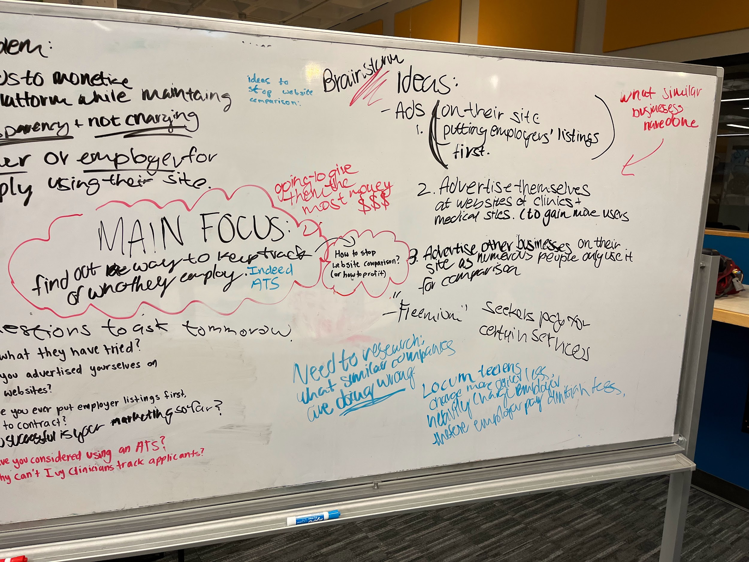
Teamship’s Value Add
My Perspective
Deemphasize Solo Achievement
Manage Uncertainty
Manage ‘no right answer’
Understand real needs of businesses
Equitable starting point
Notes:
My Insights from being a coach and program manager

Slide 11
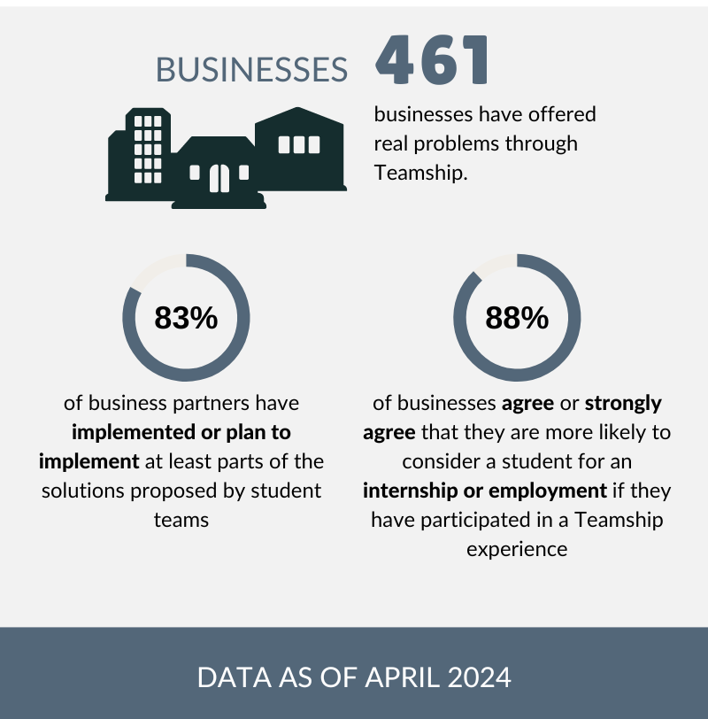
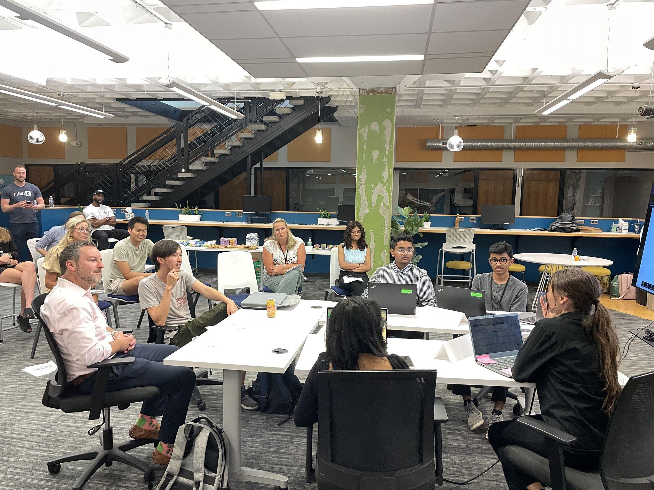
Teamship’s Outcomes
Pitch the Best Solution that Solves the Problem and How to Implement the Solution
Notes:
Mention NPS Score of 62.5 (was higher with earlier adopters to program)
Everything from Billion Dollar companies to a monster truck racetrack; many STEM business partners.

Slide 12
Introduce academically talented participants from a wide range of backgrounds to STEM research or industry and help cultivate their leadership skills
INSPIRE Program

Slide 13
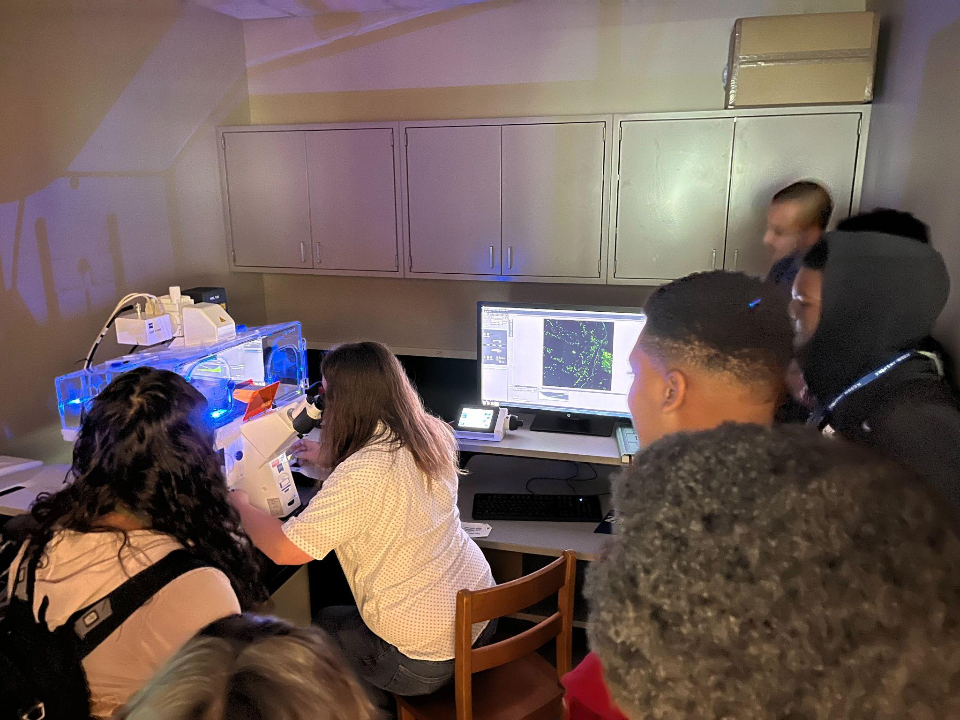
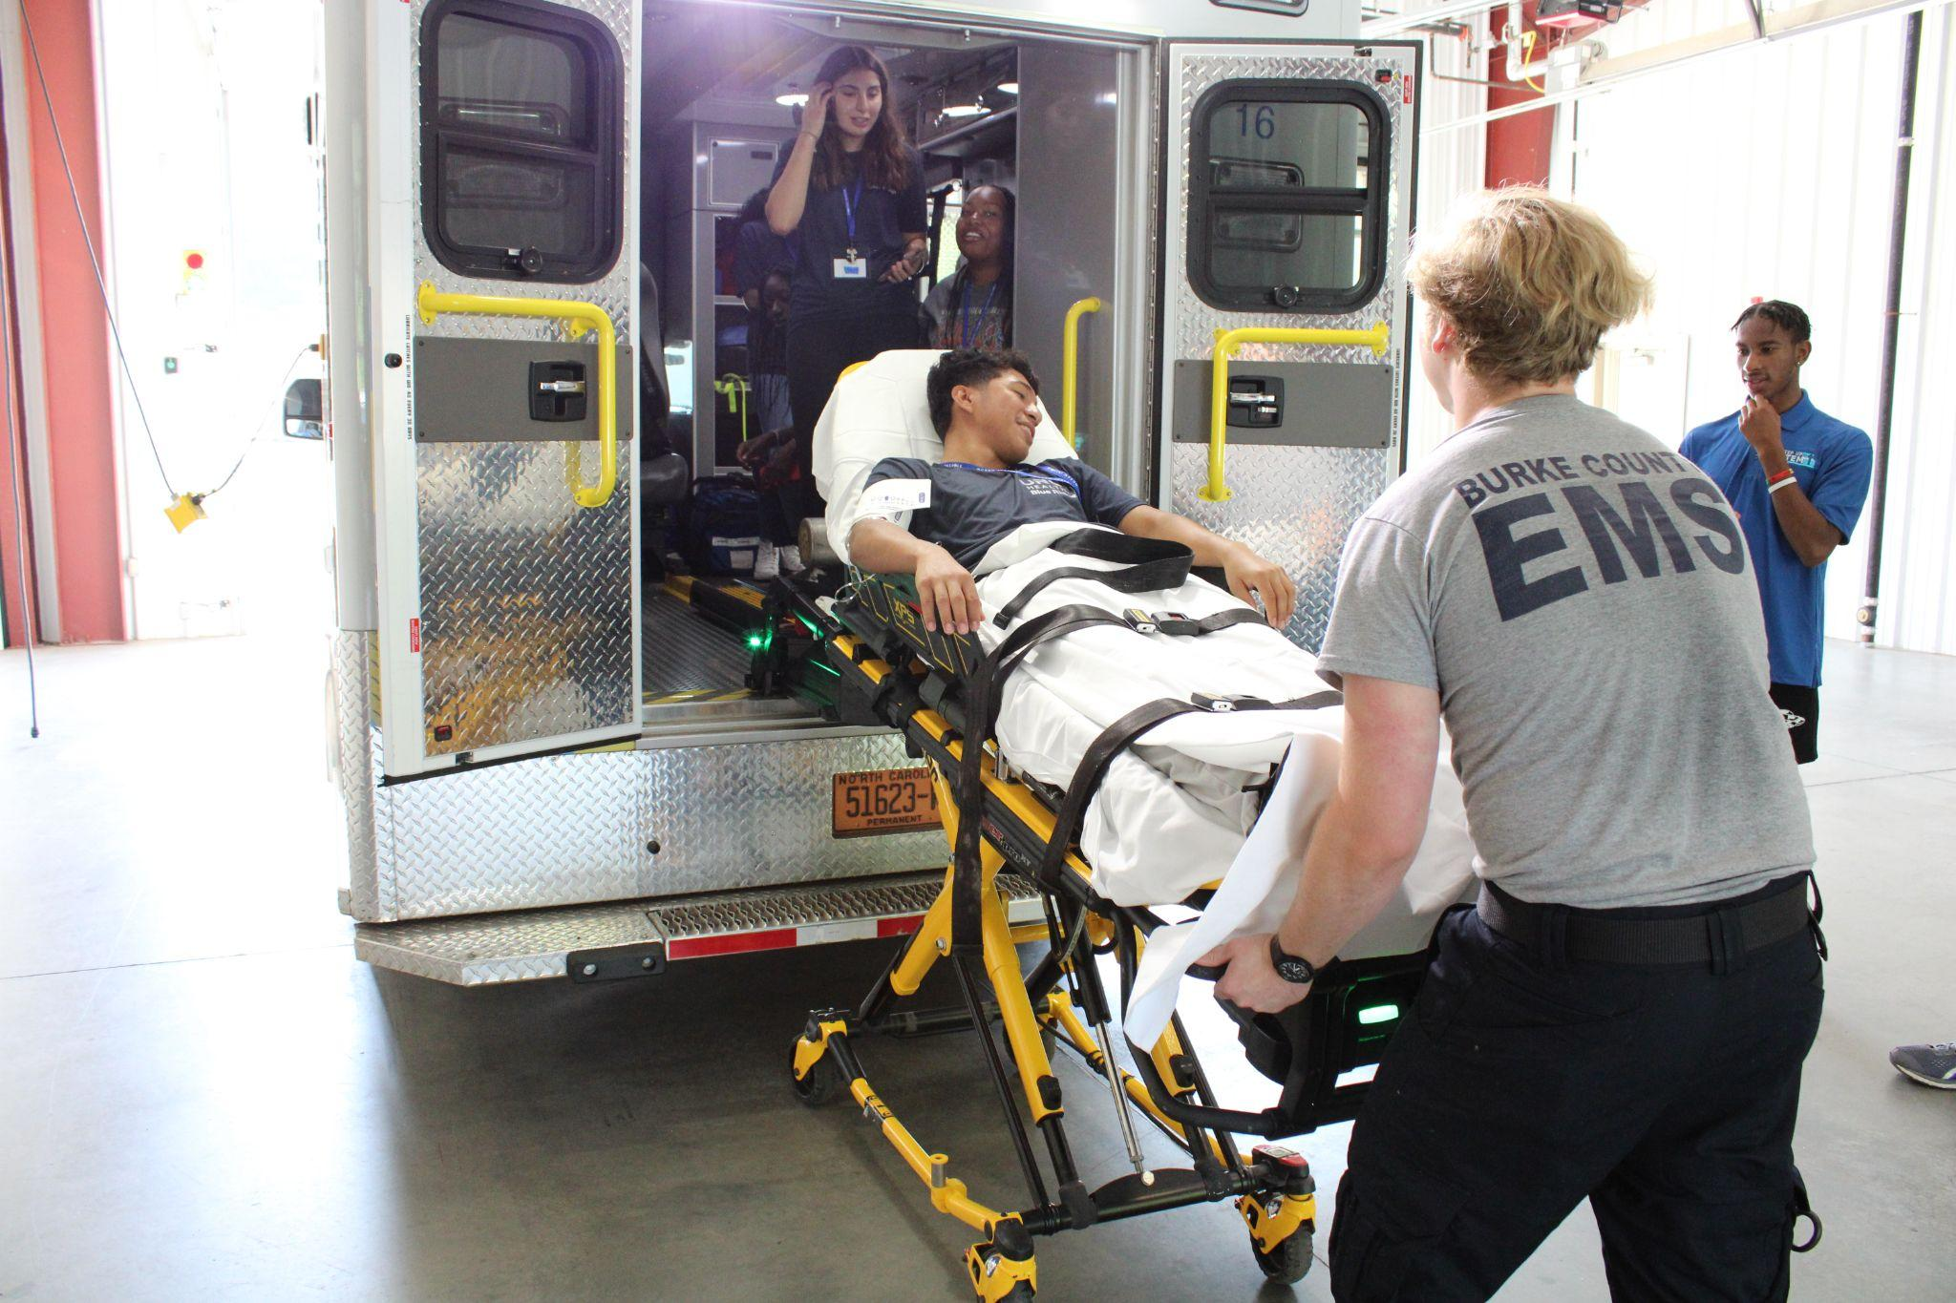
INSPIRE is…
Participants: High School (or….)
Timeline: 1 week
A one-week summer residential experience
Support for students from groups historically underrepresented in STEM fields
Teams are matched with a mentor who facilitates an inquiry or research experience.
Notes:
Program runs in Durham and Morganton; the Durham campus mostly places students in large research labs at Duke, UNC Chapel Hill, etc
African American/Black, Hispanic/Latino, Native American, Native Hawaiian or other Pacific Islander, or female; students from low-income households; and students from the three U.S. Congressional Districts in the state (1, 3, 11)
Projects were in game design, medicine, emergency management, and also can be with research labs

Slide 14
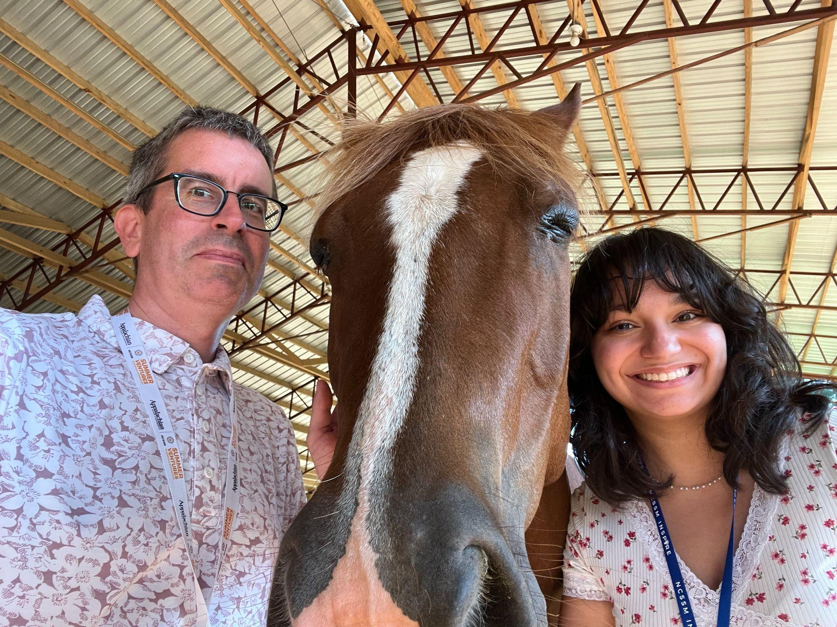
INSPIRE Offers
Complete a small project with a mentor in teams.
STEM Skills and Exploration
Enrichment activities, such as sessions and workshops on leadership competencies, team-building, etc.
Expansion of their understanding of STEM

Slide 15
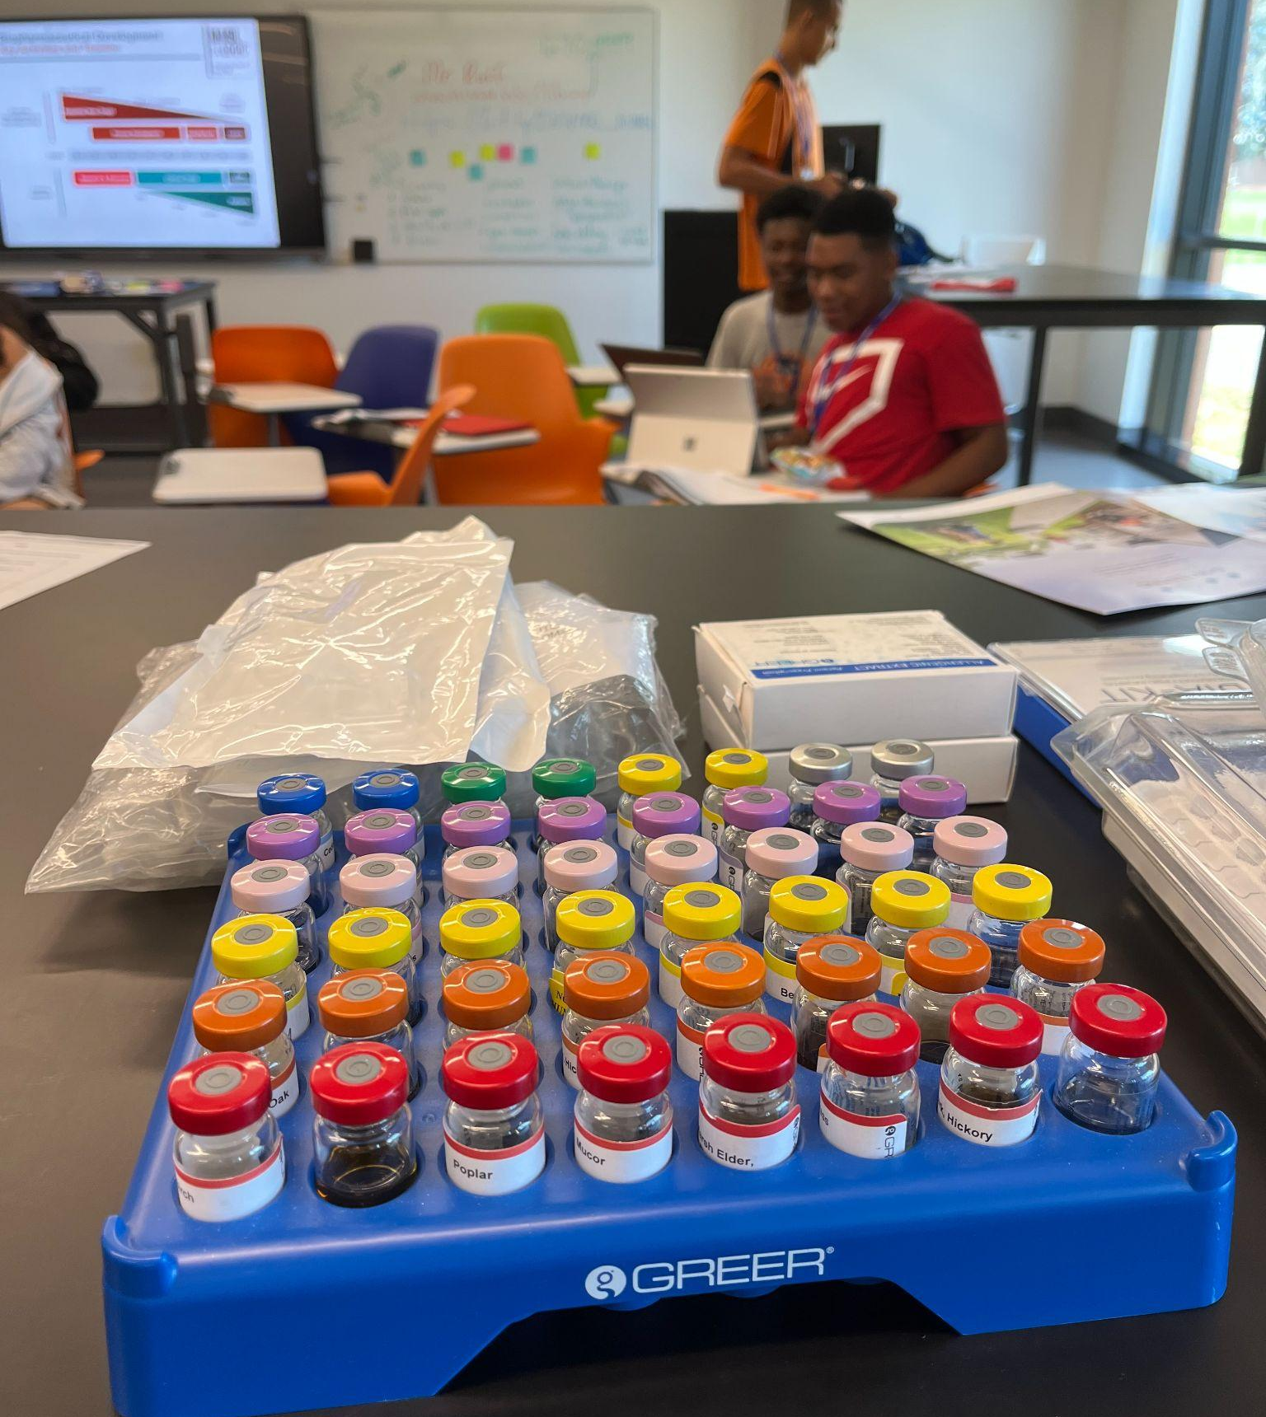
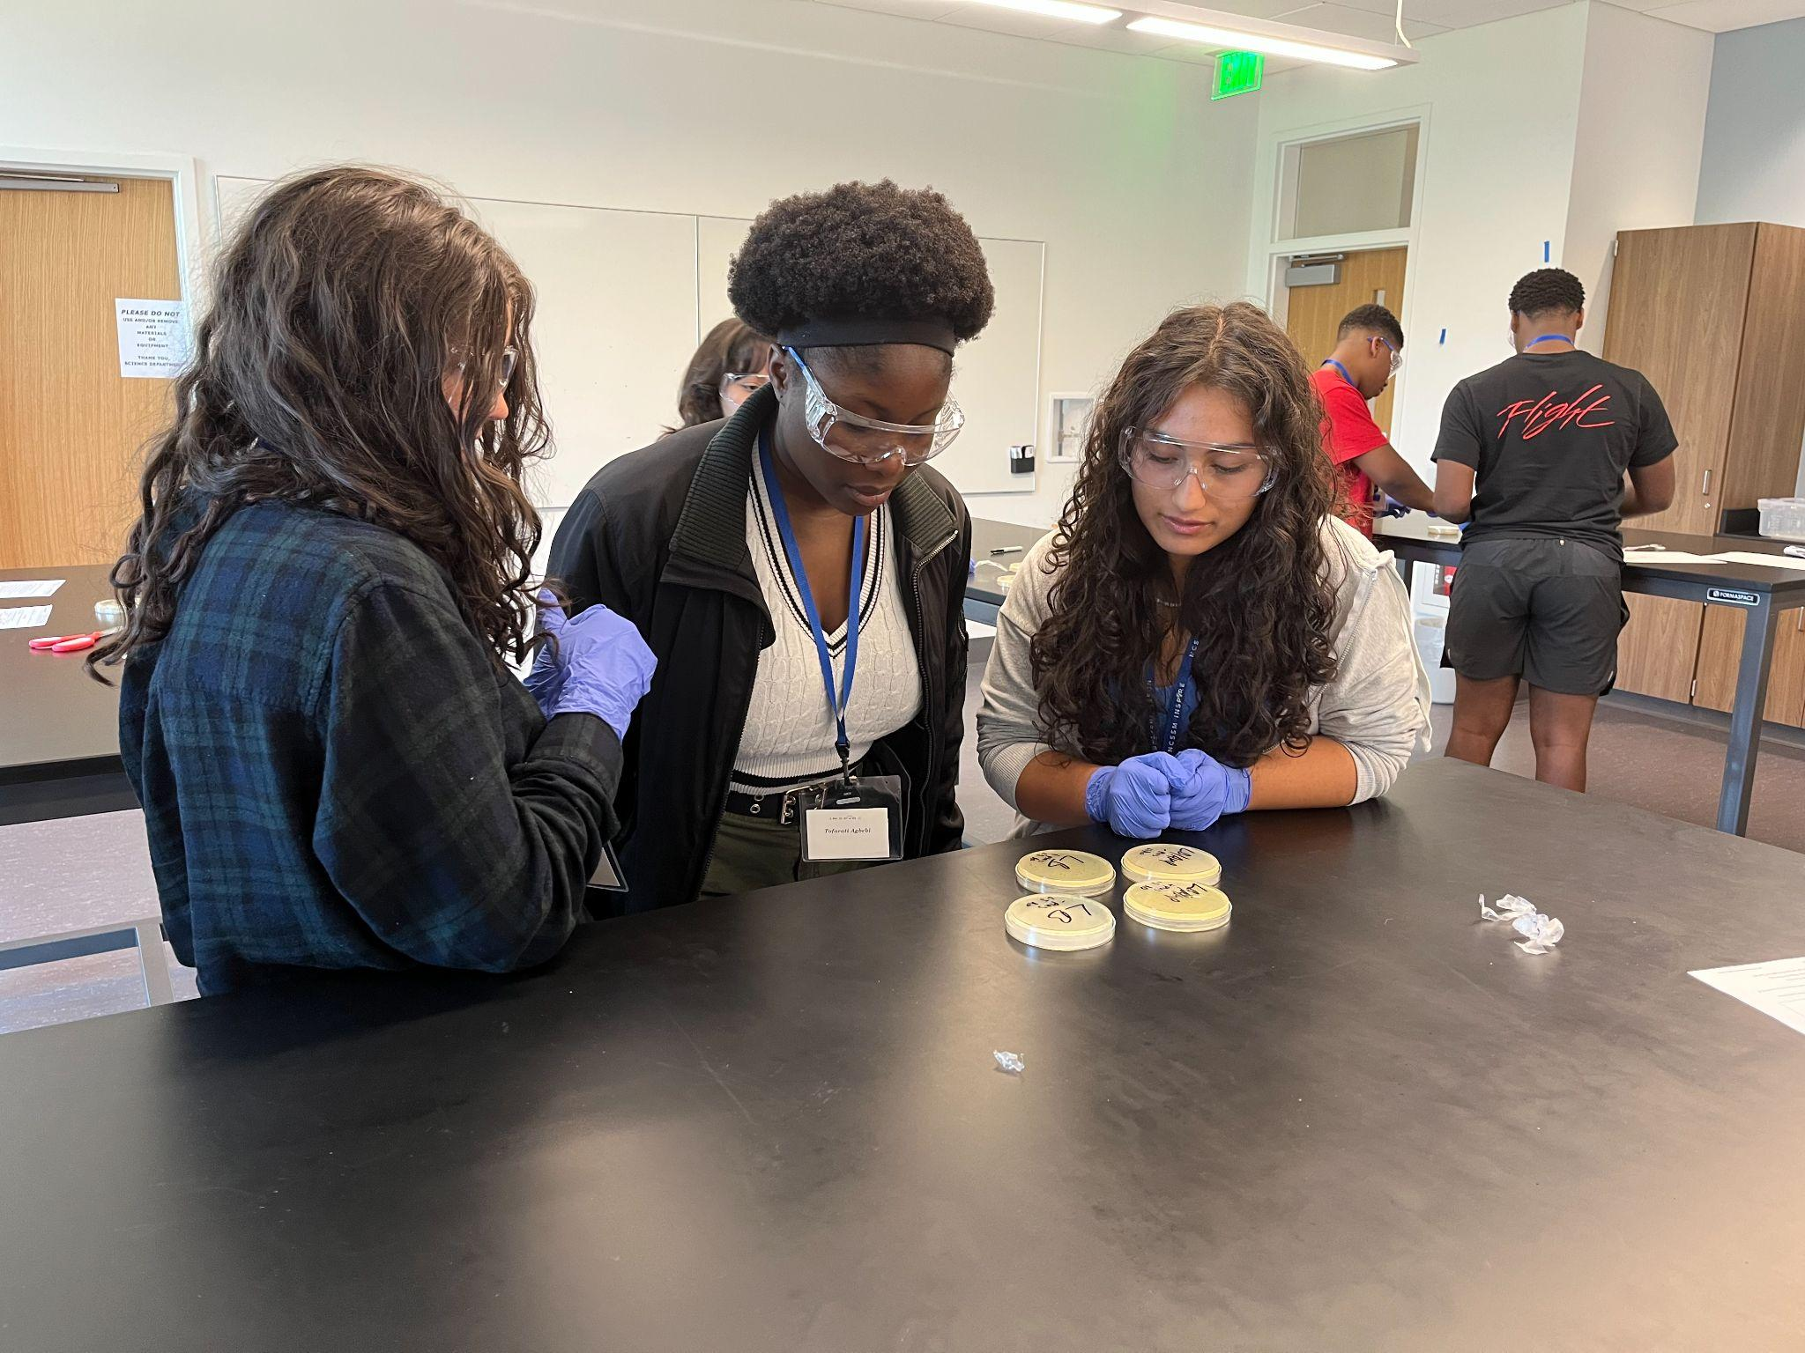
INSPIRE Value Add
Team-Based approach that builds community and confidence
Access they do not have in their family/peer network
Legitimacy of STEM careers

Slide 16
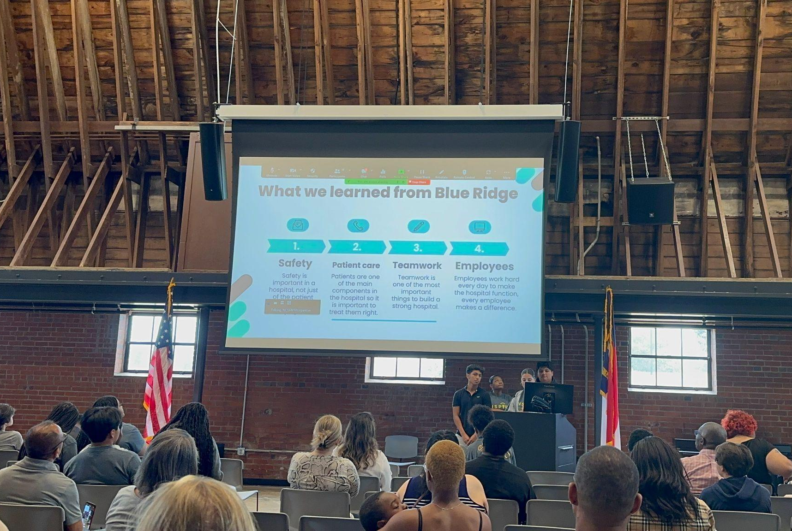
INSPIRE Outcomes
“I liked most going to Appalachian State University & looking at the bio and chem lab.”
Outcome: Pitch their project and experience
Boost to confidence in STEM Skills and STEM Careers
“My mentorship experience gave me valuable insight into a specific career area.”
59% Agree / 41% Strongly Agree
“I would recommend this mentorship experience for future Inspire
students.”
4.6% Disagree / 27.6% Agree / 68% Strongly Agree
Persistence in STEM Programs

Slide 17
A no-cost, state-funded program for academically talented to engage in research with faculty and get hands-on experience at a university.
Summer Ventures in Science and Math (App State, ECU, UNC-W, UNC-C)
Notes:
This is not like common programs that place 1-2 local students with various researchers around campus.

Slide 18
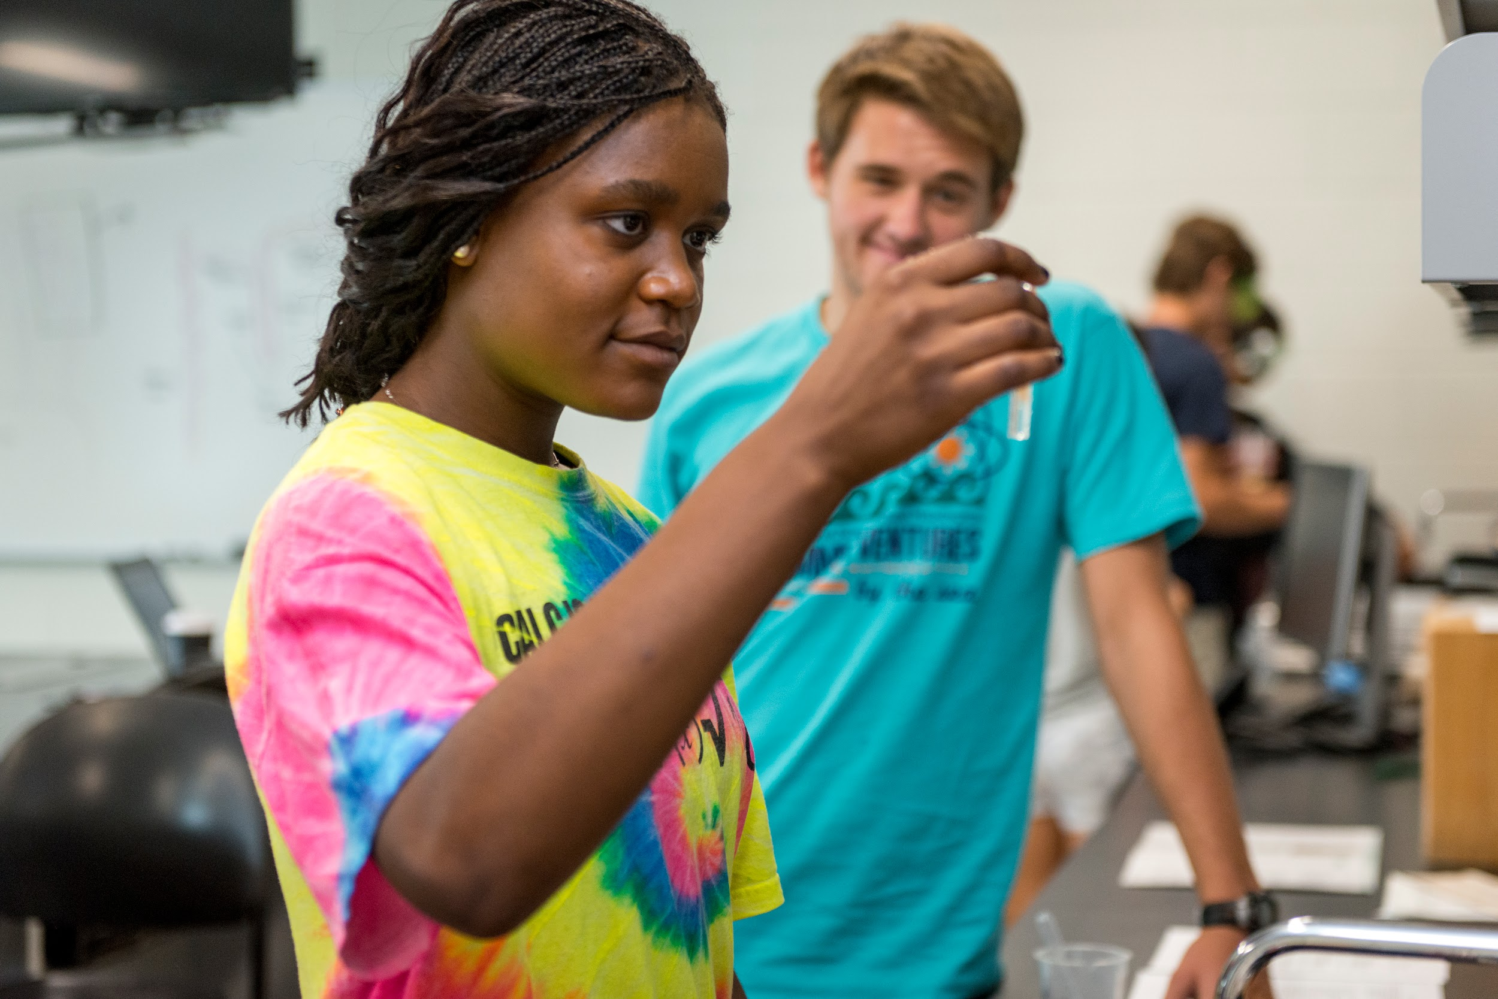
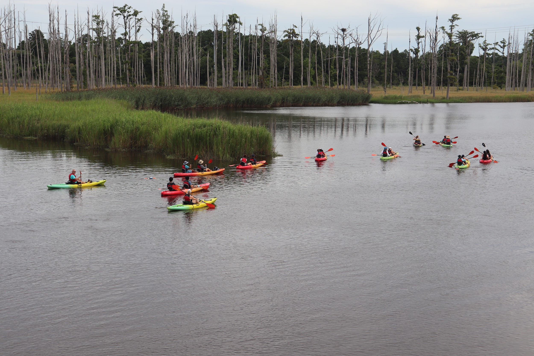
Summer Ventures is…
High School CURE/REU
Participants: High School (or….)
Timeline: 4 weeks
Four weeks in the summer and conduct research around STEM topics
Organized into cohorts that do team or individual research
Opening Access and Pathways to STEM Careers

Slide 19
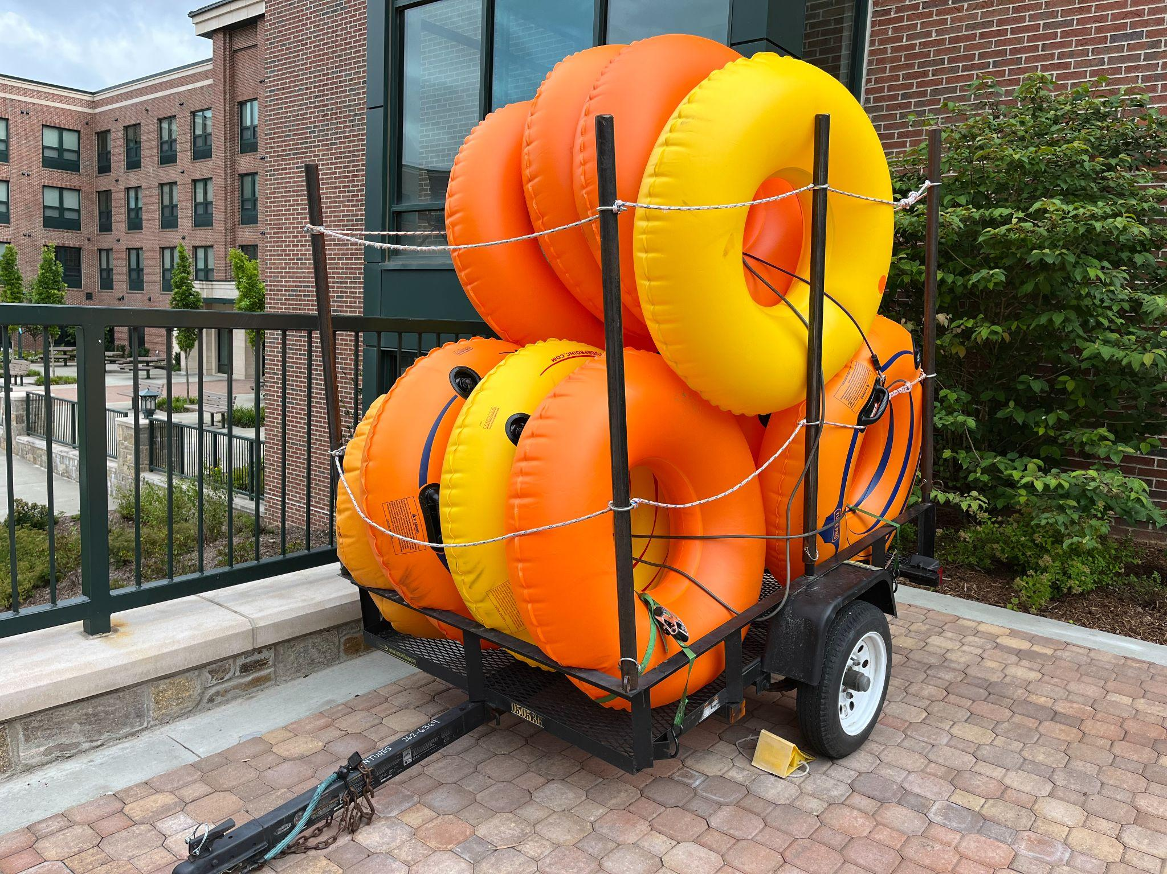
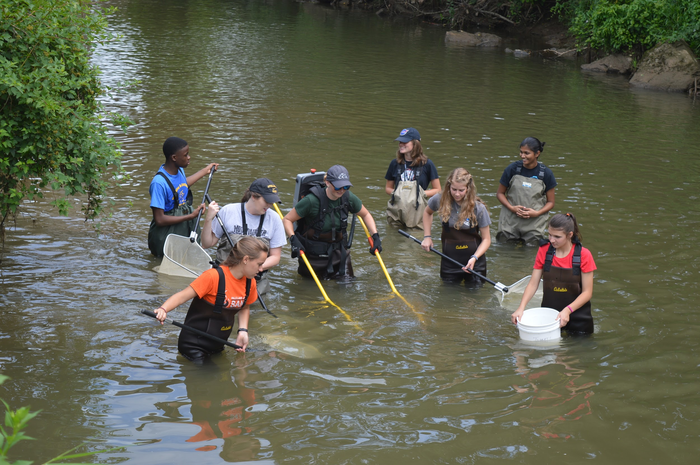
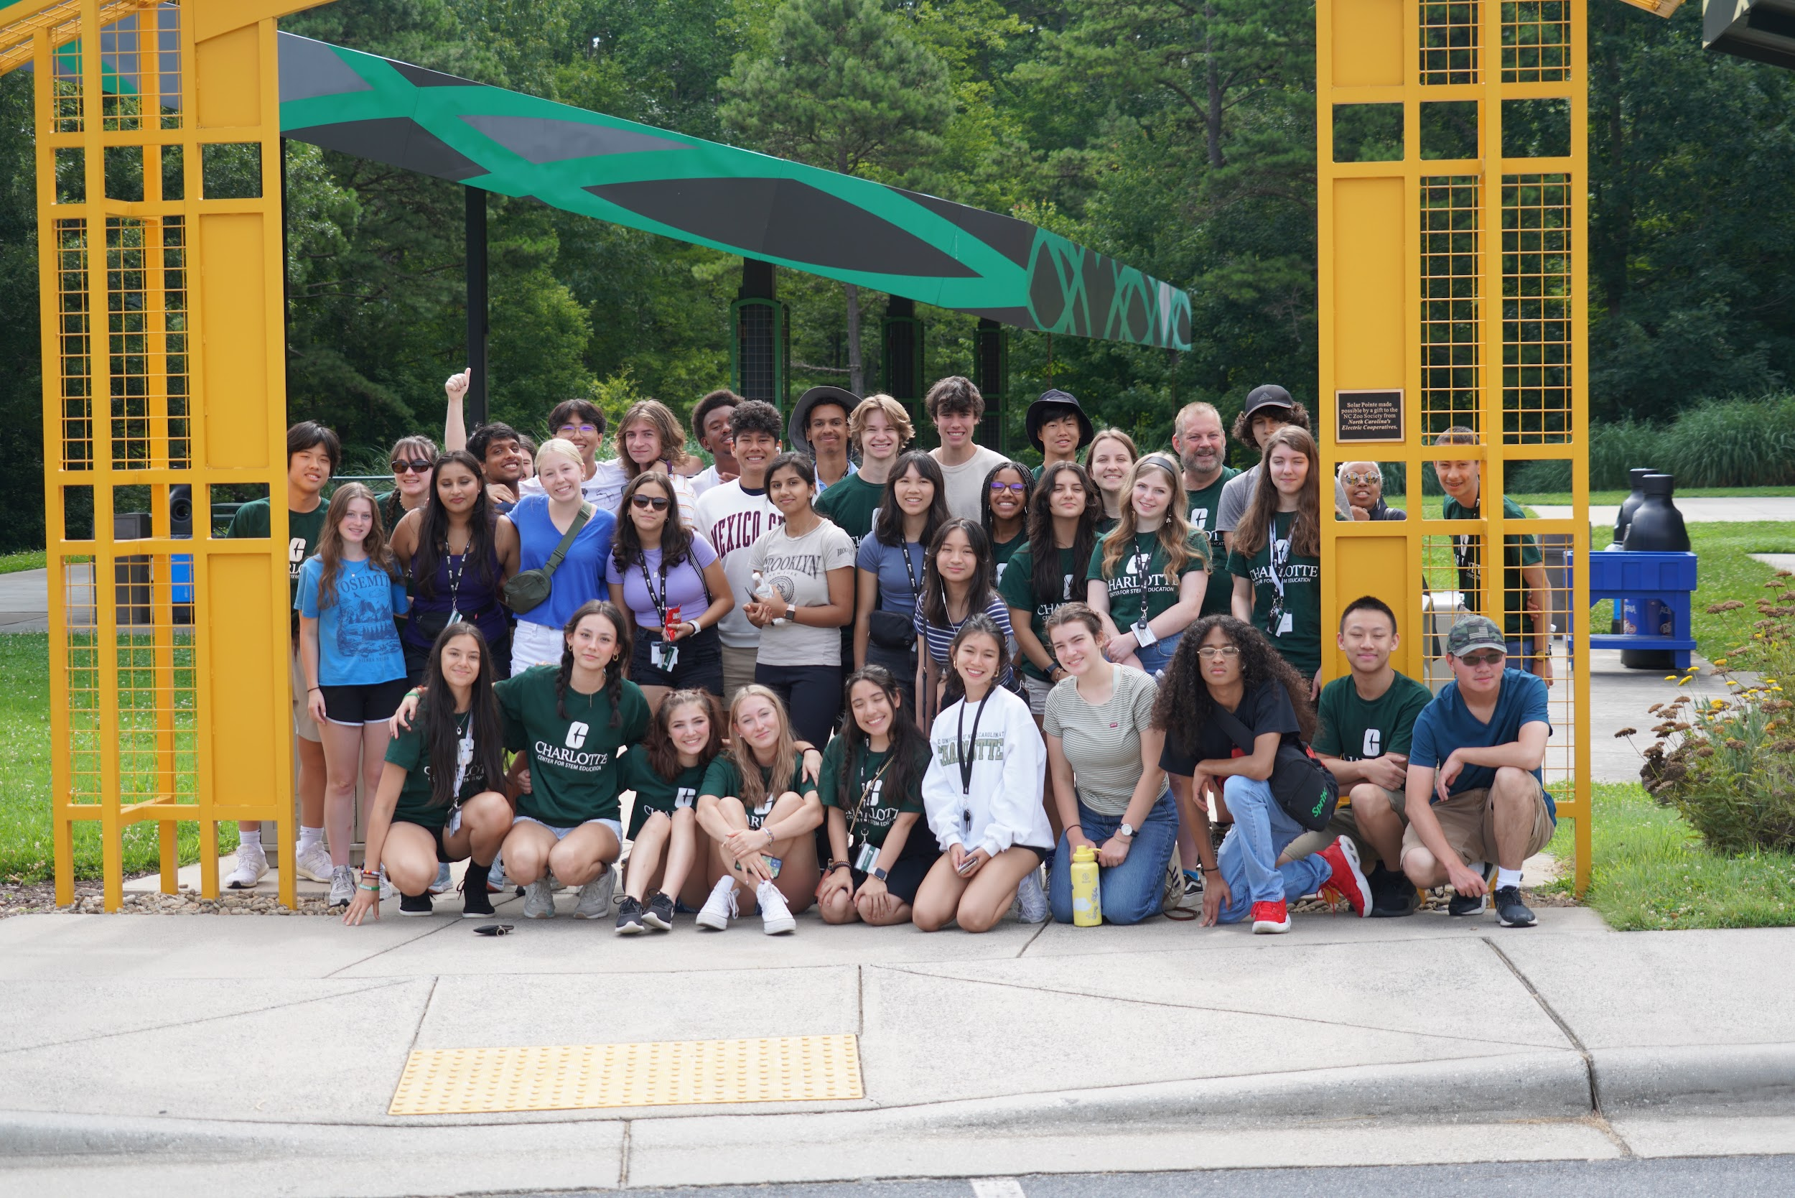
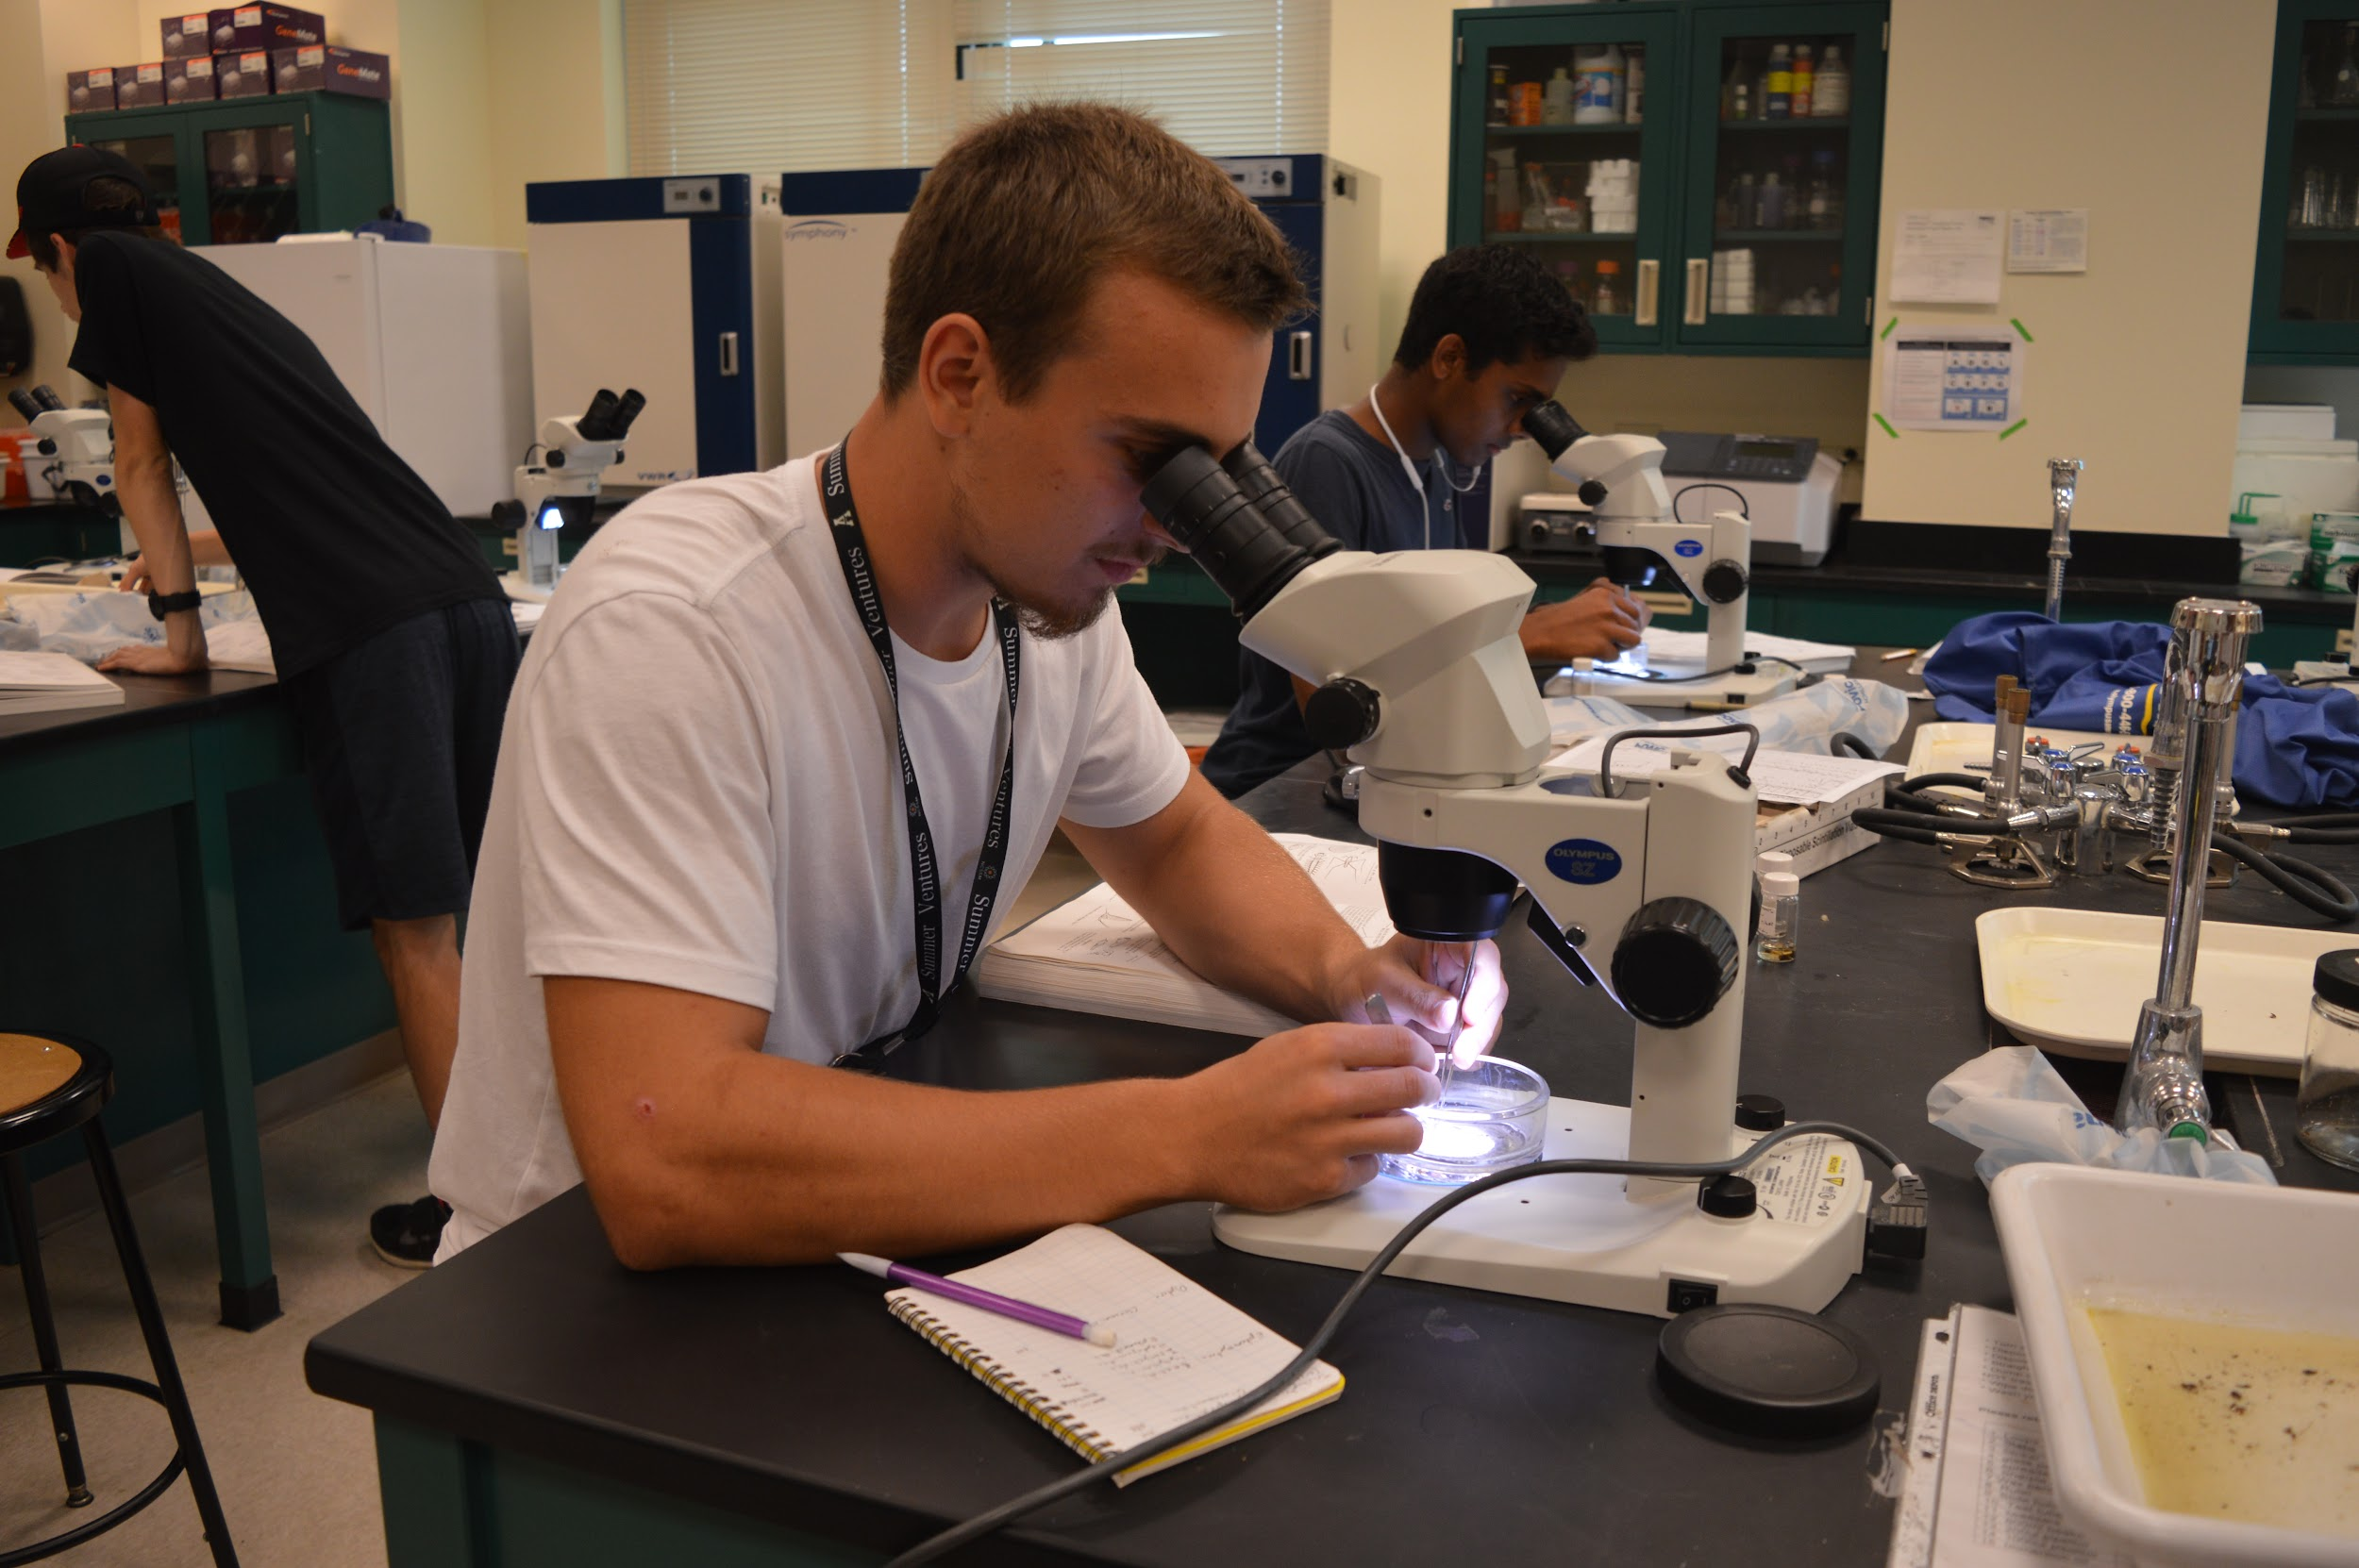
Summer Ventures Offers/Value Add
Importance of Community
Research and information skills short course prior to the experience
STEM Career exploration in topics they would not consider
Students from highest and lowest income counties succeed and collaborate
Mandatory Fun: Strong residential experiences builds a strong research experience…

Slide 20
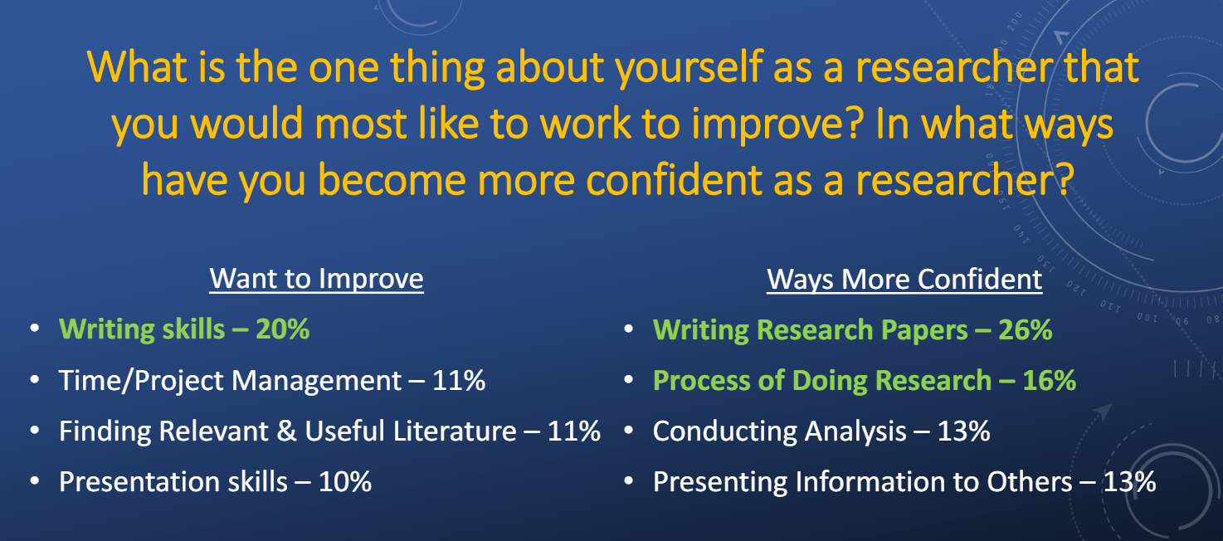
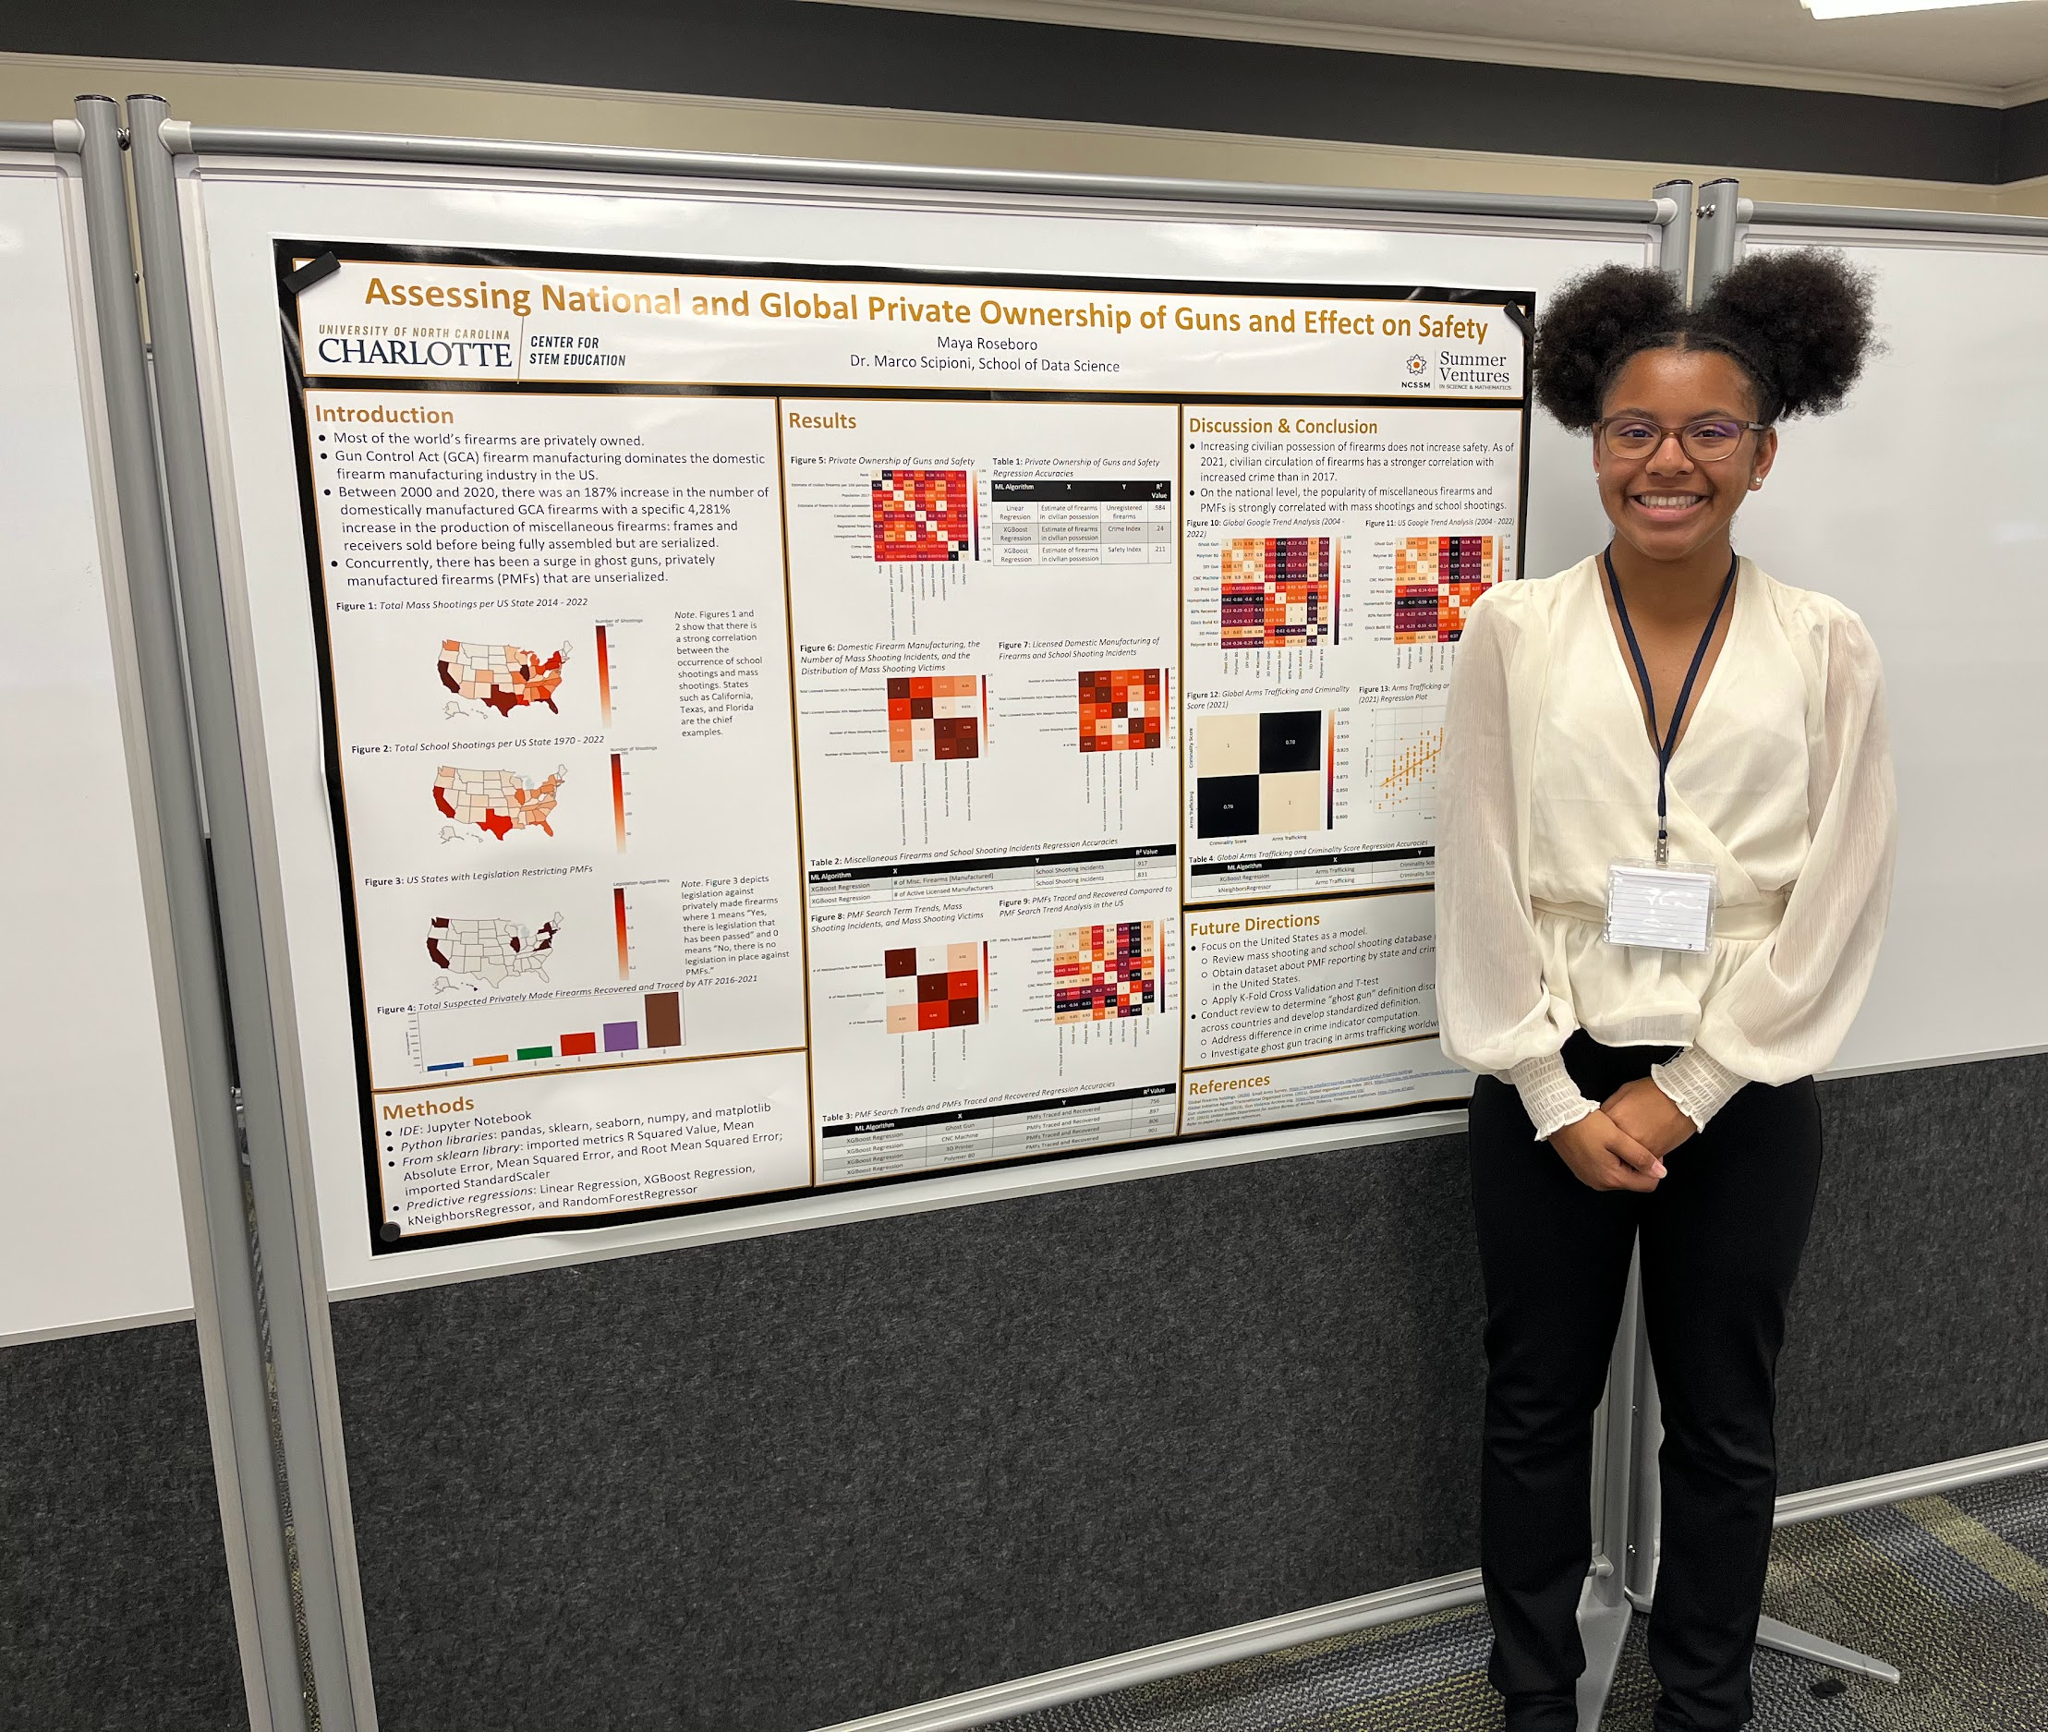
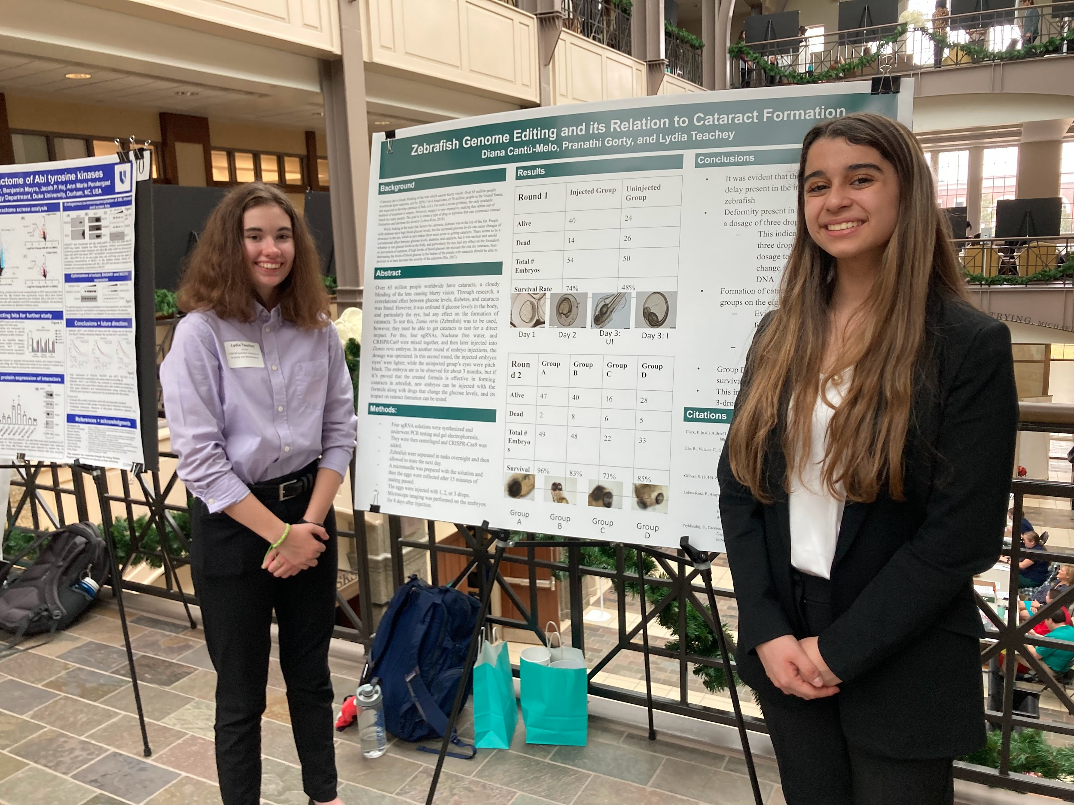
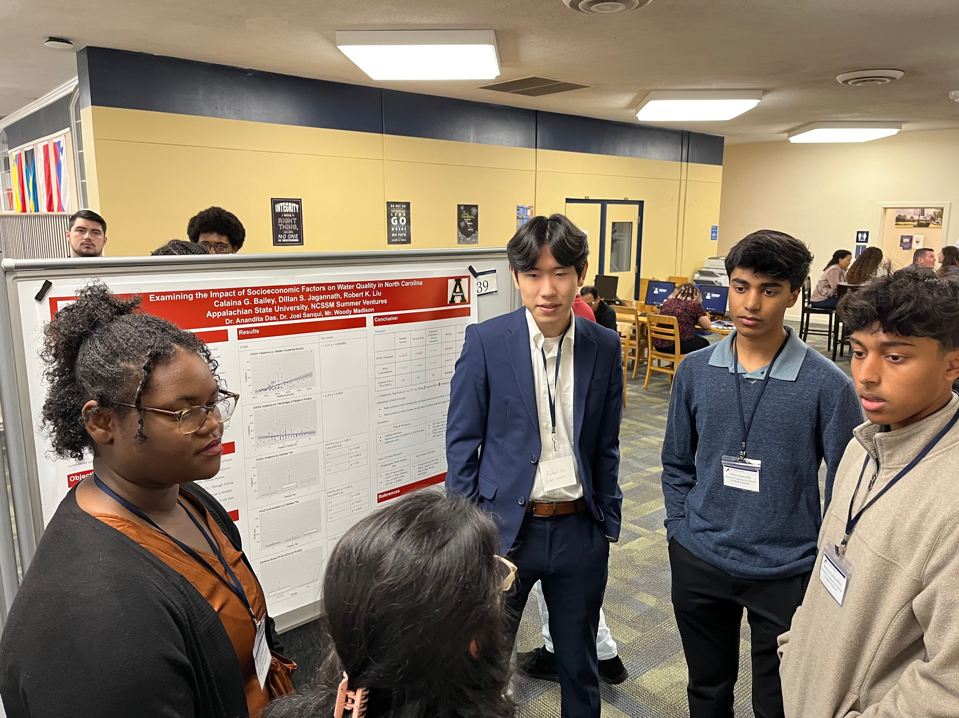
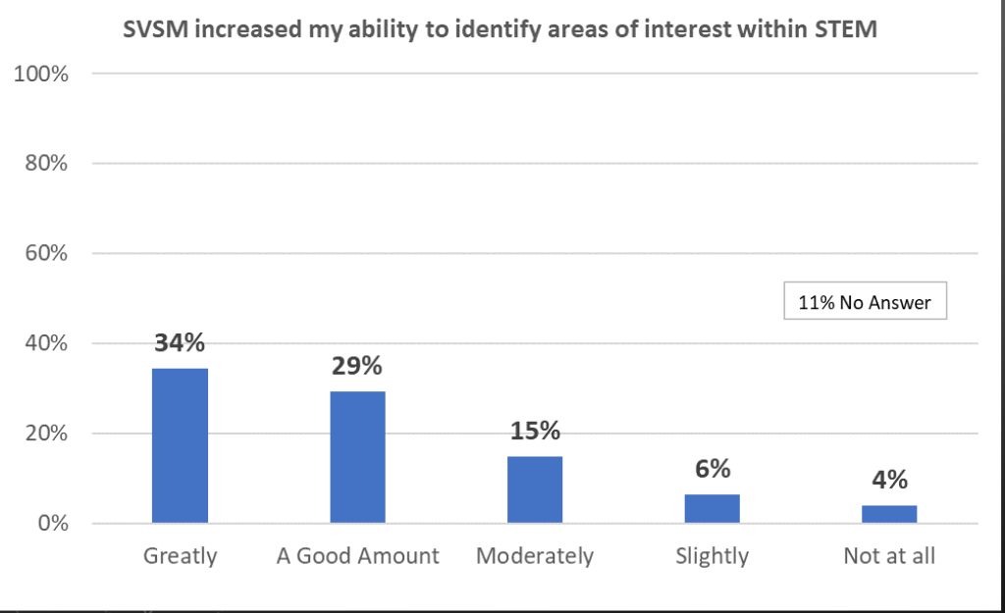
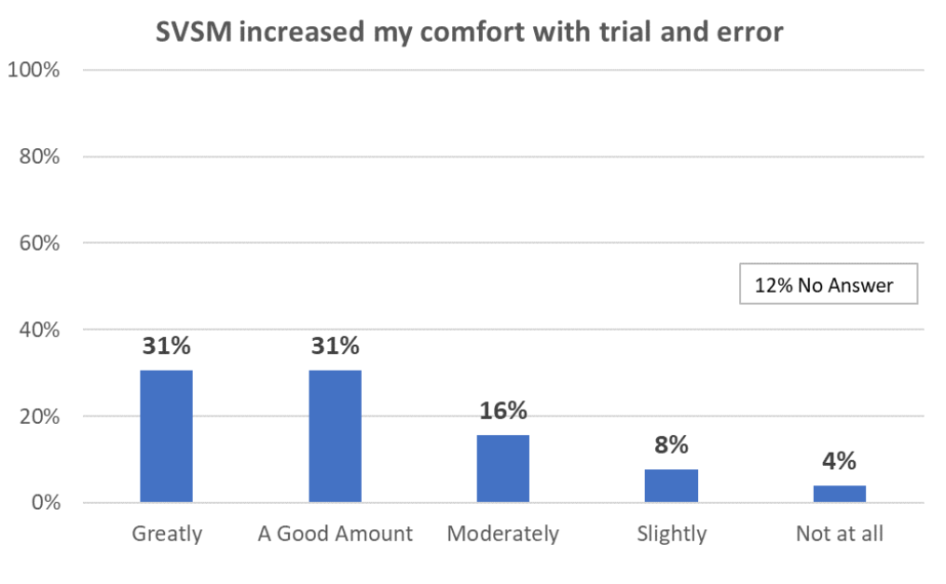
Summer Ventures Outcomes
Publications
Presentations
40 years of data!
10,000+ alumni

Slide 21
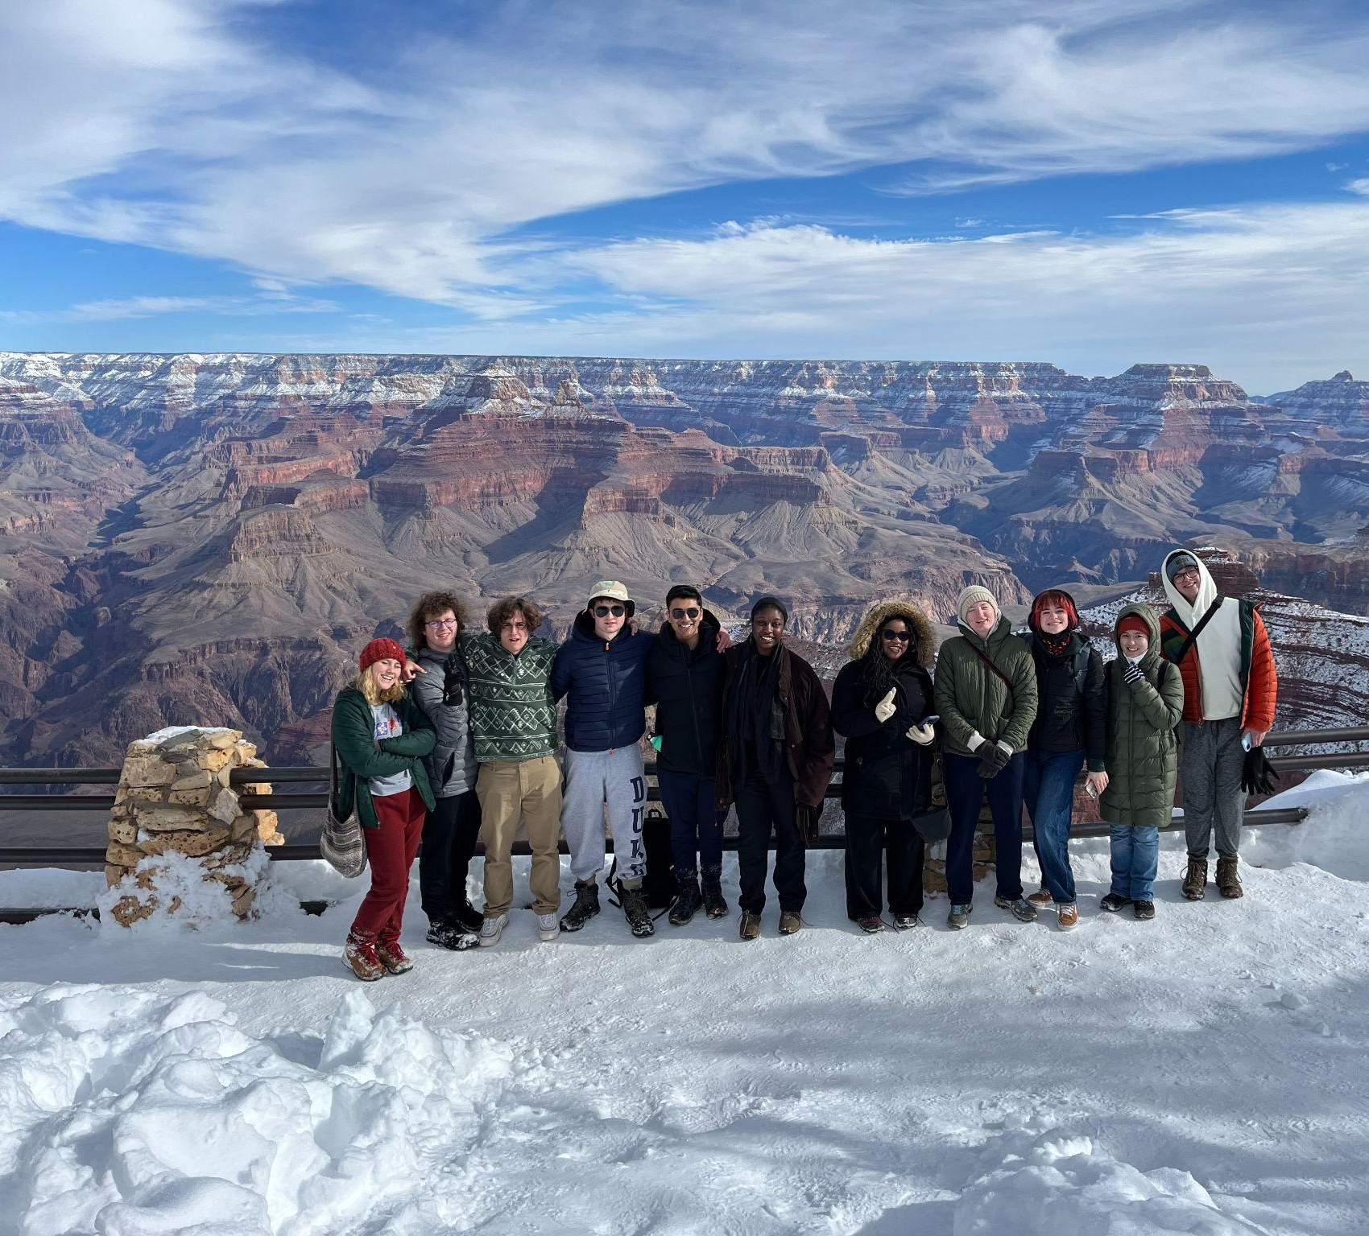
districtC.co
karen@districtC.co
ncssm.edu/summer
thomas@ncssm.edu

Slide 22
