Slide 1

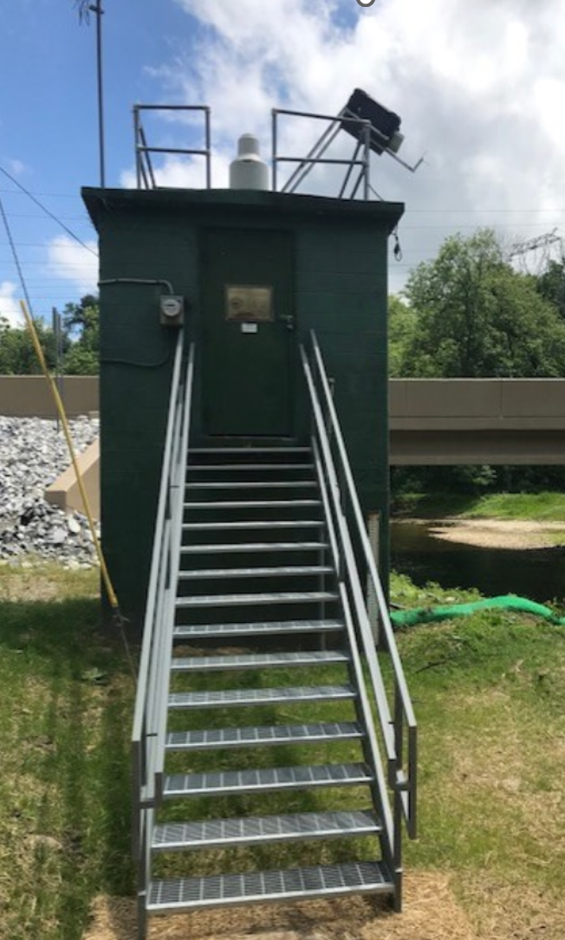
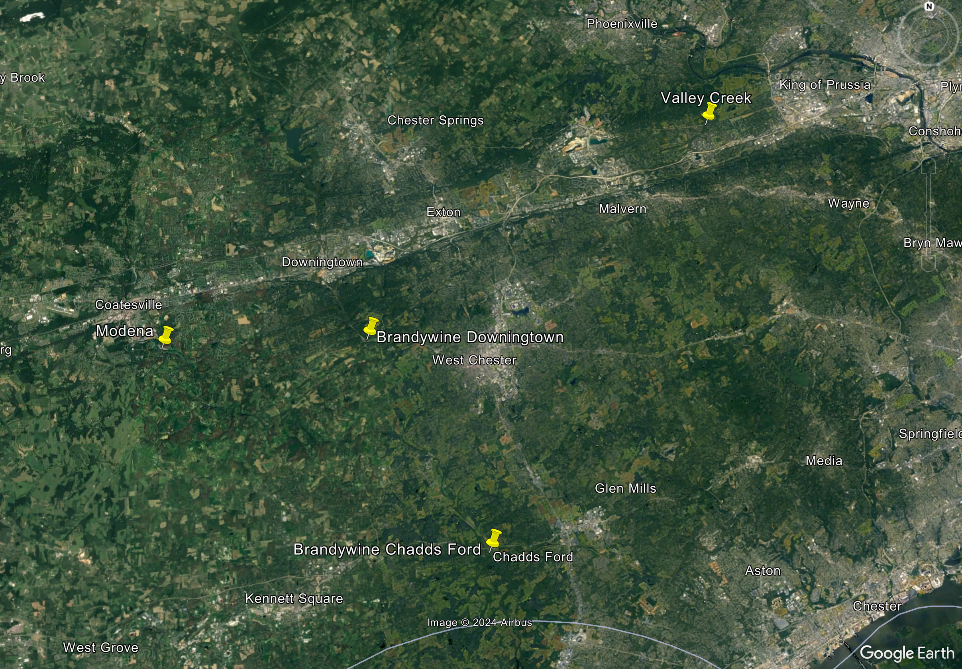
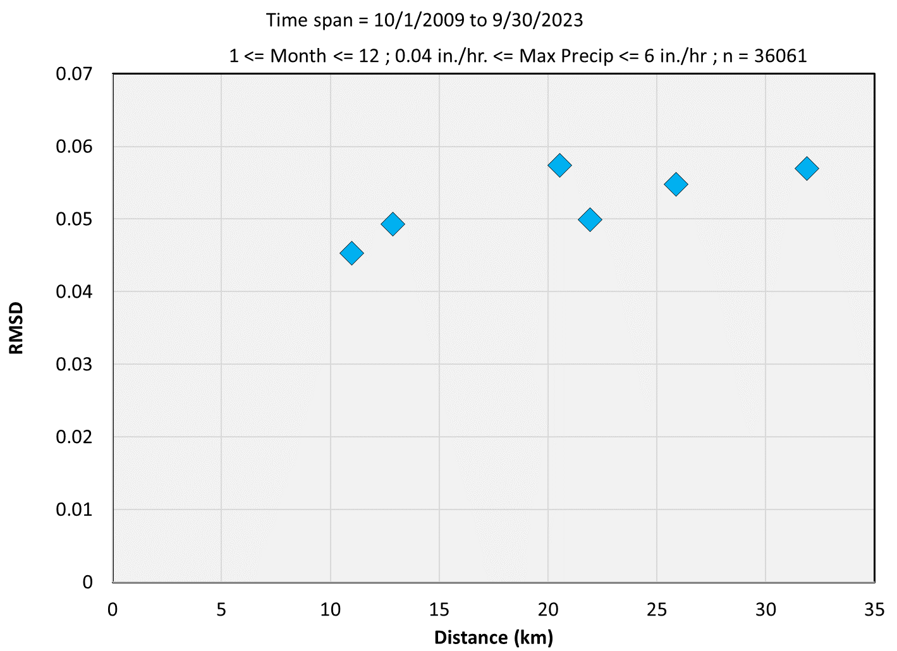
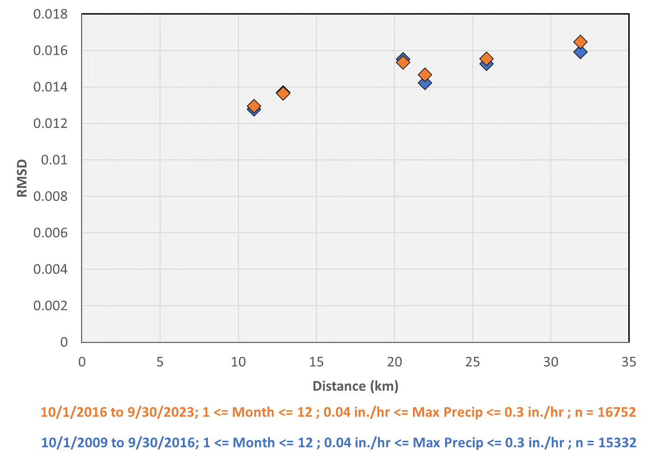
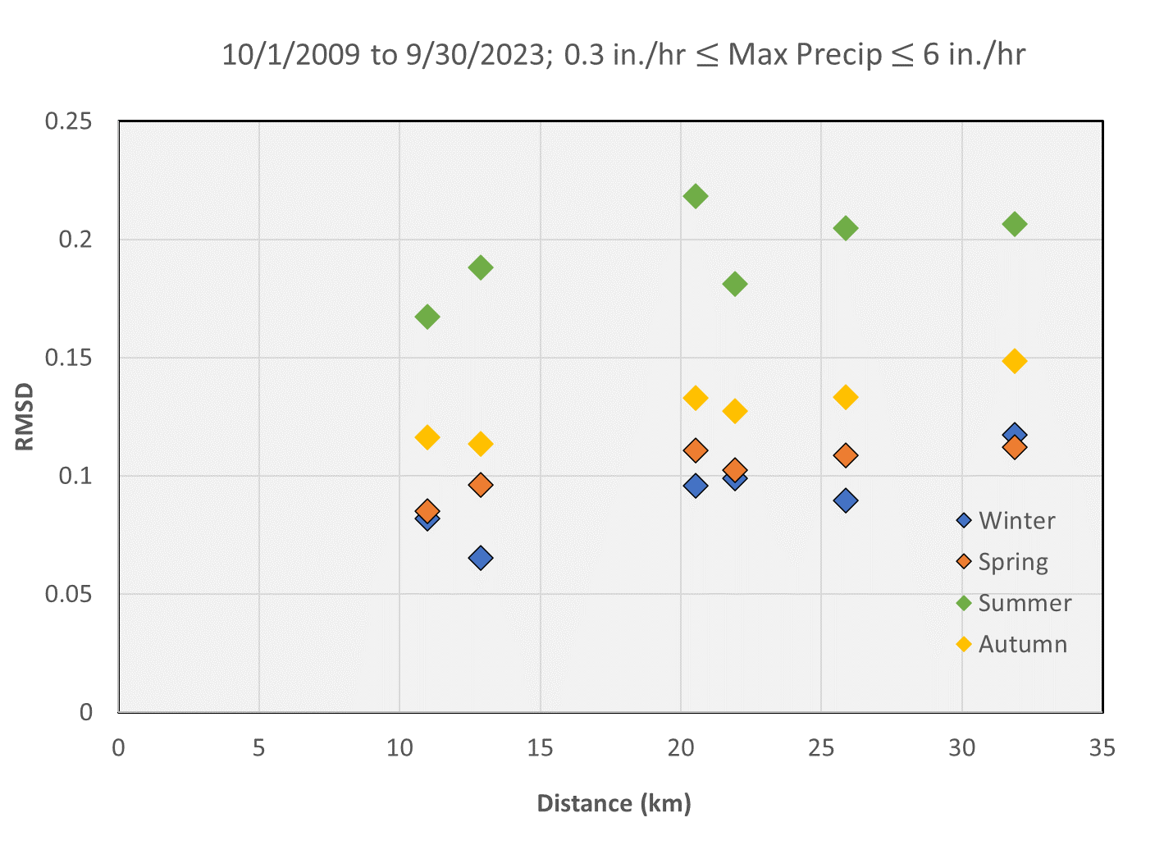
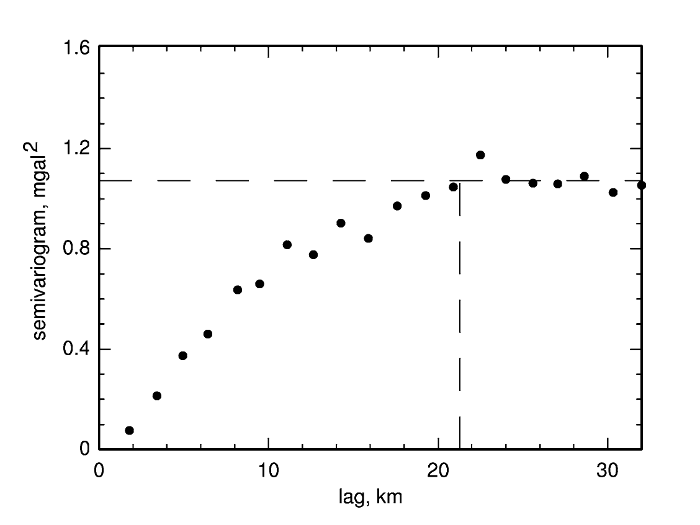
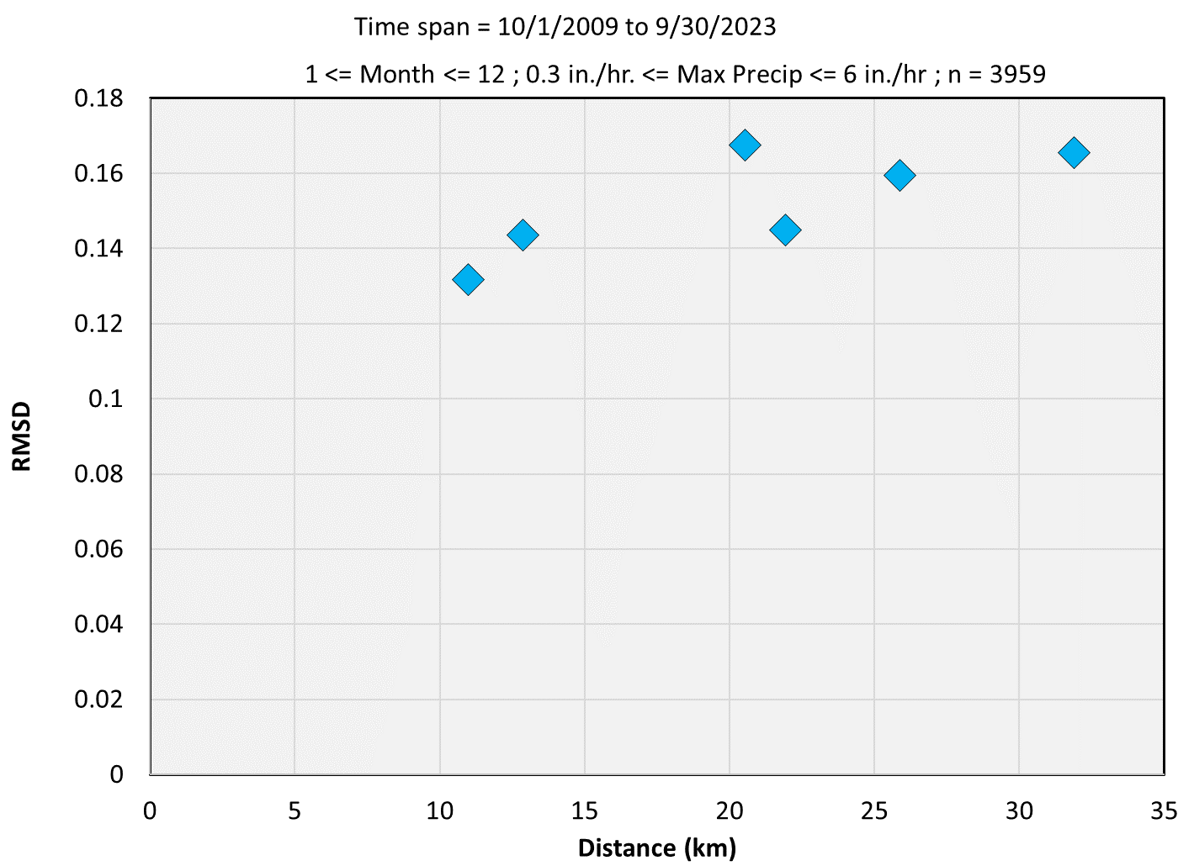
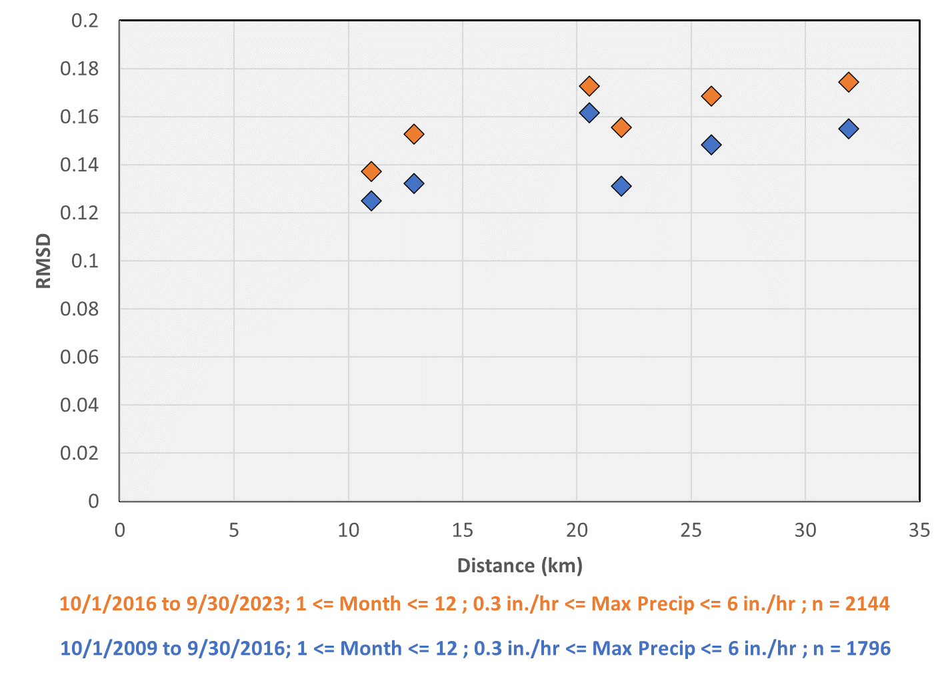
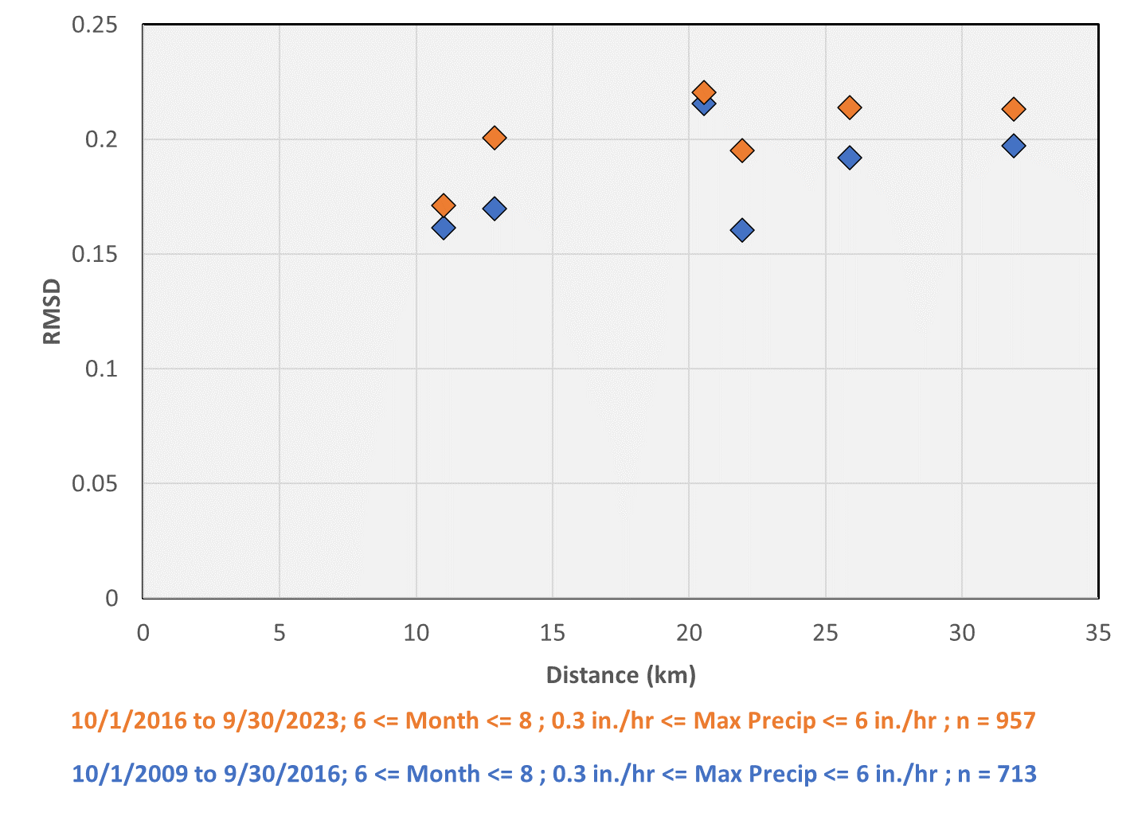
Are Localized Flash Flooding Events Increasing in Chester County, PA?
Emerson Emery, M.S. Geoscience Student Dr. Timothy Lutz, Professor Emeritus Dr. Joby Hilliker, Associate Professor
Department of Earth and Space Sciences, West Chester University, West Chester, PA
1. Introduction
3. Data and Methodology
Heavy precipitation events have increased by 70% in the Northeast over the last 50 years (DEP 2018).
These events can cause localized flash flood damage.
Studying precipitation data can give insight into whether localized flooding has increased in Chester County.
To assess the spatial variability of precipitation, Semivariograms (SVG) are employed in this study.
Matheron (1963) first used SVGs to measure the degree of continuity of mineralization in ore deposits.
Davis (2002) explores the applications of SVGs in geology.
The goal of this study is to use SVGs to determine whether the spatial variability of heavy precipitation events has changed in Chester County over the last 14 years.
At select stream gages, the United States Geologic Survey (USGS 2023) collects precipitation measurements (see Figure 2, right) every 15 minutes.
Data were analyzed from four stations across Chester County (see yellow pins on Figure 3) from water years 2009 to 2023, a 15-year data period.
Station coordinates in UTM coordinates were converted into easting and northing (km) to calculate distances for the six permutations between pairs of stations
Calculations could made for N time periods at which precipitation was recorded at all four stations.
Calculations could also be conditioned on:
Time range: Earlier (Water years 2010 - 2016) and Later (Water years 2017 - 2023), and
Precipitation rate: Light ( < 0.075” falling in 15 minutes (i.e., <0.3”/hr)); or heavy ( > 0.075” falling in 15 minutes (i.e., >0.3”/hr))
Meteorological season: e.g., (Winter = December – February, Spring = March – May, and so forth)
Figure 2. Surface water monitoring station in Downingtown PA.
Figure 3. Locations of the 4 USGS stations used in Chester County, PA in this study.
4. Results
All Data
Change with Time
Seasonal Variations
Figure 4. Precipitation variability for the entire 15-year data period for all seasons and precipitation rates
The plot reveals a general increase in precipitation variability with increasing distance between stations, an expected result.
Figure 6. Precipitation variability in the Earlier (2010-2016; shown in blue) and Later (2017-2023; shown in orange) periods for light precipitation rates only.
Only a subtle shift up is evident in precipitation variability over the last 15 years.
Figure 8 shows how precipitation variability changes over season. Only heavy precipitation rates were included.
Greatest variability occurs during the summer (green), a sensible since warm-season rainfall tends to be more convective – and thus heavier.
2. Semivariograms (SVG)
Figure 4
Figure 6
Figure 8
Semivariogram (SVG) – a plot showing the spatial correlation of an observed phenomenon.
They also measure the degree of dissimilarity between values at varying distances (Olea 2022).
Figure 1 shows an example SVG from Olea (2006) for ore samples from Kansas.
Since SVGs reveal the spatial variability of data as a function of distance between observation locations, they can provide insight into this study’s research question.
Variability can be calculated via the Sum of the Squared Differences (SSD), as shown by the formula below:
where
X_{j, t} = data value from station j at time t
X_{k, t} = data value from station k at time t
Sum is over N time periods at which j & k have observations in common
To retain units of inches, the Root Mean Squared Difference (RMSD) was then derived from SSD:
Thus, higher values of RMSD correspond to greater variability of precipitation for given pairs of locations.
Figure 5 below is the same as Figure 4 for heavy precipitation rates only.
Increasing trend is evident.
Higher RMSD values than in Figure 4 reflect the subset of higher precipitation rates.
Figure 7 below is the same as Figure 6 for heavy precipitation rates only.
Note the more significant shift up in precipitation variability over the last 15 years, suggesting localized flooding events may becoming more frequent.
Figure 9 shows the change in summertime precipitation variability with time. Only heavy precipitation rates were analyzed.
Similar to Figure 7 (left), the plot reveals there has been an increase in spatial precipitation variability over the last 15 years during the summer months.
Figure 1. SVG of ore samples in Elk County, Kansas (Olea 2006)
Figure 5
Figure 7
Figure 9
5. Conclusions
6. References
Analyzing 15-min precipitation data from 4 USGS stations across Chester County over the last 15 years suggests that heavy precipitation rates have been increasing locally with time.
This suggests, by extension, that localized flooding events may also be increasing .
However, this connection can be further explored using additional datasets such as surface permeability, damage reports, and so forth.
Further research will investigate whether the above spatial and temporal trends are valid for locations outside of Chester County, PA. Locating stations closer than 10 km will be a priority.
Davis, J.C., 2002, Statistics and Data Analysis in Geology (3rd), 255-265.
Lutz, Timothy, Ph.D (2024) – Semivariogram example PowerPoint and Excel workbook
Matheron, Georges (1963). Principles of Geostatistic. Economic Geology 58(8)
Olea, R.A (2006). A six-step practical approach to semivariogram modeling
Pennsylvania DEP Climate Change index. Available at: https://gis.dep.pa.gov/ClimateChange/index.html
USGS current conditions for the nation – precipitation. Available at: https://waterdata.usgs.gov/nwis/current/?type=precip&group_key=state_cd&search_site_no_station_nm=

