Slide 1

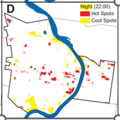
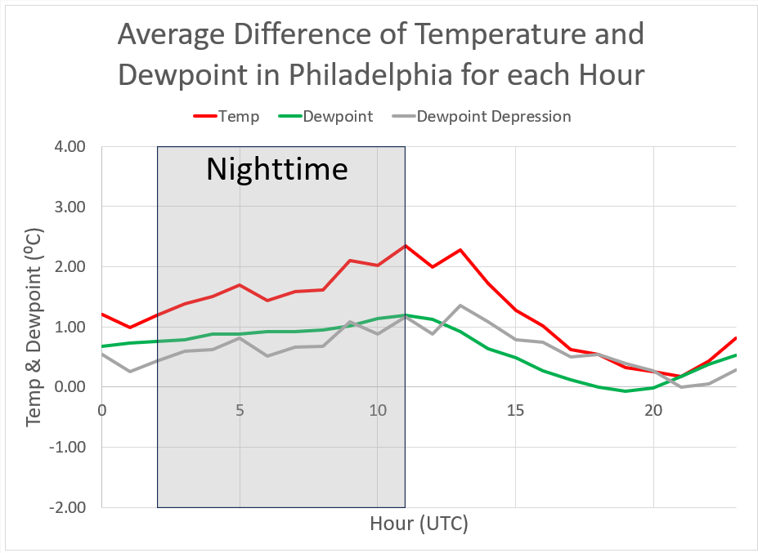
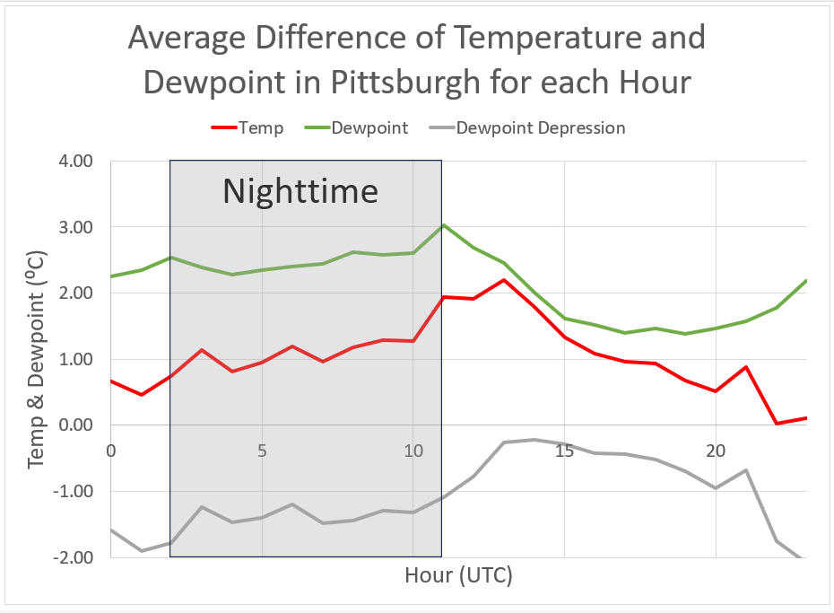
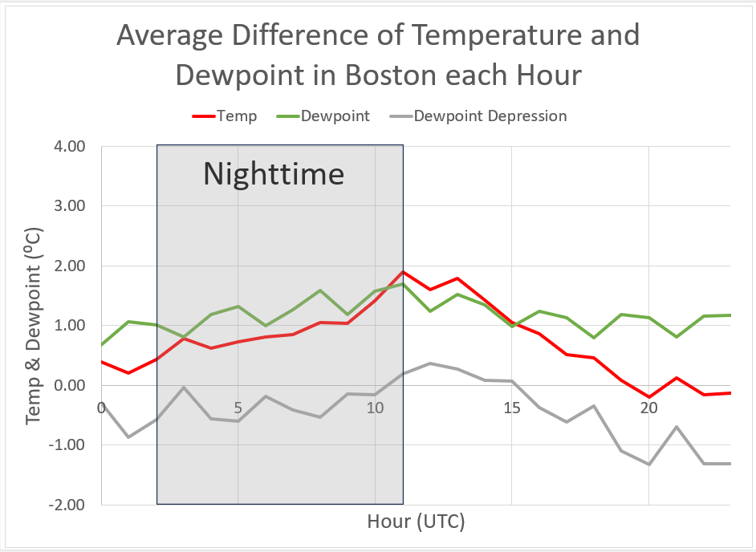
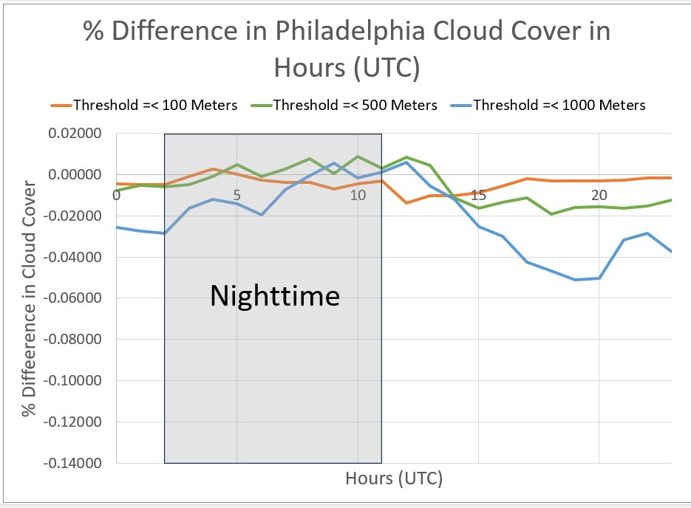
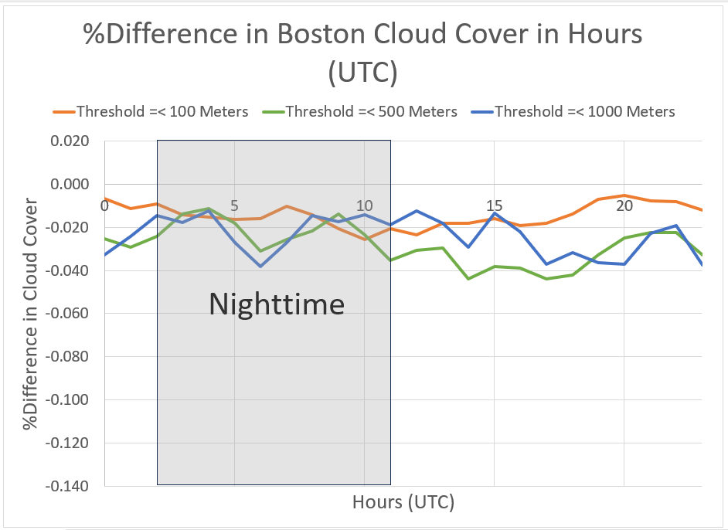
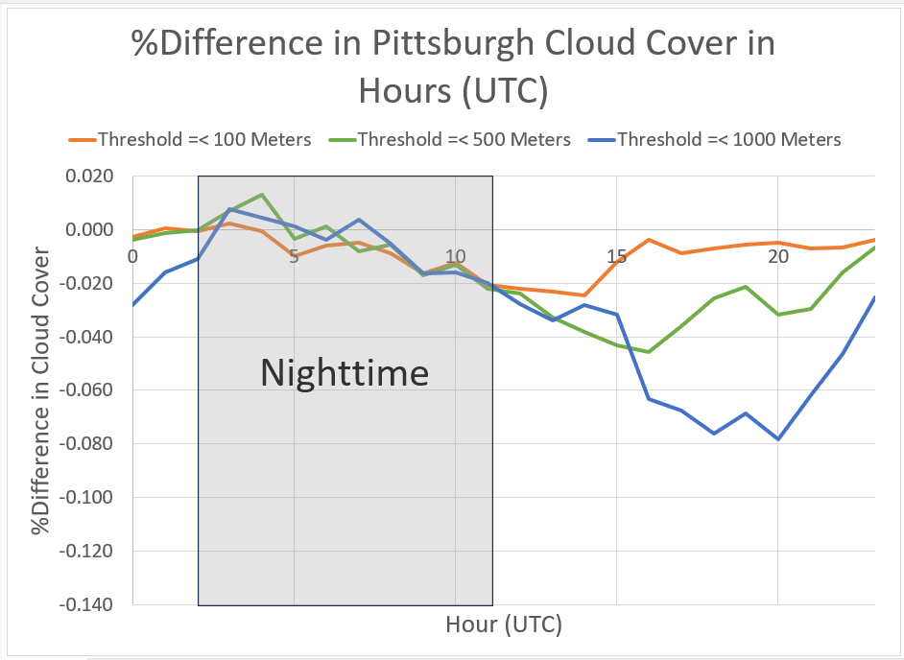
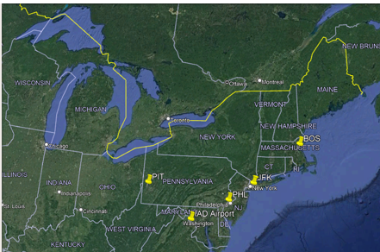
“Analyzing Moisture Contribution in Elevated Nighttime Temperatures at Major Northeast Cities”
Aaron Edwards, MS Geoscience Student Dr. Joby Hilliker, Associate Professor
Dept of Earth and Space Sciences Dept of Earth and Space Sciences
West Chester University, West Chester, PA West Chester University, West Chester, PA
1. INTRODUCTION
3. RESULTS
One of the biggest consequences of climate change has been an increase in heat-related fatalities in major cities, such as Philadelphia (Hondula, 2012).
Heat related deaths are most sensitive to elevated temperatures during the nighttime.
Thus, this study will explore how quickly temperatures have risen over the last 50 years at several major Northeast cities.
It is known temperatures remain elevated at night due to higher dewpoint (moisture content) and cloud cover.
Thus, this study will also quantitatively determine the relative contributions of dewpoint and cloud cover in elevating nighttime temperatures, for each hour and city.
a. Temperature and Dewpoint
The figures below reveal 50-year changes (differences between the 2018-2022 and 1973-1977 averages) in temp, dewpoint, and dewpoint depression for 3 Northeast cities: Philadelphia (PHL), Pittsburgh (PIT), and Boston (BOS) airports.
At PHL over the last 50 years, average nighttime temperatures have risen faster (1.7⁰F) than the dewpoint (0.9⁰F).
Conversely at PIT, average nighttime dewpoints have risen faster than temperature (2.5⁰F vs. 1.2⁰F).
While at BOS, the magnitude of nighttime temperature and dewpoint rises has been comparable, but less in magnitude (0.6⁰F for temp; 1.0⁰F for dewpoint)
50-year temp and dewpoint differences at PHL, by hour
50-year temp and dewpoint differences at PIT, by hour
50-year temp and dewpoint differences at BOS, by hour
Hot and cool spots in Philadelphia at night (Oka, 2011) .
b. Cloud Cover
Same as above, but shown are percent differences in ceiling for 3 different thresholds (100 m, 500 m, and 1000 m, representing low clouds and fog).
At PHL over the last 50 years, the frequency of ceiling < 1000 m has dropped ~2% during the nighttime. No changes have been observed at the 500 m or 100 m thresholds.
At BOS, frequencies of ceiling < 1000 m and < 500 m have dropped a bit more (~3%) during the nighttime, with a slight (1%) decrease for the 100 m threshold.
Finally, at PIT, no changes over the last 50 years in low cloud cover have occurred for the early nighttime hours (02-07 UTC); however, a slight decrease in percent frequency (for all thresholds) is evident for the late night hours (07-11 UTC).
2. DATA & METHODOLOGY
Hourly temperature, dewpoint, and ceiling data were obtained for five major Northeast cities from the National Oceanic and Atmospheric Administration (NOAA).
The five tested cities are Philadelphia (PHL), Boston (BOS), Washington, DC (IAD), Pittsburgh (PIT), and New York City (JFK).
The database ranges from 1973-2022, spanning 50 years.
Ceiling data was coded as “1” or “0” depending on whether the cloud base was lower than certain thresholds. The thresholds used were 1000 m, 500 m, and 100 m.
Nighttime is defined as 02-11 UTC (9 PM-6 AM EST).
Excel PivotTables were used to analyze temperature and dewpoint averages for each year and for each hour. For ceiling, average percent frequencies were computed.
50-year % frequency differences in ceiling for 3 different thresholds at PHL, by hour
50-year % frequency differences in ceiling for 3 different thresholds at BOS, by hour
50-year % frequency differences in ceiling for 3 different thresholds at PIT, by hour
The five northeastern cities tested in the study.
4. CONCLUSIONS
5. REFERENCES
Dewpoint (moisture) increases over the last 50 years has helped to keep overnight temperatures elevated over the nighttime hours for several Northeast cities.
For some cities, the temperature has risen faster than the dewpoint. This has increased the dewpoint depression, or difference between the temperature and dewpoint.
It is known that higher dewpoint depressions cause clouds to form higher in the atmosphere. This result is consistent with a modest decrease of low clouds and fog observed the last 50 years.
Future work includes analyzing additional urban heat islands, expanding the area of study to include the eastern United States.
Hondula, D. M., Davis, R. E., Leisten, M. J., Saha, M. V., Veazey, L. M., & Wegner, C. R. (2012). Fine-scale spatial variability of heat-related mortality in Philadelphia County, USA, from 1983-2008: a case-series analysis. Environmental health, 11(1), 1-11.
Oka, M. (2011). The influence of urban street characteristics on pedestrian heat comfort levels in Philadelphia. Transactions in GIS, 15(1), 109-123.
National Centers for Environmental Information (NCEI). Data Obtained: Team, N. G. (2011, August). Hourly/sub-hourly observational data.. https://www.ncei.noaa.gov/maps/hourly/

