Slide 1
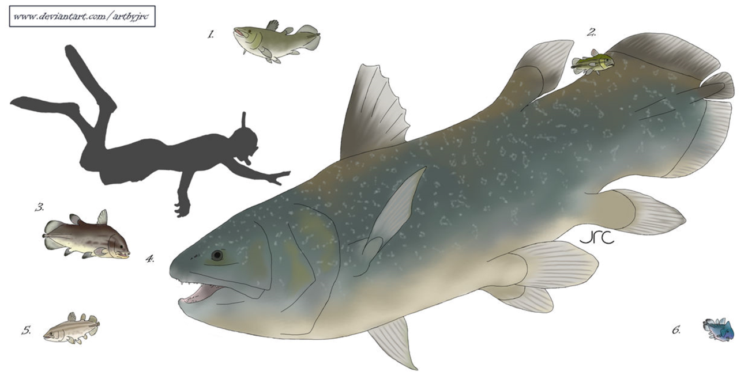
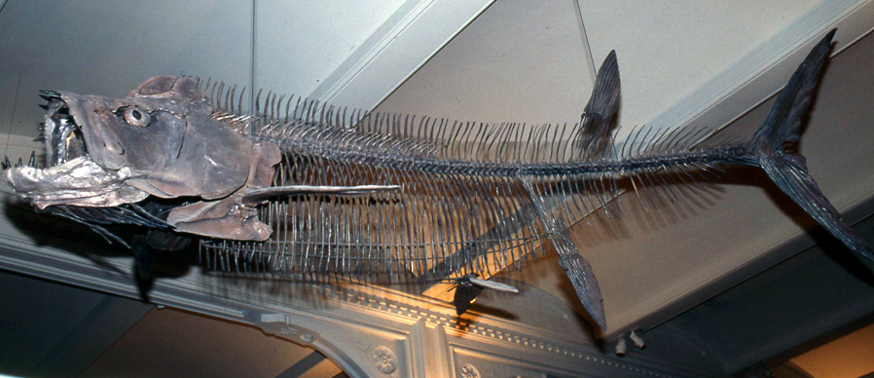
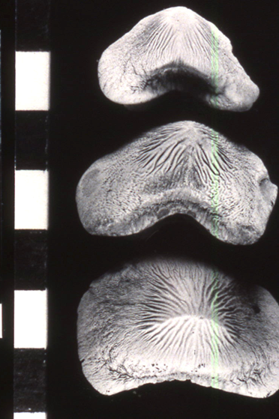
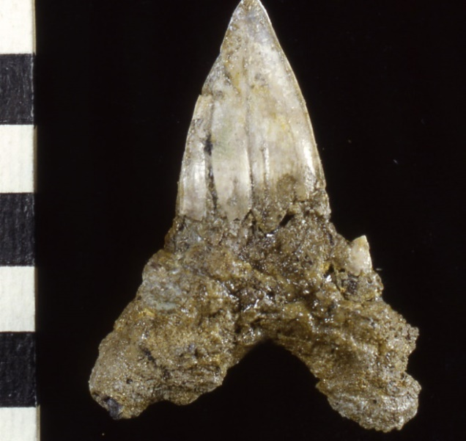

A cryptic extinction event: disappearance of multiple large marine fishes in the early Campanian North American Interior Seas
David R. Schwimmer
Department of Earth and Spaces Sciences
Columbus State University
Columbus, Georgia

Slide 2
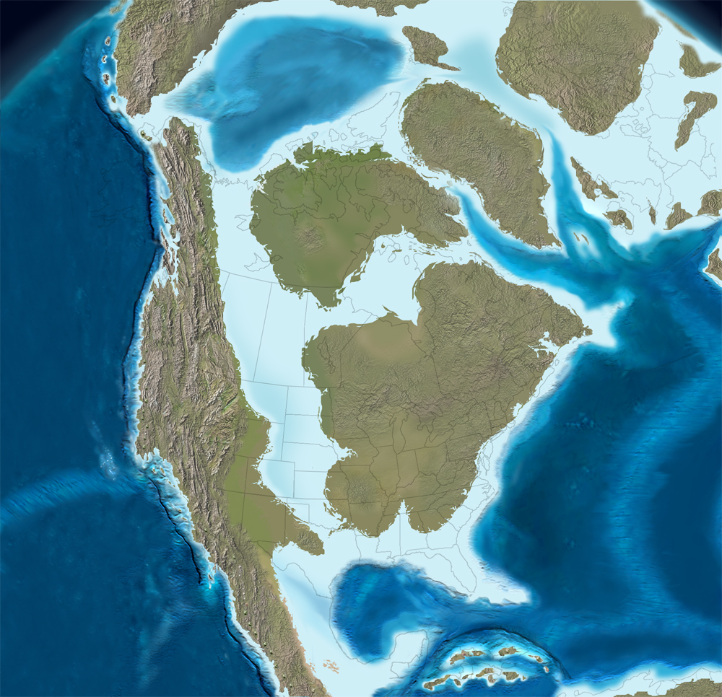
During the Late Cretaceous, Santonian to early Campanian time (ca. 86-78 Ma.), there were at least five clades of giant (> 4-5 m) marine fishes that were present across the epicontinental and marginal seas of North America. These included three selachians:
Cretoxyrhina mantelli
Cretodus crassidens (alt. semiplicatus)
Ptychodus mortoni and P. polygyrus
In addition there was one common giant teleost
Xiphactinus audax
And one giant coelacanth
Megalocoelacanthus dobiei
However, By the mid-Campanian, (ca. 78 Ma.), all of these species were extinct. New species of Xiphactinus and Cretodus appeared, but all Ptychodus species and the monospecific Megalocoelacanthus were gone.

Slide 3
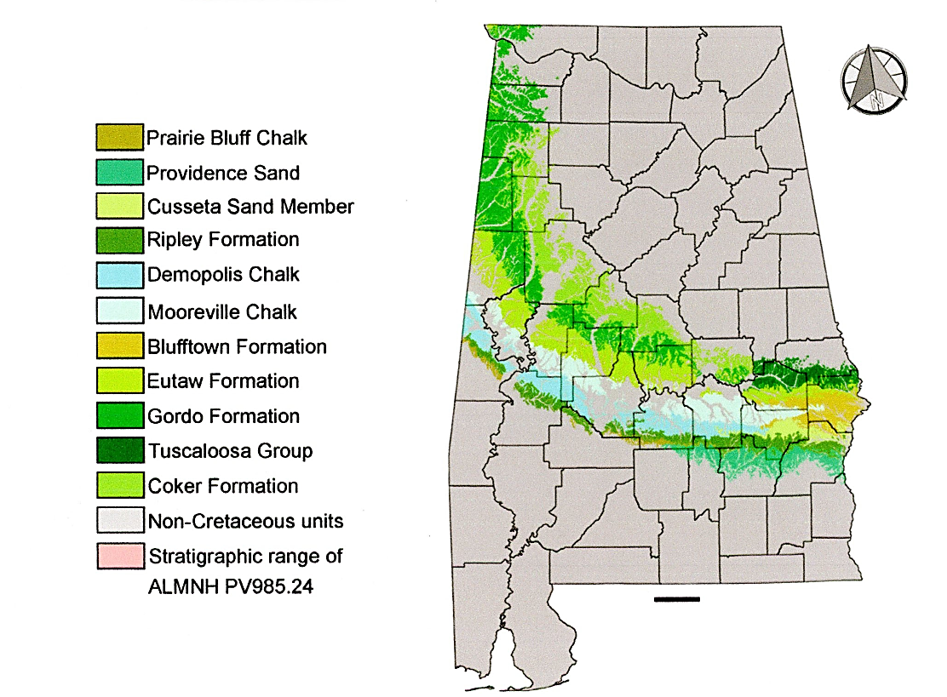
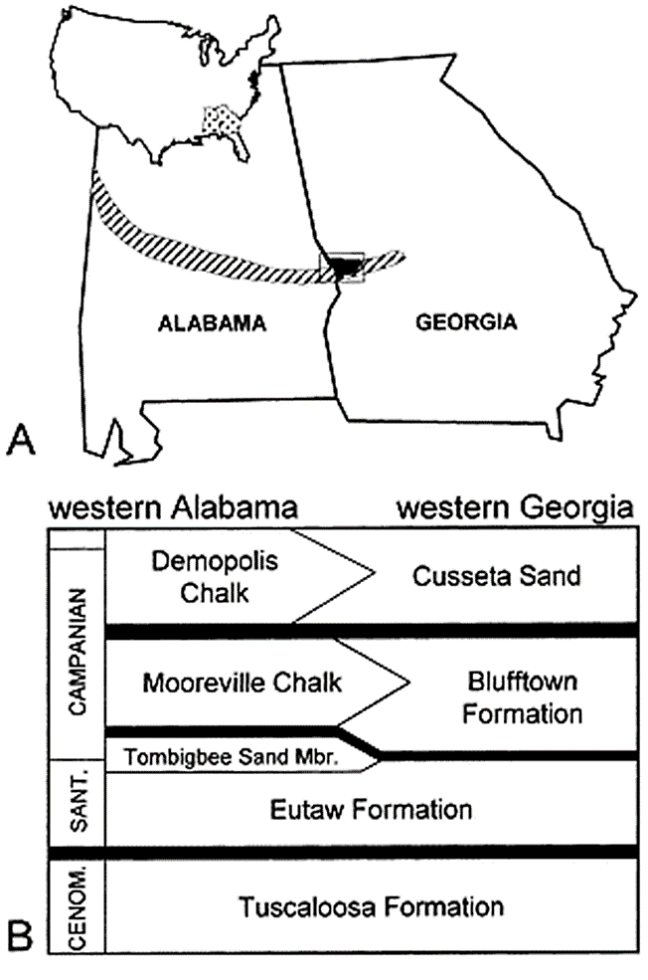
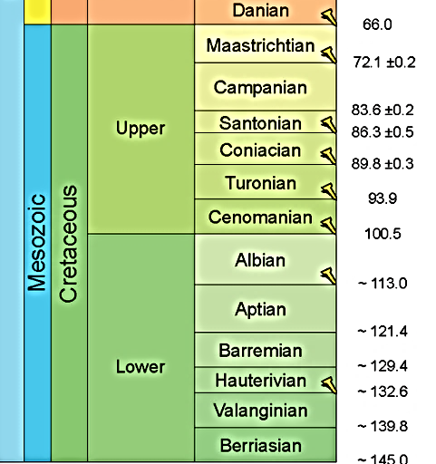
In Alabama and west Georgia,
the time of this extinction
event is incorporated into
the lower Mooreville and
Blufftown Formations.
According to the ICS current
dating, the age of these events
would be constrained between
The latest Santonian to earliest
Campanian, around 82 Ma.
to no younger than 78 Ma.
Gentry et al., 2022
International Commission
on Stratigraphy, 2022

Slide 4
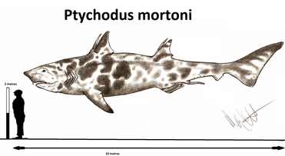
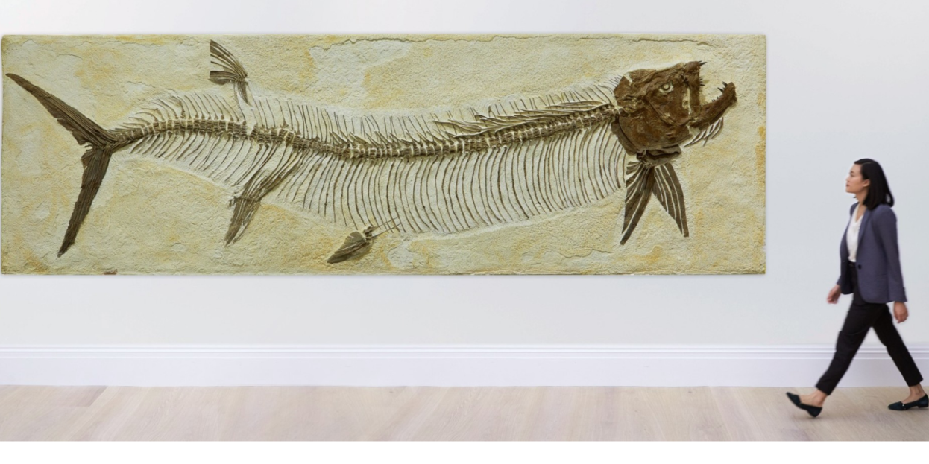
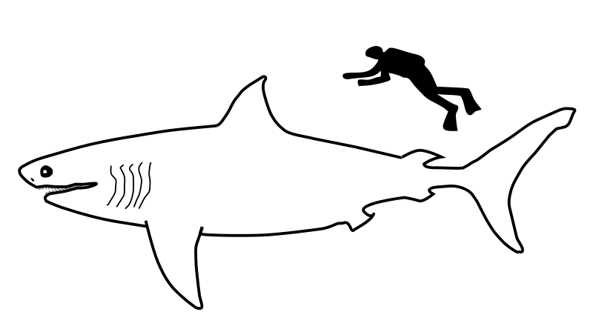
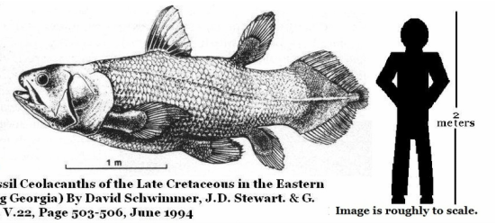
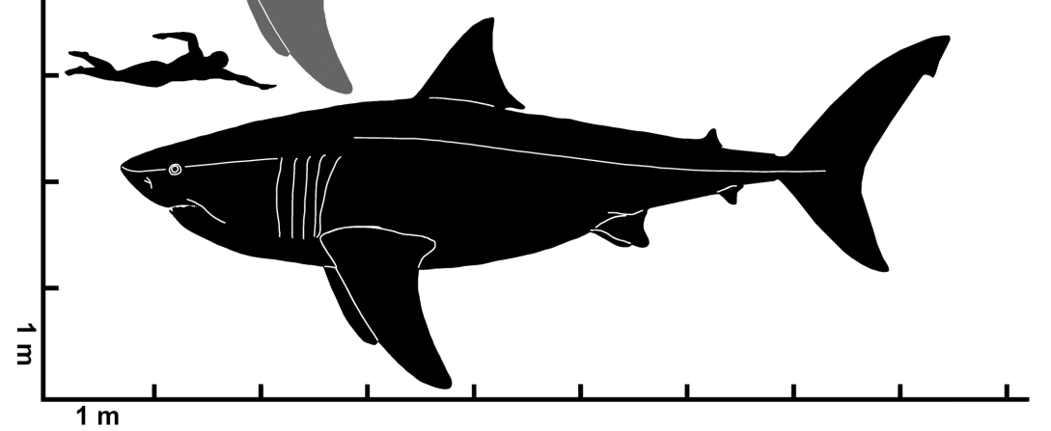
Xiphactinus audax
Giant fish that go extinct in the early Campanian
Cretodus crassidens
and Cretoxyrhina mantelli
Megalocoelacanthus dobiei

Slide 5
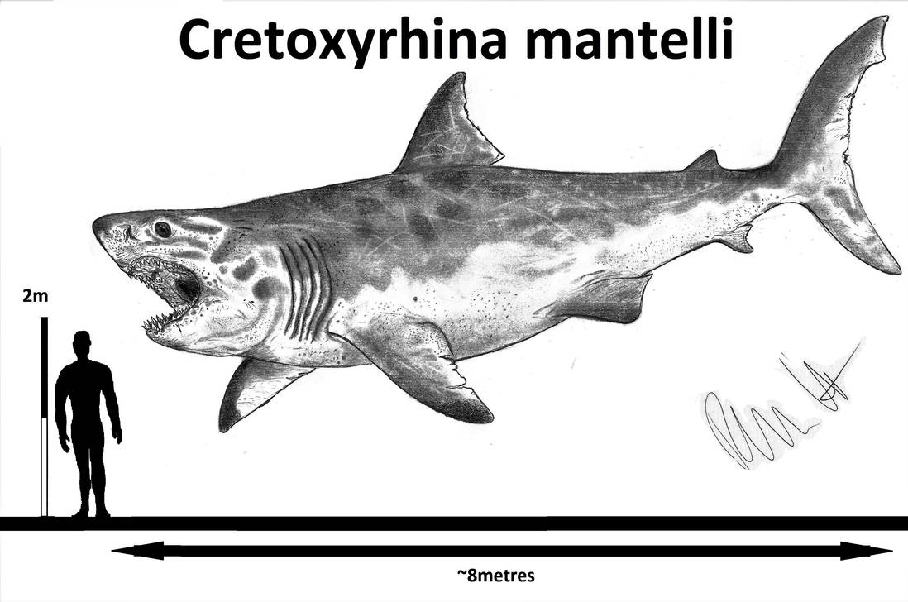
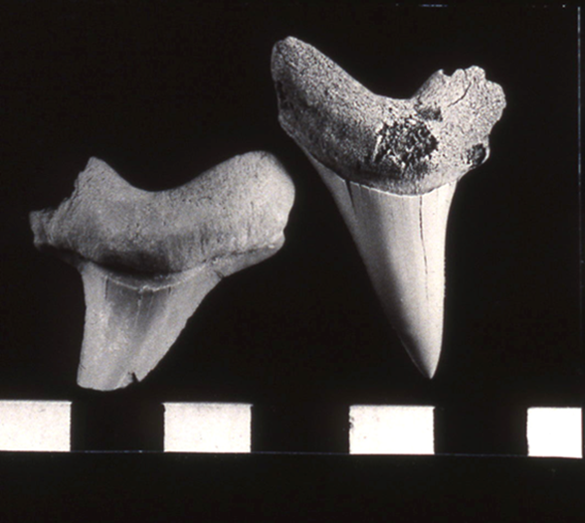
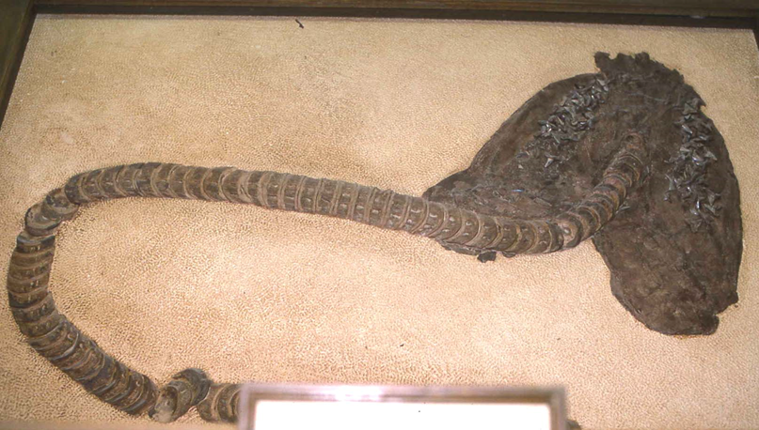
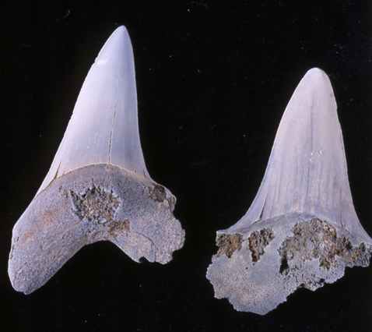
Cretoxyrhina mantelli, middle Turonian to early Campanian
a common gigantic lamnoid shark, well known from the Western Interior, also present in Alabama, largely unreported from the eastern Late Cretaceous except in the Merchantville Fm., NJ.
Cretoxyrhina mantelli,
lower Blufftown Fm.,
Russell Co., AL, lower
Campanian
Cretoxyrhina mantelli, Smoky Hill Chalk, Gove Co. KS, lower Campanian

Slide 6
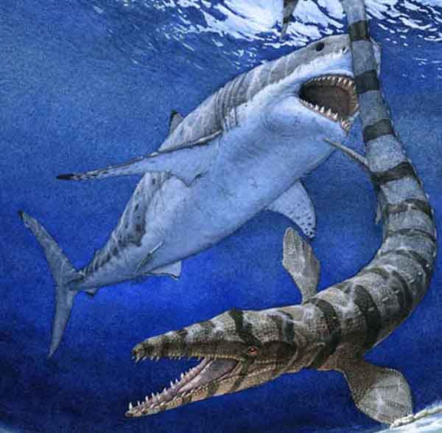
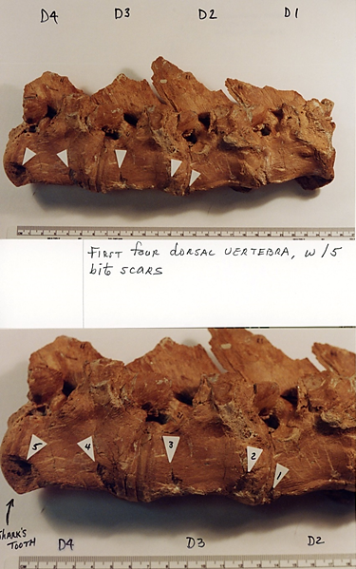
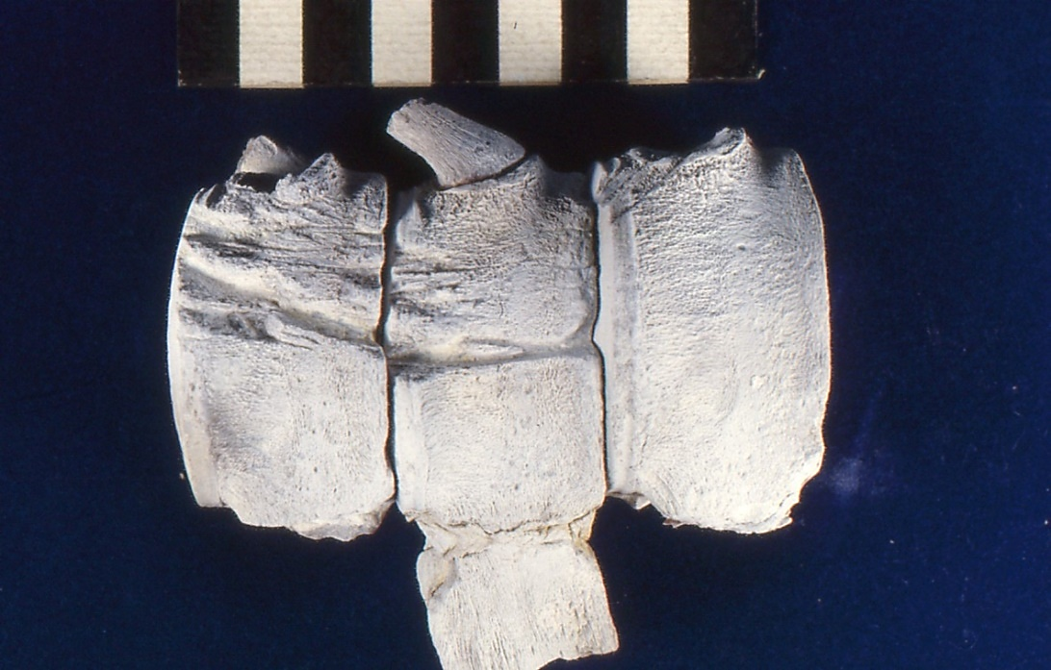
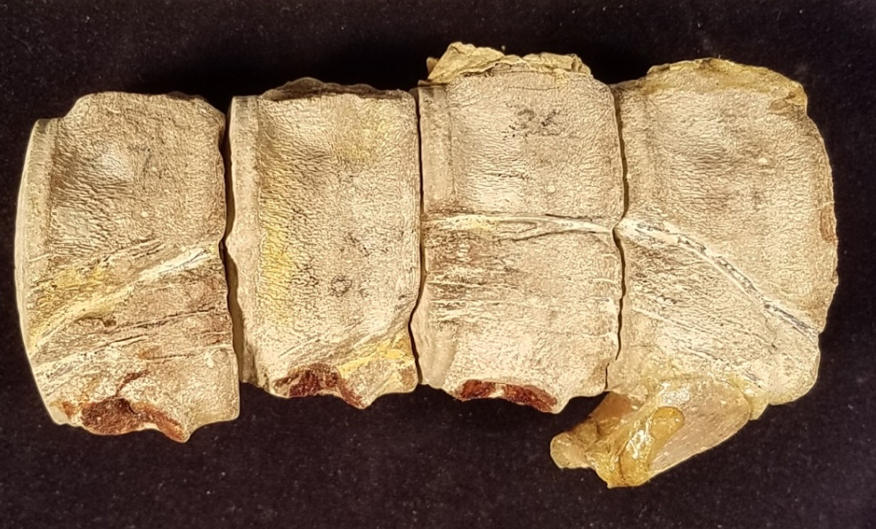
Evidence of predation on mosasaurs by
Cretoxyrhina mantelli
Signs of shark-on-mosasaur
predation are present in both
the Western Interior and
Southeast.
Bite traces on mosasaur vertebrae, Niobrara Fm.
?Tylosaurus vertebrae, Mooreville Fm. Dallas Co. AL, lower Campanian

Slide 7
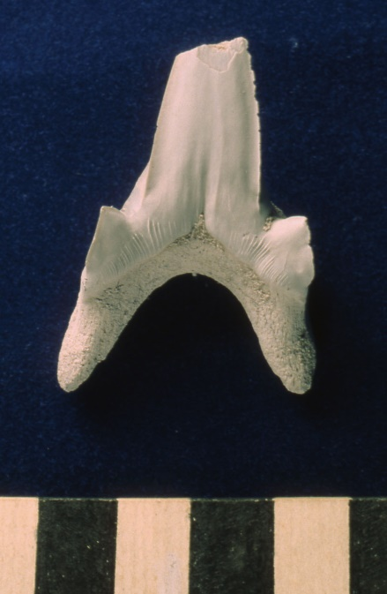
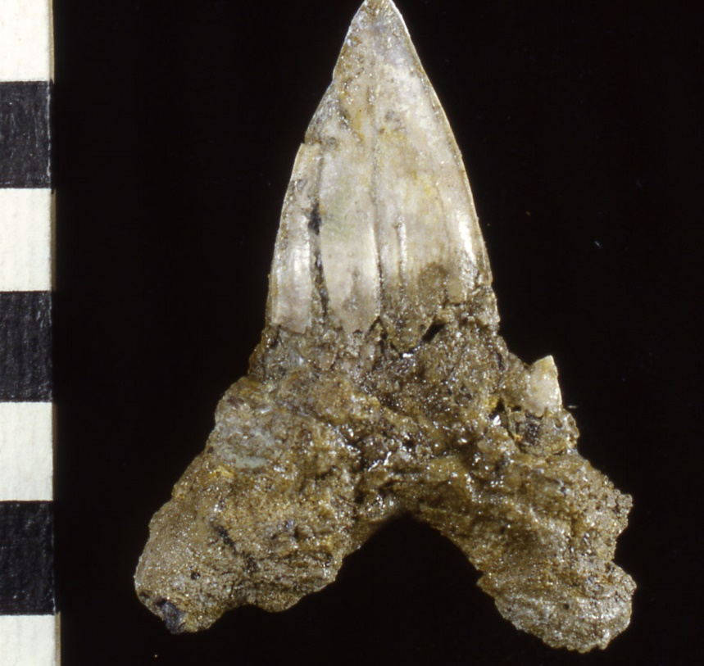

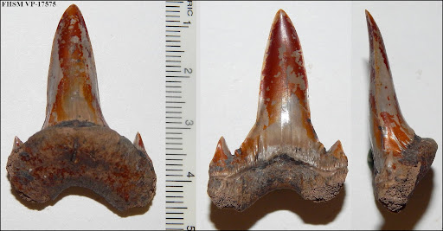
Cretodus crassidens (aka Cretodus semiplicatus)
Cenomanian-Santonian and early Campanian?
Amalfitano, et al. (2022) estimated TL at 9-11m based on
associated vertebrae and age extrapolation from a Turonian
specimen in northeast Italy.
est. 7.8m…to 11m?
Cretodus lateral (left) and anterior (right)
from the Eutaw Fm., Santonian, AL & GA
Cretodus anterolateral, Carlile Sh., KS,
Middle Turonian

Slide 8
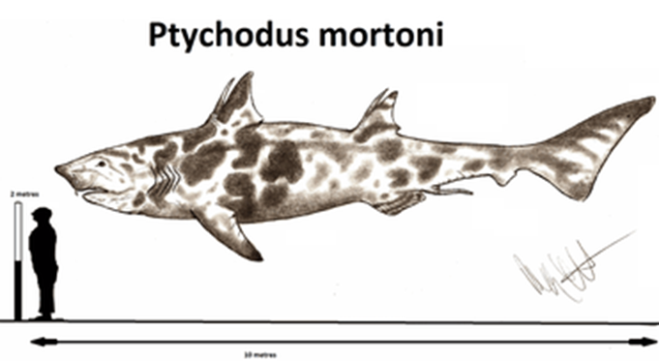
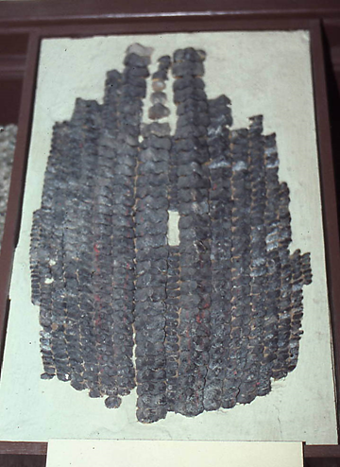
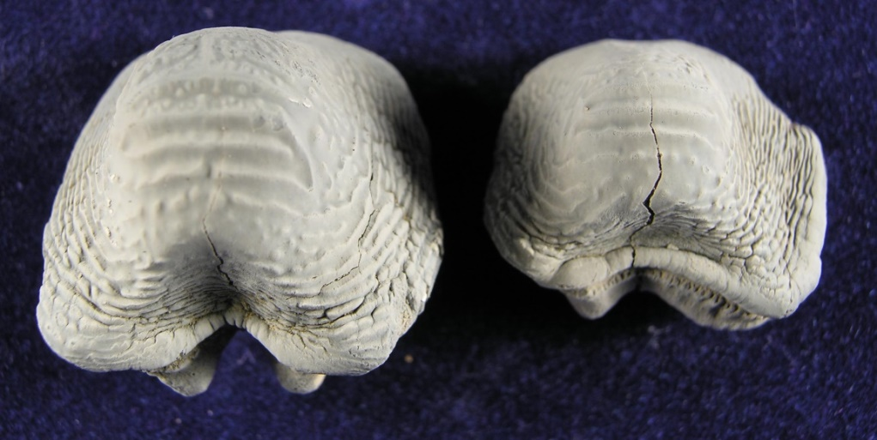
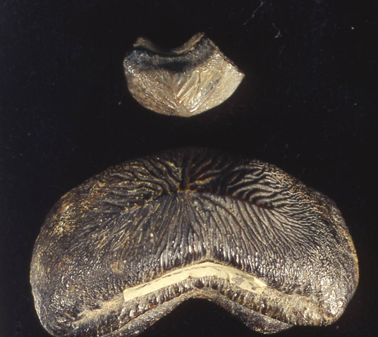
Ptychodus species
Cenomanian
to early Campanian
Est. up to 10m
Ptychodus mortoni
early Campanian
lower Blufftown Fm.,
Russell Co. AL
Ptychodus polygyrus
early Campanian,
Lower Blufftown Fm.,
Russell Co, AL
Reconstructed P. mortoni dentition,
Sternberg Museum, Ft. Hays KS

Slide 9
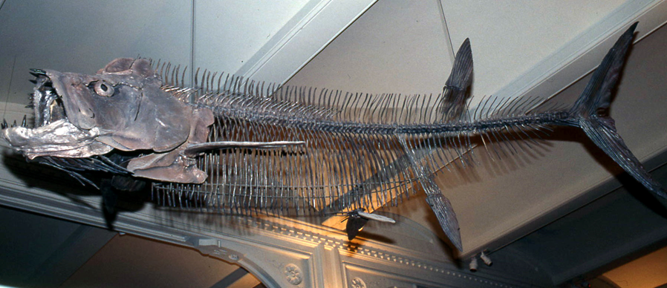
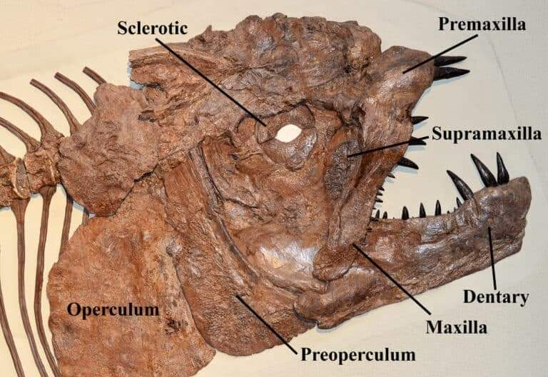
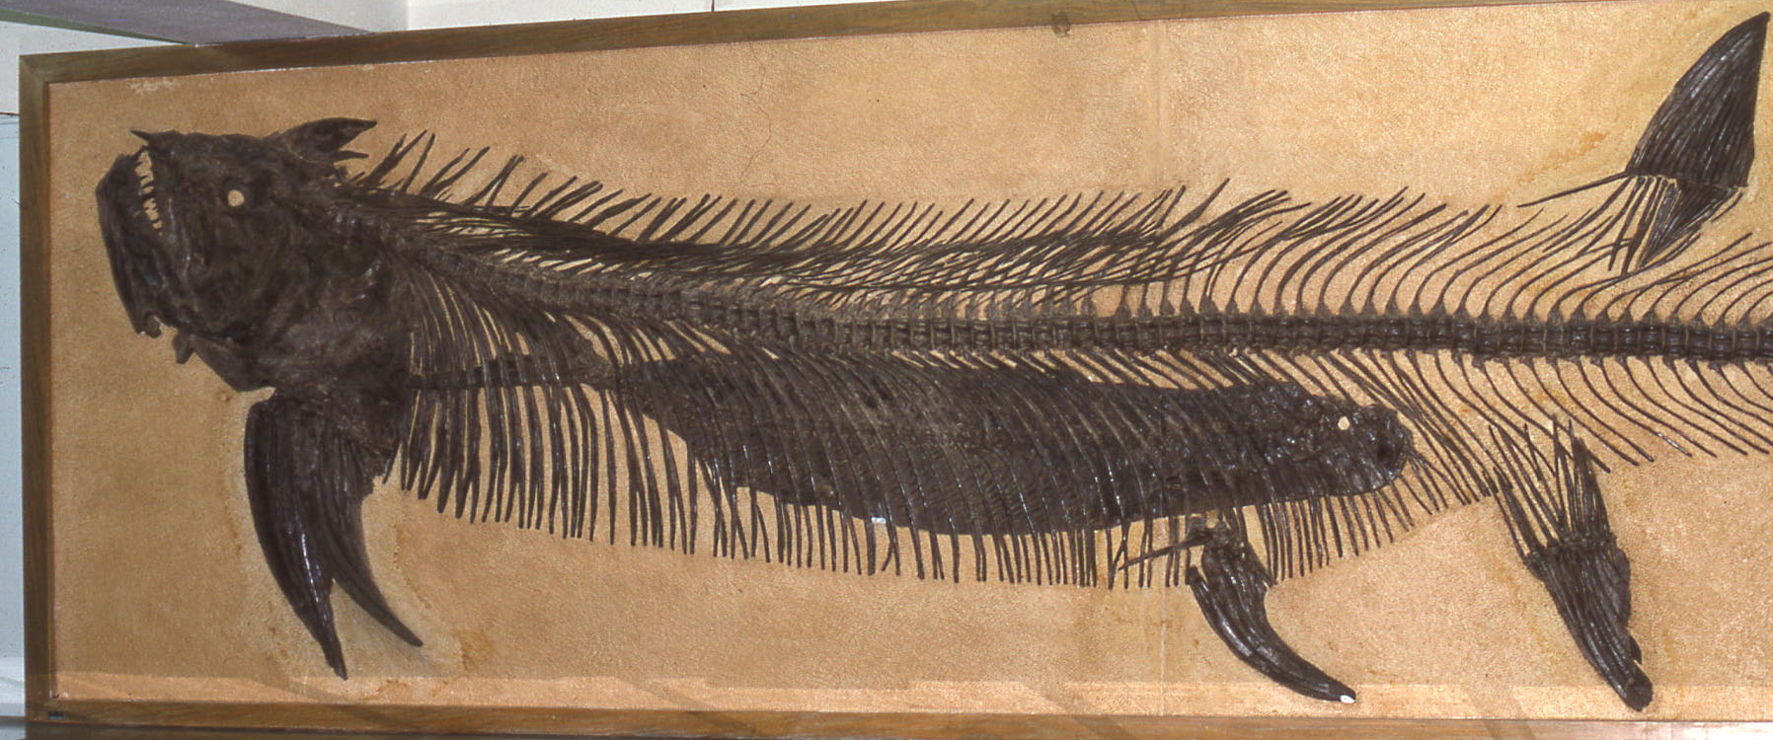
Xiphactinus species
X. audax, Cenomanian to early Campanian
X. vetus, mid-Campanian to early
Maastrichtian
Xiphactinus audax, Smoky Hill Chalk (upper Coniacian to lower Campanian), Sternberg Museum, Fort Hays, KS

Slide 10
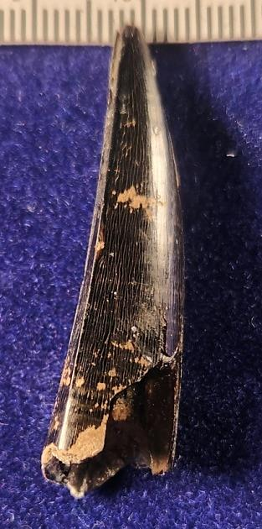
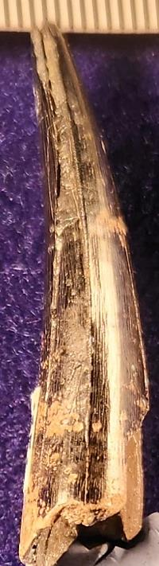
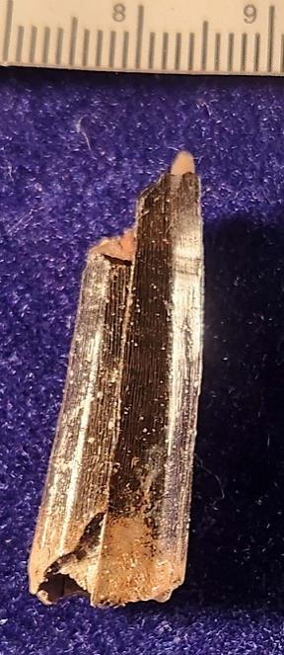
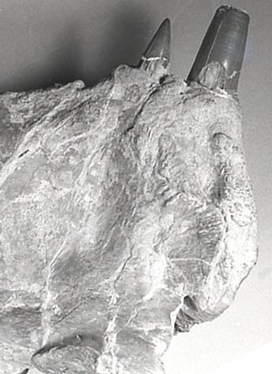
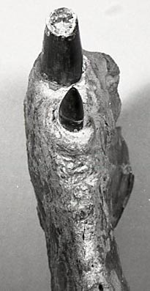
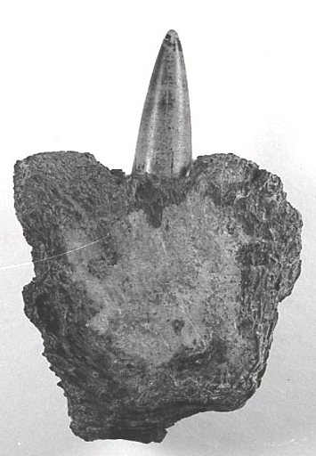
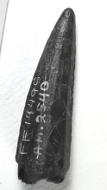
Teeth from upper Blufftown Fm.,
mid-Campanian, Stewart Co., GA
Smoky Hill Chalk, Gove Co., KS,
upper Coniacian
Lower Blufftown Fm.,Russell Co., AL,
lower Campanian
Xiphactinus vetus
Xiphactinus audax
Comparison of anterior teeth: X. audax has round cross-sections,
X. vetus are carinate and sometimes roughly polygonal
(hence the original generic name “Polygonodon vetus Leidy 1856”).
The change of species occurs after the early Campanian and before the
mid-Campanian. A single specimen from the Mesaverde Fm. in
Wyoming (DeMar and Brithaupt, 2006) reports X. vetus in the
late Campanian of the western Interior.
Holotype, Navesink Fm.
lower Maastrichtian,
Burlington Co., NJ

Slide 11
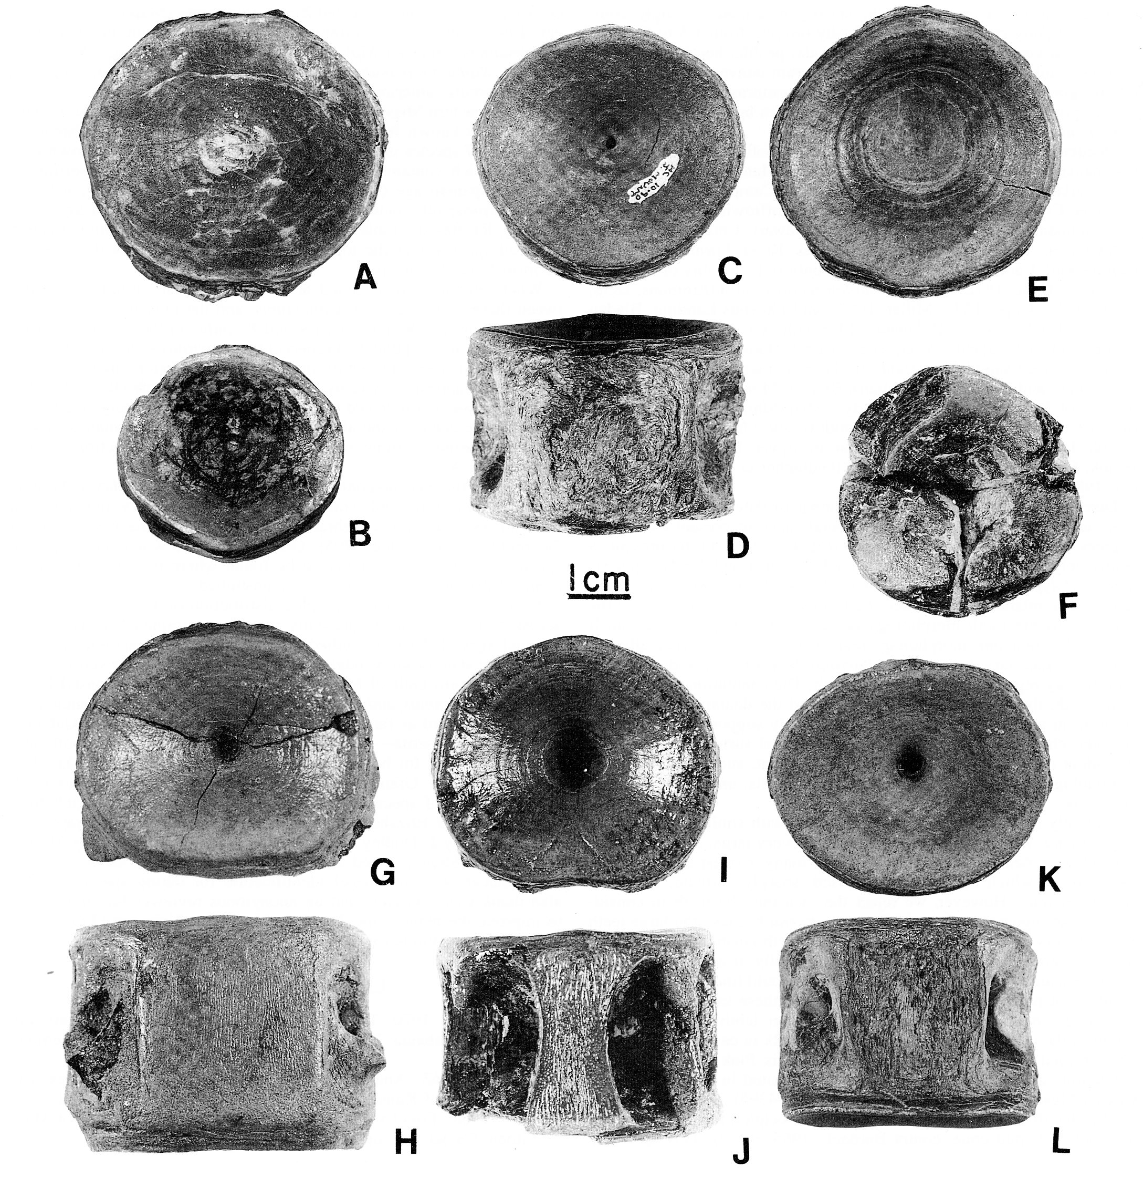
Comparison of Xiphactinus
vertebrae from the Eutaw and
Blufftown Fm., AL and GA, and
Smoky Hill Chalk, KS
X. audax (A-F): A,B, Smoky Hill Chalk, KS,
upper Coniacian
C-E: lower Blufftown Fm.,
Russell Co., AL,
lower Campanian
F: Tombigbee Mbr., Eutaw Fm.
Montgomery Co., AL,
Santonian
X. vetus (G-L): all from upper Blufftown Fm.,
and lower Cusseta Fm.,
Stewart Co., GA., mid-late
Campanian.
Note that G,H is a posterior
abdominal; I,J a caudal, and
K,L an anterior abdominal.
From Schwimmer, et al. 1997, Jour Vert. Paleo., 17(3)

Slide 12
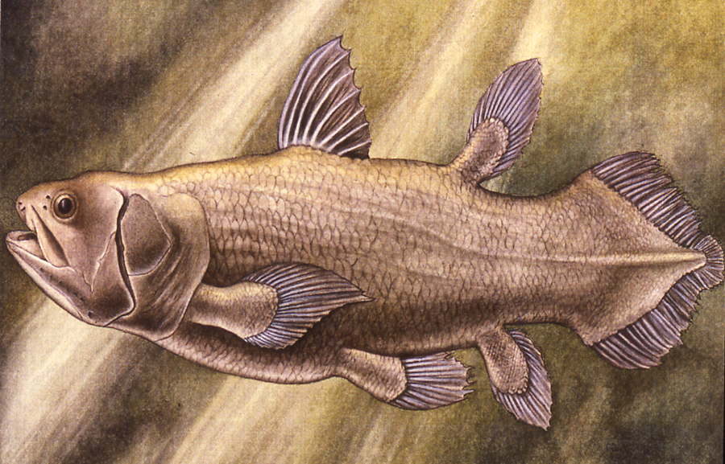
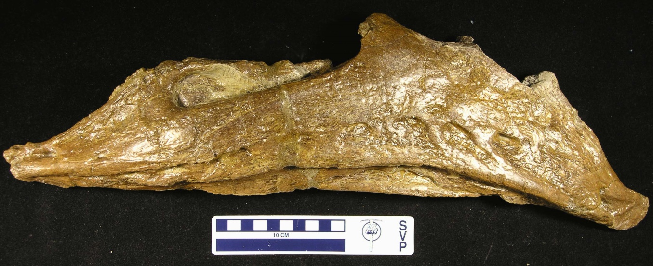
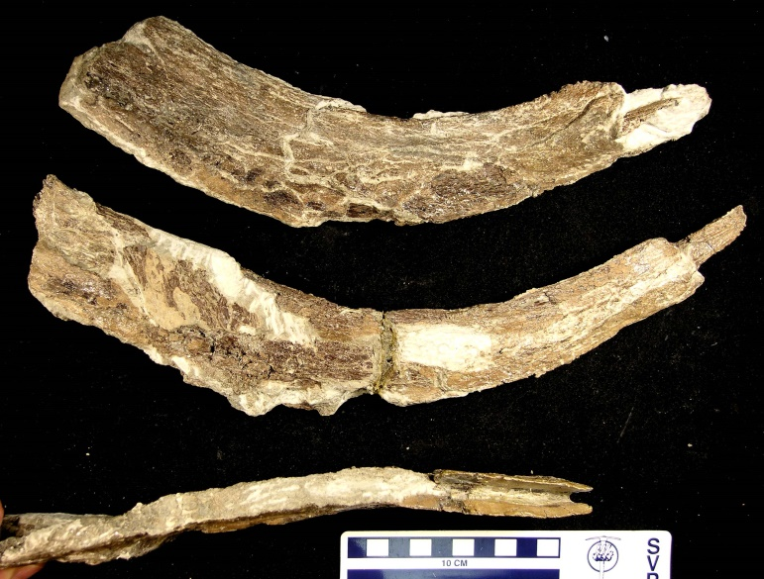
Megalocoelacanthus dobiei,
Holotype from the lower Blufftown
Fm., Russell Co., AL (Schwimmer, et al. 1994)
dated by calcareous nannofossils to early
Campanian
Southeastern specimens are found
from Mississippi to Alabama, in Santonian and
Lower Campanian deposits. A single ablated
coronoid fragment was found in New Jersey
in a lag deposit of nondescript age.
1 meter
Holotype left mandible
Holotype branchials

Slide 13
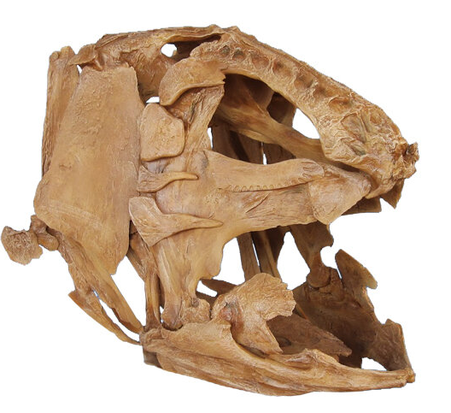
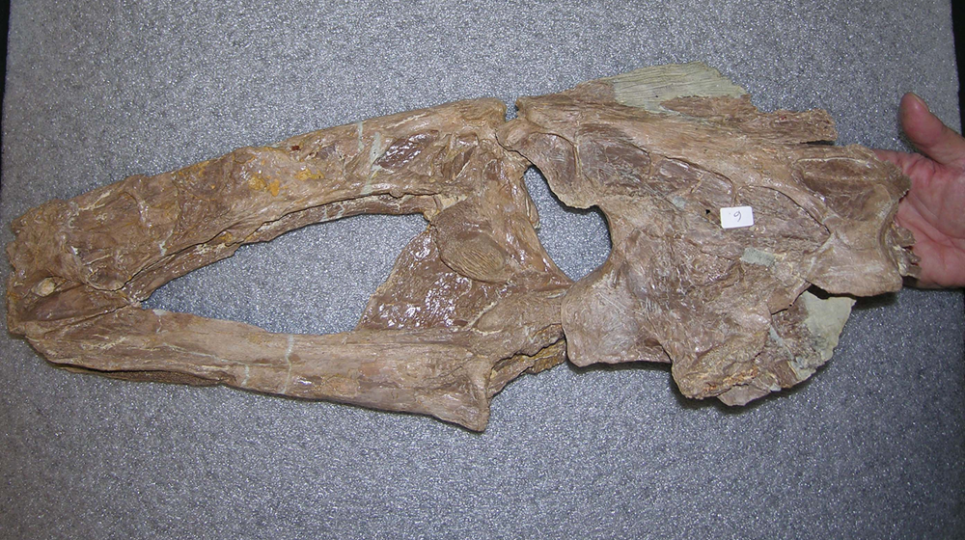
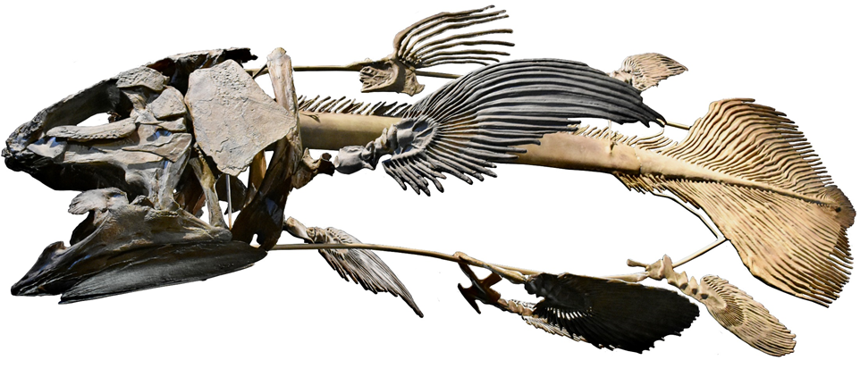
Skull roofing bones,
Megalocoelacanthus dobiei, Fort Hays Mbr. Niobrara Fm., KS
A complete skull, mandible, branchials and other
Bones were found in the Niobrara Fm, Lane Co. KS,
early Campanian age (Dutel, et al., 2012).
Reconstruction by Triebold Paleontology

Slide 14
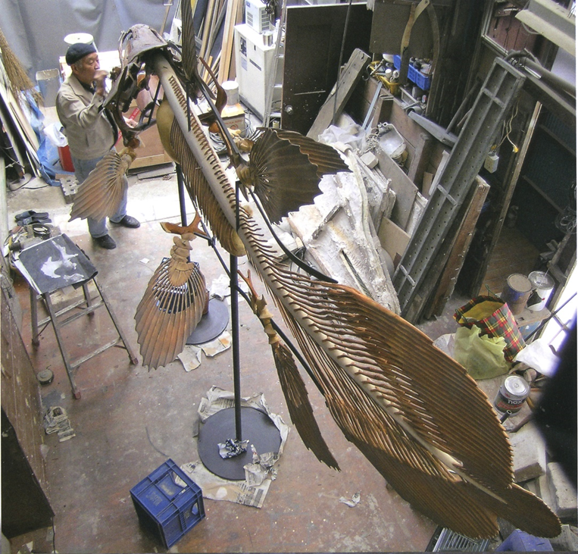
To put size of a giant coelacanth in
perspective: this is a different Cretaceous
genus, Mawsonia, of comparable size
To Megalocoelacanthus

Slide 15
What Caused The Near-Simultaneous Extinction of All Giant Fishes ~78 Ma.?
Assuming the observations here are correct, and that multiple giant fishes went extinct in North America
(and perhaps other interior seas) penecontemporaneously at 78 Ma. in the early Campanian, why?
Three of these, Cretodus crassidens, Cretoxyrhina mantelli and Xiphactinus audax, were obviously
pursuit predators of fish, tetrapods and perhaps cephalopods
Ptychodus species were apparently hard-shelled mollusk predators
Megalocoelacanthus, lacking oral teeth, was likely a suspension-feeder.
What do they have in common? Hypotheses:
Competition
Habitat Change
Stochastic processes
Unknown

Slide 16
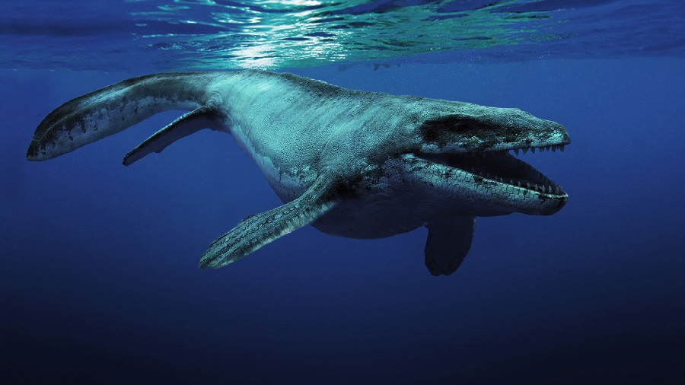
1. Competition:
The only marine organisms that plausibly overlap with large predaceous fish around 78 Ma., are mosasaurs.
Pros: 1. mosasaurs were large and predaceous
2. they appear in the Turonian, and become more
diverse through the remaining Late Cretaceous
3. they overlap in range with all of the extinct fishes
4. at least some (Globidens sp.) were likely competitors
for hard-shelled mollusks, i.e. Ptychodus
Cons: 1. they overlap with the giant fish throughout the
Santonian, including the first appearance of Megalocoelacanthus
2. no mosasaurs appear to have been suspension feeders
3. Globidens are relatively rare, whereas Ptychodus species were
very abundant and widespread during the Turonian and Santonian
4. the most abundant feeding traces from mosasaurs are on cephalopods,
and their teeth do not inherently parallel those of predaceous sharks and
Xiphactinus audax, suggesting different feeding strategies

Slide 17
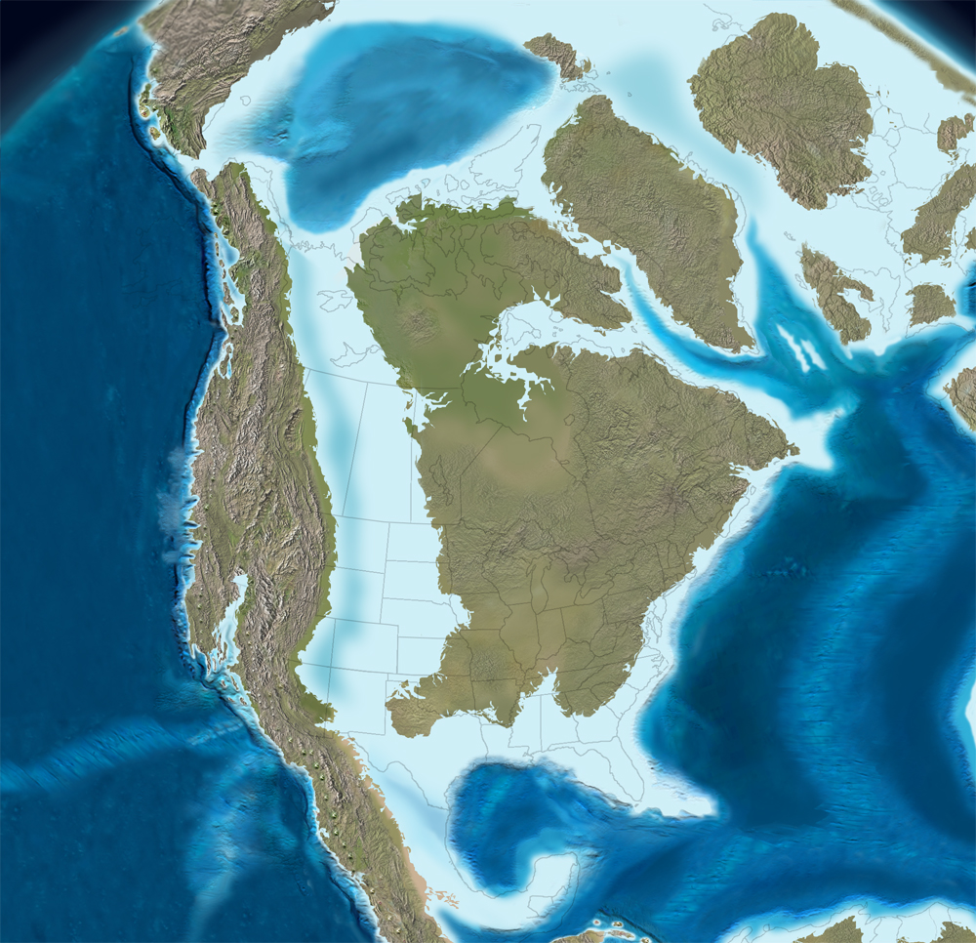
2. Habitat Change
Paleogeographic
Reconstructions from
Deep Time Maps,
Blakey, 2020
Santonian, ca. 85 Myr.
Mid-Campanian, ca. 75 Myr.
Pro- There could have been some environmental changes in the epicontinental seas between the Santonian
and early Campanian leading to stresses on the various megafaunal fish populations
Con- Current reconstructions do not reveal significant changes in areal extent of interior seas.

Slide 18
3. Stochastic Processes (i.e. Random Chance)
Pro- Extinctions are common events in the fossil record; most species have ~10 Myr. survivorships
(with many notable exceptions)
Unknown or undetectable changes in, e.g. seawater chemistry, unknown competitors, or
other factors may be adjunct causes of extinctions
Con- Nearly synchronous disappearance of five (of six known North American) taxa of giant fishes
seems statistically improbable
Only one of these extinct taxa, Xiphactinus audax, is replaced by a comparable fish,
X. vetus
No giant planktivores or durophagous molluscivores are evident in the remaining Cretaceous
fossil record, aside from Bonnerichthys, a giant pachycormid suspension-feeder.

Slide 19



4. Other hypotheses?
Acknowledgments:
Thanks for use of images from:
Ron Blakey, Deep Time Maps
Mike Everhart, Richard Zakrzewski,
Fort Hays State University
Mike Triebold, Triebold Paleontology, Inc.

