Slide 1
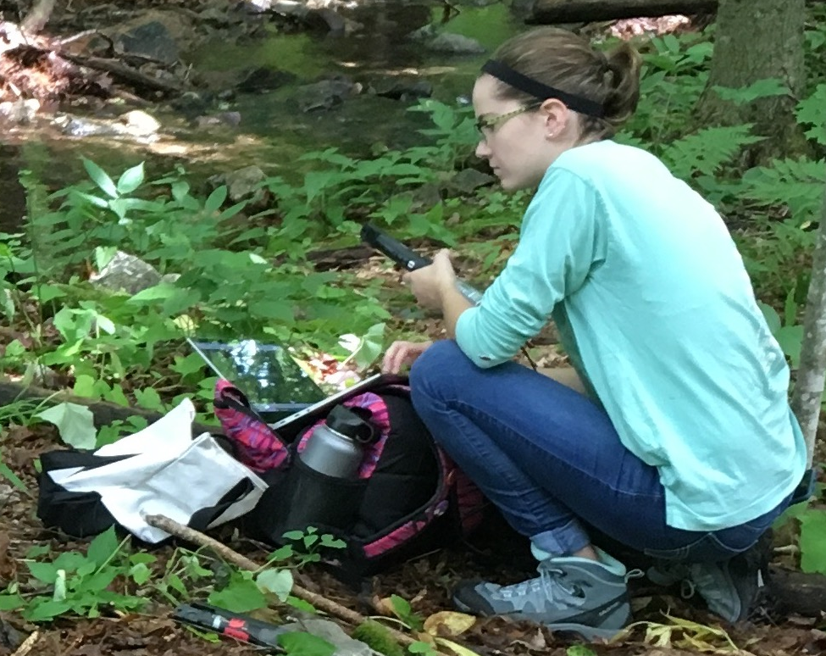
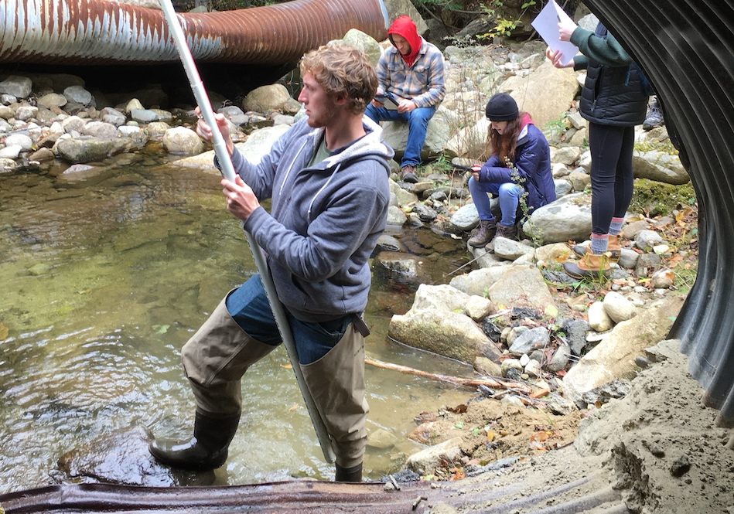
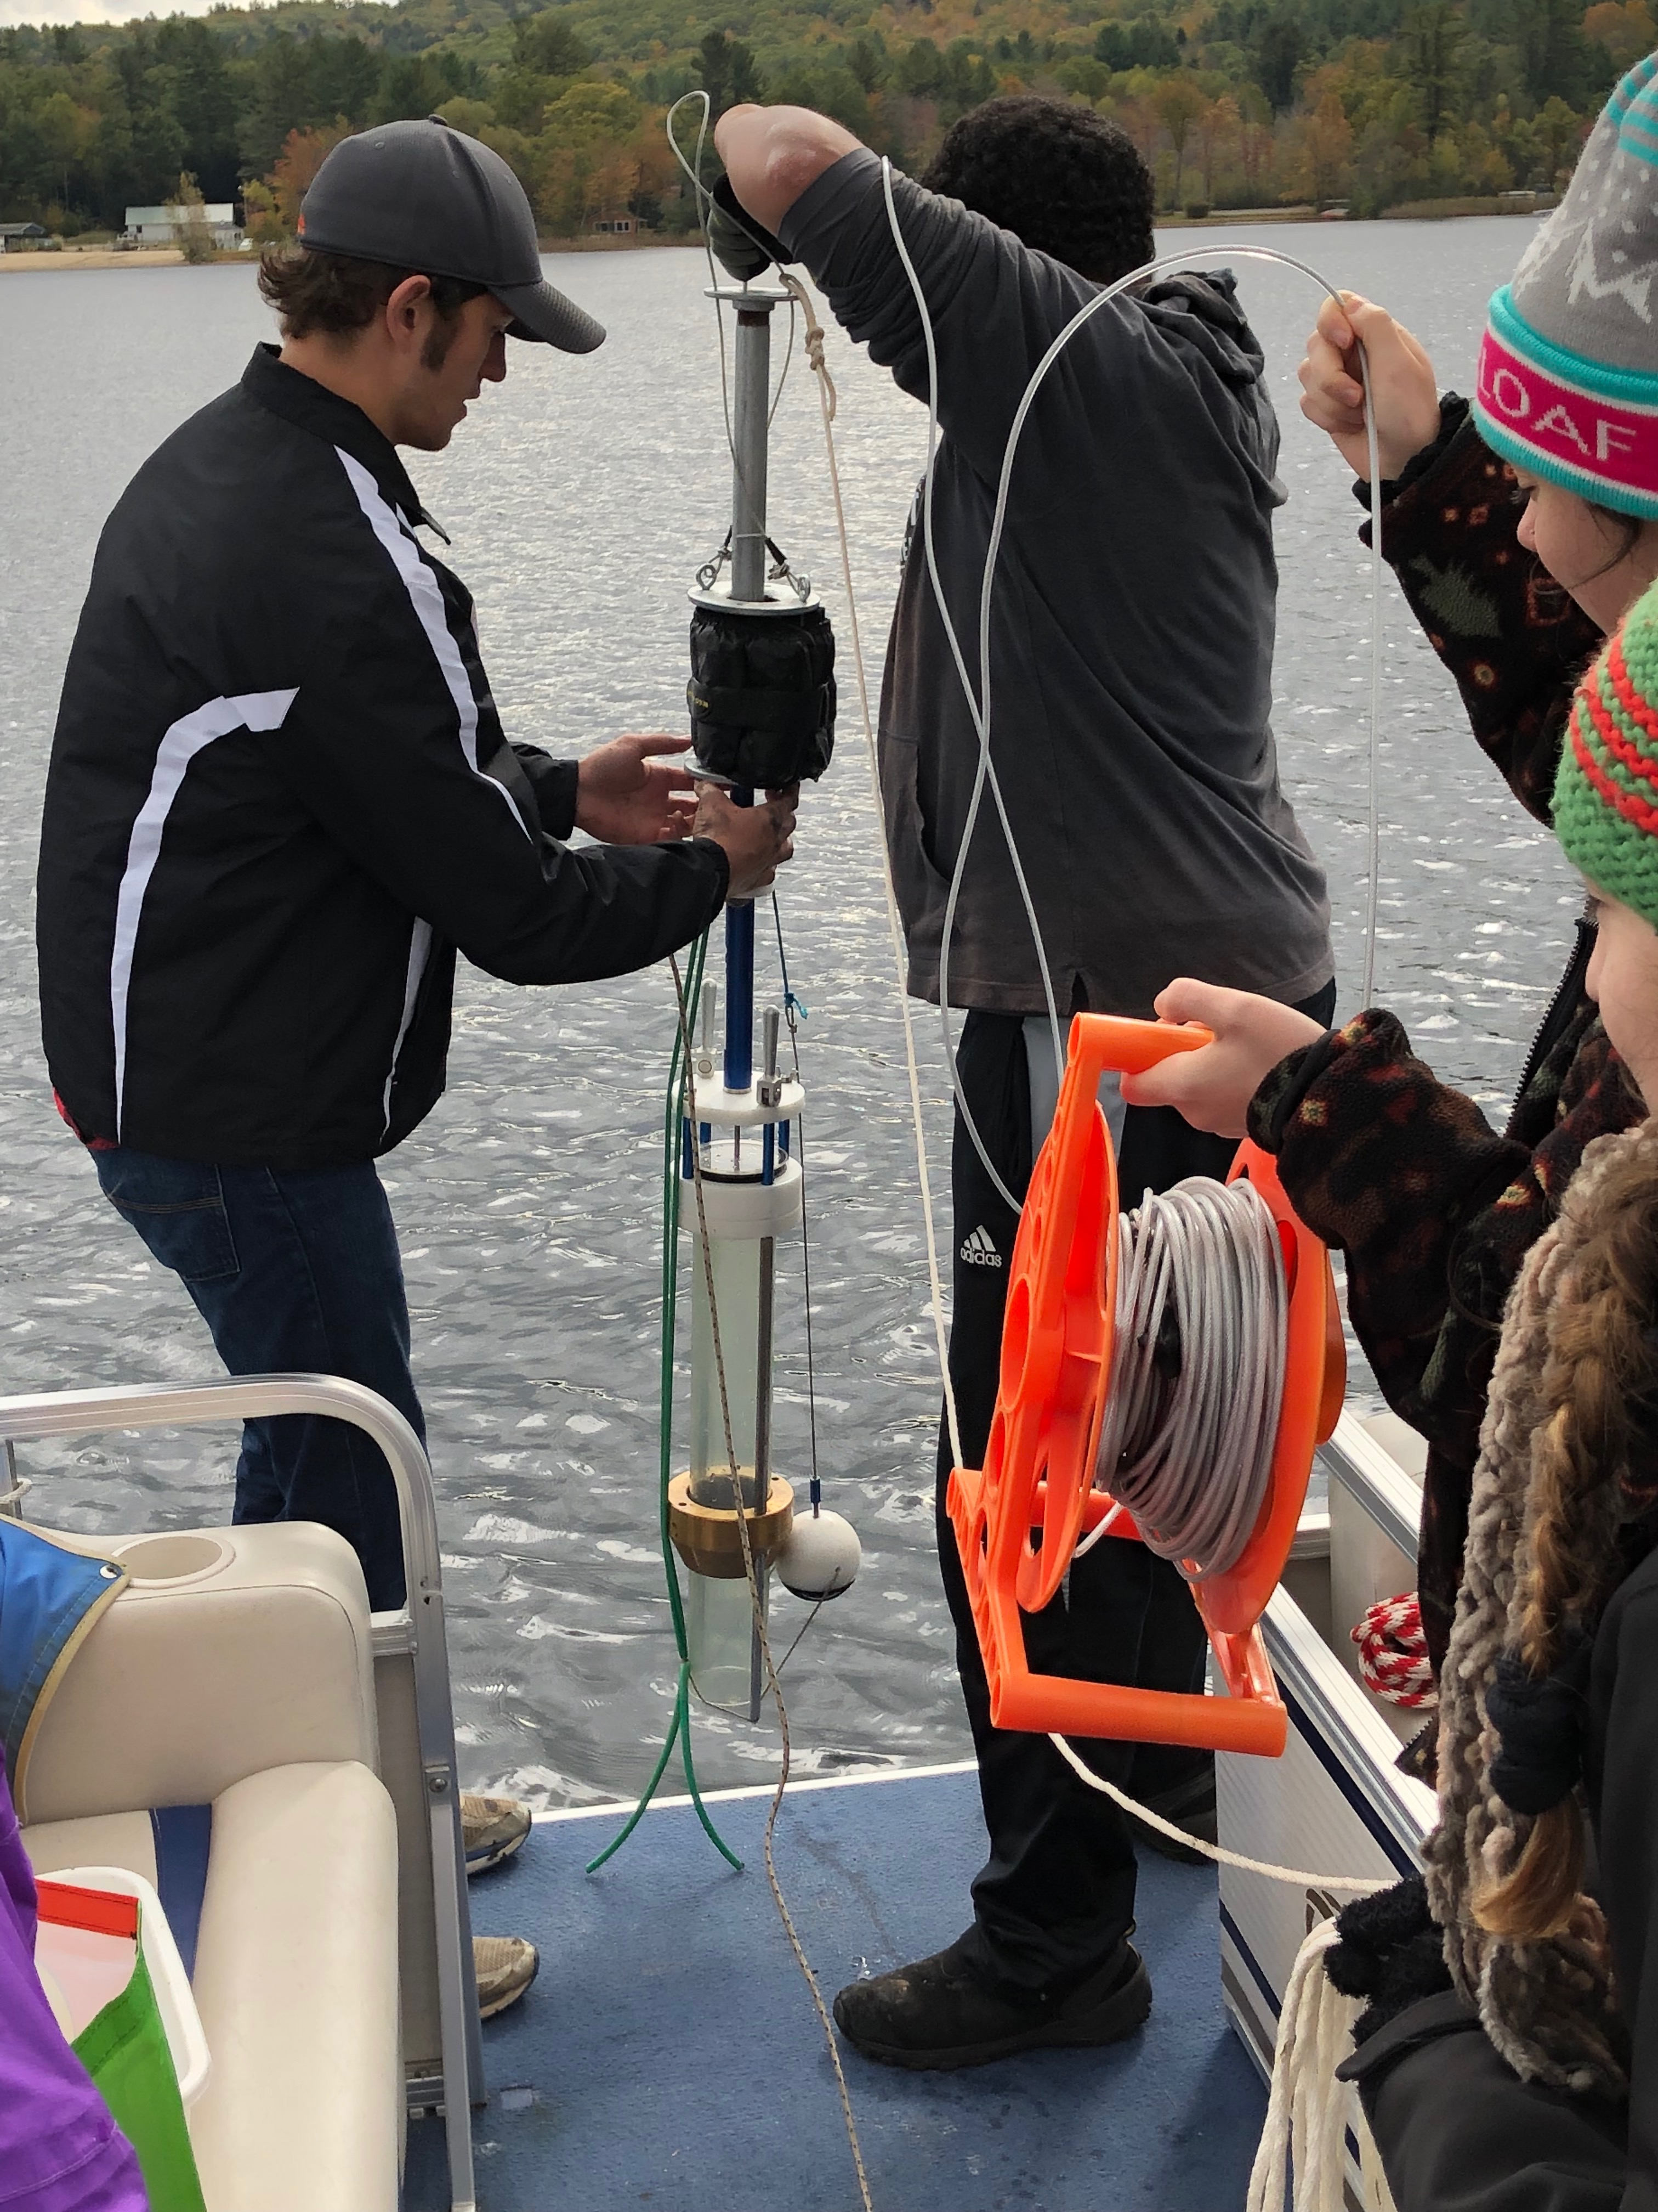

ENABLING ENTRY INTO THE GEOSCIENCES THROUGH GEO-LEANING INTERDISCIPLINARY COURSES
Prof. Lisa Doner,
Chair, Environmental Science & Policy

Slide 2
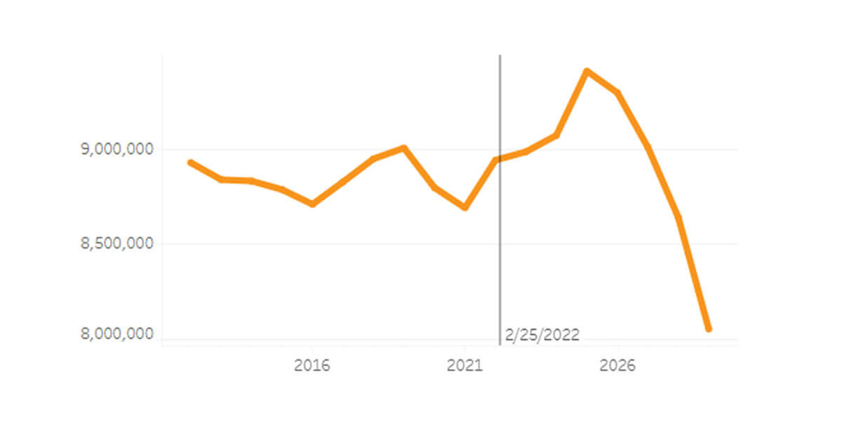
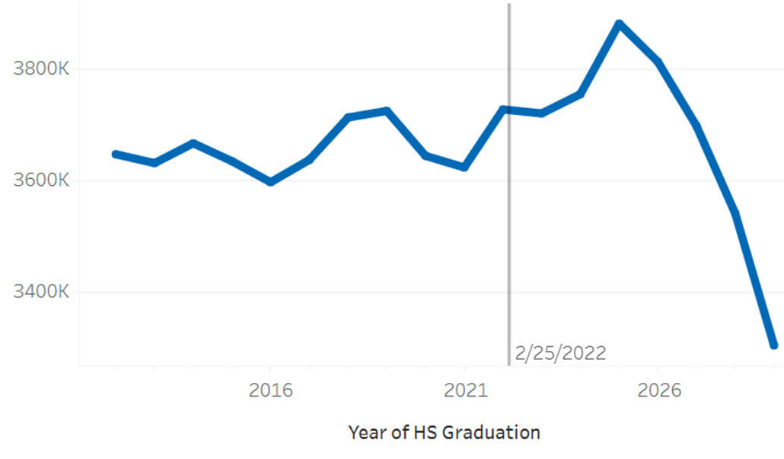
All-pervading theme in higher ed – retention, retention, retention
the dreaded demographic cliff !
9,000,000
Number of 18 yr olds
here there be dragons
8,500,000
8,000,000
Strategy - recruit & retain student enrollment – even more critical with federal funding cuts .....
4-yr college enrollments (US)
3.6 m
we are here
3.4 m
2016
2021
2026
https://www.synario.com/resources/blog/enrollment-cliff/

Slide 3
Creates Grand Challenges in Geoscience Education
Triple-whammy
Higher Ed funding cuts:
Reduction in tenured positions, explosion in temporary positions.
Low-enrolled programs and courses eliminated, consolidated or merged with other disciplines. Geology >> Earth Sciences >> Environmental Sciences.
Workforce demand high for geology trained graduates, need to produce graduates with geoscience training. How? Which courses? With what faculty?
Undergraduate student limits in reading comprehension, writing with appropriate vocabulary and sentence structure, basic applied math, and organizational and computer software/hardware proficiencies.

Slide 4
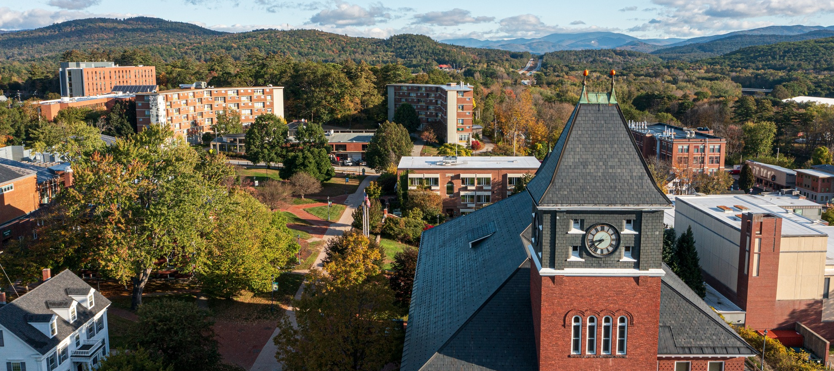
Plymouth State University
one of five institutions in the
University System of NH
under 4000 students
rural & remote (< 7000 residents)
northern most university in NH
many students 1st in family to attend higher ed
primarily UG degrees, MS degrees in two STEM programs – Meteorology, Biology
Environmental Science & Policy B.S. degree - created in 2010
number of majors – 120 (2019), 60 (Covid), currently 100
two options – Science focus, Policy & Planning focus
about 75% of first year students start in the science focus
about 40% of seniors graduate in the science focus
35% loss in geoscience-leaning majors

Slide 5
Major challenges to retention in our environmental major:
Our curriculum was created in 2009, by several 50-60 yr-old geoscience faculty
Only 1 of 3 who retired was replaced (no tenure, 30 cr/yr load)
All of us were unprepared for the students we recruited into the major post-2010
Growing proportion of majors without simple math ability (i.e. divide by 10)
Avoided textbook use creates missed homework assignments and knowledge gaps
Breadth of student vocabulary mismatched to lecture and textbook vocabulary
Vocabulary gaps mean students struggle to convey knowledge (weak answers)
Computer literacy low to non-existent (computers not used for storage or organizing)
Minimal practice with organization affects note-taking, assignments, study content
Practical knowledge of maps, outdoor navigation, global geography often missing

Slide 6
Skills needed for passing grade:
Core (all students in the major):
Intro to Field Techniques 3 credits
Intro to Enviro Science and Policy I 4 credits
Intro to Enviro Science and Policy II 4 credits
Statistics I 3 credits
GIS I: Intro to Geog Information Systems 4 credits
Energy and Society 4 credits
Climate, Risk, and Adaptation 3 credits
Environmental Geology 4 credits
Foundations of Environmental Policy 4 credits
Conservation 3 credits
Environmental Science and Policy Seminar 4 credits
Science Option :
General Chemistry I 4 credits
General Chemistry II 4 credits
Physics 4 credits
Hydrology 4 credits
Calculus 4 credits
Participation
(general skill building)
Math, organization & computer literacy
Writing & reading
Math & organization
Upper level electives 13 credits
120 needed to graduate: 60% in major
Total (excluding gen ed) 73 credits

Slide 7
Actions taken to address student needs, especially in the Science Option:
2018-21 NSF GeoPaths Award aimed at 1st year student engagement in research and career building
2019 Created a faculty-expertise-oriented advanced field techniques course (topic changes depending on faculty offering it, variable credit, can take multiple times
2022 Dropped calculus in favor of precalculus, gave student choice of a second semester of chemistry or a semester of Physics (algebra-based)
2023-25 Pilot-tested then adopted a 1-credit Science Toolkit course, aimed at:
computer literacy (how to save, organize and find files, downloading software)
reminders of basic math – decimals, fractions, exponents
creating and reading graphs, maps and visualizations
intro to Microsoft Excel (full version)

Slide 8
Grades in activities requiring math, graphing, mapping or visualization
attendance issue

Slide 9
Other Actions:
Created Geology Minor with geology gen ed and upper level electives
Added upper level courses with geoscience content aimed at multiple STEM majors (minimal to no pre-reqs):
Medical Geology – Enviro Sci, Bio, Nursing, Interdisc.
Oceanography - Enviro Sci, Bio, Chem, Meteor, Climate Studies, Interdisc
Water Resource Management - Enviro Sci, Meteor, Climate Studies
Hydrology (Geology or Intro Meteor pre-req) – Enviro Sci, Meteor, Climate
Nuclear Futures and Legacies - Enviro Sci, Bio, History
Natural Hazards - Enviro Sci, Meteor, Climate Studies, Interdisc, Business
Climate Change (Geo, Met pre-req) - Envio Sci, Meteor, Climate Studies, Interdisc
Life in the Universe - Envio Sci, Bio, Chem, Interdisc
Environmental Resource Management - Envio Sci, Bio, Interdisc

Slide 10

Future challenges
Succession planning! Out with the old dinosaurs, in with the ???
Adíos amigos!
Pixar
Few tenure-track positions, most single year contracts.
Hard to recruit, hard to retain new faculty with broad geoscience skills.

