Slide 1
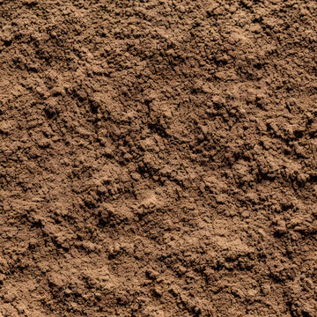


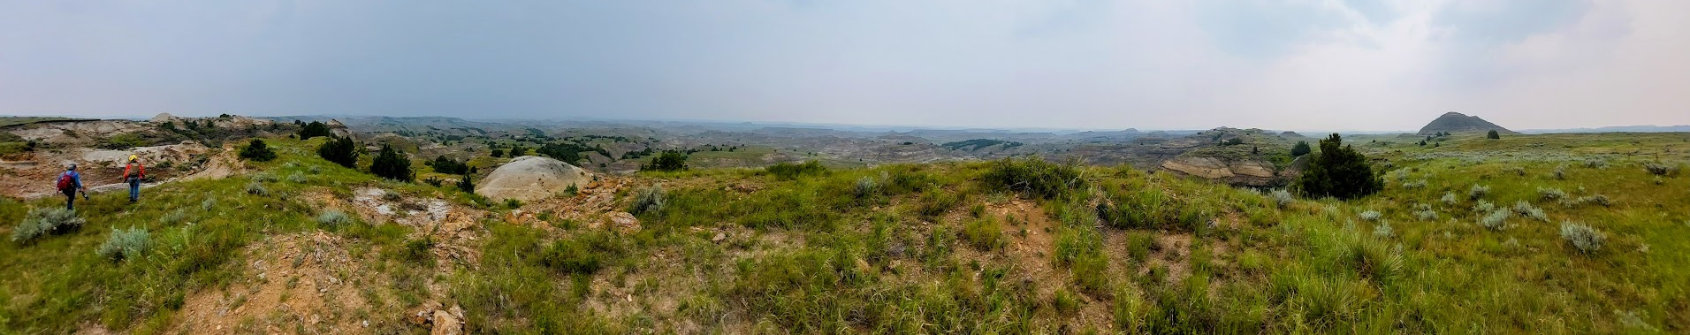
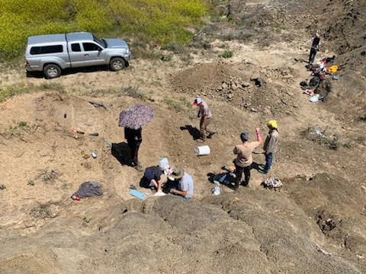
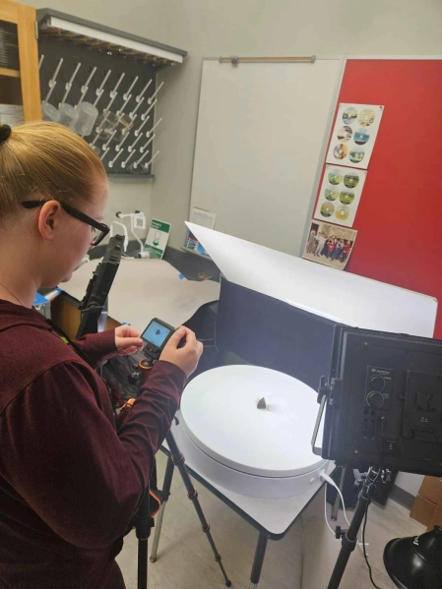
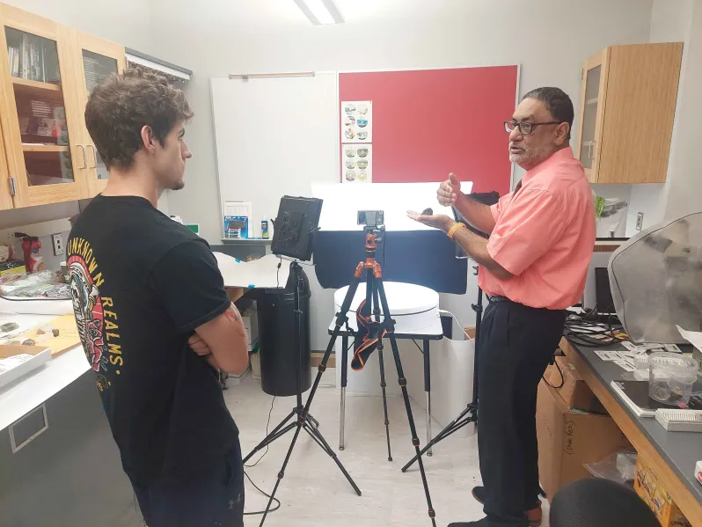
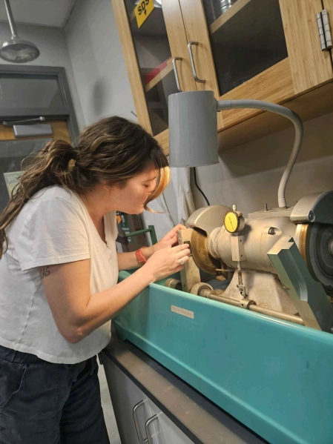
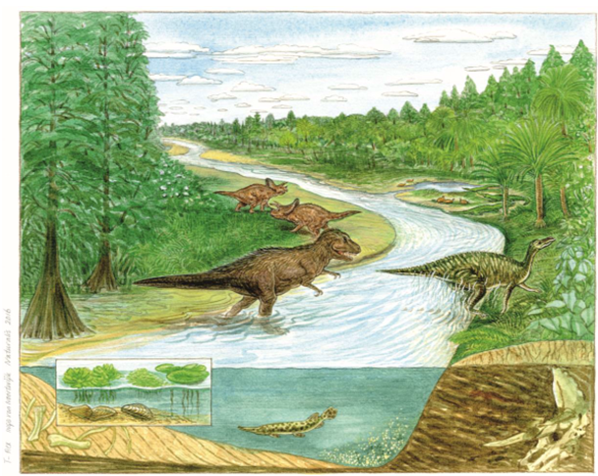
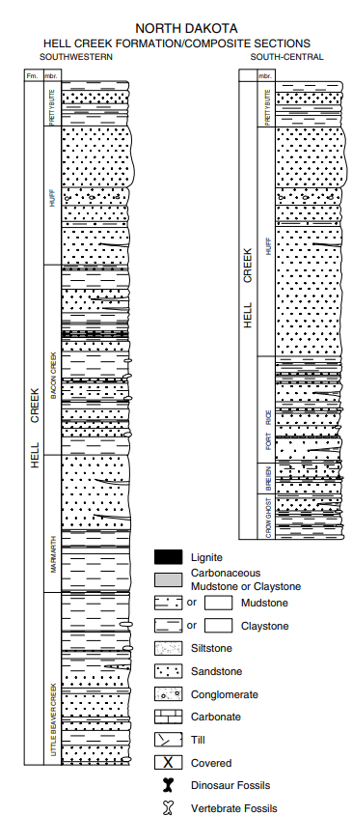
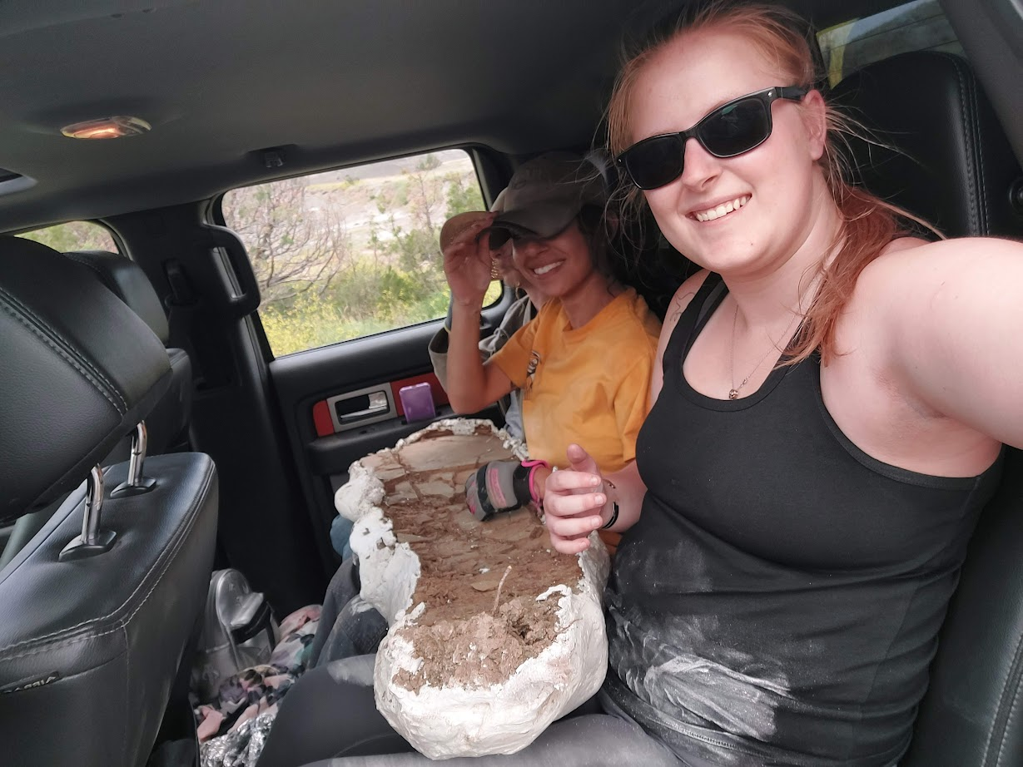
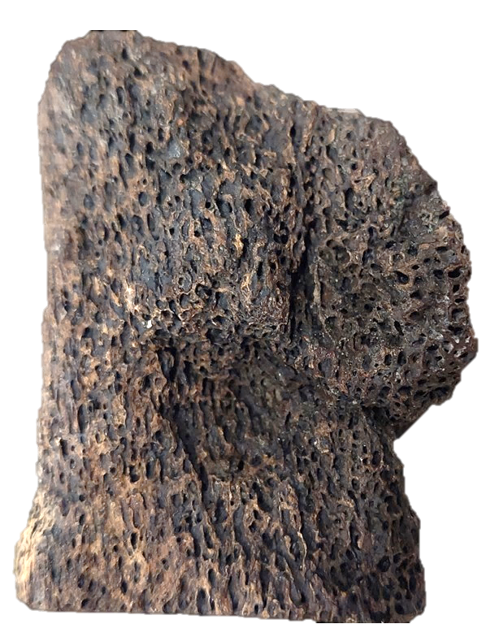
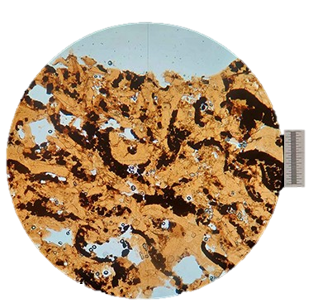
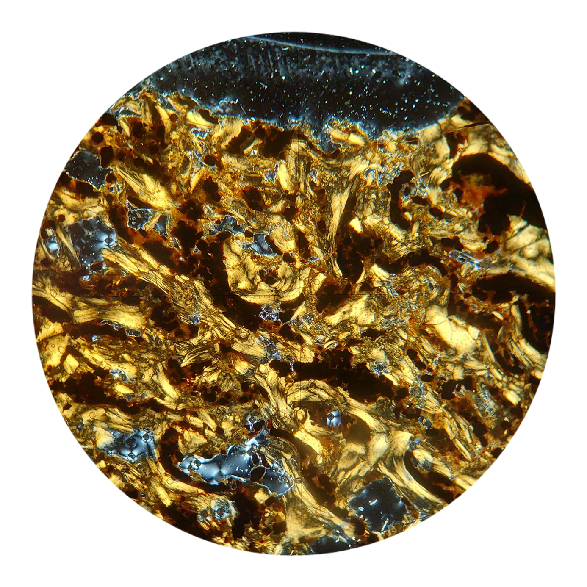
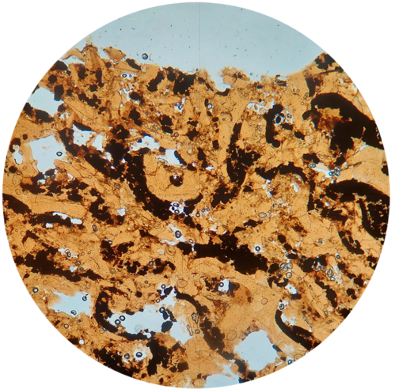
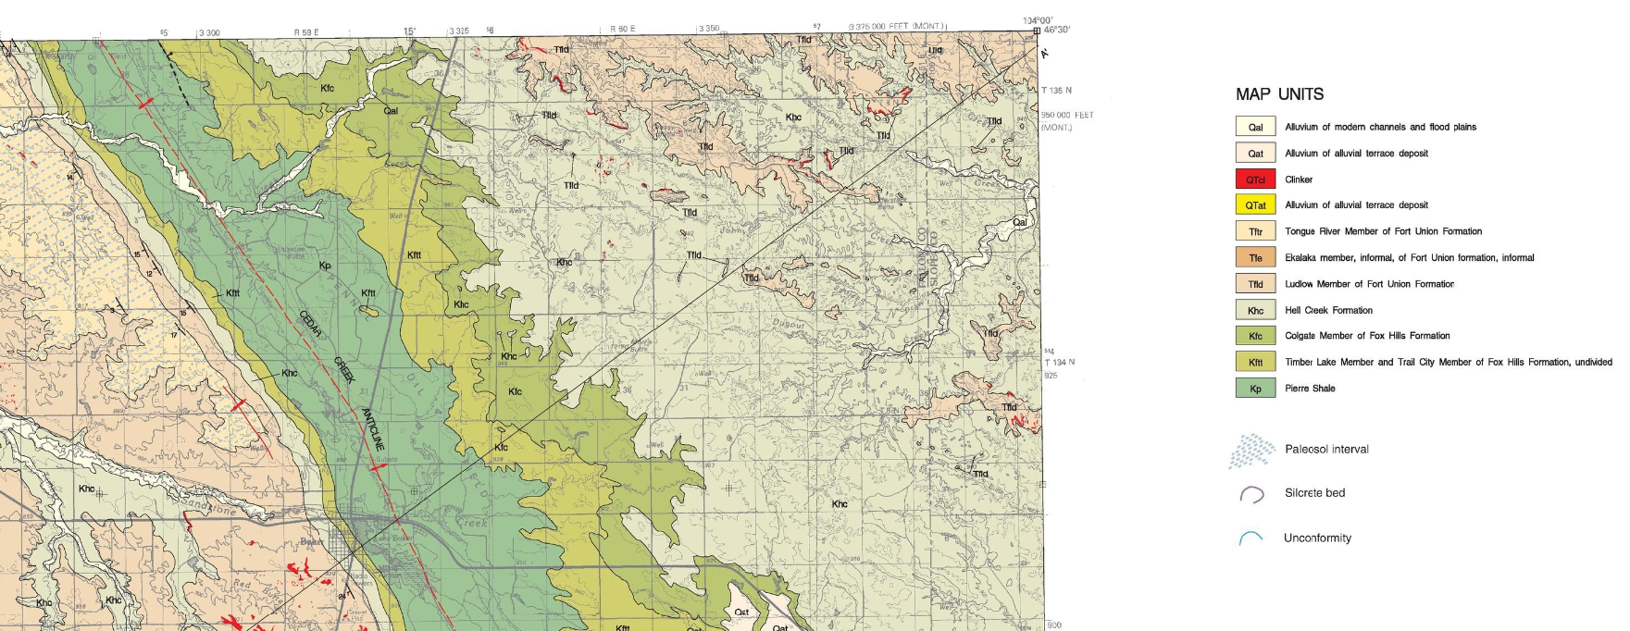
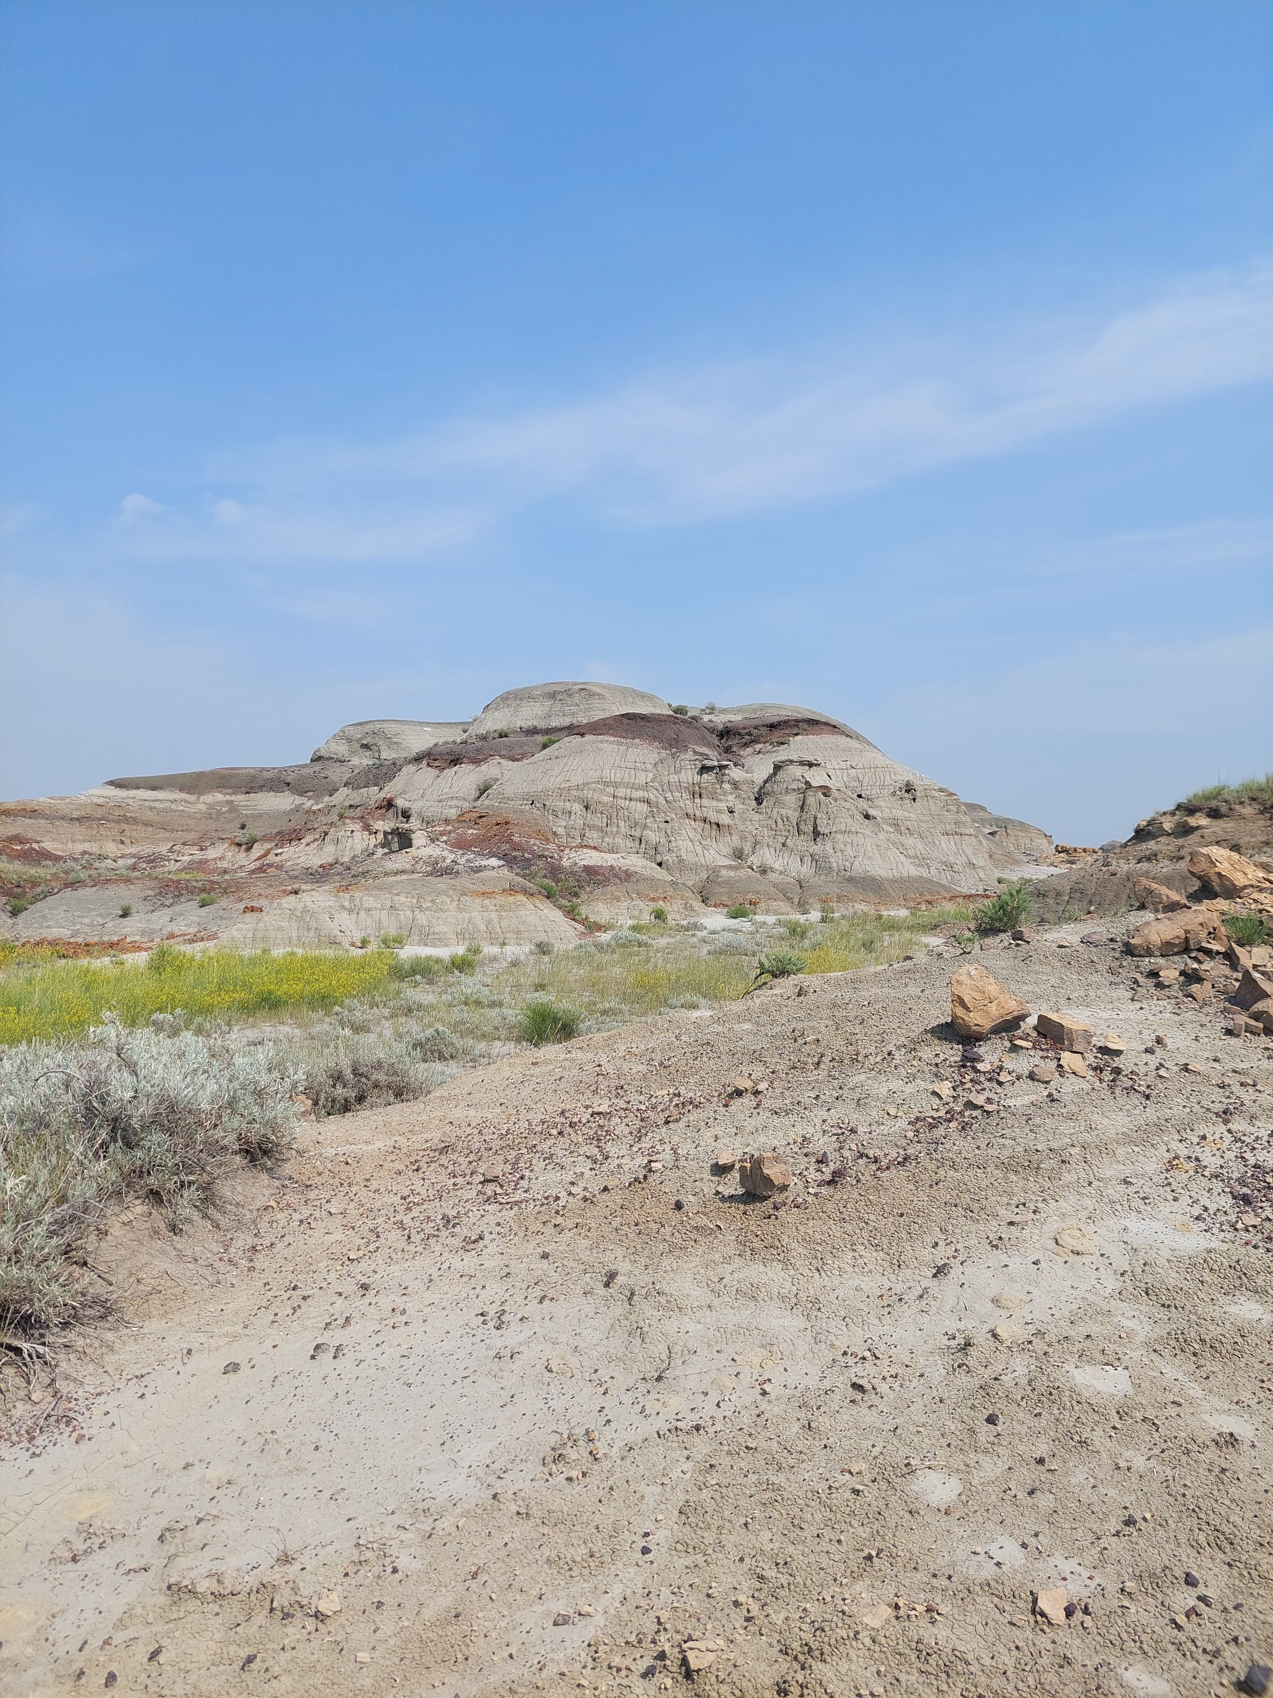
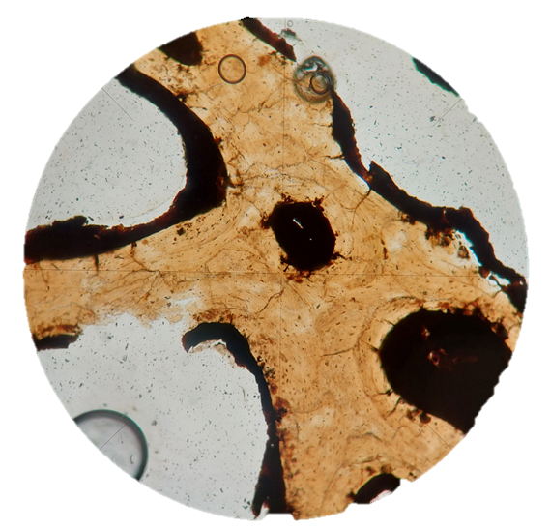
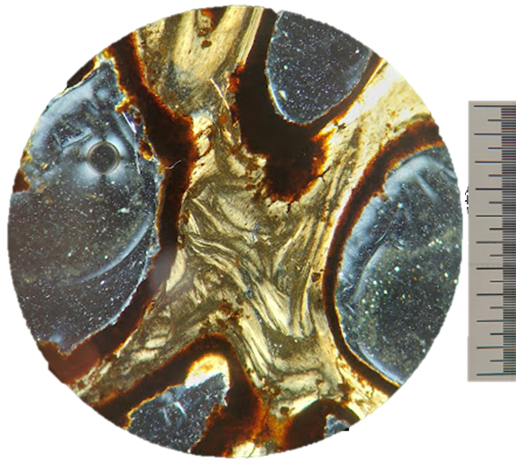
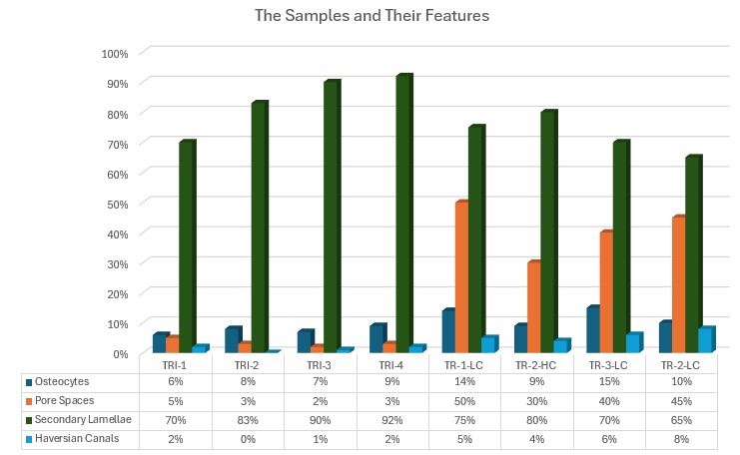
Stories from Stone: Petrographic Investigation of Tyrannosaurus Rex and Triceratops Horridus from the
Hell Creek Formation, Montana.
Katelyn HARRIS¹, Bode LINDAUER², Kristen ZIMMERMAN³, and Parvinder SETHI⁴
1: kharris125@radford.edu, 2: bhlindauer@radford.edu, 3: kbperry@radford.edu, 4: psethi@radford.edu
Department of Geospatial and Earth Sciences, Radford University, Radford, VA, USA.
The Hell Creek Formation is well known, globally, for its well-preserved variety of dinosaur fossils. However, what is not as well understood is the connection between microstructures preserved in bony materials and paleoenvironmental stressors that may have existed and impacted species during such times.
In this study we analyzed dinosaur bone samples, specifically, Tyrannosaurus Rex and Triceratops Horridus that were collected by the lead author at a field camp near Baker, Montana.
Samples were first processed for photogrammetry via 3D modeling software to preserve these fossils in a virtual sense, for perpetuity and free 24/7/365 online access. Over 100 photographs were taken of each bone sample and then rendered through the 'Agisoft Metashape-TM' software and the end products uploaded on the industry-standard 'Sketchfab-TM' viewing platform. Thereafter, a total of ten, 30-micron thick, thin sections were created, and 125 microphotographs were analyzed for a variety of microstructures including osteocytes, secondary lamellar structures, and haversian canals. Results show that patterns of abundance of osteocytes and bone growth were impacted by stressors including access to a healthy food supply.
METHODS
DISCUSSION
ABSTRACT
Field Collection:
Proficiency in distinguishing bones from rock or natural material was crucial in field collection. The collection process necessitated a keen eye and knowledge of how to identify and distinguish various types of fossils, including bones, paleolithic sites, and fish species preserved at the dig site. Our experience in Montana, guided by a prospecting company, provided comprehensive training in the collection, preservation, and excavation of fossils over a span of two weeks.
3-D Photogrammetry:
We utilized Agisoft Metashape, a 3-D modeling software, to process uploaded photos and generate a point cloud. This point cloud was then used to construct a mesh, leading to the creation of an initial model. Subsequently, we refined this model to capture more intricate details. Finally, we applied a texture to the model, resulting in a life-like, high resolution, 3D rendering of the original hand sample.
Petrography:
Creating thin sections is already challenging, and it becomes even more so when working with delicate dinosaur bones. One of the main difficulties we encountered was the lack of distinct interference colors to confirm that we had reached our samples' desired thickness of 30 microns. To address this issue without causing damage to the samples, we attempted to add pure quartz sand to the edges to provide a guideline for interference colors. Unfortunately, this approach led to the breakage of a sample, although it still remained usable. Consequently, we decided not to repeat this method. Despite this minor setback, we were able to produce a total of of ten thin sections with six for Tyrannosaurus Rex and four for Triceratops Horridus.
Petrographic analyses of the Tyrannosaurus Rex and the Triceratops Horridus bones show microstructures which offer insight into the stressors that likely impacted growth of these species. Features including osteocytes, haversian canals, pore spaces, and lamellar structures, together indicate that these two species lived during a time and in an environment wherein food supply may have been a dominant stressor.
The marginally higher osteocyte presence in the Tyrannosaurus Rex samples likely indicates that it had access to a healthy food level, whereas the type and frequency of microstructures observed in the Triceratops Horridus samples suggests that it had a limited access to food and/or that it was possibly of a much older age.
While studies generally portray a lush, heavily vegetated, humid paleoenvironment for such species (Figure 12 c), such a depiction, of a seemingly endless food supply, can be at times, misleading, as results of this study clearly show the correlation between a food-stressed environment and type and abundance of specific microstructures.
Geologic Setting
A
*
B
GEOLOGIC SETTING
The Hell Creek Formation consists of blocky sandstones interspersed with layers of mudshales, lignite, carbonates, and bentonitic materials (Murphy et al., 2002). Additionally, occasional deposits of iron and manganese oxides are found in thin section. The landscape in this area is significantly shaped by river deposits and erosion, leading to the formation of hoodoos and buttes (Kaskes, 2016).
C
* - Sample is a granitoid
Figure 9: Comparison of MRF conglomerates and Mount Rogers rhyolite units
Figure 2. Student Katelyn Harris taking multiple, overlapping pictures of a Trixie sample for 3D modeling.
Figure 3. Dr. Sethi (right) and student Bode Lindauer (left) engage in a discussion of the process of 3D photogrammetry of samples.
Figure 4. Student Kristen Zimmerman processes a Trixie thin-section to reach the standard 30 micron thickness.
Petrographic Analysis
RESULTS
A total of ten thin sections were created, six of Tyrannosaurus Rex and four of Triceratops Horridus.
A total of 125 microphotographs were then analyzed for frequency of occurrence of the most common microstructural features. Such features include osteocytes, secondary lamellae, and haversian canals.
Figures 6-9 provide the most representative imagery of the features in question and figures 10 and 11 are a synthesis of percentages of the surface area these features occupied in each sample.
Figure 12. A) Panoramic photo taken by Katelyn Harris of the Montana terrain. B) Photo taken by a prospecting team member, Cheyenne Teal, of one of the dig sites. C) Artist’s rendition of the paleoenvironment of the Hell Creek Formation. Illustrated by Inge van Noortwijk, from Kaskes (2016).
CONCLUSIONS
Osteocyte presence can generally be linked to food availability or effects of old age (e.g., Guo and Bonewald, 2009). The diminished osteocyte count in the Triceratops Horridus samples could be indicative of old age and/or a lack of food hindering healthy osteocyte growth.
The Tyrannosaurus Rex samples reveal an opposite trend, suggesting that it had enough food to sustain healthy osteocyte growth in its bone material.
Such a direct correlation between abundance of osteocytes and food availability can, however, also be complicated by a generally higher presence of osteocytes in the Trabecular bone versus the Vertebral and therefore other indicators of healthy versus unhealthy bone growth must be evaluated for accurate reconstruction of stressors in such paleoenvironments.
B
Figure 10. Surface area percentages of features analyzed in the ten thin sections including osteocytes, pore spaces, secondary lamellae, and haversian canals.
Features
Sample ID | Osteocytes | Pore Spaces | Secondary Lamellae | Haversian Canals
 | (% occupied) | (% occupied) | (% occupied) | (% Occupied)
TRI-1 | 6% | 5% | 70% | 2%
TRI-2 | 8% | 3% | 83% | 0%
TRI-3 | 7% | 2% | 90% | 1%
TRI-4 | 9% | 3% | 92% | 2%
TR-1-LC | 14% | 50% | 75% | 5%
TR-2-HC | 9% | 30% | 80% | 4%
TR-3-LC | 15% | 40% | 70% | 6%
TR-2-LC | 10% | 45% | 65% | 8%
Figure 5. Trixie fossil bone before cut into thin section billets. The red dash indicates the location of lengthwise diamond blade cuts. The orange dash indicates the location of the cross-sectional cut.
A
C
Figure 6. Sample TRI-4 thin section in PPL view at 40x magnification. Osteocytes are indicated by a yellow circle.
Figure 7. Sample TRI-4 thin section 40x magnification XPL. Secondary lamellae (Orthogonal Plywood structure) indicated by the red arrow and haversian canal indicated by the red circle. Iron cementation between fibers indicated by the yellow arrow.
ACKNOWLEDGEMENTS
Authors thank Mr. George Stephenson, Dr. Jonathan Tso, Dr. Adam Pritchard, the Virginia Museum of Natural History’s Assistant Curator of Paleontology, Dr. Michael D’Emic, Associate Professor in the Department of Biology at Adelphi University, and Patrick Hess.
D
E
WORKS CITED
Francillon-Vieillot, H., de Buffrénil, V., Castanet, J., Géraudie, J., Meunier, F.J., Sire, J.Y., Zylberberg, L., and de Ricqlès, A., 1989, Microstructure and Mineralization of Vertebrate Skeletal Tissues, in Carter, J.G. ed., Skeletal biomineralization: patterns, processes, and evolutionary trends, Washington, D.C., American Geophysical Union, p. 473–529, doi:10.1029/SC005.
Guo, D., and Bonewald, L.F., 2009, Advancing our understanding of osteocyte cell biology. Ther Adv Musculoskelet Dis. Apr;1(2):87-96. doi: 10.1177/1759720X09341484. PMID: 22870430; PMCID: PMC3383482.
Murphy, E.C., Hoganson, J.W., and Johnson, K.R., 2002, Lithostratigraphy of the Hell Creek Formation in North Dakota, in Hartman, J.H., Johnson, K.R., and Nichols, D.J. eds., The Hell Creek Formation and the Cretaceous-Tertiary boundary in the northern Great Plains: An Integrated continental record of the end of the Cretaceous, Geological Society of America, p. 9–34, doi:10.1130/0-8137-2361-2.9.
Wings, O., 2004, Authigenic minerals in fossil bones from the Mesozoic of England: poor correlation with depositional environments: Palaeogeography, Palaeoclimatology, Palaeoecology, v. 204,
p. 15–32, doi:10.1016/S0031-0182(03)00709-0.
Mitchell, J., and Heteren, van H.A., 2015, A literature review of the spatial organization of lamellar bone: Comptes Rendus Palevol, v. 15, p. 23–31, https://www.sciencedirect.com/science/article/pii/S1631068315000718.
Kaskes, P., 2016, Unearthing the background of Naturalis Tyrannosaurus rex: taphonomy, stratigraphy and paleoenvironment: TU Delft , https://resolver.tudelft.nl/uuid:1cb2b7f8-57a5-4575-8b9d-ea4b4d717594.
Kim, J.K., Kwon, Y.E., Lee, S.G., 2017, Disparities in correlating microstructural to nanostructural preservation of dinosaur femoral bones: Scientific Reports, v. 7, doi:10.1038/srep45562.
Bijl, X.S., 2019, An Analysis of Growth and Aging in a Tyrannosaurus rex through Histology and Synchrotron Micro-Tomography: Uppsala University, doi:diva2:1284689.
de Buffrénil, V., de Ricqlès, A.J., Zylberberg, L., and Padian, K. (Eds.), 2021, Vertebrate Skeletal Histology and Paleohistology (1st ed.). CRC Press. https://doi.org/10.1201/9781351189590.
See Fig. 3
Figure 1. A) Stratigraphic column adapted from Murphy et al., 2002. B) Field photo of students Katelyn Harris and Leila Hamze (orange) transporting a 1.2 m gar from a site. C) Geologic map of the Baker, Montana area (yellow star is Baker). The red rectangle contains the collection area. D) Geologic unit legend for map shown as C. E) Photo of the Hell Creek Formation near Baker, Montana. The Tyrannosaurus Rex was found in a sideritic horizon on the butte, shown above indicated by a red circle.
Figure 8. Osteocytes indicated by a yellow arrow and haversian canal indicated by a yellow circle in lamellar structures in PPL.
Figure 9. 100x magnification, lateral cut thin section. XPL. Pore space indicated by a red circle, haversian canal and osteocytes indicated by a green circle, secondary lamellae indicated by a yellow circle.
Figure 11. A synthesis of the most abundant structures seen in an analysis of 125 microphotographs. Secondary lamellar structures dominate in the Triceratops Horridus samples whereas haversian canals and abundant pore spaces are dominant in the Tyrannosaurus Rex samples.
Notes:
The main challenge of this project was to maintain the integrity of the fossils.
The Tyrannosaurus Rex bone was identified as Trabecular bone, which is the spongy material found in the center of large bones. It contains fat, blood vessels, and more.
The lack of diminished quantity of pore spaces within the Triceratops coincides with a difference in bone material
The increased quantity of pore spaces in the Tyrannosaurus Rex coincides with Trabecular bone material.
Lamellar structures indicate bone growth over time and are more present in different bone types.
The secondary lamellar structures in the Tyrannosaurus Rex are of a variety of plywood features called twisted plywood structures. These are representations of healthy or unhealthy bone growth as the creature ages.
The Triceratops Horridus features a different type of secondary lamellar structure called orthogonal plywood structure that also represents bone growth but in a different orientation to the twisted plywood structure
These growth periods vary depending on food availability.
Longer periods of uninterrupted growth correspond to broader lamellar structures, indicating high food availability.
Lamellar structures with a break indicate a change in food availability, specifically a more food-scarce environment at that time.
The lack of osteocytes in the triceratops gives reasonable evidence that the animal was old or there was a lack of enough sustainable food sources to promote normal or healthy osteocyte growth.
There is no evidence of severe food shortage for the Tyrannosaurus Rex as indicated by the healthy distribution of osteocytes.
The Triceratops Horridus contains more of the iron cementation than the Tyrannosaurus Rex in continual fragments and in the finely disseminated form as seen in the microphotographs.
the pore space percentage is higher in the T Rex because it is a different bone type compared to the Triceratops
Osteocytes presence derived from food availability (expand)
Expand on plywood structures
Haversian canals average difference due to differing bone types
Change and include conclusions details that up until now were not available with the provided information
Haversian canals are a product of the osteocytes and reflect the same trends.

